Slide 1
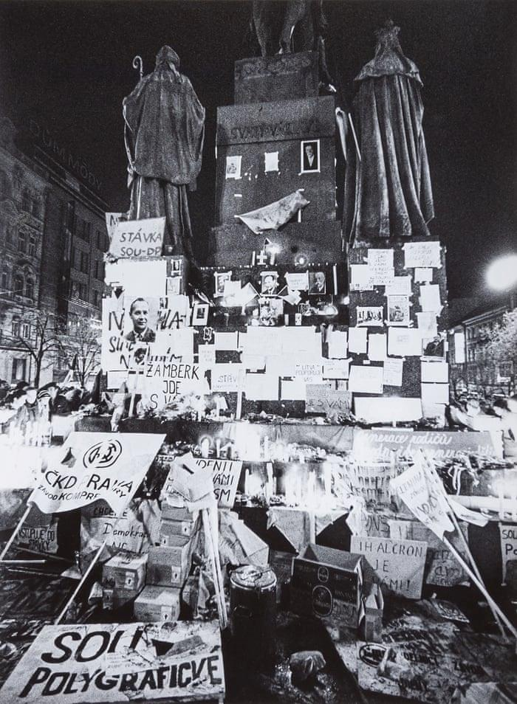
Velvet Revolution 1989
Sofia N. Knoteková, Kristián Viglaš

Slide 2
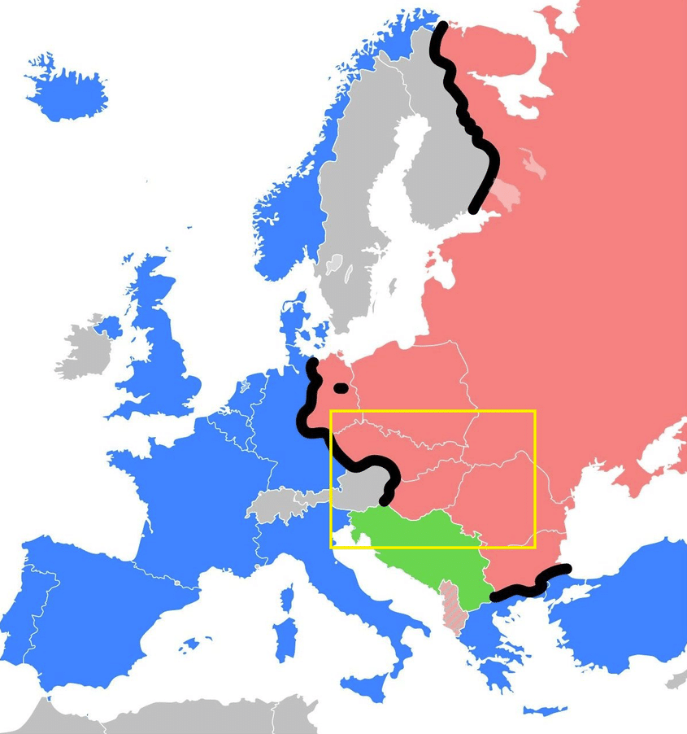
The Beginning of Velvet Revolution
In 1989 almost everybody knew what was going on. People were tired of communist rule and with growing resistance abroad, a wave of revolution came to Czechoslovakia.
Communist rule was in Czechoslovakia since 1948 when the left-wing communist party of Czechoslovakia took power after manipulated election and strong influence of Soviet Union.

Slide 3
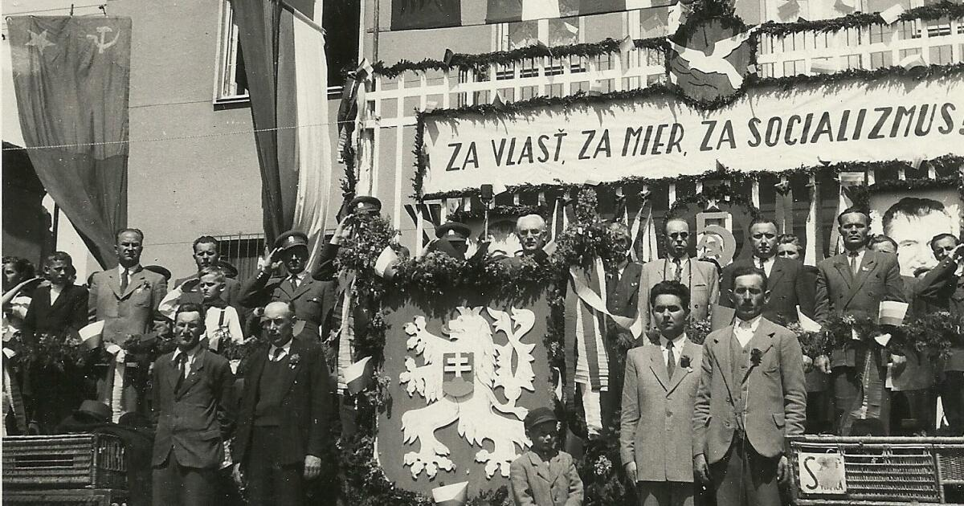
Situation under communist rule
It was an unfree era during which communists had all the power over our country and made all decisions.
People could not travel freely, listen to foreign music and everything had to be censored by the government. People could not say their true opinion about the system and they were punished for it.

Slide 4
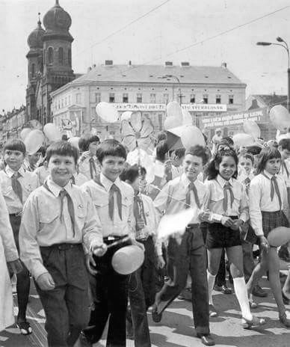
Situation under communist rule
The one-party rule organized everything from agriculture to media-people did not have much choice and if some relative of yours had some trouble with state, your life was burdened-people got fired from their jobs or were kicked out of school.
As a start of the fall of the communist regime is considerate the fall of Berlin Wall (in Berlin).

Slide 5
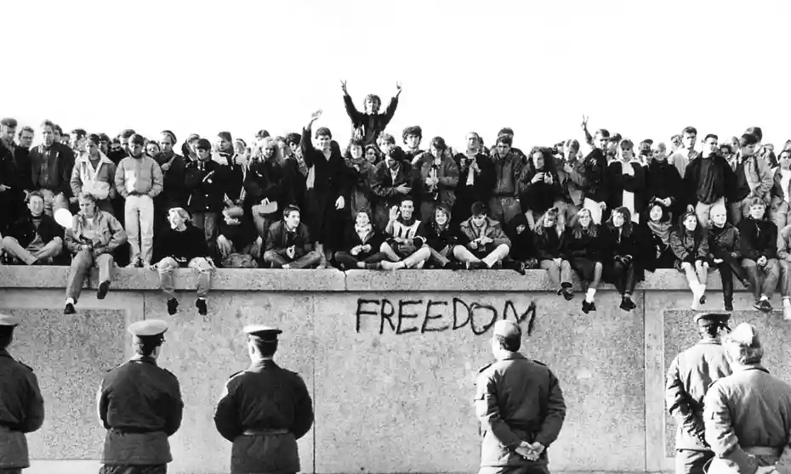
International Students’ day
People of communist block were tired of the senseless rule of the communists and the laws that existed only to keep the communist party in power.
So on 17th of November 1989 (International Students’ day) started protesting in the areal of Charles university holding candles and chanted slogans for freedom.

Slide 6
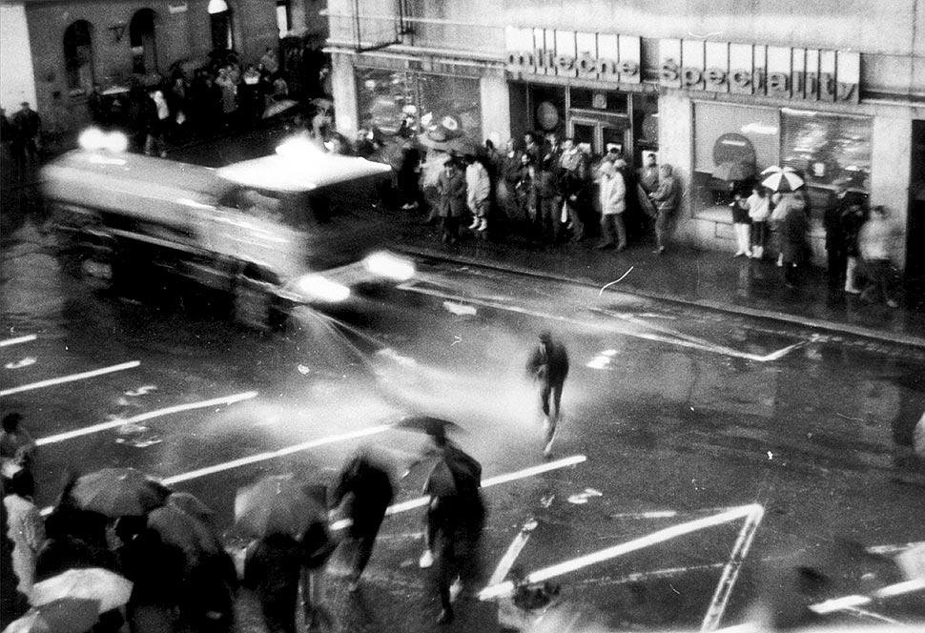
Inernational Student‘s day
This protest did not last long and students were attacked by Czechoslovakian police unit called “Červené Barety” (Red Barrettes) which injured over 600 students and 35 of them were hospitalized.
This attack was the main booster for all students to start assembling and protesting. Later on much more people joined them and the revolution begun.

Slide 7
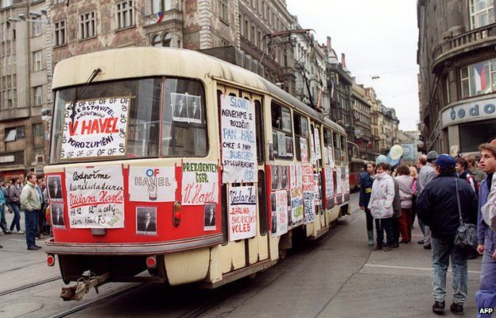
The new start-Democracy
After that, protests took place in every major city or town-workers left workplaces to protests, students occupied collages and organized more protests against communist party.
Protests continued for few weeks with more and more people involved.

Slide 8
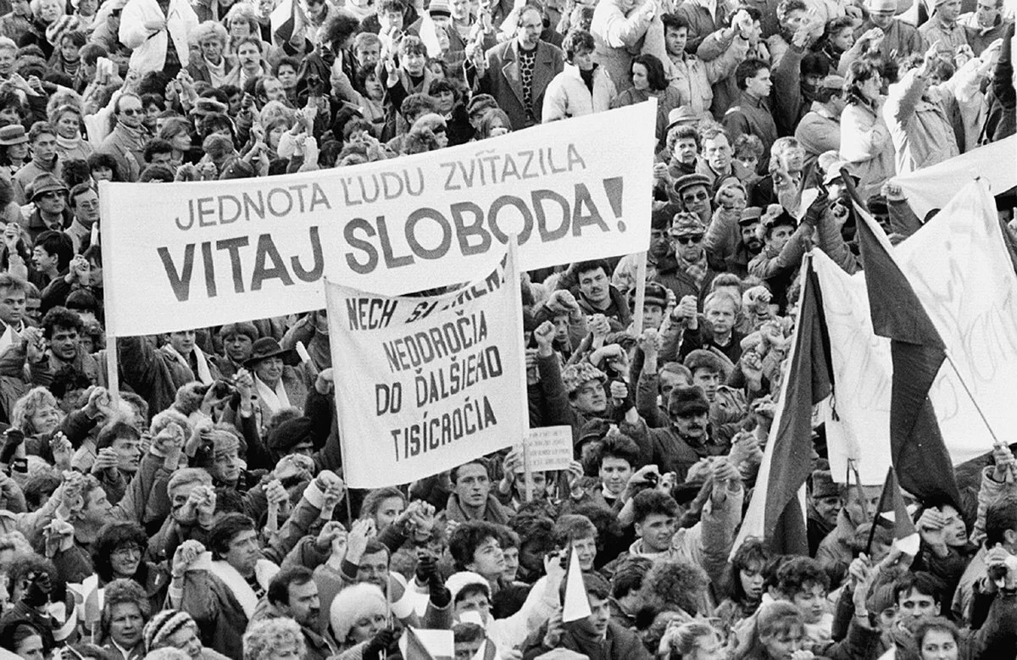
The new start-Democracy
After a huge pressure from the people communist party finally resigned and new non-communist parties could be found and ran in elections - Czechoslovakia became a parliamentary democracy.
Václav Havel was elected the first president and country war ready for new fully democratic elections. The new era of freedom just began.

Slide 9
Thank you for your attention

