Slide 1
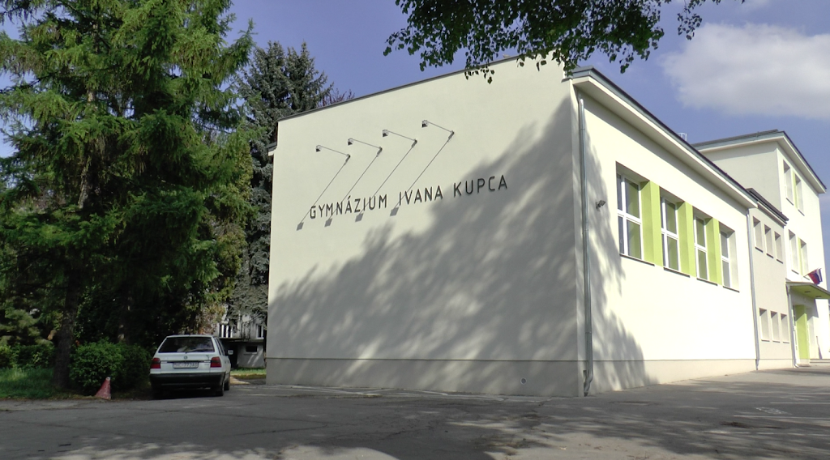
Secondary Grammar School Of Ivan Kupec

Slide 2
Basic information
Secondary Grammar School of Ivan Kupec is a four-year, five-year bilingual and eight-year grammar school in Hlohovec. It is located close to the centre of Hlohovec. The secondary grammar school in its current form has been operating for 86 years.

Slide 3
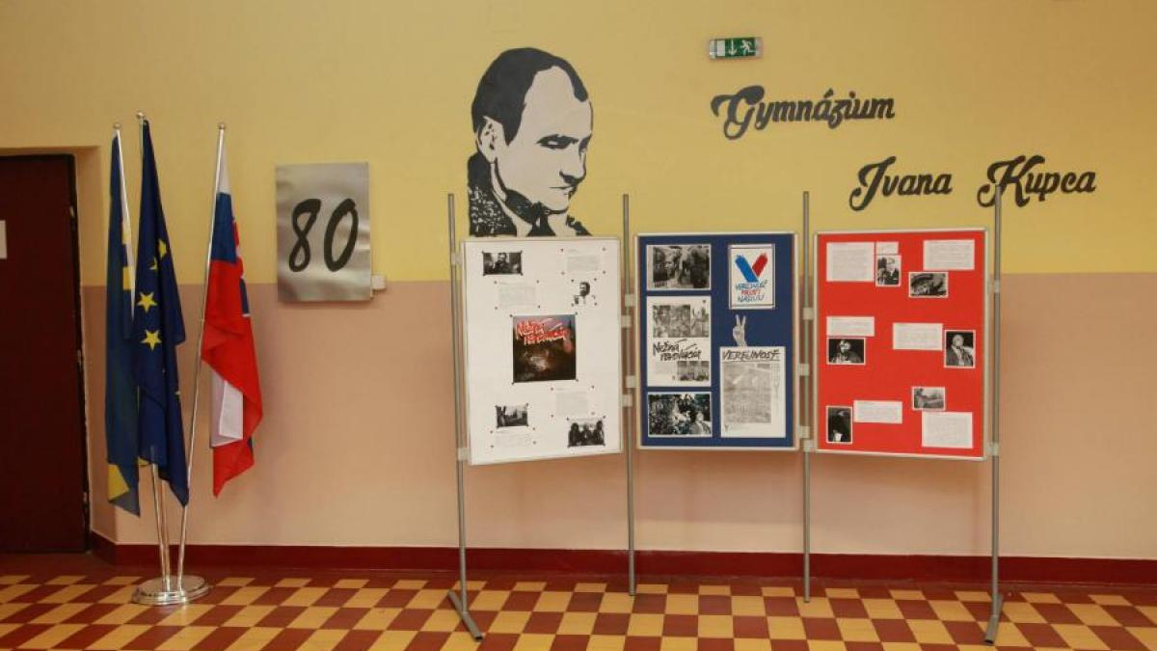
Purpose of our school
Our school prepares us to study at university, teach us to work with computer technology and to speak a foreign language (English, German, French, Russian). Bilingual students learn basic subjects also in English. Our school is the right place for many future lawyers, teachers, programmators, doctors, scientists and more.

Slide 4
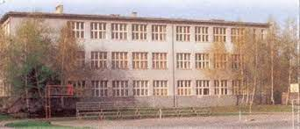
History
The grammar school in Hlohovec was established at the beginning of the 17th century. It was known throughout Slovakia. The school was founded by the owner of Hlohovec Castle Stanislav Thurzo.
The present appearance of the secondary grammar school building has been in function since 1936. The school is named after Ivan Kupec, who was a Slovak poet and writer from Hlohovec.

Slide 5
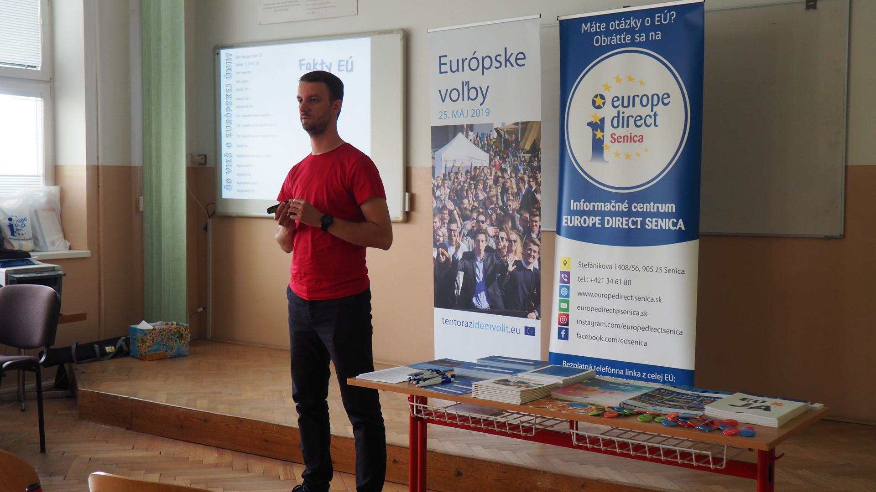
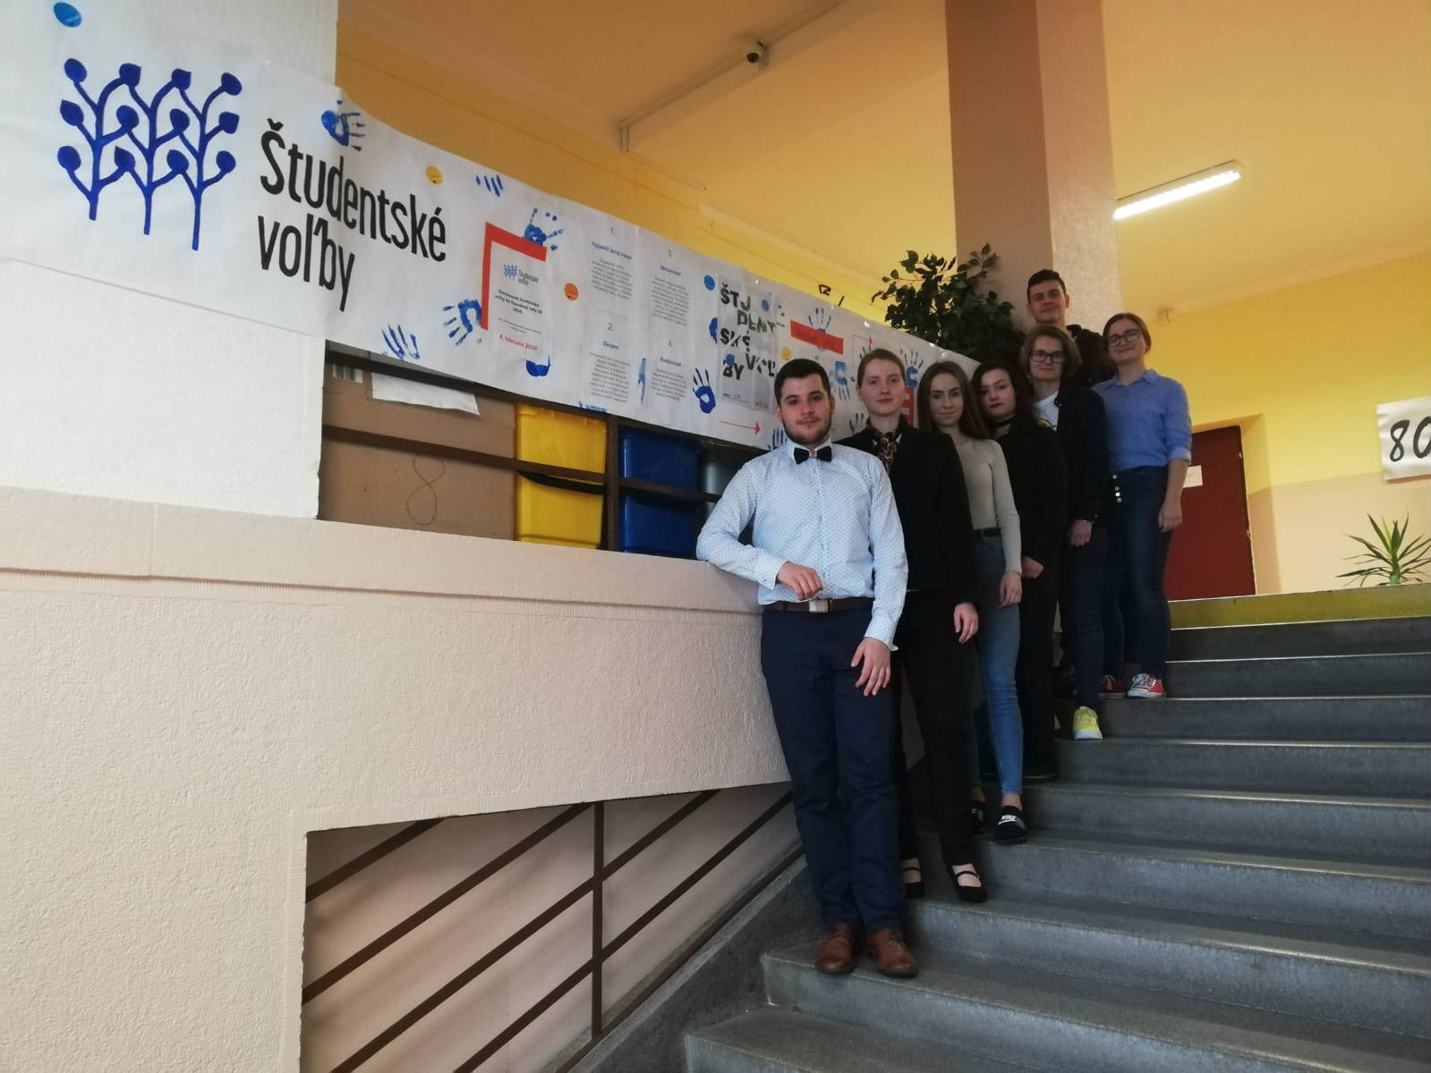
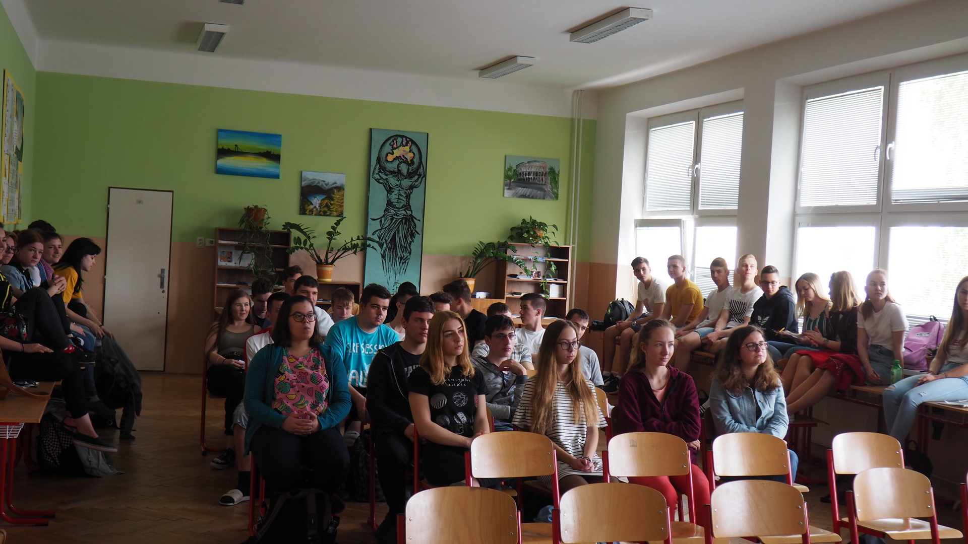
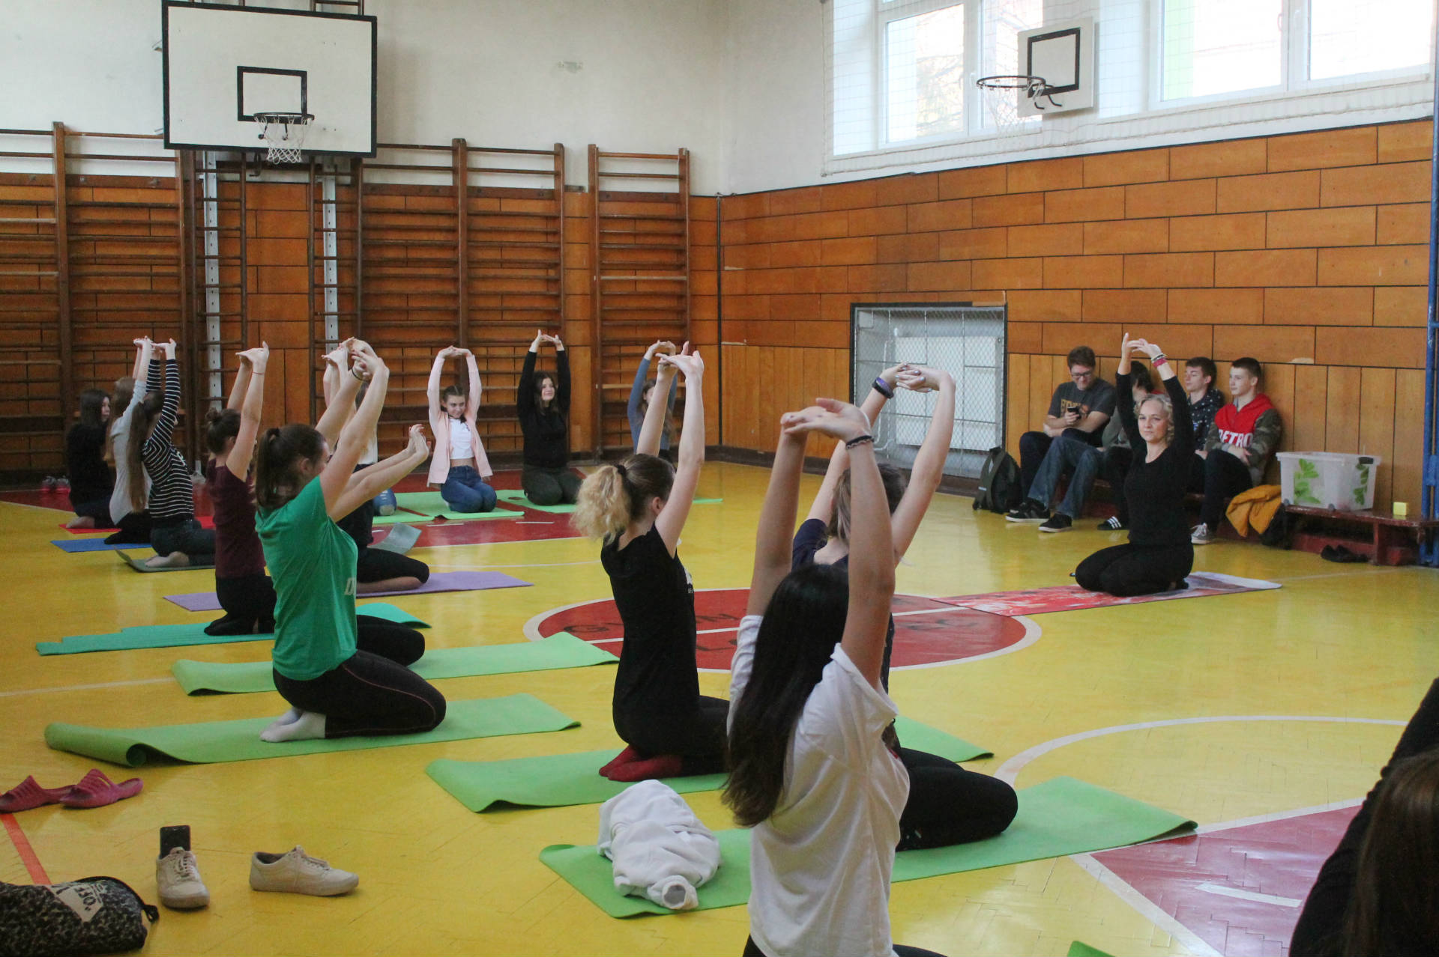
School Interior
Our school has biology, geography, IT, Slovak language and physics classrooms and a chemistry laboratory, fitness centre, gym, meeting room, cafeteria and relax zone.

Slide 6
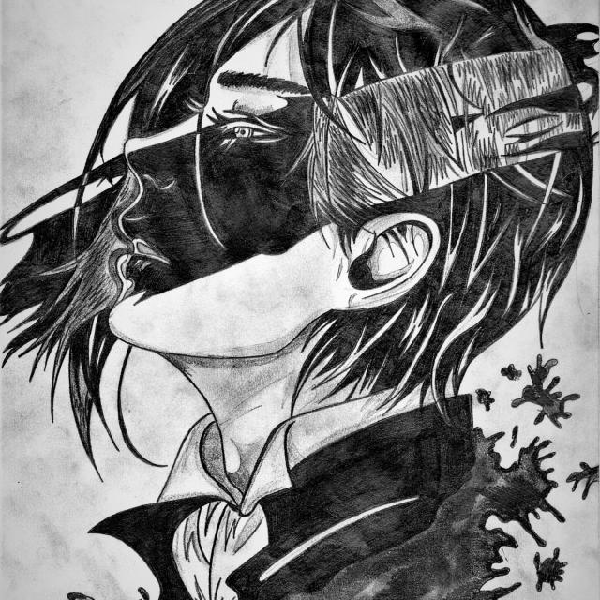
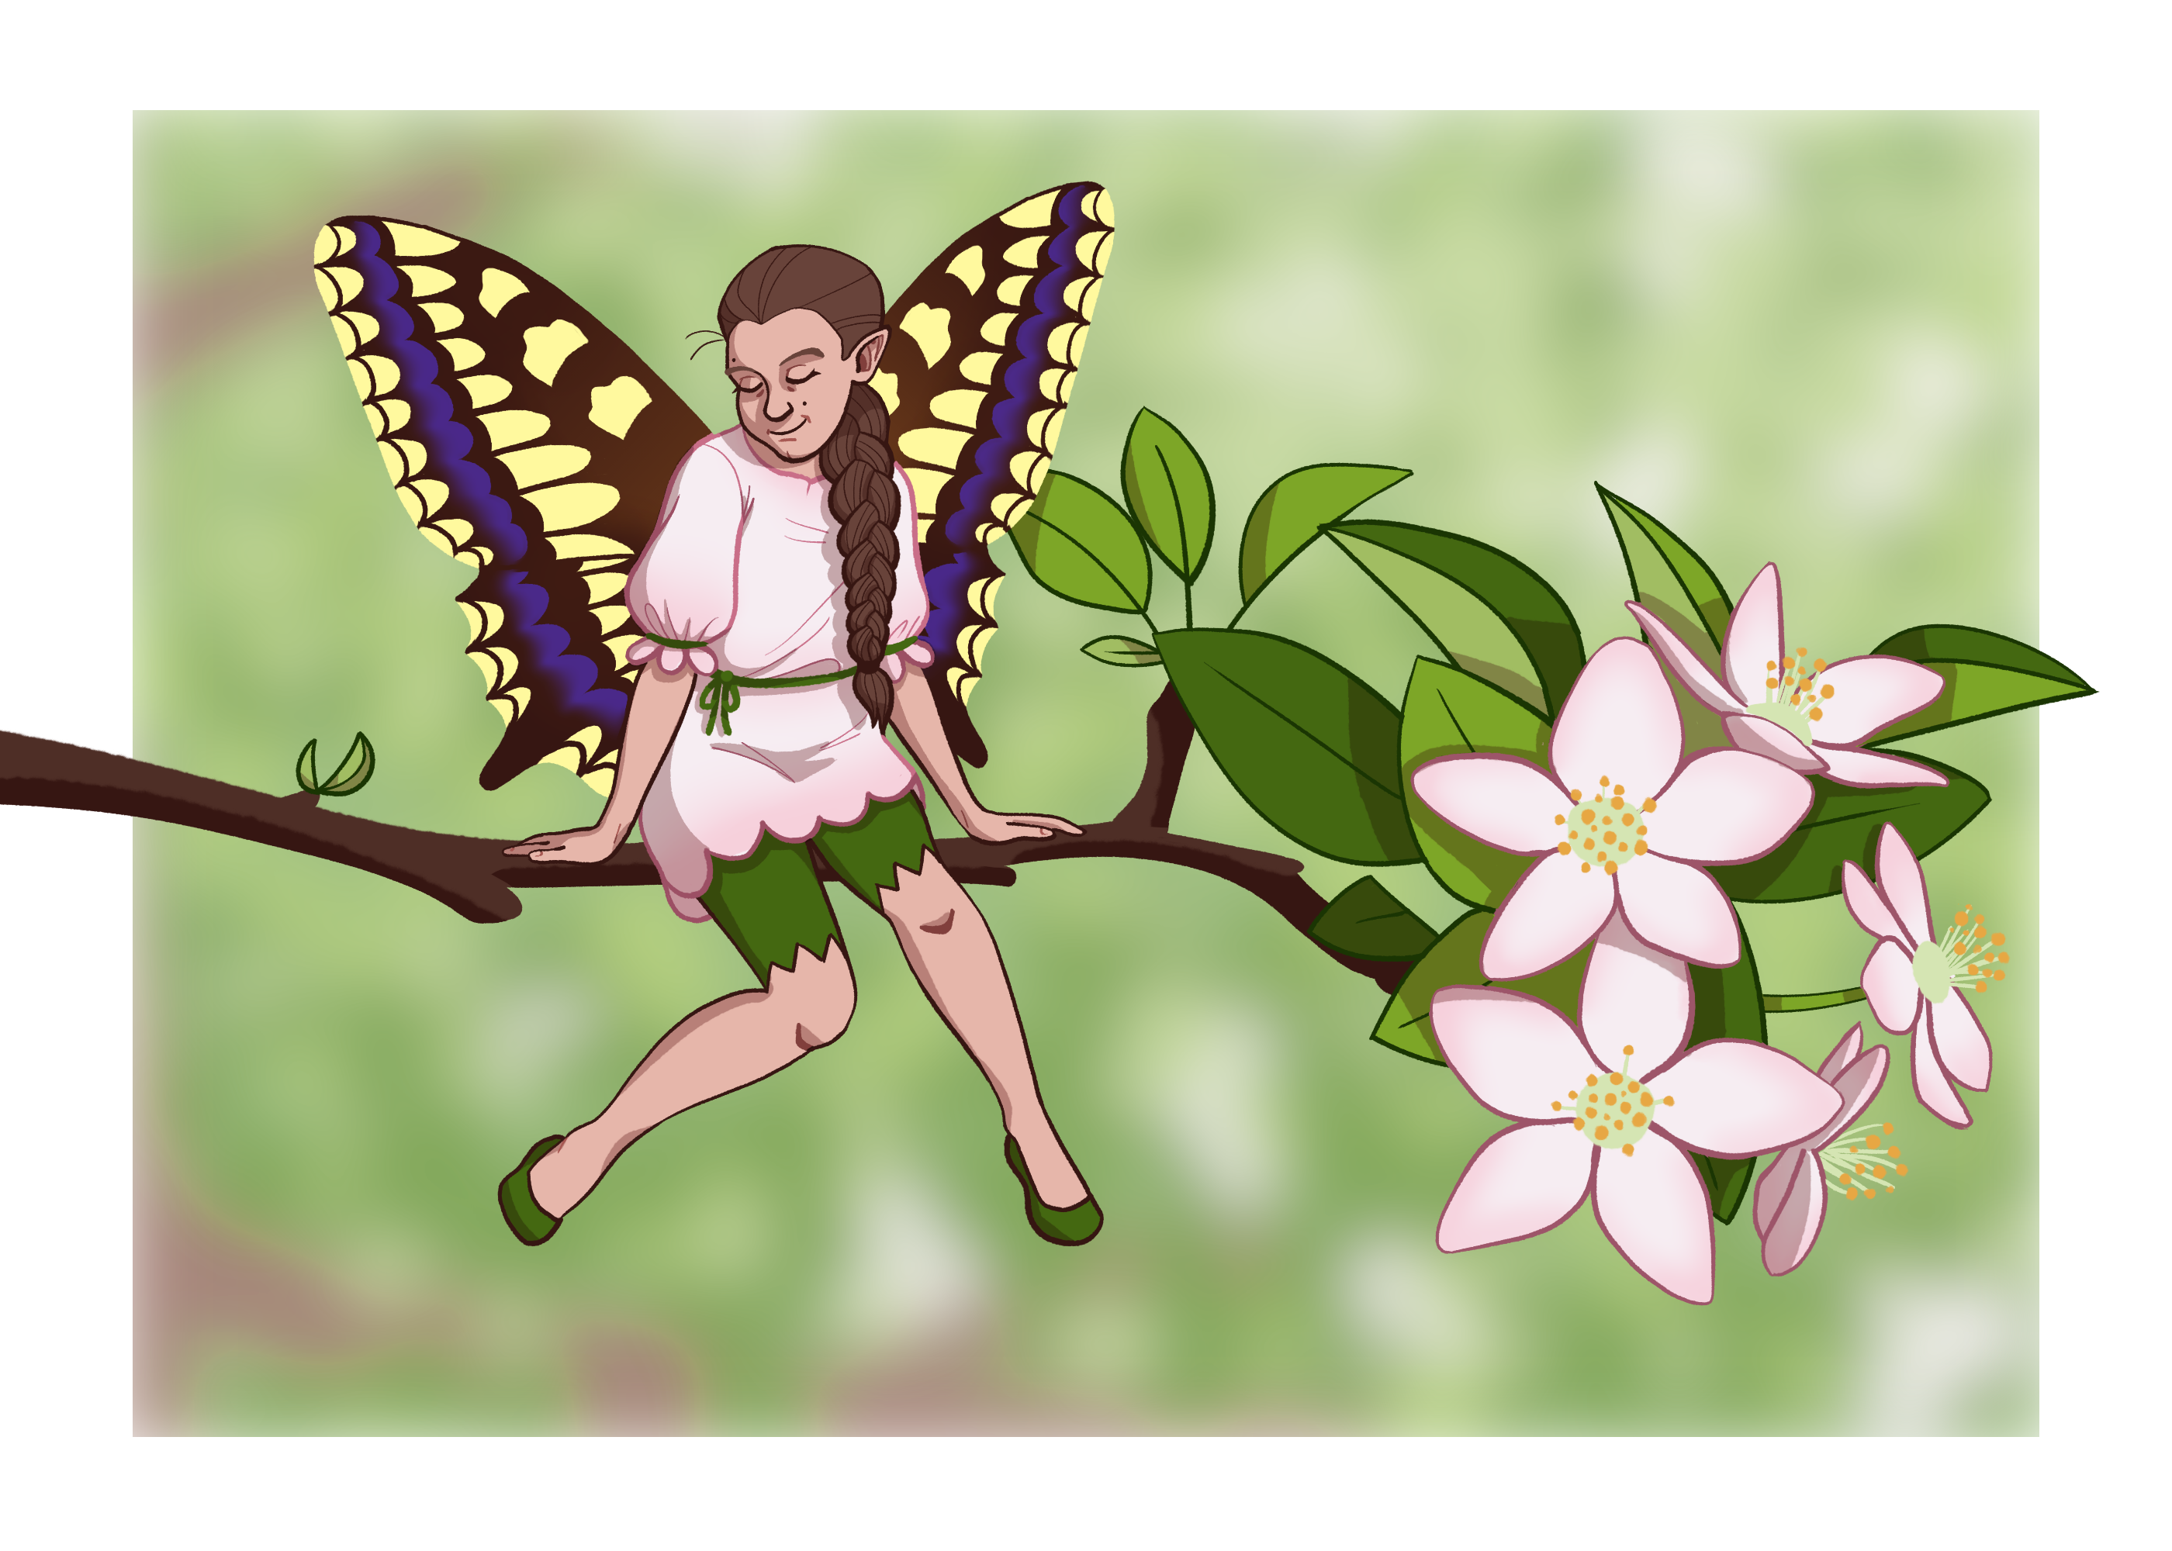
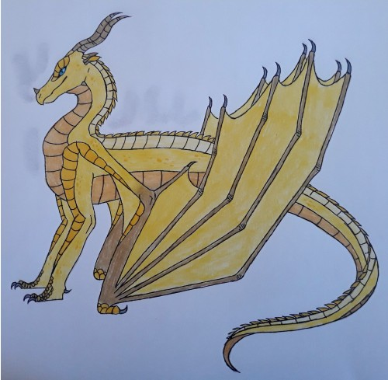
School magazine MOZAIKA
We have our own school magazine called Mozaika in which students publish their works like poems, articles and drawings. They are written both in Slovak and English language.

Slide 7
Green School-Zelená škola
The Green School program is part of the international Eco-Schools network. It has been working since 1992, because environmental problems became more and more urgent. Today, there are involved around 59,000 schools from 68 countries around the world.

Slide 8
Erasmus+
The Erasmus Program works to provide students with the opportunity to experience a global education. Students from our school have been cooperating with Poland, Lithuania, Portugal, Turkey, Sweden and Denmark so far.

Slide 9
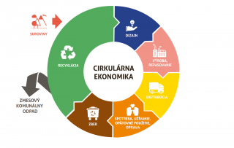
Other School Partners

Slide 10
Thank you for your attention
Sofia Natalia Knotekova

