Slide 1
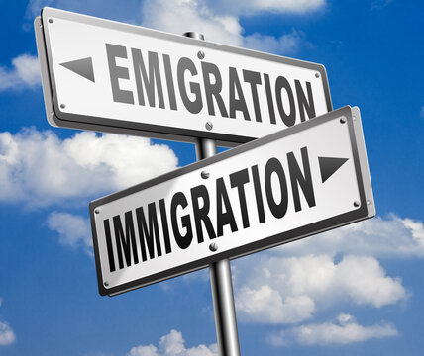
EMIGRATION AND IMMIGRATION IN SLOVENIA
Staša Zavec, Ela VELIKONJA, JULIJA KENDA, DUNJA HRAST
2021/22

Slide 2
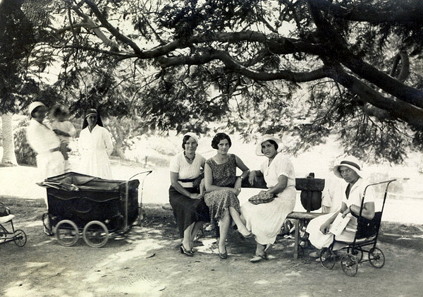
EMIGRATION
1860- 1914
The Alexandrian women

Slide 3
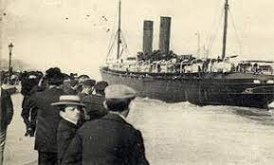
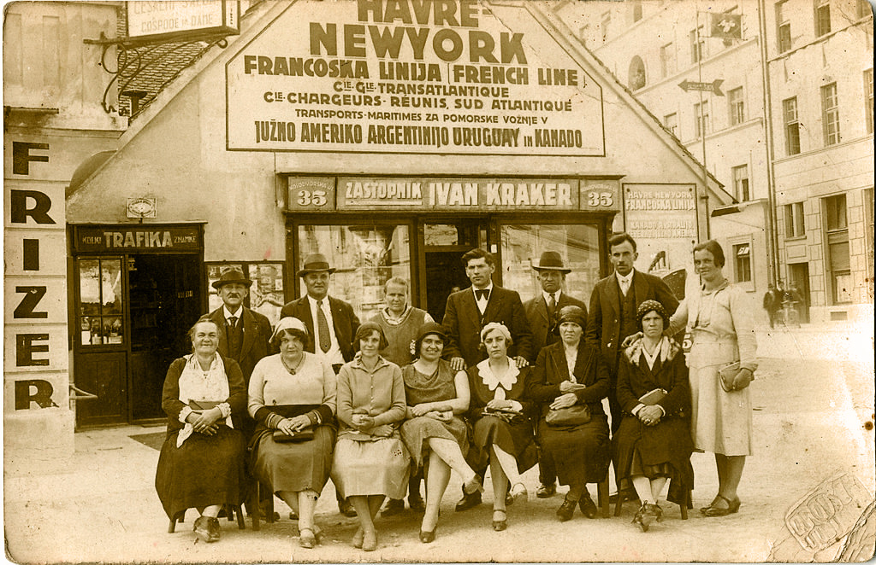
1918-1941, the Interwar period
Emigration of Slovenes to America
Slovenes in New York

Slide 4
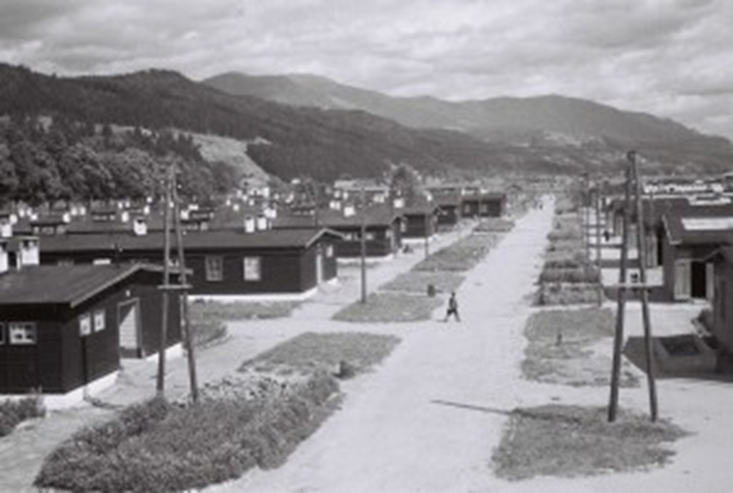
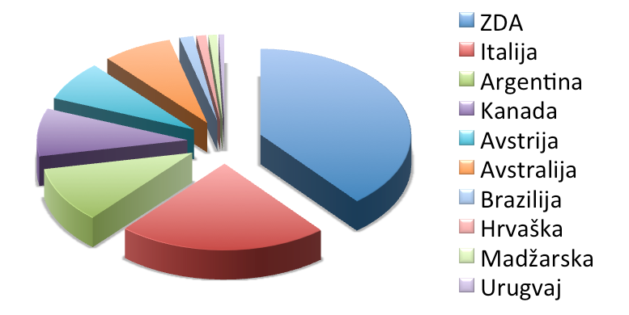
After World War II
Slovenian refugee camp in Austria
Percentage of Slovenes who emigrated in other countries

Slide 5
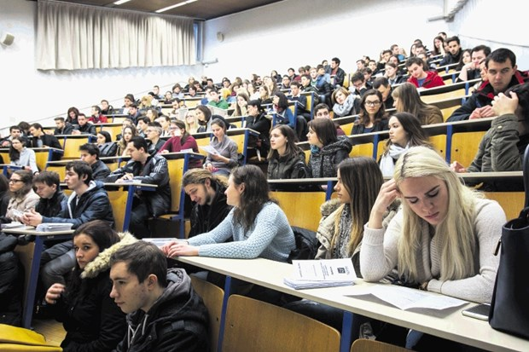
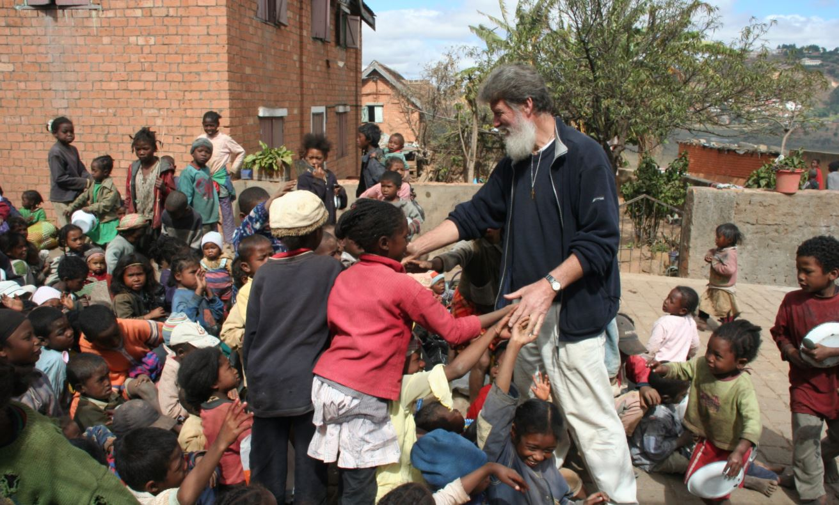
Emigration today
Brain drain
Slovenian missionaries

Slide 6
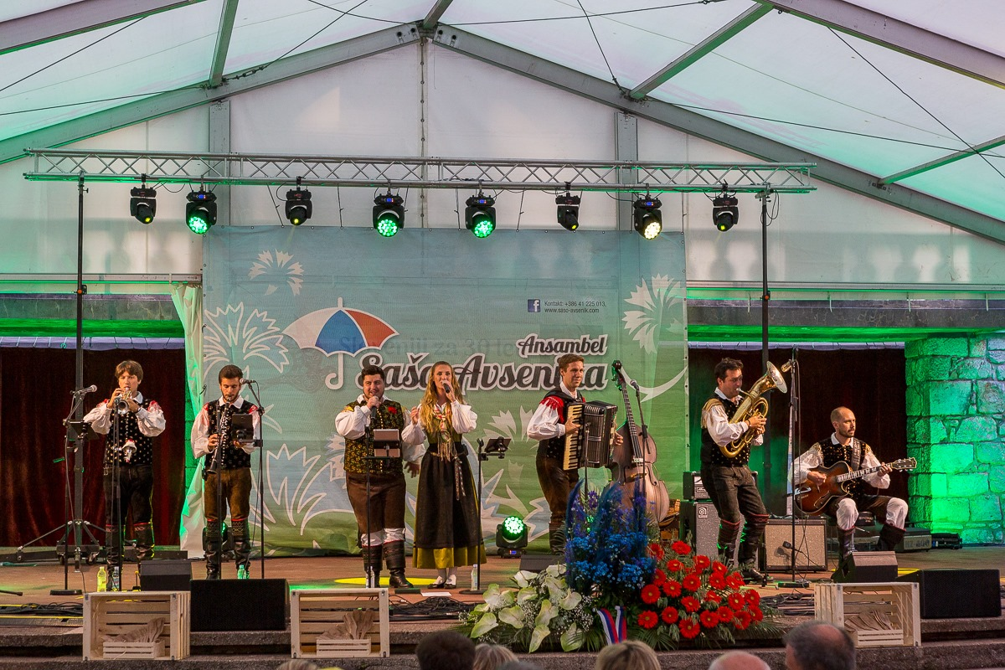
Staying in touch with Slovenia
Slovenija v svetu
Rafaelova družba
An event organized by Svetovni slovenski kongres

Slide 7
IMMIGRATION

Slide 8
After World War II
Yugoslav countries

Slide 9
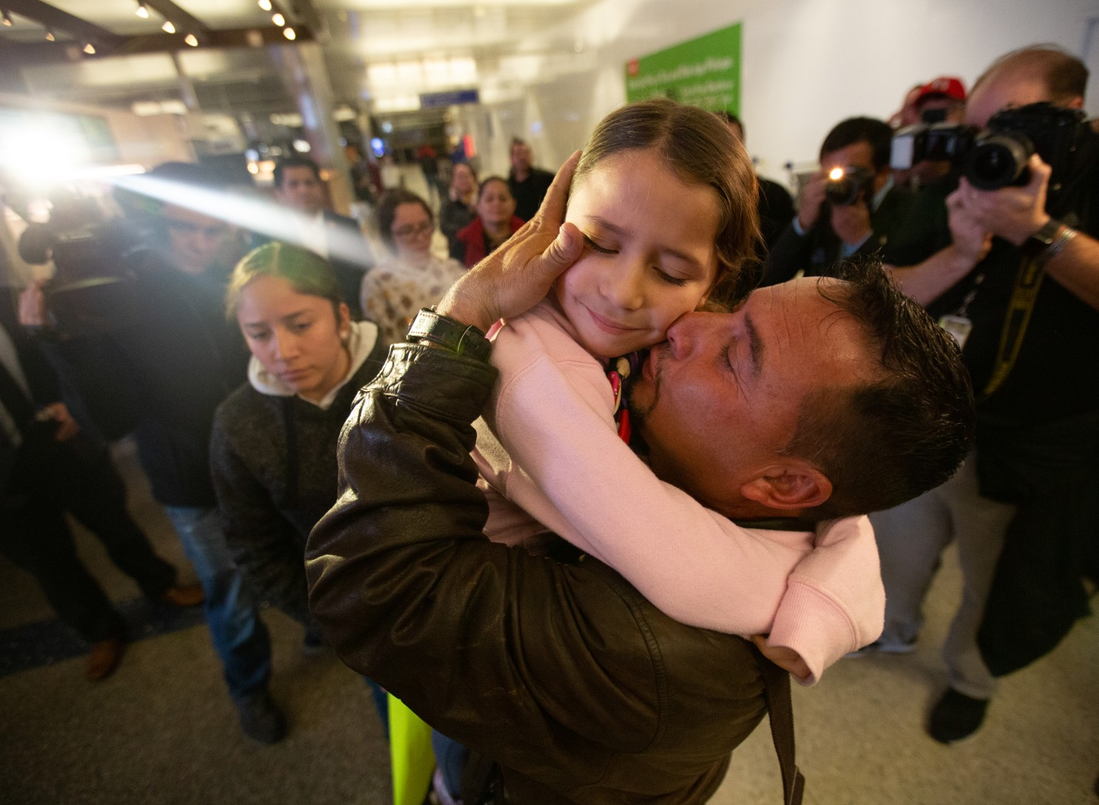
After Slovenia gained independence
Family reunification
Slovenia gaining independence, 1991

Slide 10
2015, ‘‘refugee wave‘‘
Refugees in Slovenia

Slide 11
Immigration today
Migrations in Slovenia

Slide 12
SOURCES
https://www.gov.si/podrocja/zunanje-zadeve/slovenci-zunaj-slovenije/slovenci-po-svetu/?fbclid=IwAR1doqvNCP7jOi2cipd_fo144JdAxicUrC9-SpkN_SBSdGJGy_V4qQJgv7E
https://dijaski.net/gradivo/soc_ref_emigracije_slovencev_01?fbclid=IwAR2t-4qqeBj3ShdduQ6-pXcg_y9ulBGPb3bB0sPYHYkWQtgOnNQEEHhXoV8
https://www.europarl.europa.eu/news/sl/headlines/world/20200624STO81906/raziskovanje-vzrokov-za-migracije-zakaj-ljudje-migrirajo
https://www.sloga-platform.org/wp-content/uploads/2020/12/Obrazi-migracij-2020-SLO-b.pdf
https://www.knjiznica-celje.si/raziskovalne/4201902894.pdf
http://dk.fdv.uni-lj.si/diplomska_dela_1/pdfs/mb11_peterka-tina.pdf?fbclid=IwAR3F1BrpK_B2pQYs1h0XdMURYJ7MLjIYVAagsCfD56PnaFua1oeieOKFIa4
https://www.worldcat.org/title/priseljenci-iz-nekdanje-jugoslavije-in-njihove-osebne-izkusnje-migracije-diplomsko-delo/oclc/922871038
https://slovenci.si/en/screenshot_2020-08-13-rafaelova-druzba-logo-iskanje-google-2/
https://m.facebook.com/Slovenska-izseljenska-matica-177937545972537/
https://www.facebook.com/186947204674653/photos/a.186947418007965/186947421341298/
https://www.facebook.com/slokongres/
https://sl.wikipedia.org/wiki/Aleksandrinka#/media/Slika:Aleksandrinke_v_parku.jpg
https://www.dnevnik.si/1042857607/slovenija/vse-vec-mladih-slovencev-se-izseljuje-v-azijo
https://www.istockphoto.com/vector/slovenia-map-with-people-gm508965202-85543391
http://www2.arnes.si/~tbolko/R09/projekt2c1/jugoslavija.html
https://slonovice.wordpress.com/2017/04/18/zaposlitev-v-sloveniji/
https://www.racunovodstvo-svera.si/delovna-dovoljenja/
https://www.latimes.com/california/story/2020-01-23/families-reunite-after-nearly-two-years-apart-beginning-of-a-whole-other-journey
https://www.metropolitan.si/aktualno/30-let-od-afere-jbtz-ki-je-okrepila-demokratizacijo-slovenije-in-pospesila-osamosvojitev/
https://www.24ur.com/novice/svet/sirija-8.html(modal:p/image/61745301)
https://www.dnevnik.si/1042723390
https://www.stat.si/statweb/News/Index/8990
http://www.politikis.si/2014/03/zn-so-leta-1966-21-marec-razglasili-za-mednarodni-dan-za-odpravo-rasne-diskriminacije/
https://www.knjiznica-celje.si/raziskovalne/4201902894.pdf
https://www.jaiktravelblog.com/2017/05/12/croatia-slovenia-bosnia-herzegovina-summed-up/

