Slide 1
MIGRATIONS
Ana Čargo, Jakob Šavli, Tomaž Rutar, Miha Jermol
Gimnazija Tolmin, November 2021

Slide 2
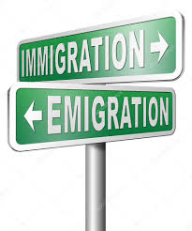
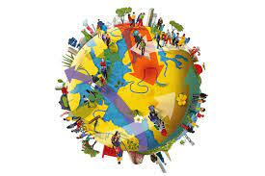
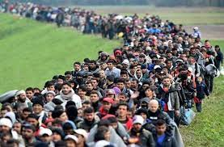
WHAT ARE MIGRATIONS?
change of permanent or temporary residence (emigration, immigration)
They take three forms:
regular
free migration
coercive
illegal

Slide 3
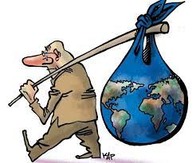
WHO IS A MIGRANT?
Any person who changes his or her country of habitual residence and, in doing so, changes his or her permanent or temporary residence.

Slide 4
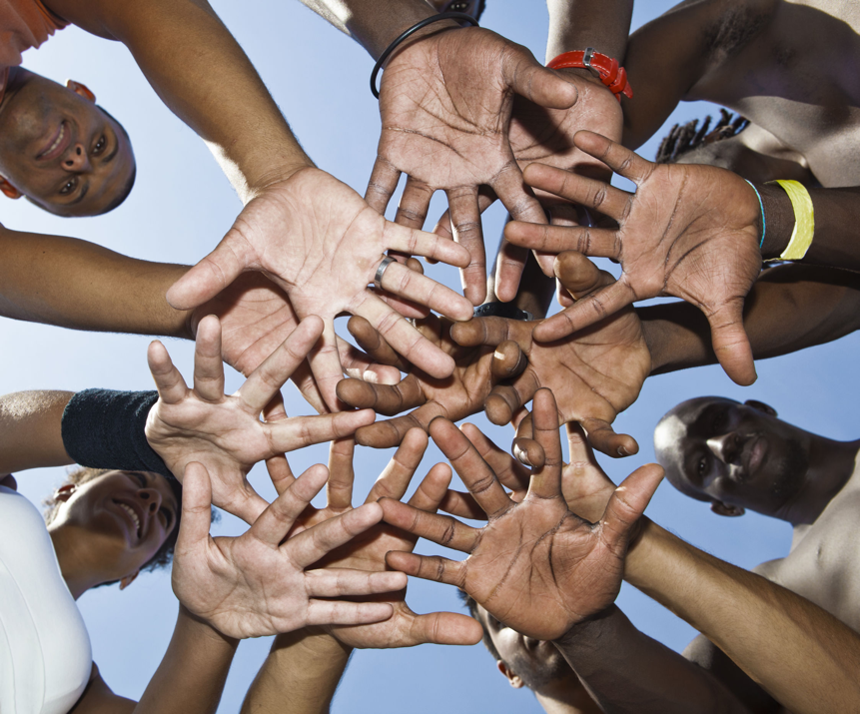
CAUSES FOR MIGRATION
SOCIO-POLITICAL CAUSES
ethnic, religious, racial, political and cultural persecution
wars
example: war in Afghanistan - people fleeing to European countries

Slide 5
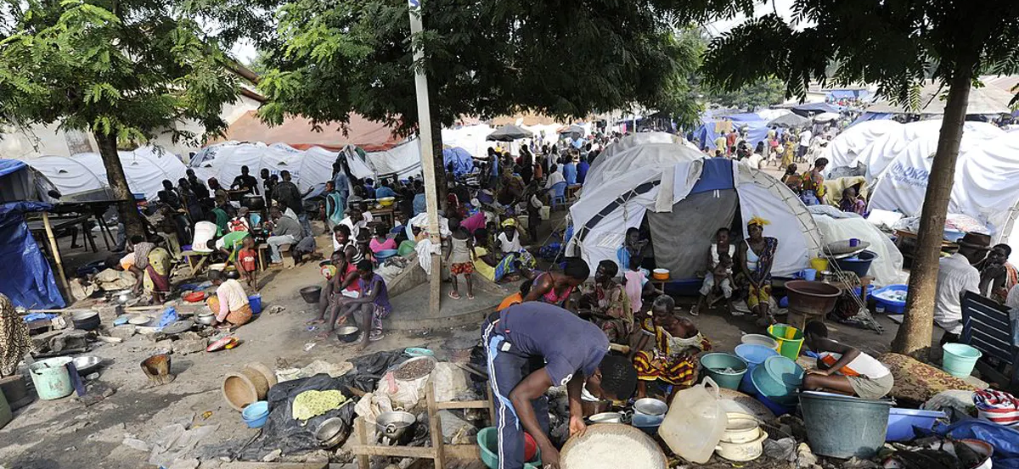
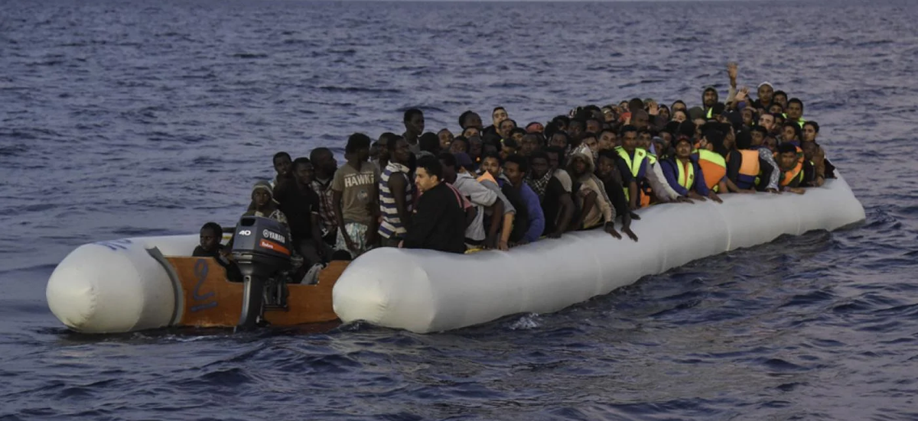
ENVIRONMENTAL FACTORS
natural disasters
floods, hurricanes, earthquakes

Slide 6
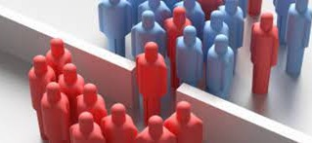
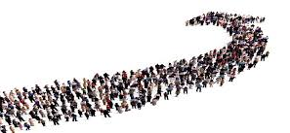
DEMOGRAPHIC AND ECONOMIC FACTORS
related to labour standards, unemployment and the health of the economy. People are attracted by higher salaries, better job opportunities, higher living standards and educational opportunities
example: the Balkans - people moving north for better jobs

Slide 7
The impact of migration on the area of immigration

Slide 8
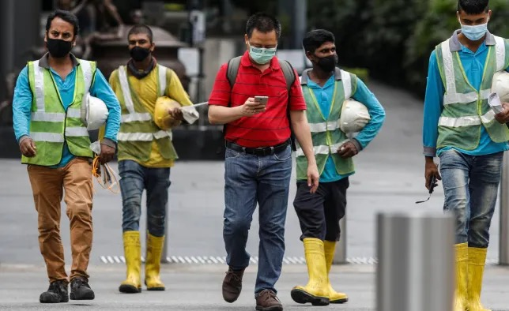
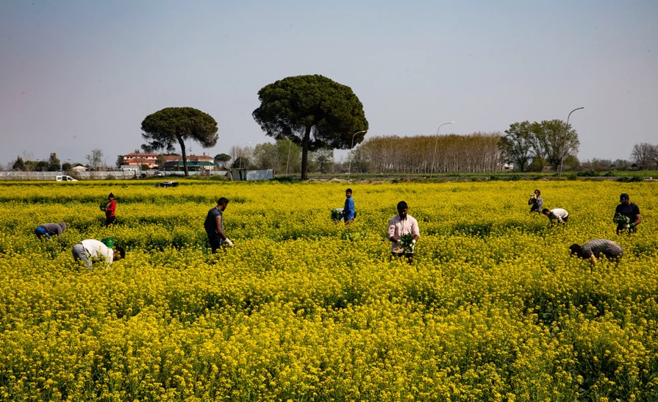
IMPACT ON THE ECONOMY
Generally good
Perhaps problematic, because of the displacement of locals from jobs
Technological progress and economic growth

Slide 9
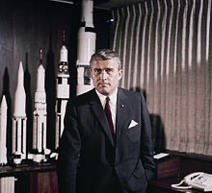
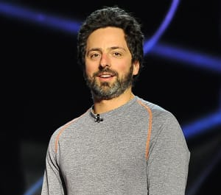
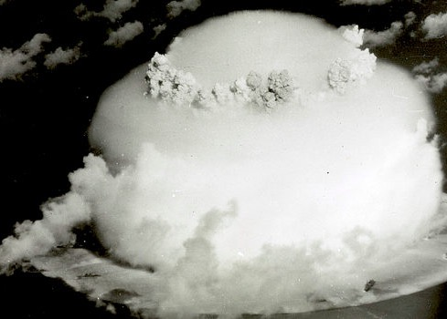
TECHNOLOGICAL ADVANCES
Atomic weaponry (Albert Einstein)
Space Exploration (Wernher von Braun)
GOOGLE (Sergey Brin)

Slide 10
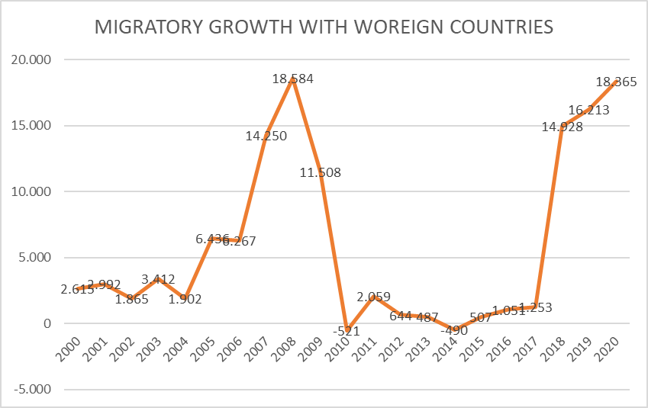
IMPACT ON DEMOGRAPHY
Changing age structure - mostly young people moving in
Change in growth composition
Displacement of the native race and racial mixing

Slide 11
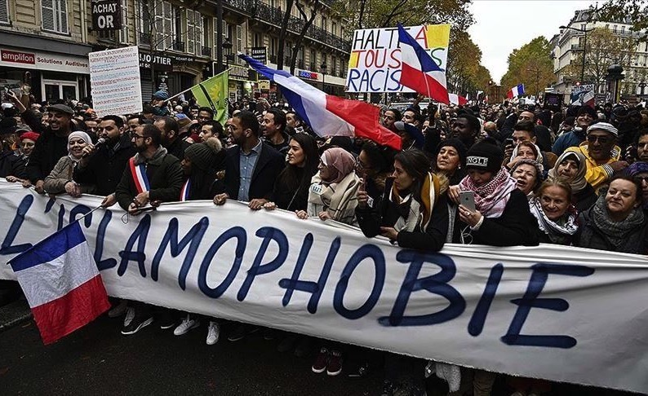
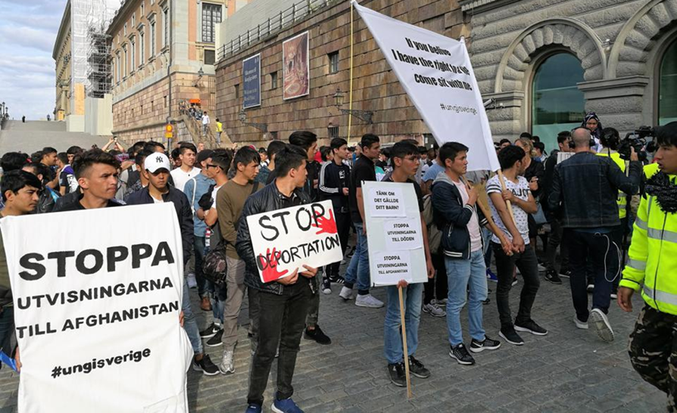
DISCRIMINATION
Tension between groups
Prejudice
What contributes to discrimination?

Slide 12
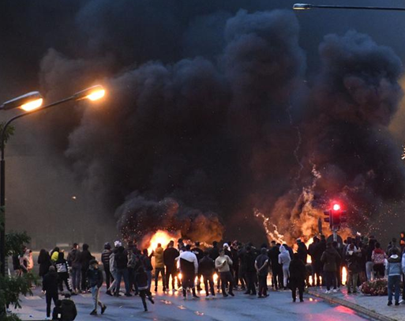
CRIME
Overall increase in crime
Crime brought by immigrants
Crimes against immigrants

Slide 13
POSSIBLE SOLUTIONS

Slide 14
SOURCES:
Slika 1: https://opensocietyfoundations.imgix.net/uploads/e4110f2e-a42f-471a-90bc-3aecb2f02d92/20200526-esposito-italy-migrant-workers-coronavirus-3000.jpg?auto=compress%2Cformat&fit=min&fm=jpg&q=80&rect=0%2C0%2C3000%2C2000&w=1140
Slika 2: https://www.ft.com/__origami/service/image/v2/images/raw/http%3A%2F%2Fcom.ft.imagepublish.upp-prod-eu.s3.amazonaws.com%2F907f80a0-a592-11ea-a27c-b8aa85e36b7e?fit=scale-down&source=next&width=700
Slika 3: https://upload.wikimedia.org/wikipedia/commons/thumb/f/ff/Wernher_von_Braun.jpg/220px-Wernher_von_Braun.jpg
Slika 4: https://assets.pogo.org/image/content/2018/_575xAUTO_crop_center-center_none/bikini-atoll_575.jpg?mtime=20180803160201&focal=none&tmtime=20210827002507
Slika5: https://doallthingswithjoy.com/24726487-a-group-of-mixed-race-people-putting-hands-together-2/
Slika 6: https://theconversation.com/governments-need-to-do-more-for-refugees-affected-by-coronavirus-heres-how-135861
Slika 7: https://www.middleeasteye.net/news/high-quality-refugee-boats-sale-chinese-website-despite-eu-criticism
Slika 9: https://www.forbes.com/sites/freylindsay/2020/02/11/sweden-has-a-problem-sending-asylum-seekers-back/?sh=253d2a091d36#16166649339952&{"sender":"offer-1-gMPCY","displayMode":"inline","recipient":"opener","event":"resize","params":{"height":287,"iframeId":"offer-1-gMPCY"}}
Slika 8: https://static.dw.com/image/54749030_401.jpg

Slide 15
Thank you for your attention

