Slide 1
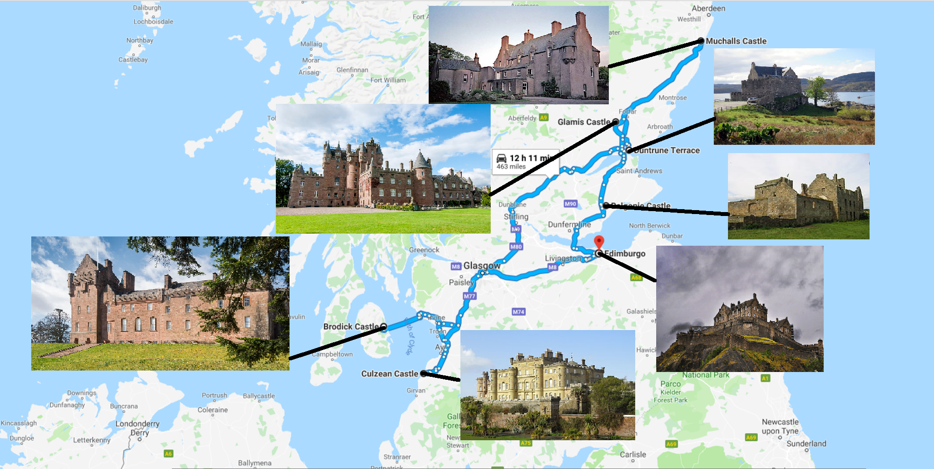
A castle ghost tour

Slide 2
Balgonie Castle
Luigi, Matteo and Giacomo

Slide 3
Location

Slide 4
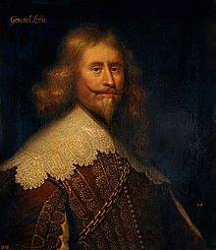
Alexander Leslie, 1st Earl of Leven was a Scottish soldier in Swedish and Scottish service. Born illegitimate and raised as a foster child.

Slide 5
Two investigators inside the castle felt observed and claimed to have been touched at the ankles. Others, on the other hand, saw a green woman or the ghost of a dead general.
What happened today?

Slide 7
MUCHALLS CASTLE

Slide 8
LOCATION
Muchalls castle is in the countryside of Kincardine and Mearns,Aberdeenshire.

Slide 9
Main character of the story
The main character of the story is the Green Lady.

Slide 10
What happend
Years ago, a young lady ventured into the tunnel to meet her lover out by the waters, but she drowned when the tide came in and filled the tunnel.

Slide 11
What happens today?
She is said to haunt, and sometimes even appear, in one of the rooms of the castle.

Slide 12
Culzean Castle
By Marco and Eric

Slide 13
location of culzean castle

Slide 14
the protagonist of this legend is sir John Cathcart who was pushed to death in a cliff and became a ghost

Slide 15
what happens today
Today if you pass near the cliff where John Cathcart died you can still see his ghost

Slide 16
GLAMIS CASTLE

Slide 17
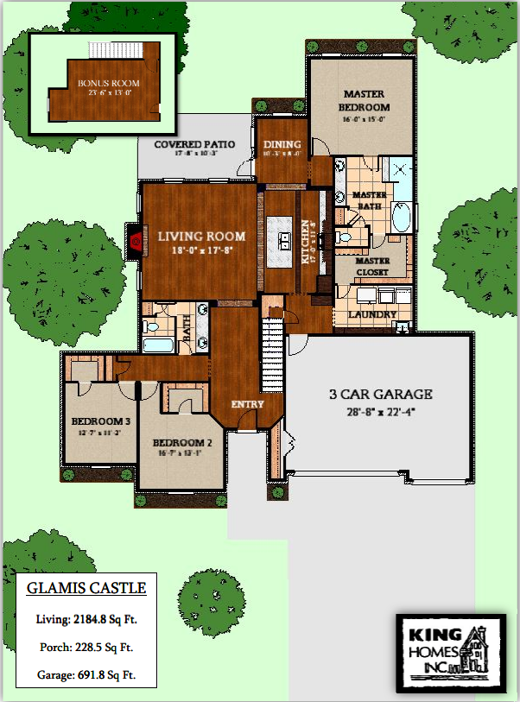
Glamis castle is one of the most beautiful castles in Scotland, which occupies the village of Glamis at angus in Scotland

Slide 18
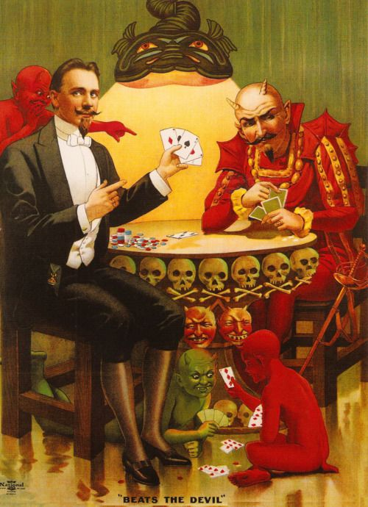
EARL BEARDIE
Earl Beardie was what we may call a compulsive gambler who liked cards.
this story is about this man who played cards, but at a certain point he died because he made a pact with the devil.
Today it is thought that Earl has become a ghost and that he plays for eternity at cards in a secret room of the castle with the devil

Slide 19
DAY 1:Edinburgh Castle
Beatrice & Rebecca

Slide 20
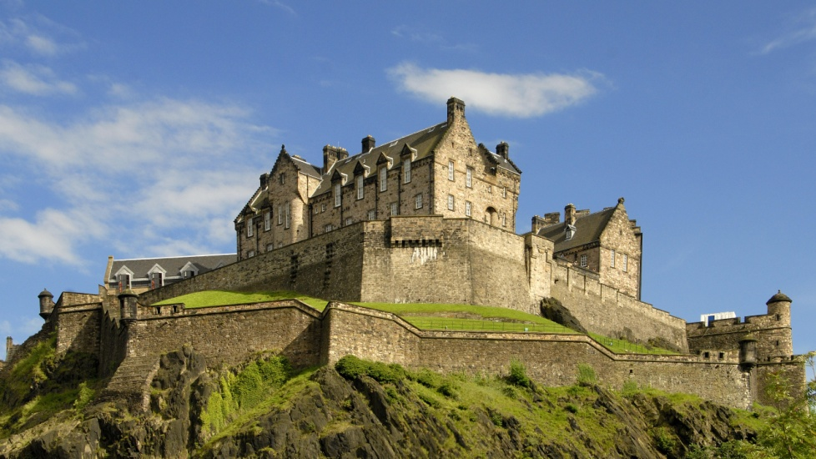
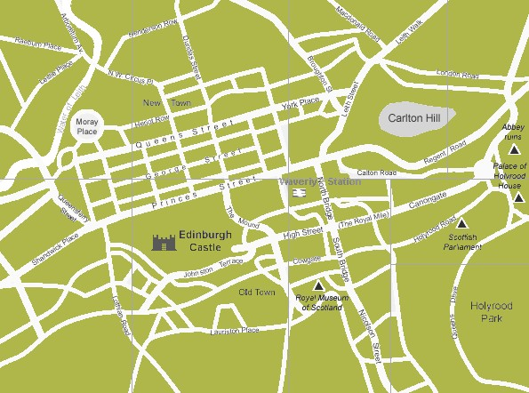
LOCATION
The Edinburgh Castle is situated in Edinburgh.

Slide 21
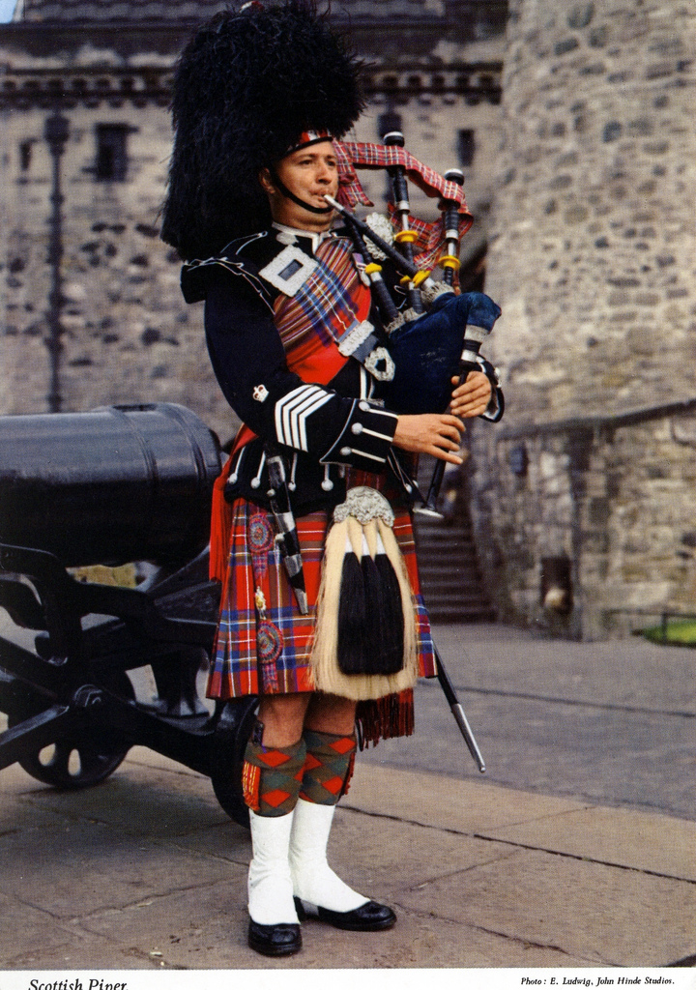
MAIN CHARACTER OF THE STORY
The principal character of the story is The Piper, a musician.
I’M A PIPER!

Slide 22
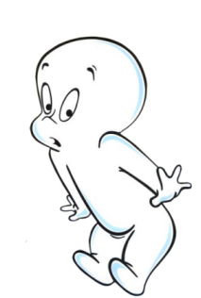
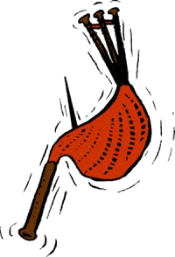
WHAT HAPPENED
The Piper was sent to explore the secret tunnels to the Royal Mile and he vanished while he was playing the bagpipes.

Slide 23
Duntrune Castle
DAY 5

Slide 24
Location
Duntrune castle is located on the northside of Loch Crinan in Scotland.

Slide 25
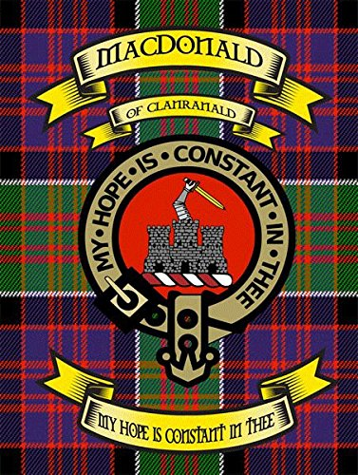
Story
It was originally built by the clan MacDonald in the 13° century. A spy from the Campbell clan was discovered and imprisoned in a tower. He played the accordion and they cut off his hands

Slide 26
. A handless skeleton was discovered.

Slide 27
DAY 6 – BRODICK CASTLE

Slide 28
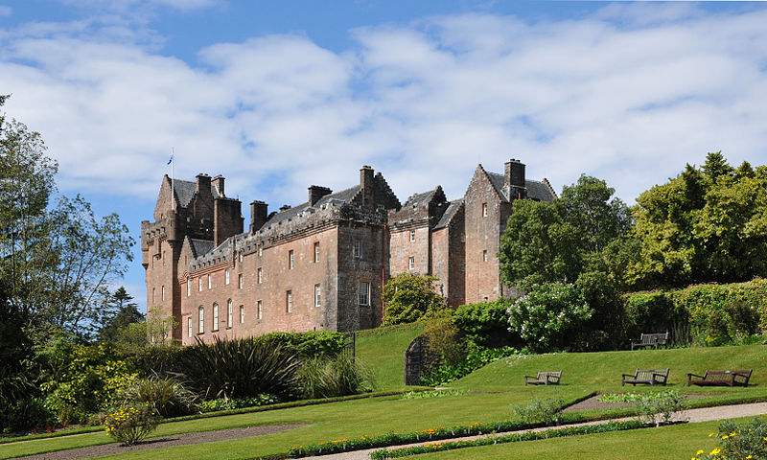
LOCATION
Brodick Castle is a castle situated outside the port of Brodick on the Isle of Arran, an island in the Firth of Clyde, Scotland. It was previously a seat of the Dukes of Hamilton, but is now owned by the National Trust for Scotland.
https://www.google.com/maps/place/Brodick+Castle,+Garden+and+Country+Park/@55.593863,-5.150884,15z/data=!4m5!3m4!1s0x0:0x7265357884584afb!8m2!3d55.593863!4d-5.150884

Slide 29
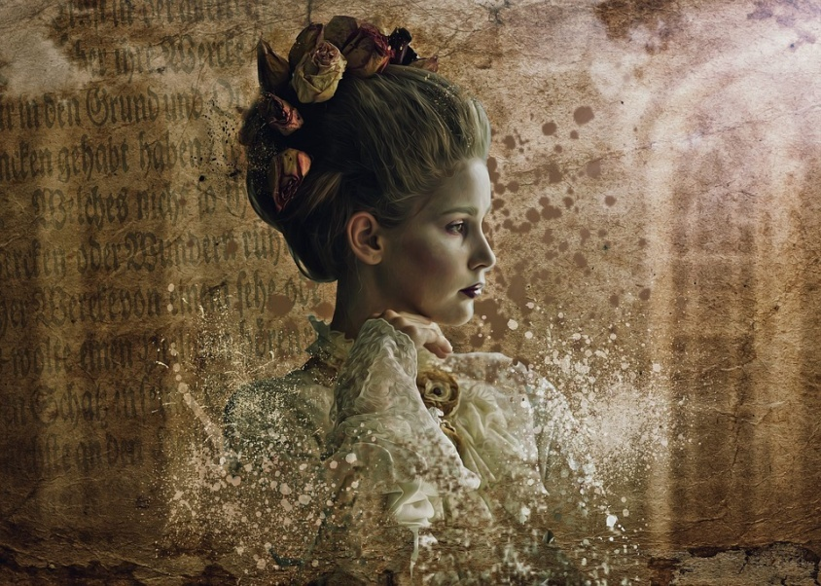
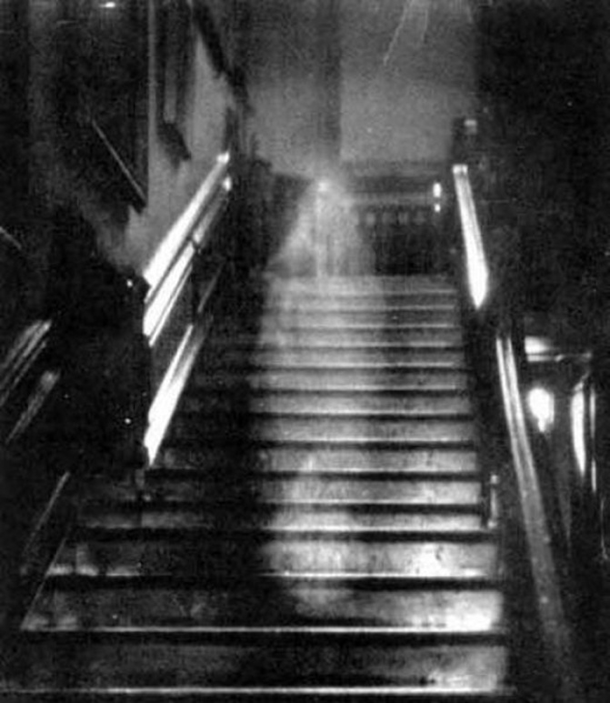
Grey Lady
Giovanni di Nava was married to Isabella, a noble woman, but Giovanni betrayed his wife with another woman, Grey Lady. Giovanni had her killed, but her spectrum remained in the castle.

Slide 30
What happened
The castle has a long turbulent history and is alleged to be haunted by a “Grey Lady” clad in grey clothing with a large white collar.
She was followed and at the end she vanished in front of the people.

