Slide 1
SYMBOLS OF IRELAND

Slide 2
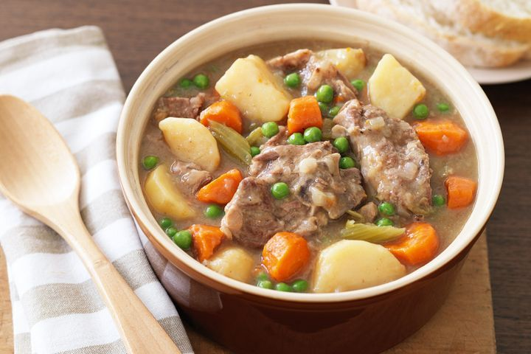
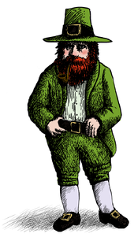
IRISH STEW
What can you eat in Ireland?
You can eat a typical IRISH STEW

Slide 3
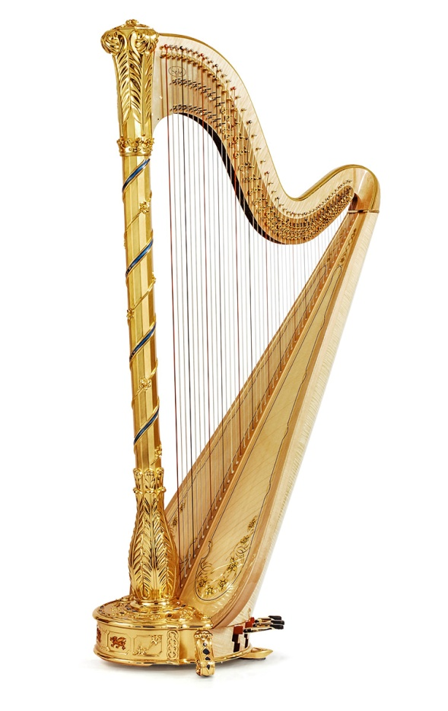
THE HARP
What is the traditional instrument in Ireland?
The traditional instrument in Ireland is the HARP and it is also the traditional symbol of Ireland

Slide 4
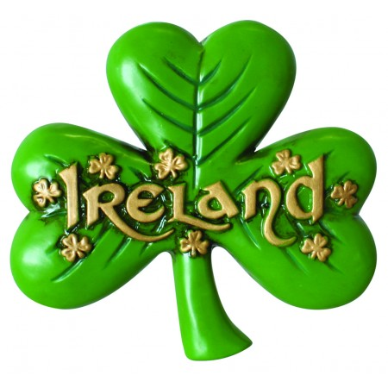
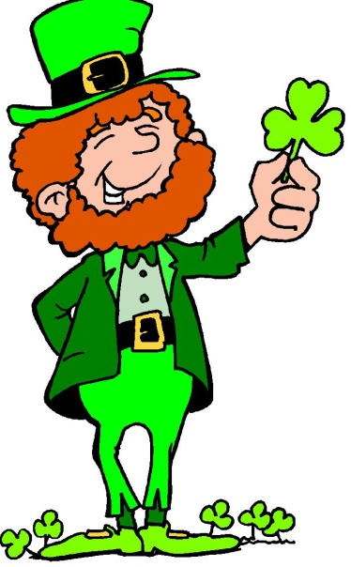
THE SHAMROCK
What is the typical symbol of Ireland?
The typical symbol of Ireland is the SHAMROCK

Slide 5
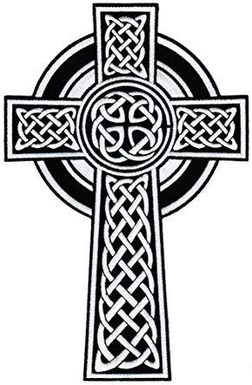
THE CELTIC CROSS
Where can you find these crosses?
Today, this ancient symbol seems to be everywhere in Ireland. Not just out in the countryside or in cemeteries but in many logos and advertising formats.

Slide 6
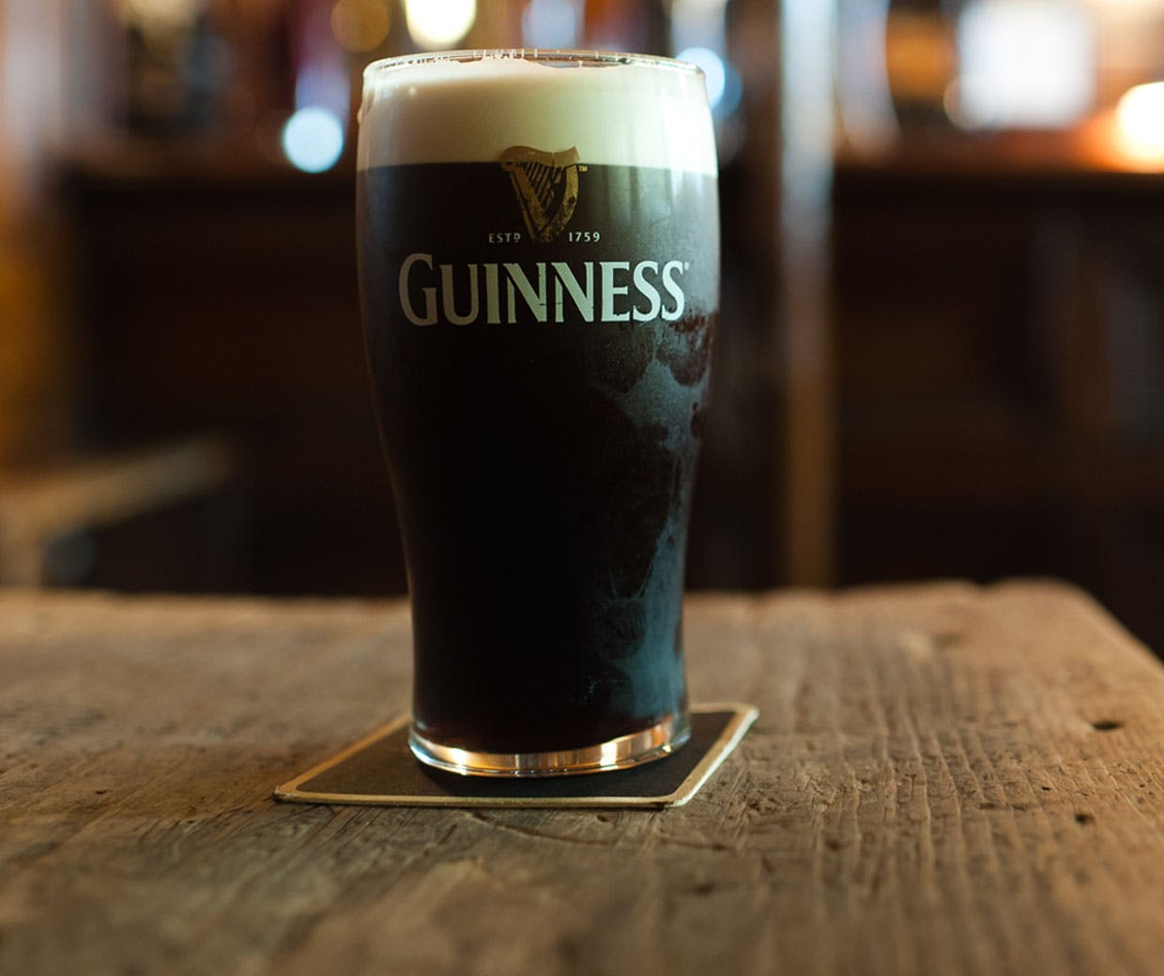
THE GUINNESS
What can you drink in Ireland?
You can drink a typical beverage.
It is the most popular drink in Ireland . It is dark beer, GUINNESS.

