Slide 1
GAELIC FOOTBALL
SPORTS IN IRELAND

Slide 2
What is the national sport in Ireland?
It’ s Gaelic Football!

Slide 3
Gaelic football it’s our national sport in Ireland.
In Gaelic Football you can touch the ball with your hands and also kick it with your feet. There is a team of 15 players.
The Champonship starts in May and finishes in September with the final at the Croke Park Stadium in Dublin.

Slide 4
Gaelic football

Slide 5
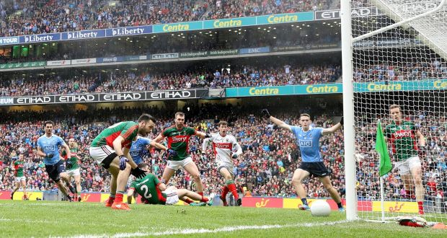
Did you know that…
You can touch the ball with your hands and your feet

Slide 6
This is the croke park stadium in Ireland
Did you know that…
The final Championships take place at the Croke Park Stadium

Slide 7
HURLING

Slide 8
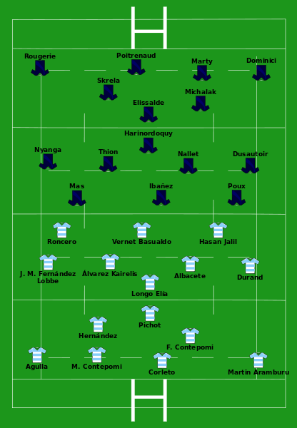
Did you know that…
There are 15 players
In one team.

Slide 9
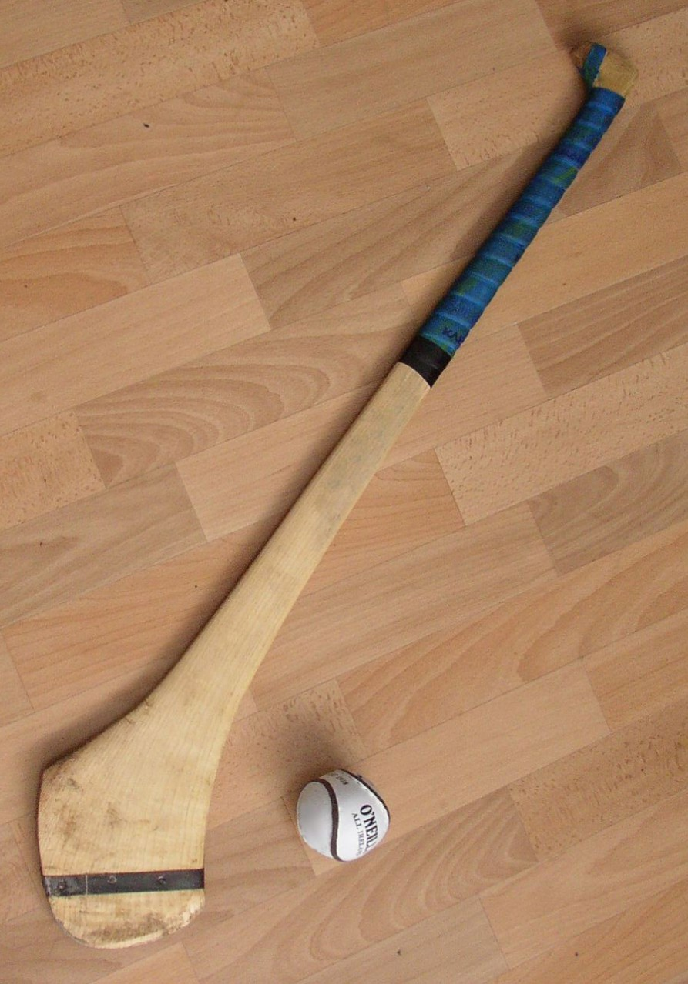
This is the raquet and
the ball you use for
the game.

