Slide 1
Country Profile

Slide 2
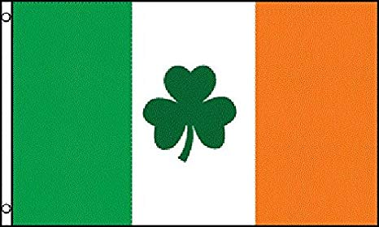
The flag of Ireland

Slide 3
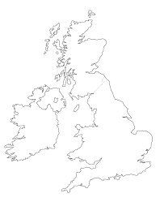
SCOTLAND
NORTHERN IRELAND
IRELAND
Edinburgh
ENGLAND
Belfast
Dublin
London
Cardiff
WALES

Slide 4
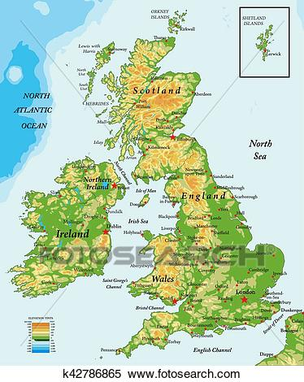
IIt is in Europe, it is part of the British Isles but it doesn’t belong to the UK!
Where is Ireland situated?

Slide 5
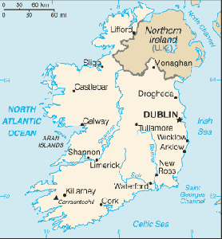
What is the capital city of Ireland?
Dublin

Slide 6
What languages do they speak in Ireland?
English and Irish

Slide 7
Yes, you can
Can I use Euros in Ireland?

Slide 8
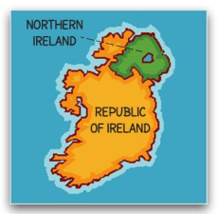
Tell me about the government…
It’s a Republic

Slide 9
Green,white,orange
What are the colours of the flag?

Slide 10
The capital city of IRELAND is DUBLIN.
Ireland is in Europe, it is part of the British Isles but it doesn’t belong to the U.K.
The flag of Ireland is GREEN, WHITE, ORANGE.
The nickname of Ireland is Emerald Island because it is very green

