Slide 1
Klaipėda Vytautas Dydisis gymnasium
Traditional Irish Dishes And Drinks
Made by Gabija Vaivadaitė
English teacher Vilija Rakštienė
Klaipėda, 2018

Slide 2
Good food starts with good ingredients, so it was only natural for an artisan food movement to launch in Ireland. The island has always been home to excellent raw ingredients and communities with traditional skills like bread making and butchering.
While there’s no shortage of must-try menu items in Ireland, I’ve compiled a list of my favorites.

Slide 3
1. Soda bread
Every family in Ireland has its own recipe for soda bread, hand-written on flour-crusted note paper and wedged in among the cookery books. Some like it sweet with a spoonful of honey, sugar or dried fruits. Others prefer sprinkled-in seeds, bran and oats for a health boost, or treacle and Guinness for the opposite effect. However, the basic ingredients don’t change (bicarbonate of soda and buttermilk form the raising agent, which is mixed in with flour) and nor does the way it’s eaten: sliced and spread liberally with butter.

Slide 4
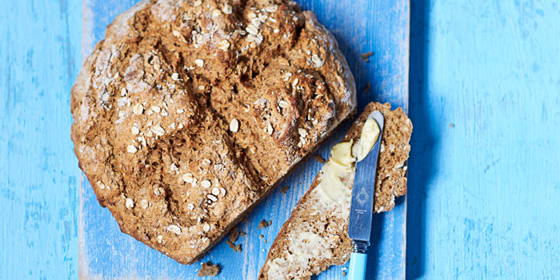

Slide 5
2. Irish stew
One-pot cooking doesn’t get much simpler than Irish stew, traditionally made with mutton, onions and potatoes (the addition of carrots can be a divisive issue). To avoid the stew being watery (a childhood horror for many of us), some recipes recommend adding pearl barley, a spoonful of roux or sliced potatoes, while others reduce the liquid by leaving the stew to simmer. These days, you’re more likely to find Irish stew made with lamb (as the more flavourful mutton is harder to come by), with stock and herbs – such as thyme, parsley and bay leaves – adding depth of flavour.

Slide 6
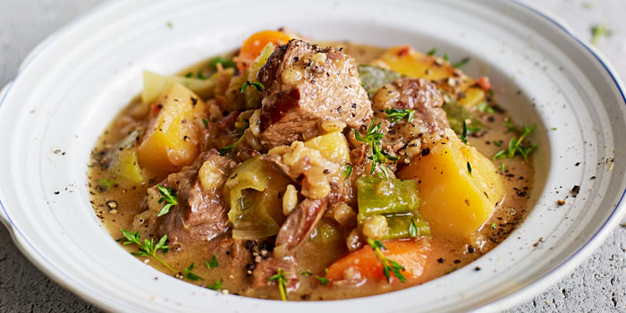

Slide 7
3. Whiskey - The Water of Life
Ireland is home to several distilleries, which produce some of the world’s finest whiskeys. Uisce Beatha is the Gaelic term for whiskey and translates to “water of life”. The most common types of whiskey distilled in Ireland include single malt, single grain and blended whiskey. Examples of Irish whiskey include Black Bush, Bushmills, Jameson, Paddy, Powers, and Tullamore Dew to name a few.

Slide 8
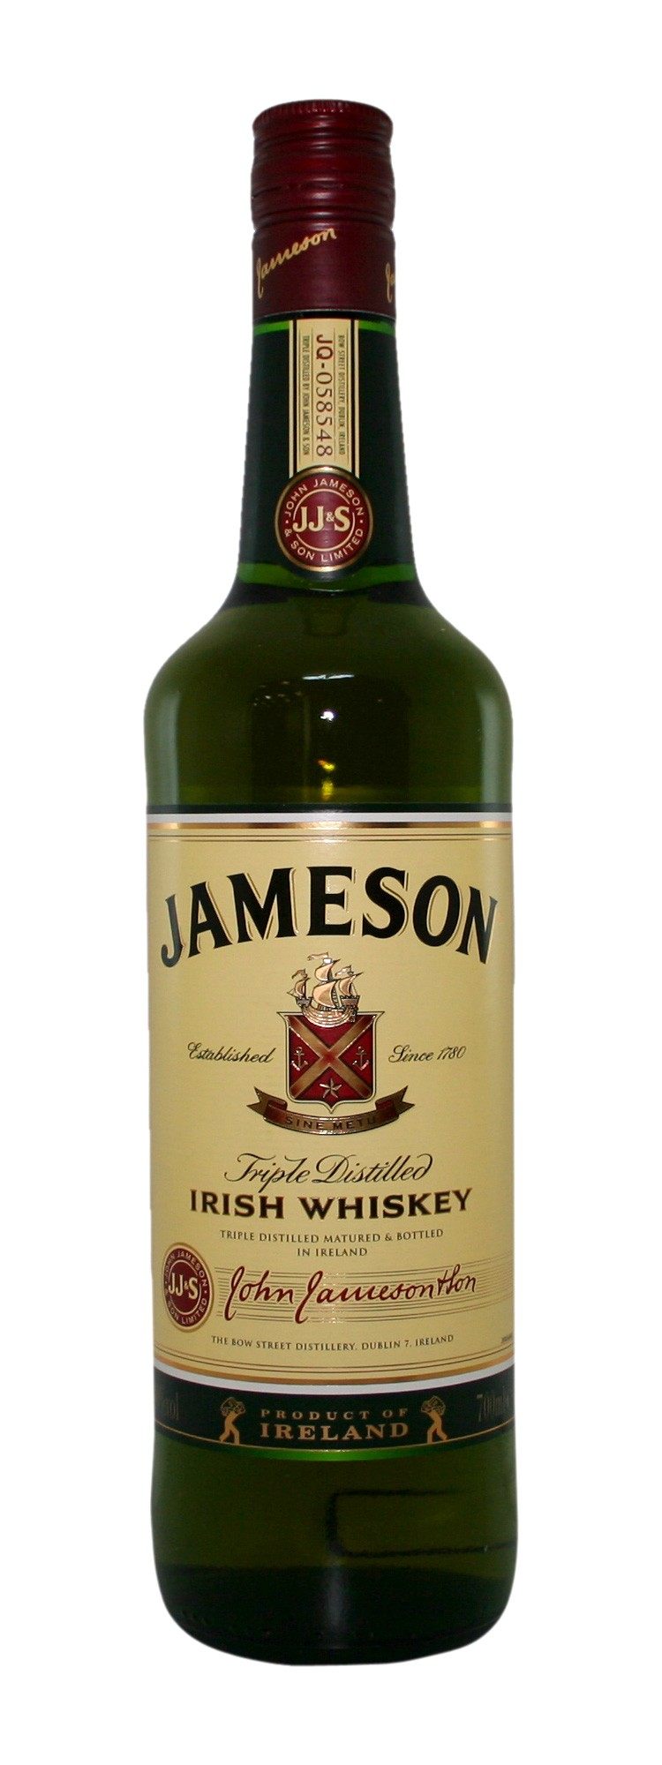

Slide 9
4.Guinness - A Pint of Plain
Like silk being poured into a glass. The Guinness brand is synonymous with Ireland. In 1759, Arthur Guinness acquired a four acre site and signed a 9,000-year lease for the St. James’ Gate Brewery in Dublin. The brewery became well known for brewing “porter,” which was a dark ale. Over the past 250 years, the dark ale has evolved in to an unique dark stout, which is enjoyed across the globe. According to the company, over 10 million glasses of Guinness are enjoyed daily around the world.

Slide 10
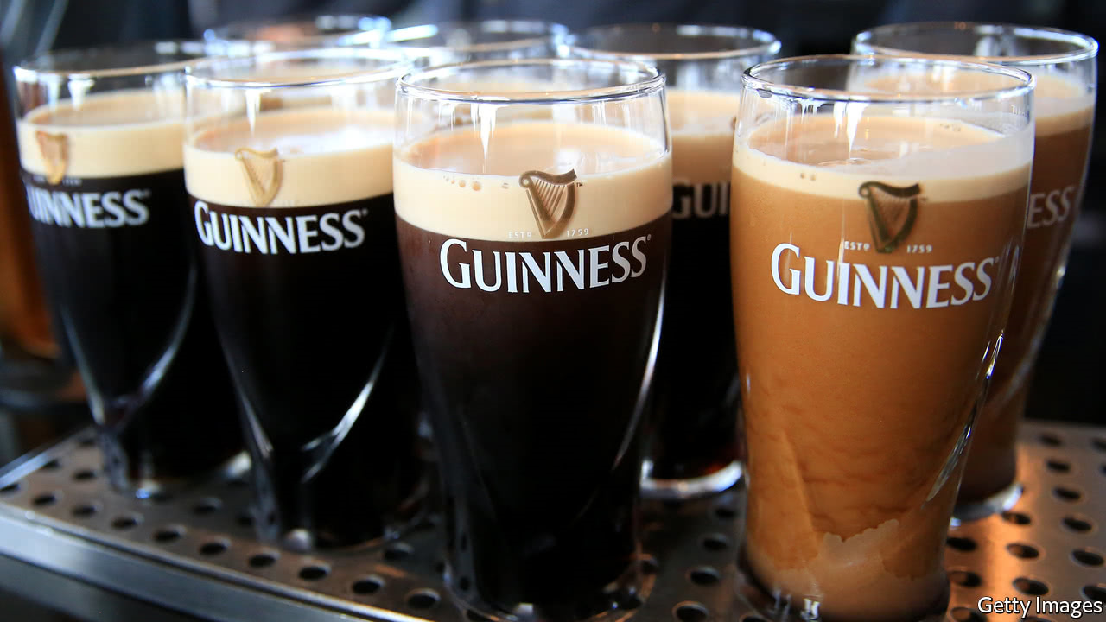

Slide 11
Thanks for your attention ! ☺

