Slide 1
Ireland
The republic of Ireland and its simbols

Slide 2
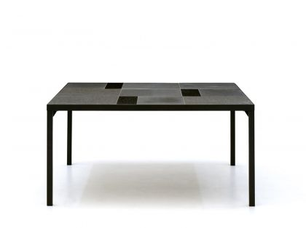
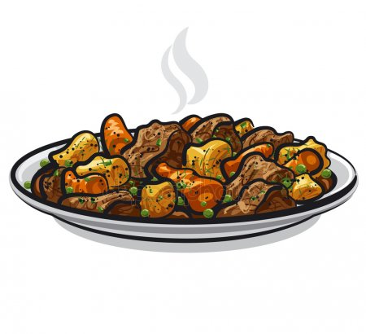
This is the Irish stew. It is a dish made from lamb or mutton and potatoes,onions and carrots.

Slide 3
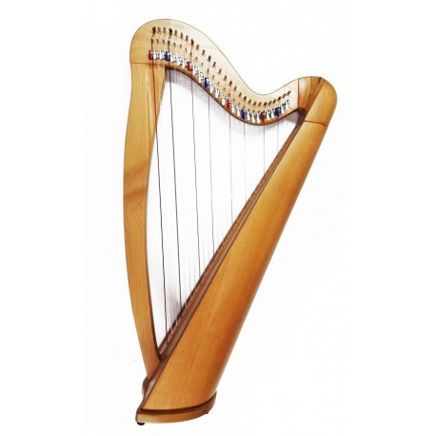
The harp is the traditional symbol of Ireland and it’s also the traditional Irish instrument.

Slide 4
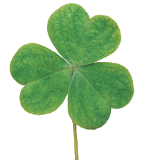
In ancient times the people believed that a shamrock had magical powers and numbers three was a lucky number. It’s a symbol of good luck.

Slide 5
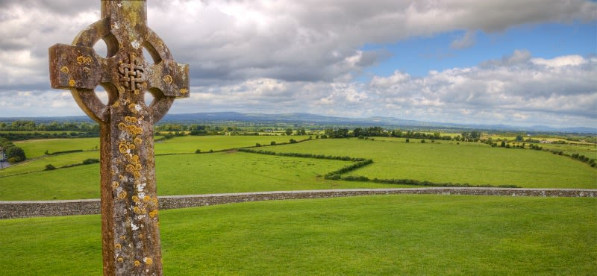
The legend says that Saint Patrick brought the Celtic Cross to Ireland.

Slide 6
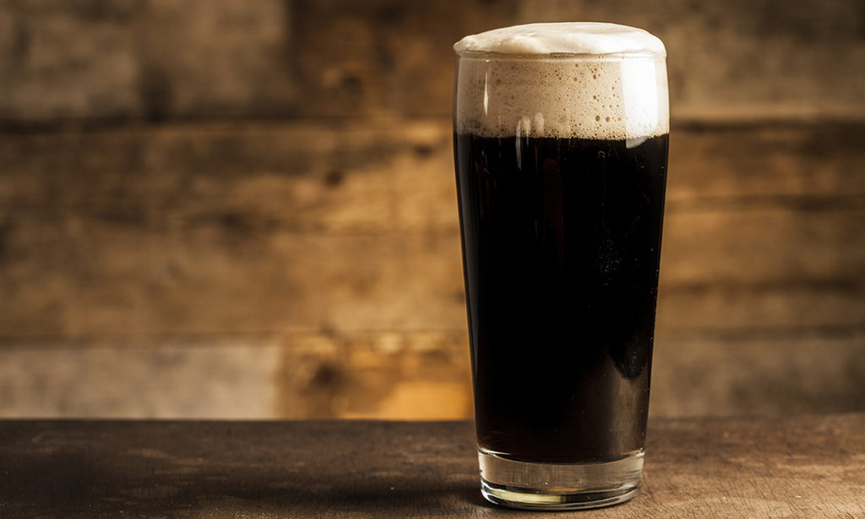
Guinnes is the name of the most popular drink in Ireland. It is dark beer.

