Slide 1
THE POTATO FAMINE

Slide 2
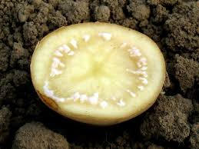
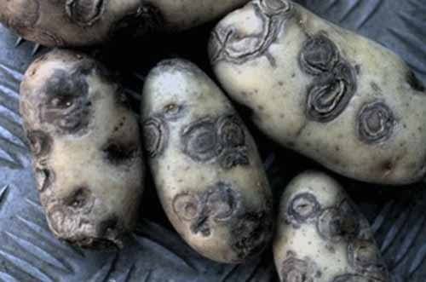
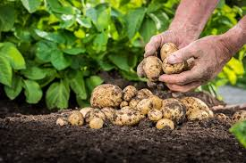
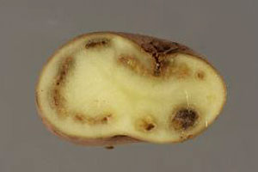
It was a disaster that happened in Ireland between 1845 and 1849 when most of the potato crop was destroyed by a plant disease

Slide 3
Potatoes were the main food of the poor in Ireland and about a million people died for lack of food

Slide 4
«Thousands are sailing Across the western ocean, To a land of opportunity That some of them will never see, Fortune prevailing Across the western ocean Their bellies full Their spirits free They'll break the chains of poverty»
(The Pogues, Thousands are Sailing)
What is that?
It is a Coffin Ship.

Slide 5
“A million people died on these ships
because of disease and hunger.”

Slide 6
In memory of this misfortune, memorial statues were placed in Dublin.
Potato Famine Video.

