Slide 1
Irish cuisine by: Sofija Bagdonaitė
Klaipėda, 2018

Slide 2
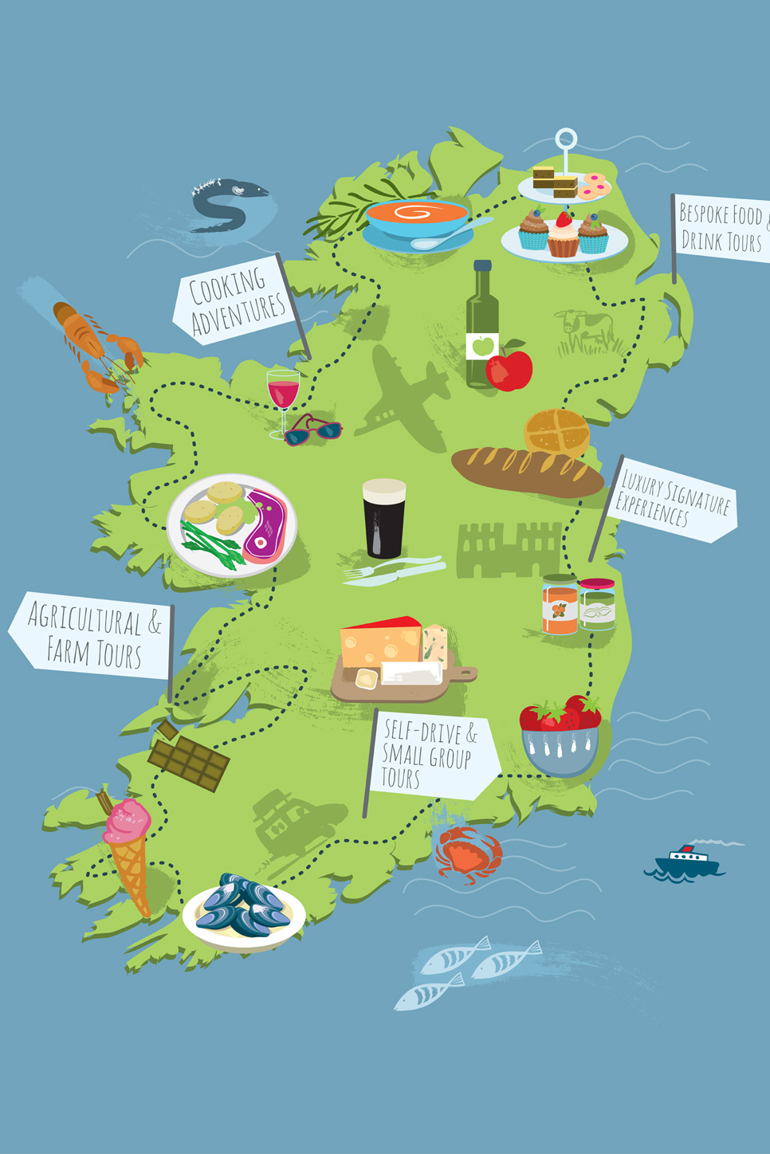
GEOGRAPHIC SETTING AND ENVIRONMENT
Ireland, or officially the Republic of Ireland, is an island nation in the North Atlantic Ocean. Almost 20 percent of the land is devoted to farming. Less than 10 percent of farmland is used to grow crops and the majority is used as grazing land for livestock.

Slide 3
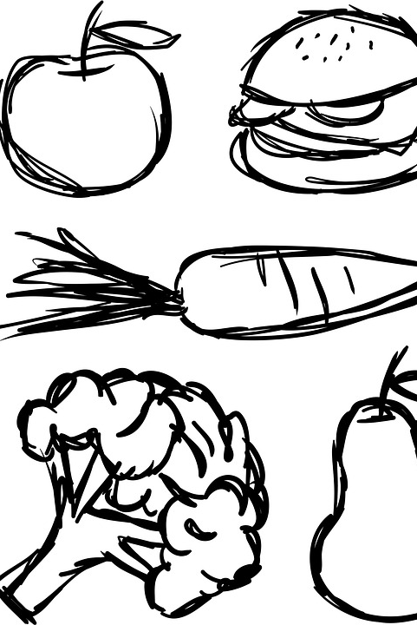
IRISH FOODS
Most cooking is done without herbs or spices, except for salt and pepper. Foods are usually served without sauce or gravy.
The staples of the Irish diet are potatoes, grains and dairy products.
Ireland makes about fifty types of homemade "farmhouse" cheeses, which are considered delicacies.
Soups of all types, seafood, and meats also play important roles in the Irish diet. Irish soups are thick, hearty, and filling, with potatoes, seafood, and various meats being common ingredients.
Since their country is surrounded by water, the Irish enjoy many types of seafood, including salmon, scallops, lobster, mussels, and oysters.
A typical Irish dinner consists of potatoes, cabbage, and meat.

Slide 4
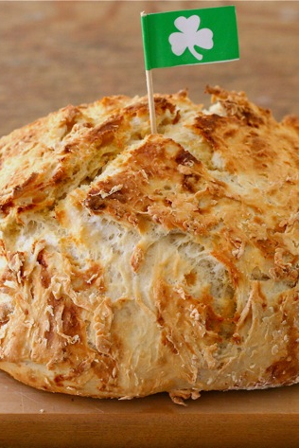
SODA BREAD
A real soda bread is a simple loaf with a beautifully browned, craggy crust and a nice chew, best eaten liberally smeared with salty Irish butter.
Soda bread has been an Irish household staple since baking soda became commercially available in the early 19th century. It uses only a few ingredients that most people kept on hand—flour, salt, baking soda, and buttermilk. It also didn’t require an oven; it could be baked in a bastible, a type of cast-iron Dutch oven, suspended over an open turf fire.
But now that we have ovens and refrigerators, this bread has gotten so easy to make that you, too, might find yourself baking fresh soda bread almost every day.

Slide 5
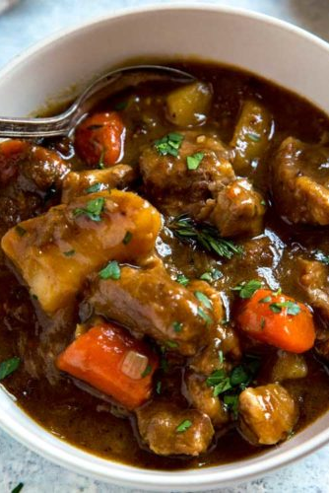
TRADITIONAL IRISH STEW
Irish stew is Ireland's national dish
It's a hugely popular dish on St Patrick's Day
Irish stew is the product of a culinary tradition that relied almost exclusively on cooking over an open fire. It seems that Irish stew was recognised as early as about 1800.
Irish stew was traditionally made with mutton - older sheep - but more often nowadays, is made with lamb which may seem a little of a waste but the flavor is amazing.
Stewing is an ancient method of cooking meats that is common throughout the world. However, the Celts did not possess their first bronze cauldrons, copied from Greek models, until the 7th century AD. After the idea of the cauldron was imported from Europe, the cauldron became the dominant cooking tool in ancient Ireland.

Slide 6
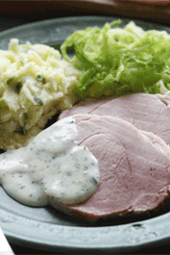
BOILED BACON CABBAGE
Irish bacon with cabbage is the original, quintessential St. Patrick's Day dish.
Historically, this dish was common fare in Irish homes as the ingredients were readily available as many families grew their own vegetables and reared their own pigs. It was considered nourishing and satisfying. The dish continues to be a very common meal in Ireland.
Traditionally, salted pork – a cut from the shoulder or back of the pig – would have been soaked overnight before being boiled, with the cabbage added to the cooking pot in the last 10 minutes.
The dish is served with the bacon sliced, and with some of the boiling juices added. Another common accompaniment to the dish is white sauce, which consists of flour, butter and milk.

Slide 7
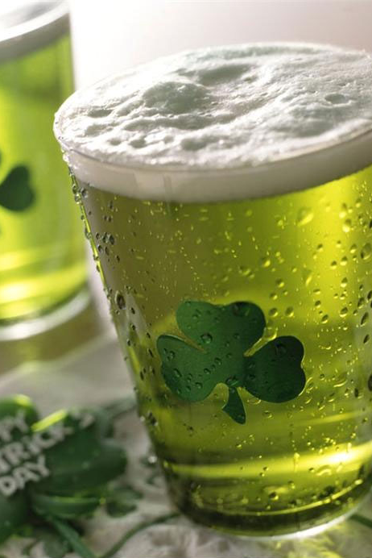
IRISH DRINKS
The most common everyday beverage in Ireland is tea. Popular alcoholic beverages include whiskey, beer, and ale. Coffee mixed with whiskey and whipped cream is known throughout the world as "Irish coffee."
Ireland is the biggest tea drinking community in the world
From tea to toddy, Ireland is swarming with many types of drinks, which are alcoholic and non-alcoholic too.

Slide 8
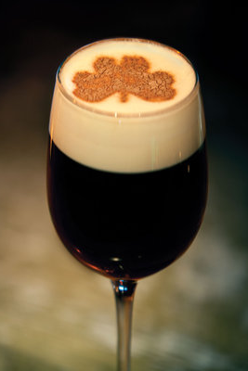
IRISH COFFEE
When it comes to coffee drinks, there’s nothing more quintessentially Irish than adding in a little drop of Jameson Irish Whiskey. Whether you’re looking for something tasty on such an occasion or a special St. Patrick’s Day cocktail to celebrate national day, an Irish coffee is just the brew.
Irish Coffee was invented in 1947 by Joe Sheriddan in Shannon Airport when transatlantic flights recommenced after WW1. Joe wanted to serve the travellers an Irish drink, so the obvious choice was tea and whiskey! When he realised that American’s drank a lot of coffee he carried out an experiment and so irish coffee was born.

Slide 9
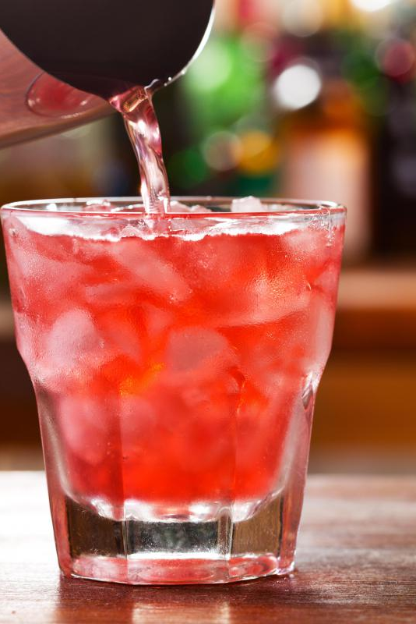
RED LEMONADE
If you are in Ireland, and want some lemony drink, go for some with a little color in it.
You can find this fizzy lemon drink in white, yellow, or even brown. Brown lemonade is more popular in the northern part of the country. Like the red, brown lemonade is also a specialty of Ireland.
It is also used as a mixer in whiskey.
To begin with, even the origins of red lemonade are shrouded in mystery.
Anyone who went to school in Ireland in the 90's will have heard the urban legend which explained that the reason you could only get red lemonade in Ireland was because the red colour additive used was carcinogenic and had been banned everywhere else.

