Slide 1
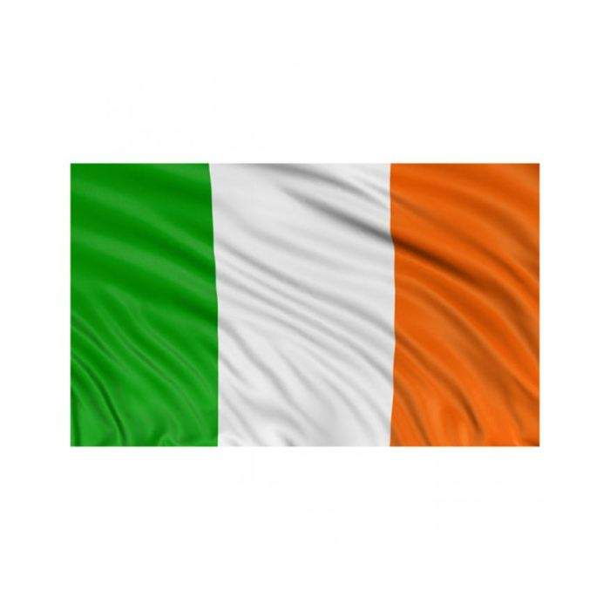
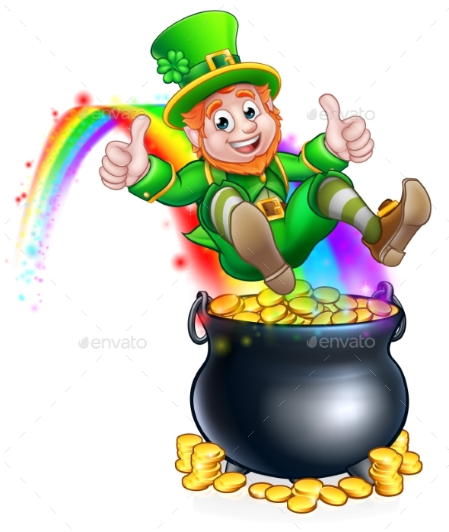
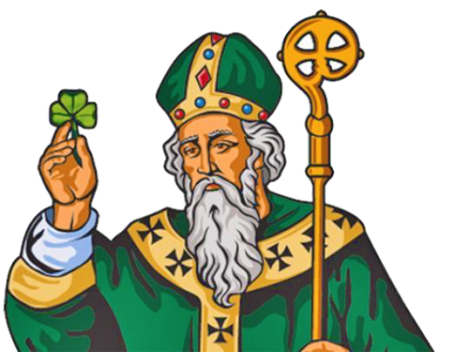
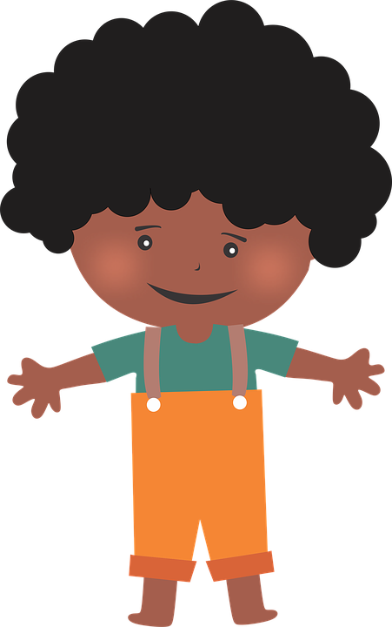
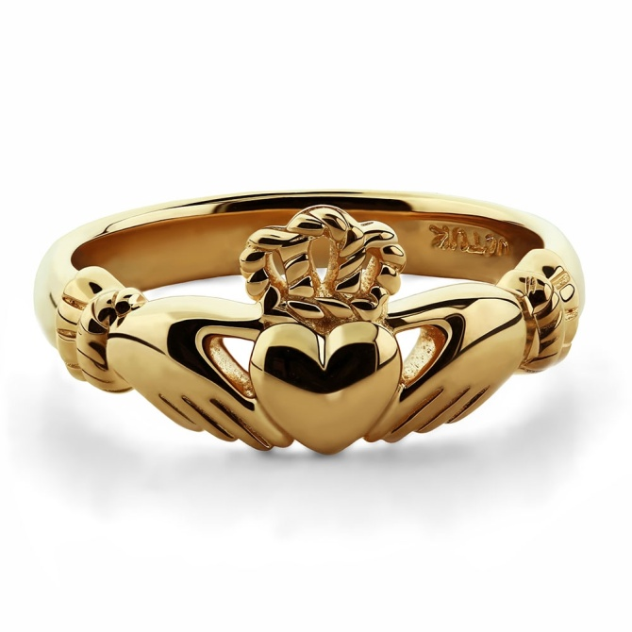
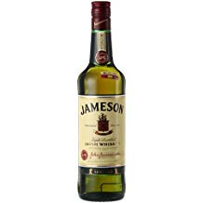
A leprechaun, the national flag, Irish whiskey, the claddagh ring and ST Patrick.
What are the symbols of Ireland?

Slide 2
A leprechaun is an old man but he is small. He has got a green coat, green trousers, his hair is red. He keeps his money in a pot of gold at the end of the rainbow.

Slide 3
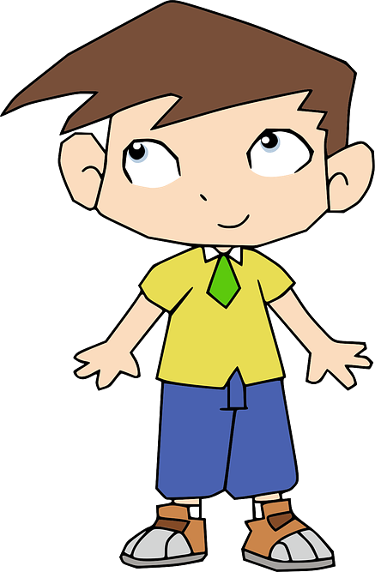
The national flag of Ireland is green, white and orange.

Slide 4
Irish whiskey is one of the most popular whiskeys in the world.

Slide 5
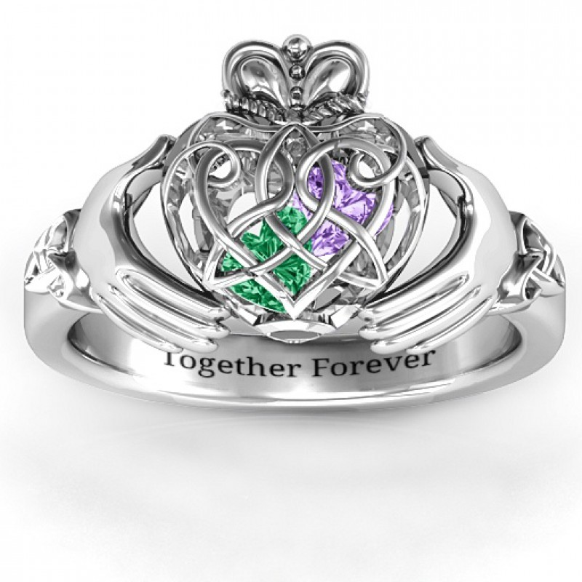
The Claddagh ring is the traditional irish wedding ring. It symbolizes love, fidelity and friendship.

Slide 6
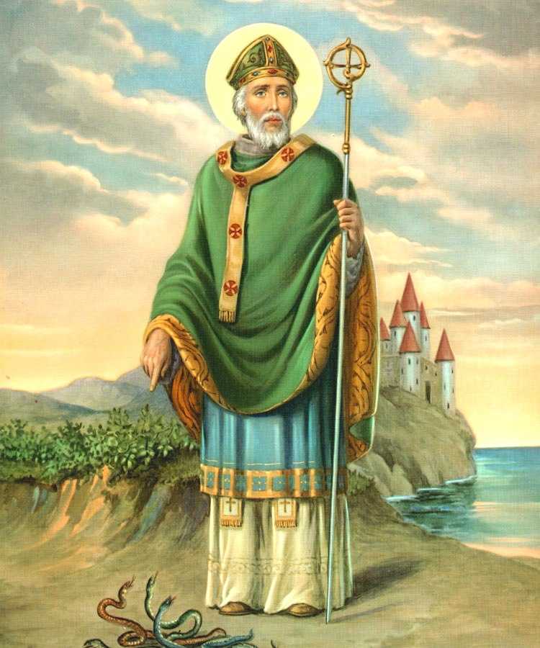
St Patrick was a bishop in Ireland and lived in the 5th century. He is the patron saint of Ireland. It is celebrated on March 17th.

