Slide 1
Scotland
By: Sofija Bagdonaite, Deimante Naujokaite, Gabija Vaivadaite, Markas Slavinskas, Modestas Vilcinskas

Slide 2
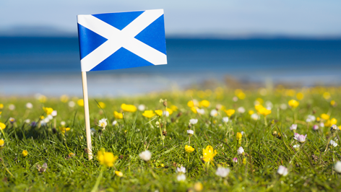
General facts about Scotland
Scotland is believed to have been founded in 843 AD;
The total area of Scotland is 78,387km2, comparable to the size of The Czech Republic;
Scotland is divided into 3 topographic areas;
The form of government in Scotland is Constitutional monarchy;
The head of the Scottish Government is the First Minister Nicola Sturgeon.

Slide 3
General facts about Scotland
The national music instrument of Scotland is the Great Highland bagpipe;
The national drink of Scotland is whiskey.
The national sport of Scotland is football.
The national day of Scotland is St Andrew's day.

Slide 4
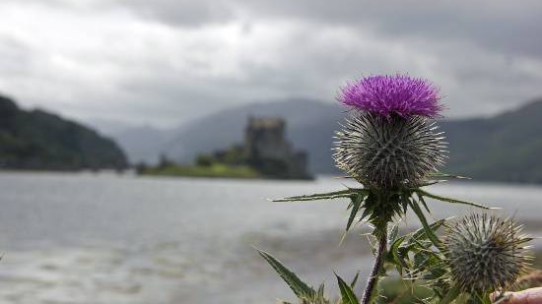
General facts about Scotland
The national symbol of Scotland is the Scottish thistle;
Scottish people drive on the right side of the rode;
Scotland is the second-largest of the constituent nations of the United Kingdom.

Slide 5
Interestig facts about Scotland
The town of Lark Hall in Scotland hates color green;
Scotland is known for red hair;
The most famous fictional character in Scotland is Sherlock Holmes;
One of the seven wonders of the industrial world in Scotland is Bell rock lighthouse.

Slide 6
Interesting facts about Scotland
The most powerful historic hero of Scotland is William Wallace;
Edinburgh was just recently named as one of the most LGBTI-friendly cities in the entire world;
The flag of Scotland is often referred as St Andrew’s Cross;
The most famous actor in Scotland is Gerard Butler.

Slide 7
Interesting facts about Scotland
The first telephone was invented by Alexander Graham Bell, who was from Scotland;
The easiest way to anger a Scotsman, is to call him an Englishman;
The capital of Scotland, Edinburgh, is the greenest city in the UK;
Writer K. Rowling began writing her first book about Harry Potter in one of Edinburgh's cafes, called "Nicholson Cafe“.

