Slide 1
ERASMUS + UniDiversity I Mobility Satu Mare Romania March 2018

Slide 2
Activity Diary
This presentation is a a final product from all the work students have performed during the preparation and meeting in Romania for the first Mobility of the Project.

Slide 3
Analyse the most representative traditions in Poland:
Wianki nad Wysla
Smingus Dingus
Easter Holidays
Independence Day

Slide 4
Wianki Nad Wysla
The celebration take place during 23-24 of June in Poland close to the Vistula River.
The tradition is a Catholic celebration aimed to welcome the arrival of summer.
During the celebration and starting in XIII century people would gather and set a fire. The fire is the sympol of purification.

Slide 5
This tradition has similarities with celebration in Spain „Noche de San Juan”.
In Poland young males and females would release on the Vistula River „Wianki”.
Wianki is a ceremonial Crown of flowers traditionally made up of fern.
The Crown of flowers represent the desire of getting married.
If the Crown of flowers get stucked, it means that the female won’t get married.

Slide 6
Puszczanie wianków w Noc Świętojańską (zdjęcie: www.pitupitu.pl)

Slide 7
Smingus Dingus
Wet Monday, Monday after Easter.
The tradition was first mentioned in the XV century. The tradition seems to be prechristian.
The tradition consist in boys trowing water to girls.
Particularly beautiful women would be soaked during the day.

Slide 8
Photo source:http://expresselblag.pl/2016/03/28/smigus-dyngus-zanika/

Slide 9
Easter Holydays
Palm Sunday.
Blessing of the Easter Basket.
Holy Sunday.
Easter Eggs.
The blessing of the Easter Basket is 0probably the most famous ritual during this celebration. Poles go to the church to bless the food that they will be eating during Easter. Of course, it is just a symbolical gesture.

Slide 10
“Pisanki” is a traditional costume of drawing on the eggs. Children decorates the eggs using crayons, paint and others art techniques. They will be used as a decoration for the table during the celebration.
https://www.youtube.com/watch?v=AMYBRHXvKL8#action=share

Slide 11
Independence Day
National Independence Day (Polish: Narodowe Święto Niepodległości) is a national day in Poland celebrated on 11 November to commemorate the anniversary of the restoration of Poland's sovereignty as the Second Polish Republic in 1918 from the German, Austrian and Russian Empires. Following the partitions in the late 18th century, Poland ceased to exist for 123 years until the end of World War I, when the destruction of the neighbouring powers allowed the country to reemerge. It is a non-working day in Poland.

Slide 13
Traditional Song
Hej sokoły
1. Hej, tam gdzieś znad czarnej wody Siada na koń kozak młody, Czule żegna się z dziewczyną, Jeszcze czulej z Ukrainą. ref. Hej, hej, hej sokoły Omijajcie góry, lasy doły, Dzwoń, dzwoń, dzwoń dzwoneczku, Mój stepowy skowroneczku. 2. Pięknych dziewcząt jest niemało, Lecz najwięcej w Ukrainie, Tam me serce pozostało, Przy kochanej mej dziewczynie. Hej, hej... 3. Ona biedna tam została, Przepióreczka moja mała, A ja tutaj w obcej stronie, Dniem i nocą tęsknię do niej. Hej, hej... 4. Żal, żal za dziewczyną, Za zieloną Ukrainą, żal, żal serce płacze, że jej więcej nie zobaczę. Hej, hej... 5. Wina, wina, wina dajcie , A jak umrę pochowajcie Na zielonej Ukrainie Przy kochanej mej dziewczynie. Hej, hej...
https://www.youtube.com/watch?v=jhaTXWEVgHA

Slide 14
Climate Information
Average temperature in Warsaw during 2017
Source information:https://www.timeanddate.com/weather/poland/warsaw/climate

Slide 15
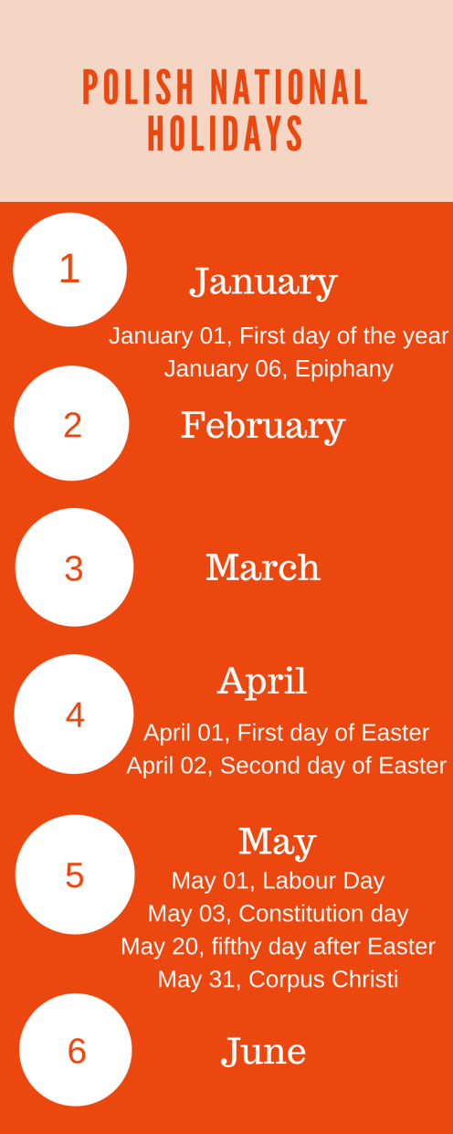
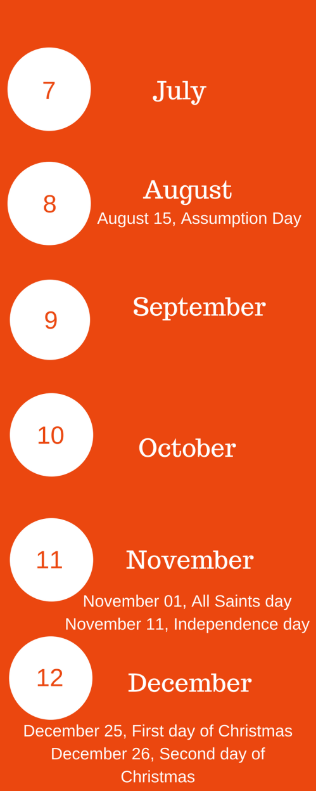
Polish National Holidays

Slide 16
Food In Poland

Slide 17
Life Expectancy in Poland

Slide 18
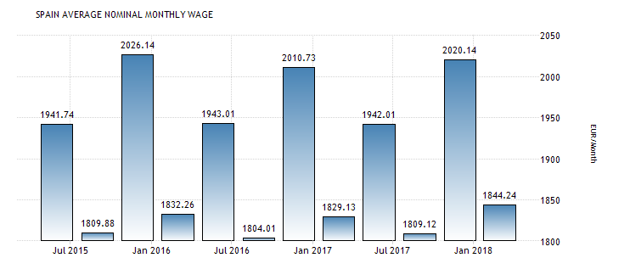
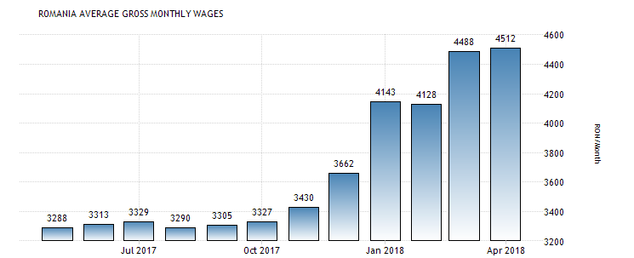
Comparison of average Wages in Poland-Rumania-Spain
https://tradingeconomics.com/romania/wages
Average Wages Poland
1 Euro = 4.2 PLN
Average Wages Spain
Average Wages in Romania
1 Euro = 4.6 RON

Slide 19
Sources
http://expresselblag.pl/2016/03/28/smigus-dyngus-zanika/
http://www.foreignersinpoland.com/polish-easter-traditions/
https://tradingeconomics.com/romania/wages
https://www.timeanddate.com/weather/poland/warsaw/climate
https://www.youtube.com/watch?v=AMYBRHXvKL8#action=share
https://www.youtube.com/watch?v=jhaTXWEVgHA
https://en.wikipedia.org/wiki/National_Independence_Day_(Poland)
https://112.international/society/over-30000-people-take-part-in-march-on-polands-independence-day-in-warsaw-1445.html

