Slide 1
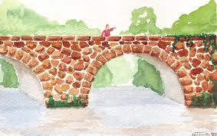
THE STORY OF STONE BRIDGE
By Group Adana

Slide 2
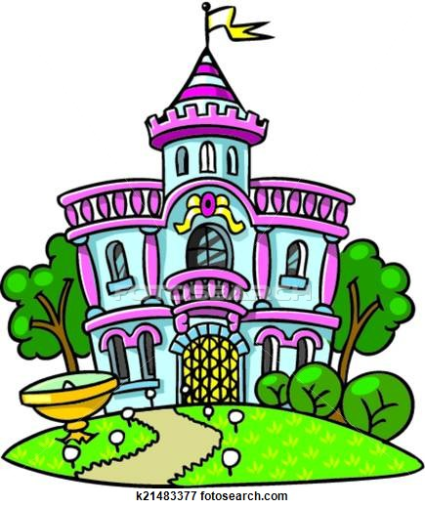
Once upon a time there was a beautiful princess who lived in the city of Adania.

Slide 3
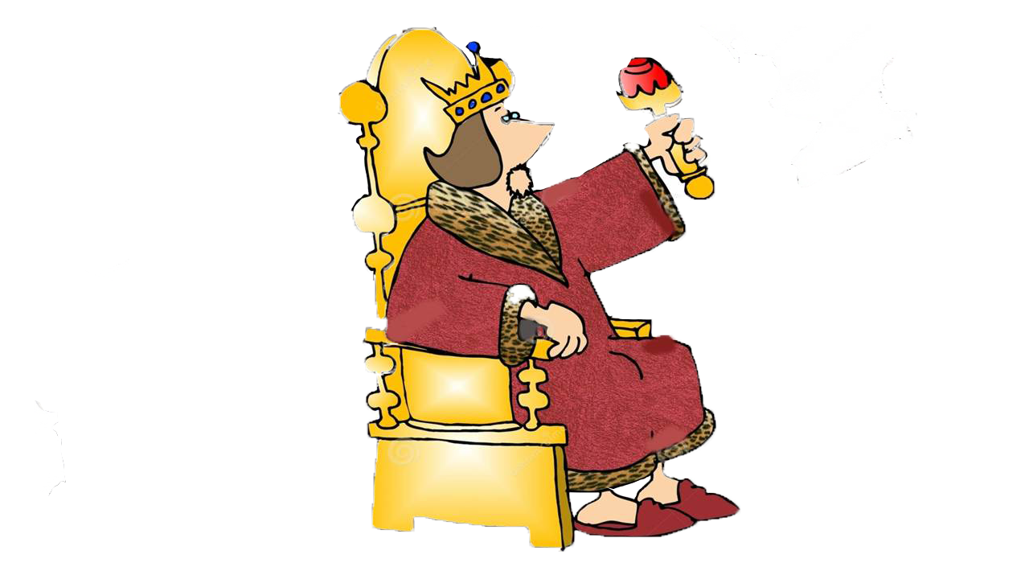
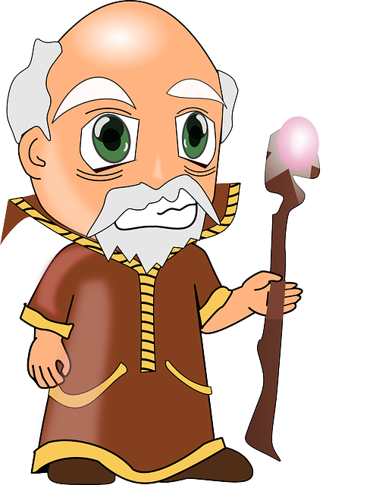
One day a soothsayer predicted her early death by snakebite.

Slide 4
Her father,Emperor,who loved her dearly ,sent her to the islet on the river flowing through Adania.
He hoped that he could prevent the fatal end.

Slide 5
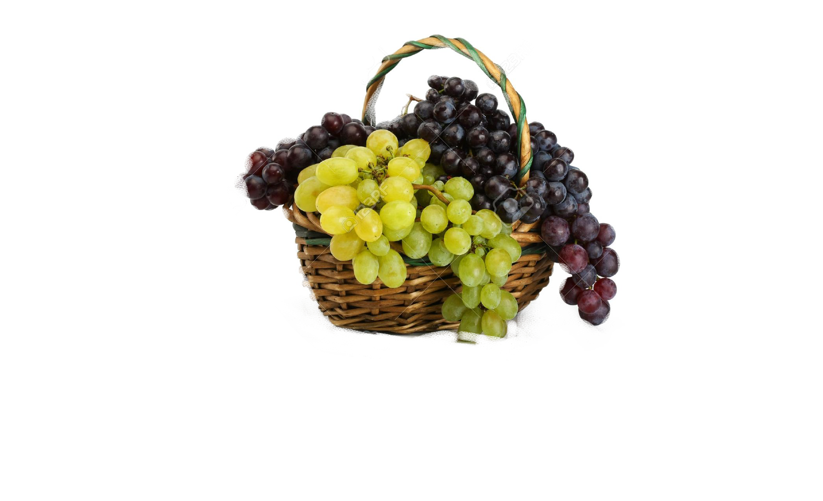
Eventually the princess died from snakebite ,which reached the palace in a grape basket.

Slide 6
In memory of his beloved princess The Emperor built a bridge connecting the two sides of the city of Adania and called it Stone Bridge as it was built of stones.

Slide 7
The Emperor willed that whoever wished to restore the bridge could take the treasure which he placed under one of the arches but he needed to put it back afterwards for the further restorations.

Slide 8
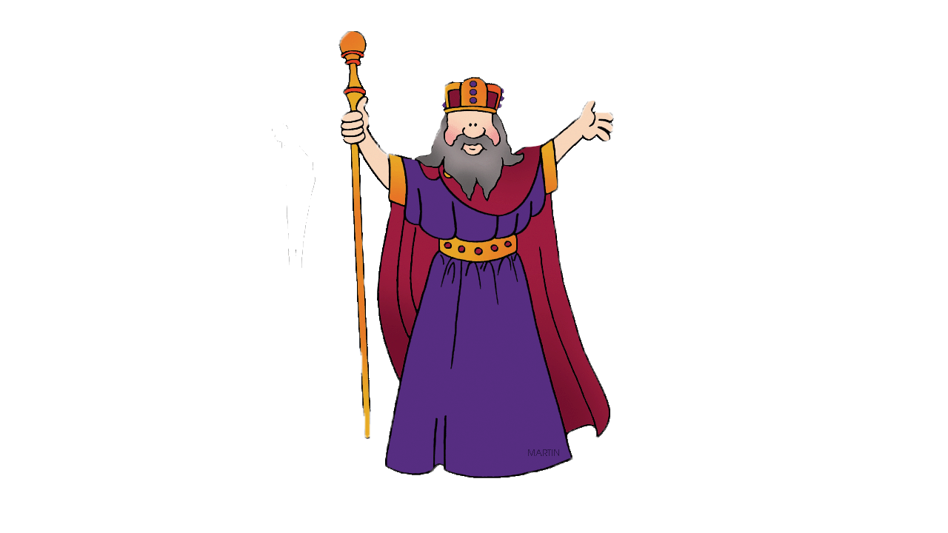
The Emperor said:
I couldn’t keep my beautiful princess alive but this bridge will exist forever and cherish the memory of her.

Slide 9
The End
We are not sure if the story is true but we know that Stone Bridge is one of the oldest bridges in the world that is still
Standing and still in every-day use today.

