Slide 1
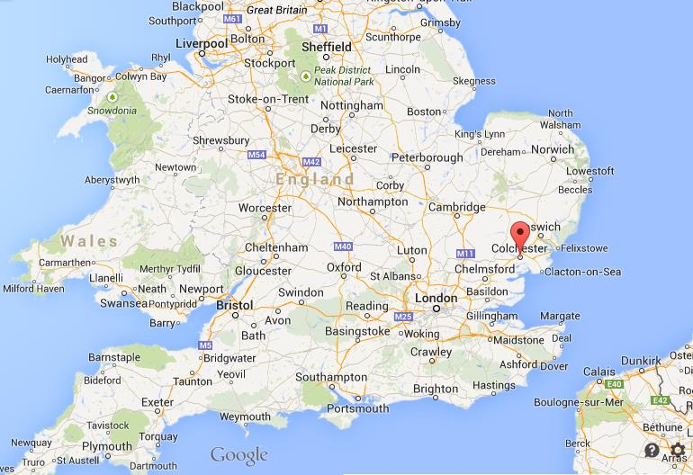
Colchester Castle
Colchester castle is a historic building situated in Colchester, Essex, England.

Slide 2
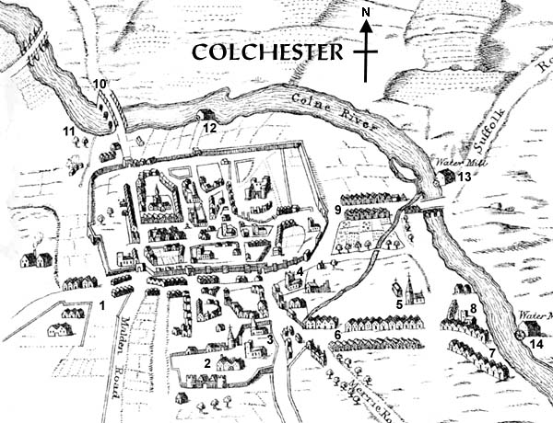
It is a grade 1 listed building that was built by the Normans in the 1100’s.
In the 13th century the castle was used to keep prisoners in there from the many battles that had just taken place, however nowadays it is used as a museum to store thousands of antiquated artefacts.
Medieval Map

Slide 3
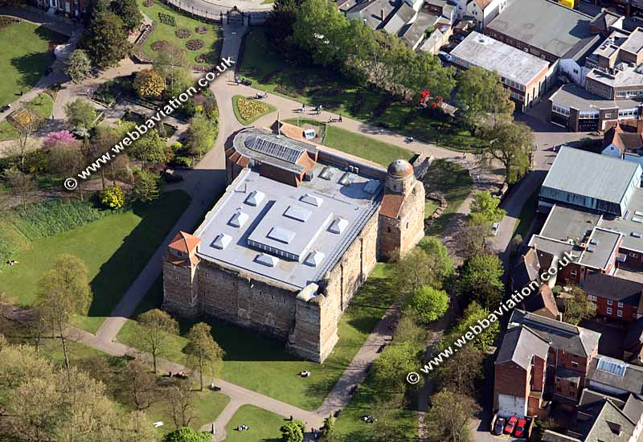
Colchester Castle was built on the remains of the historic temple of Claudious after it was destroyed in 400AD.
In 407AD, the Romans burnt down the castle after the recent battles that had taken place there.

Slide 4
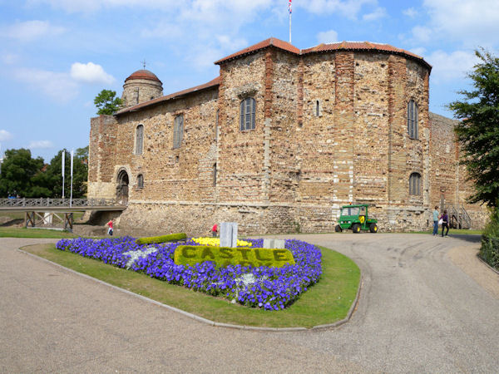
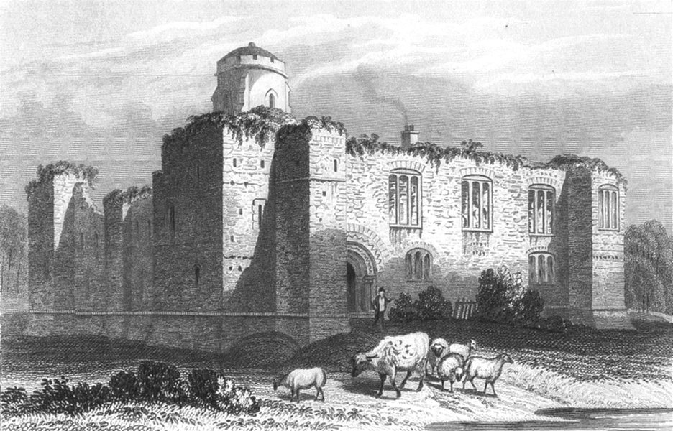
Colchester Castle
←
Colchester Castle (old) →

