Slide 1
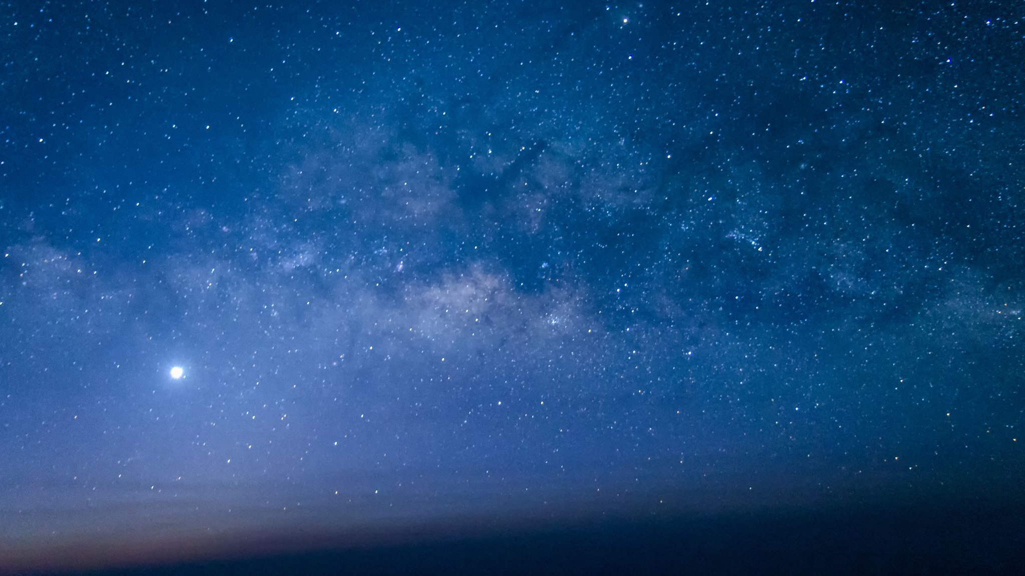
Periodic phenomena
Developed by Sofia Braga

Slide 2
The Day/Night Cycle
The change between day and night is caused by the rotation of the Earth on its axis. If the Earth did not rotate as it does, the day/night cycle would be very different or possibly even nonexistent. The changing lengths of days and nights depends on where you are on Earth and the time of year. Also, daylight hours are affected by the tilt of the Earth's axis and its path around the sun.
Source: quora.com

Slide 3
The Moon Phases
The Moon changes its apparent shape with four distinct phases depending on the Moon’s position as it orbits around the Earth, and the Earth’s position as it orbits around the Sun. There are four main Moon phases, also known as Lunar Phases: First Quarter, Full Moon, Last Quarter and New Moon.
Source: moonconnection.com

Slide 4
Ocean Waves
Ocean waves are created by energy passing through water, causing it to move in a circular motion. Waves transmit energy, not water, across the ocean and if not obstructed by anything, they have the potential to travel across an entire ocean basin. Waves are most commonly caused by wind.
Source: pinterest.com

Slide 5
The Seasons (Seasonality)
Seasonality is the presence of variations that occur at specific regular intervals less than a year, such as weekly, monthly, or quarterly. Seasonality may be caused by various factors, such as weather, vacation, and holidays and consists of periodic, repetitive, and generally regular and predictable patterns in the levels of a time series.
Source: blog.pillow.com

Slide 6
Calendars
A calendar is a system of organizing days for social, religious, commercial or administrative purposes. This is done by giving names to periods of time, typically days, weeks, months and years. A date is the designation of a single, specific day within such a system. A calendar is also a physical record (often paper) of such a system.
Source: riceville.k12.ia.us

