Slide 1
eTwinning project: Periodicity in our life
Project realized by:
Bagrin Mădălina
8th grade
IPL “Da Vinci”
Chișinău, Moldova

Slide 2
The purpose of the research
To observe and describe the periodic phenomenons in our life.
Objectives:
To identify 6 periodic phenomenons important for us.
To analyze the periodic phenomenons and indicate their causes, consequences, periodicity and importance.
To elaborate a Power Point presentation.
Project Dissemination

Slide 3
6 periodic phenomenons in our life:

Slide 4
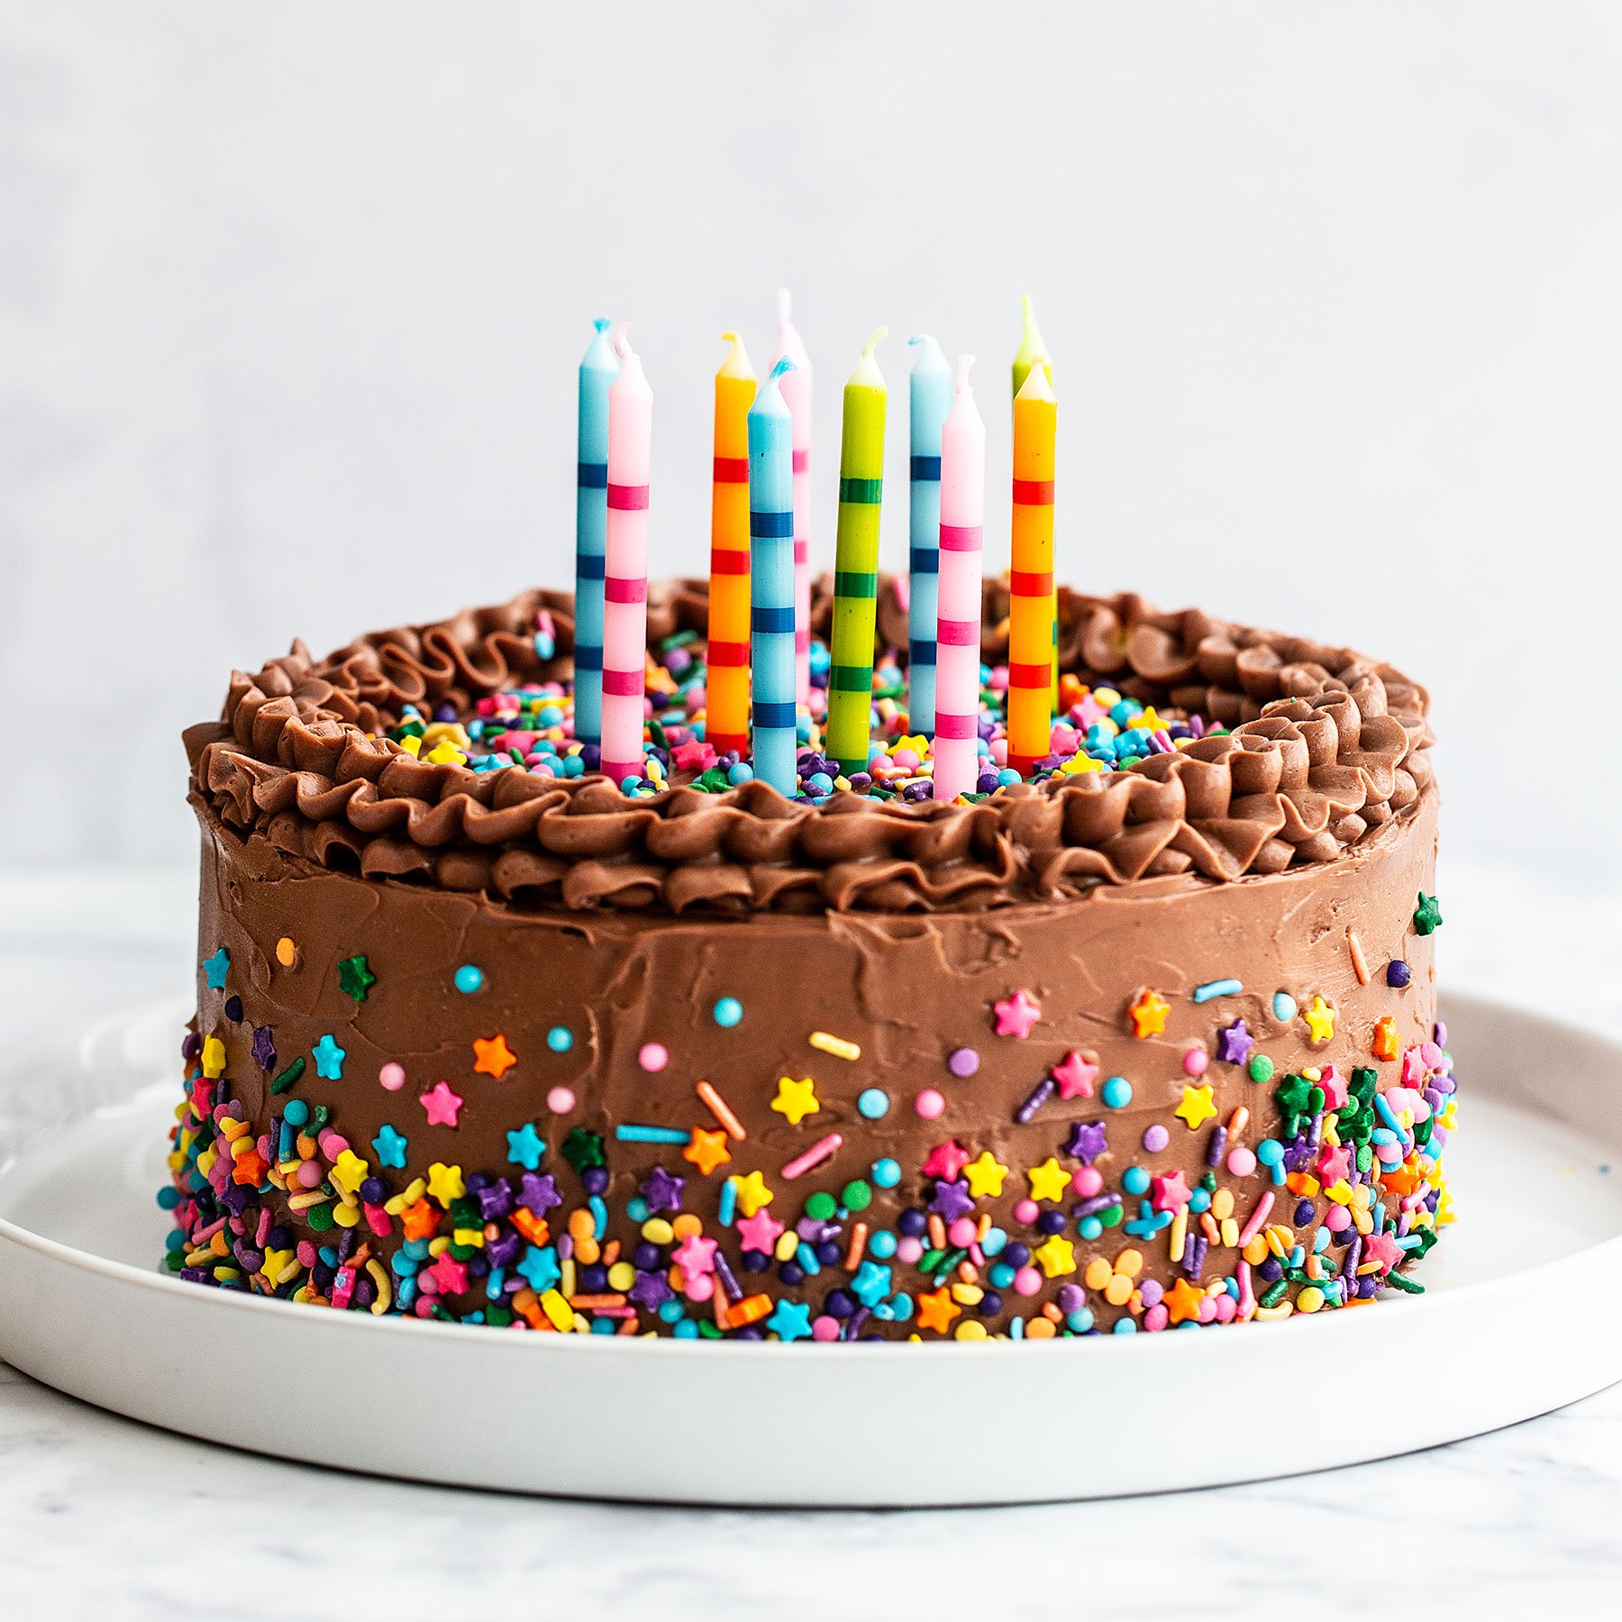
1. My Birthday
My Birthday is a periodic phenomenon that happens once a year. The date remains the same each year, but the day of the week is different. I was born on the 6th of August, so I celebrate my birthday every year on that date.
This phenomenon plays a special role in my life. It is very important for me, because, each year, this day marks the fact that I’m one year older, that I’m more responsable and mature.
https://www.handletheheat.com/best-birthday-cake/

Slide 5
2. My scholar schedule
My scholar schedule is also an important periodic phenomenon. It repeats once a week. For example, if today it’s Monday, all the lessons that I had today I’m going to have again, next week, on Monday.
It is important, because, after the scholar schedule I plan what books to bring at school and what homework I have to do for the next day.
https://www.freepik.com/free-vector/simple-school-schedule-template_949257.htm

Slide 6
3.The day- night change
The day-night change it’s a periodic phenomenon, that determines and affects every day of my life.
By this phenomenon are influenced some parts of my daily life: which hour I wake up every morning, which hour I go to sleep every night. It also influences the way I plan my time. At the end of the day, for example, I can make a “To do list” for the next day, so, the next day I know what I have to do. Then, at the end of the day I see what I’ve realized.
https://creativemarket.com/Drum-magic/3450156-To-do-list-or-planning-icon

Slide 7
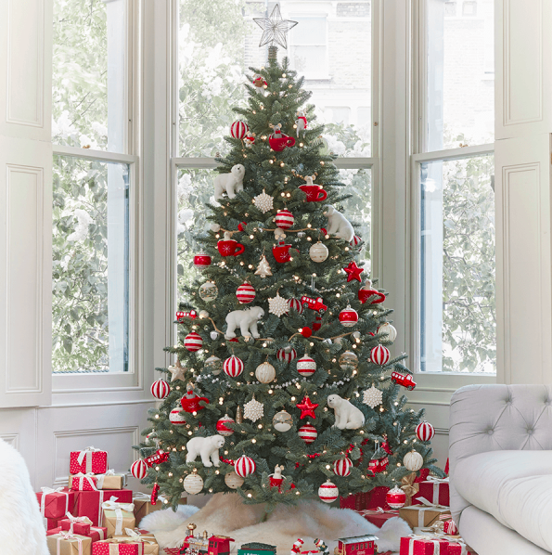
4.Decorating the Christmas Tree
Decorating the Christmas Tree it’s a periodic phenomenon that happens in my life once a year.
It’s about decorating a special tree for the holiday Christmas, which we celebrate on the 25th of December or the 7th of January.
It is a special tradition for me, because, since I was a little child, we would do this as a family tradition, to spend time together.
https://www.redonline.co.uk/christmas/christmas-decorations/g24729217/the-best-prelit-christmas-trees/

Slide 8
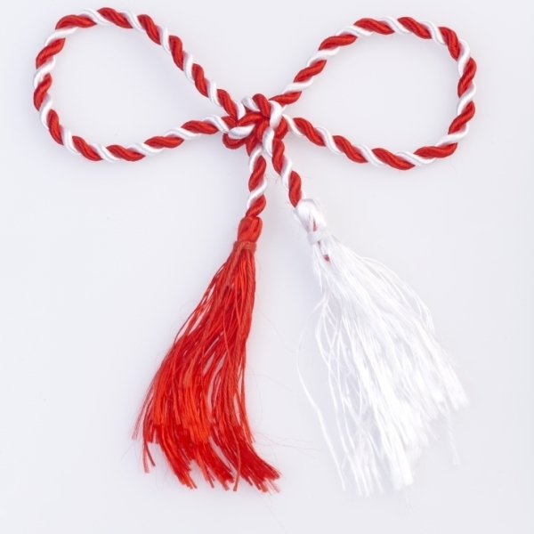
Mărțișorul- 1 martie
Mărțișorul it’s another important periodic phenomenon in my life. We celebrate this holiday on the 1st of March(first day of spring). This holiday it’s specific mostly for Moldavians and Romanians.
In our family, we usually gift each other a mărțișor in this day. We wear it for the rest of the month, and then we hang this mărțișor in a tree(as the tradition says, that tree will bring harvest).
https://ortodoxinfo.ro/2017/03/01/martisorul-vechi-simbol-pagan-specific-meleagurilor-noastre/

Slide 9
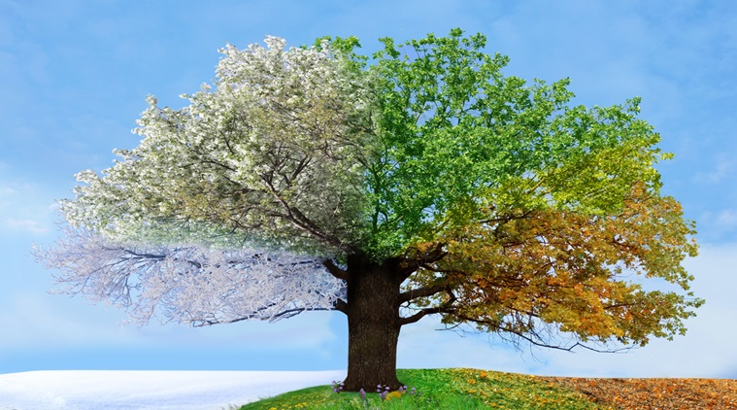
The seasons’ change
The seasons’ change it’s a periodic phenomenon that represents the passing from a season of the year to another. It happens 4 times a year:
winter- spring;
spring- summer;
summer- autumn;
autumn- winter.
It is important for me, because, as the time passes and the seasons change, I also change and grow everyday. It also determines the weather outside, so, it influences the way I should dress in that day, according to the weather.
https://indianexpress.com/article/lifestyle/life-style/karma-sutra-seasons-change-4785265/

Slide 10
Project Dissemination
I had the chance to take part in an amazing project on eTwinning. The name of the project is “Periodicity in our life”. The main reasons why I enjoyed this project are:
I had the chance to communicate with students from other countries.
I learned so many new things about periodicity and the Periodic Table through the games and activities of this project.
I developed my communicating abilities in English.
I’m very thankful and happy that I had the chance to be a part of this project, that helped me grow in an intellectual way.

