Slide 1
SLOVAK Record Breaker from Primary School 6 Komenský St., Spišské Vlachy,
SLOVAKIA
Dávid TRÁVNIČEK, 15
Making Abdominal Crunches in 30 minutes

Slide 2
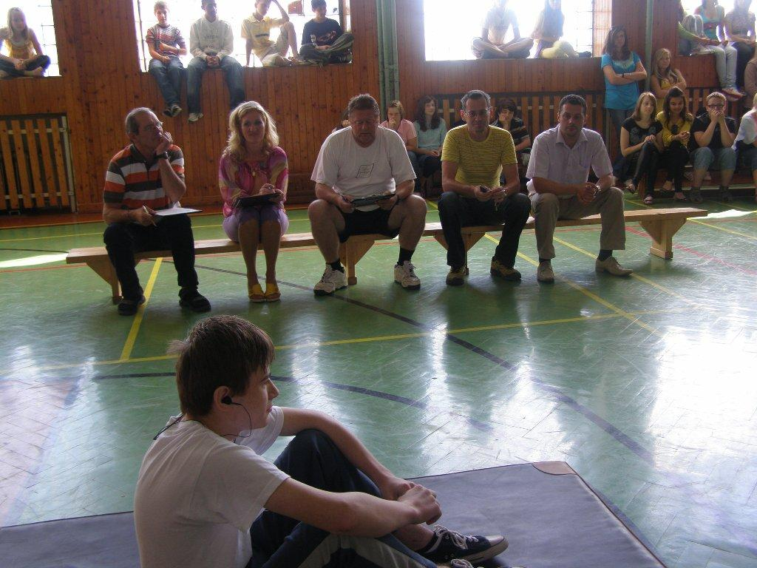
Dávid is getting ready for Slovak national record

Slide 3
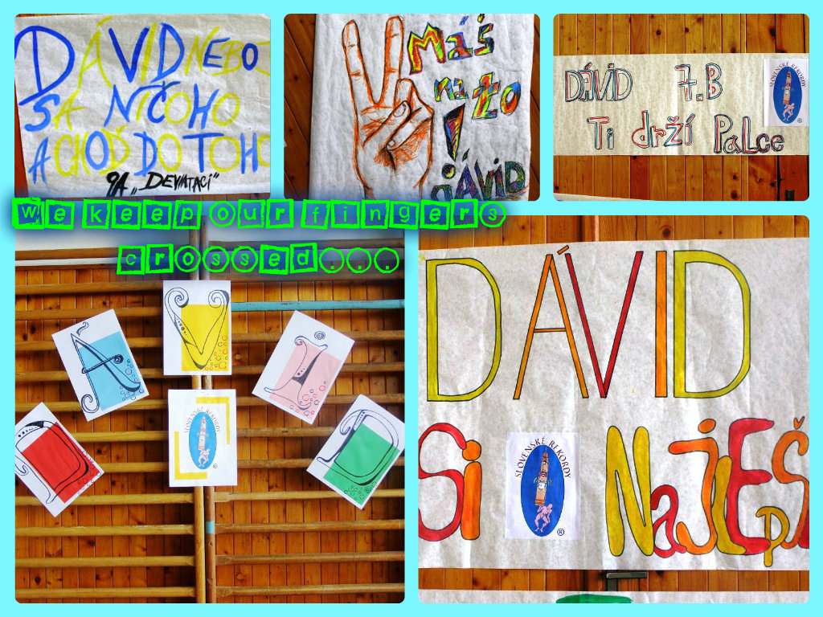

Slide 4
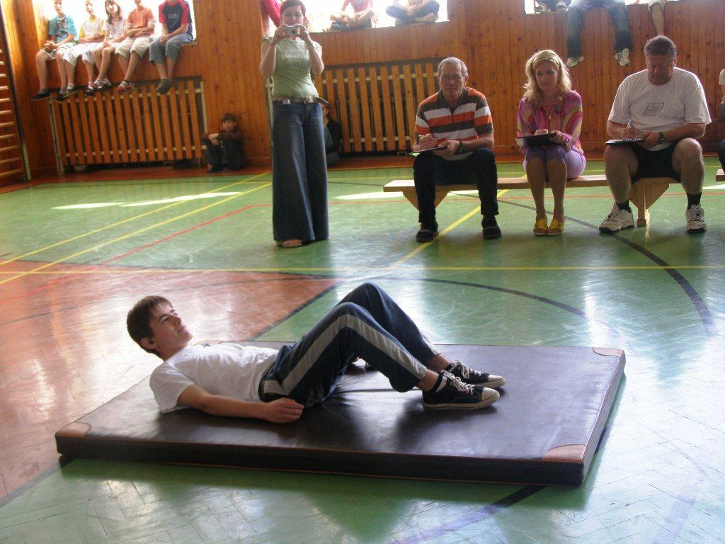
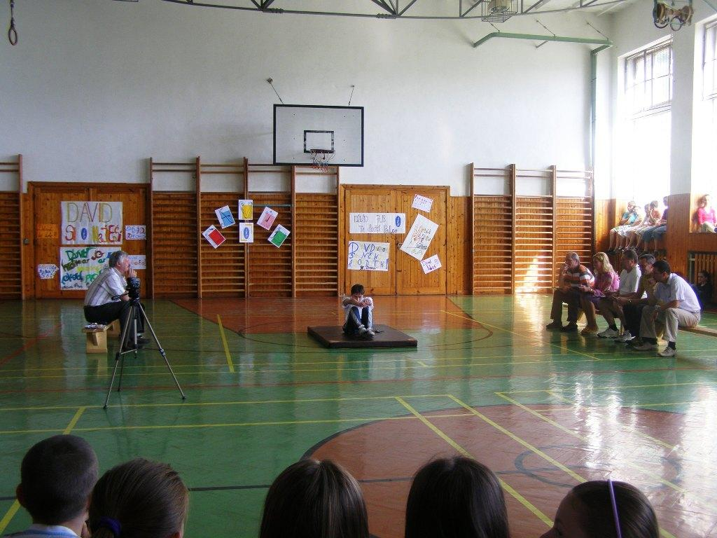
Working hard...

Slide 5
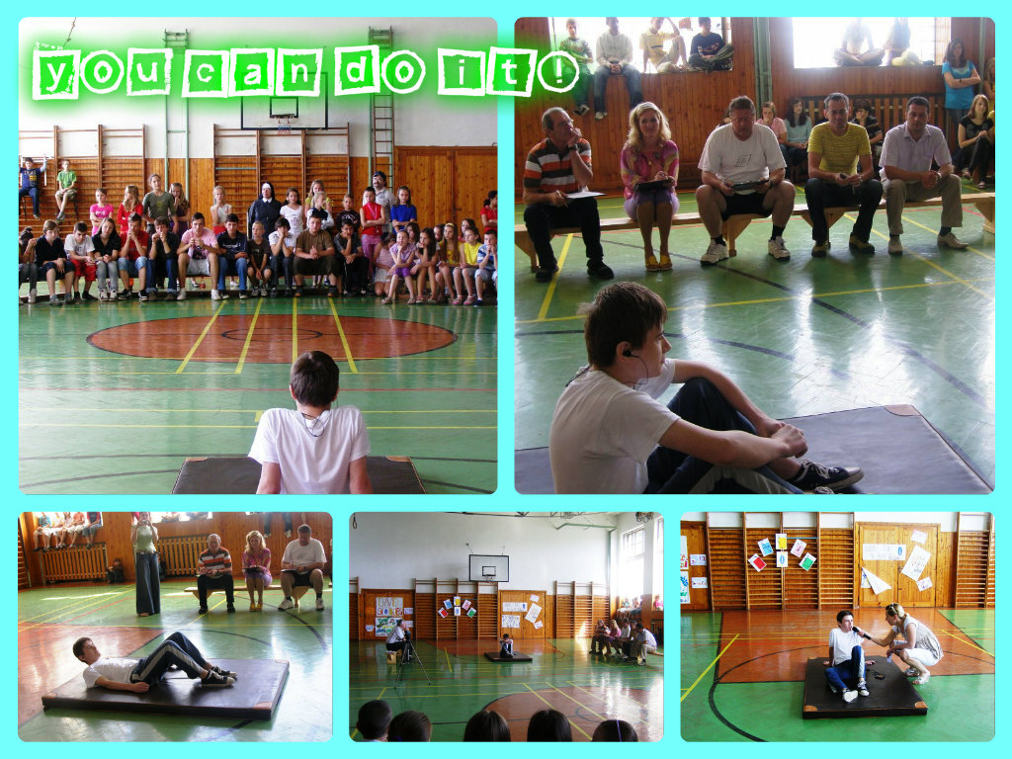

Slide 6
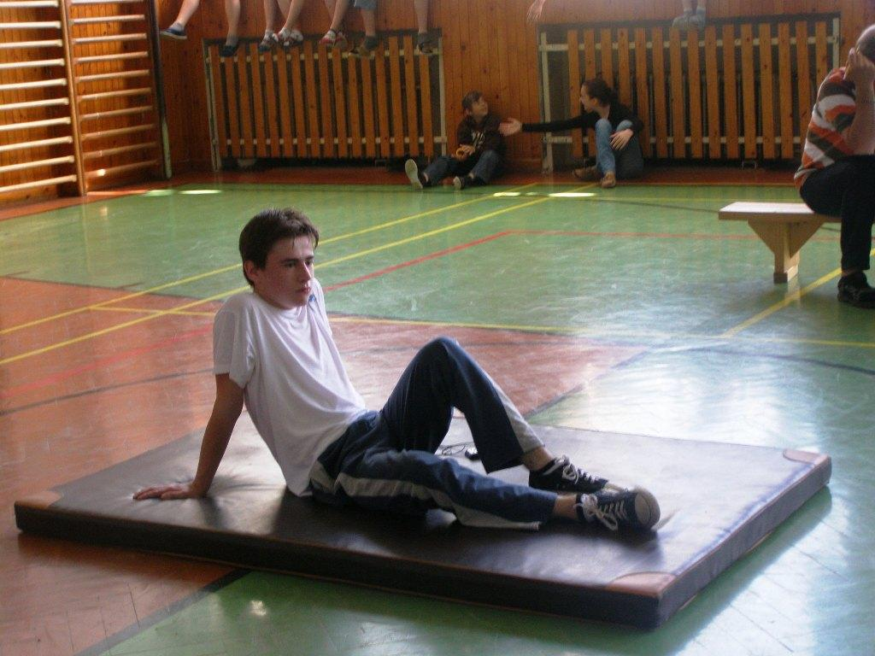
A little rest...

Slide 7
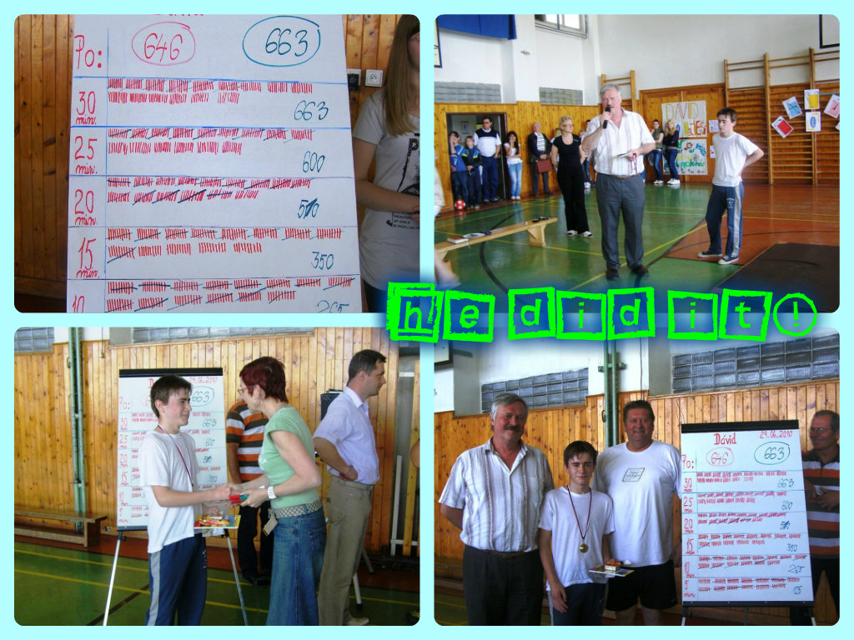

Slide 8
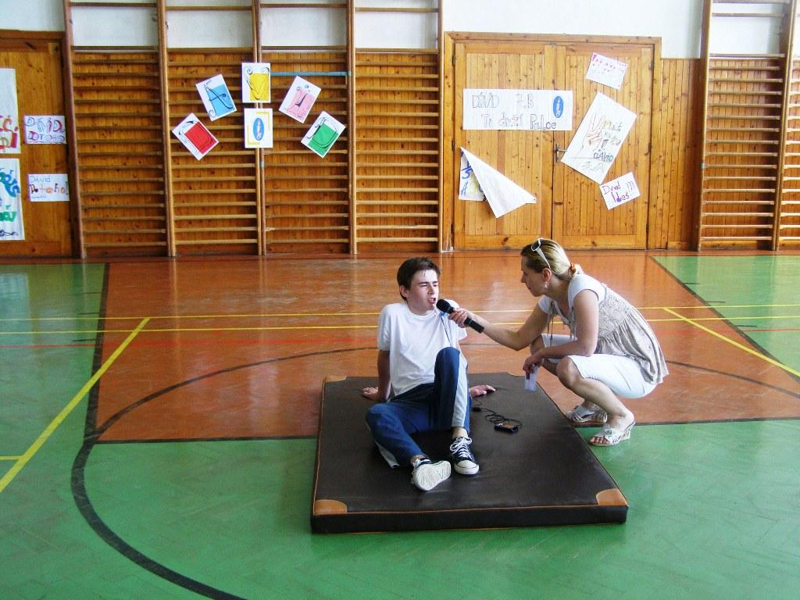
HE DID IT!!! SLOVAK NATIONAL RECORDER –
giving interview:

Slide 9
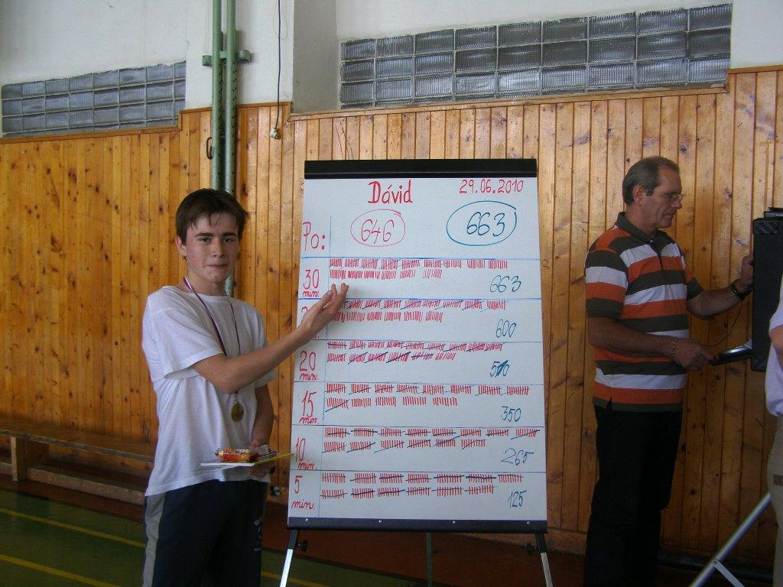
Result in numbers:

Slide 10
Congrats! We are proud on you, Dávid!

Slide 11
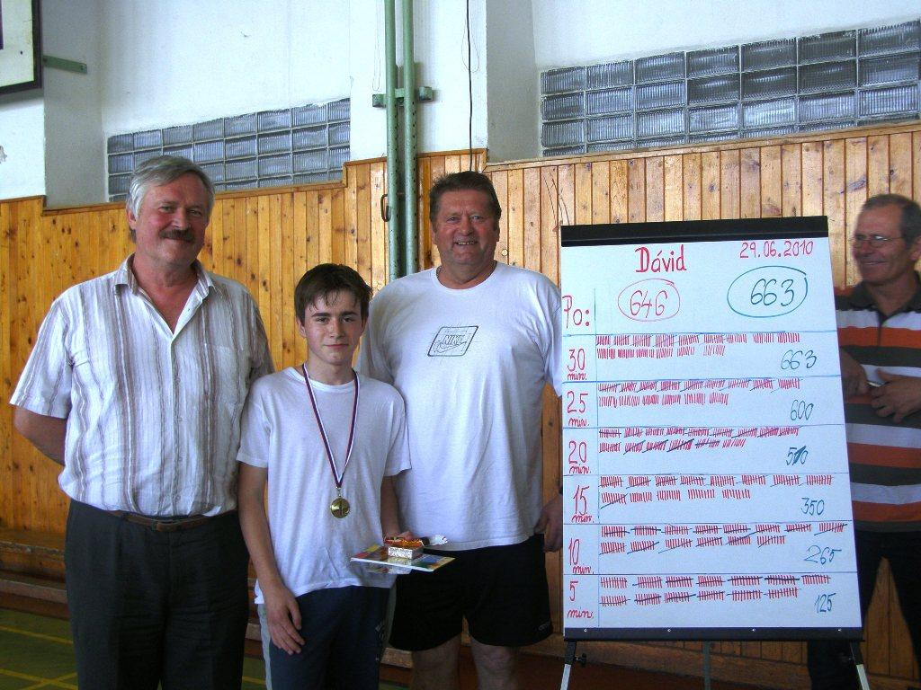
Tired but happy with headmaster and PE teachers:

Slide 12
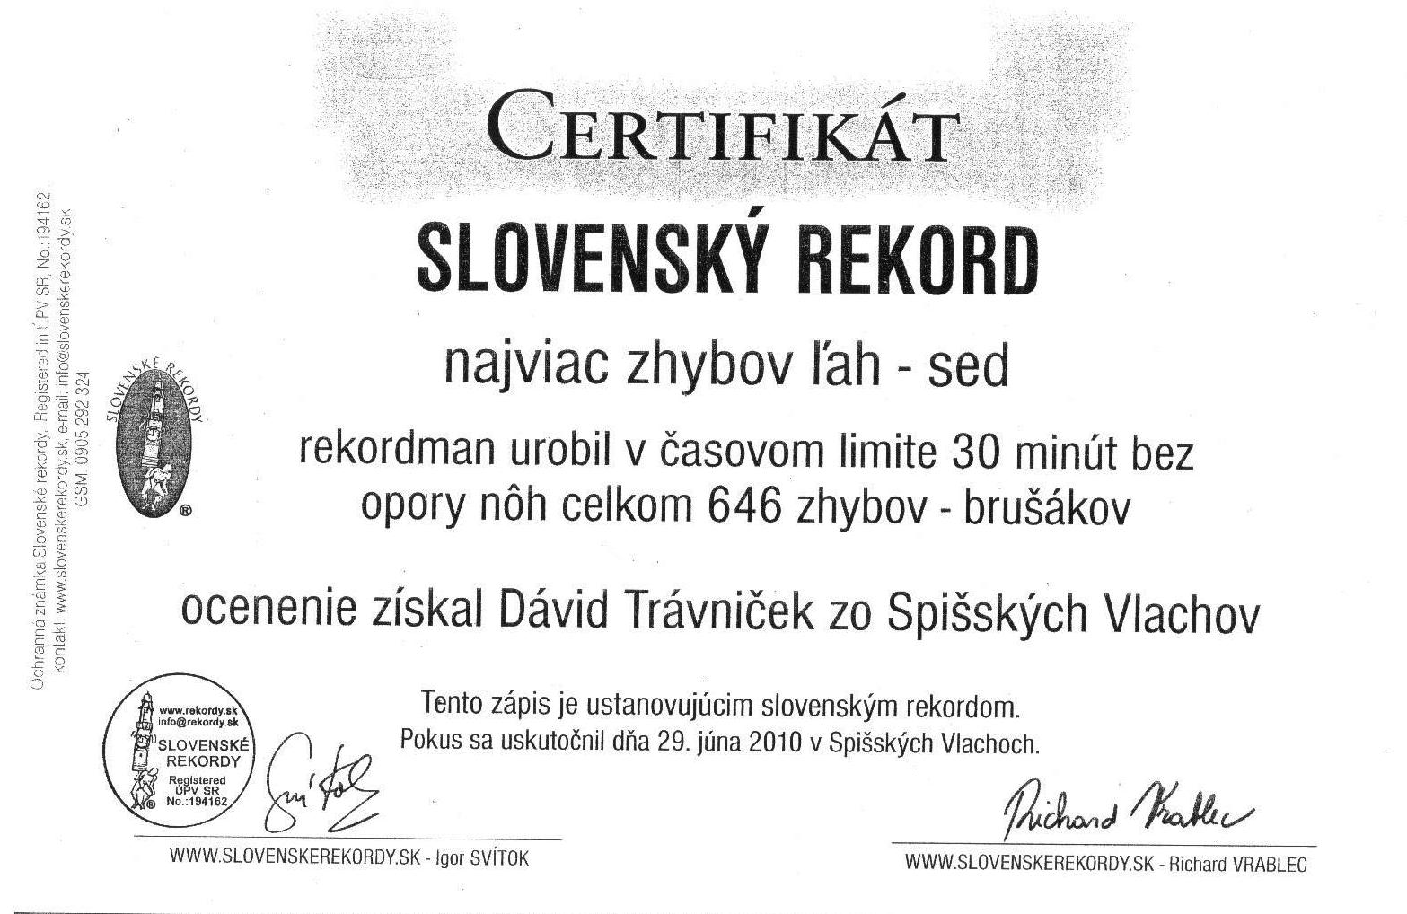
OFFICIAL SLOVAK RECORD CERTIFICATE

Slide 13
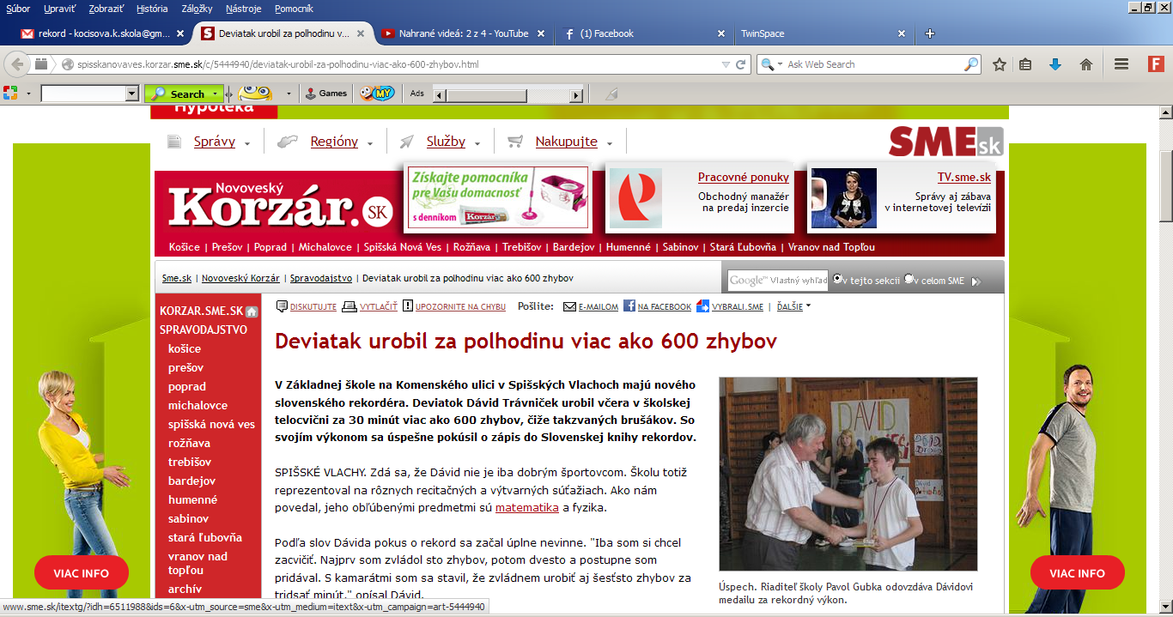
Article in Spiš region newspaper Korzár http://spisskanovaves.korzar.sme.sk/c/5444940/deviatak-urobil-za-polhodinu-viac-ako-600-zhybov.html

Slide 14
PPT by Mgr. K. Kočišová
PS Komenský 6 St.
Spišské Vlachy
SLOVAKIA

