Slide 1
WHO
we are?

Slide 2
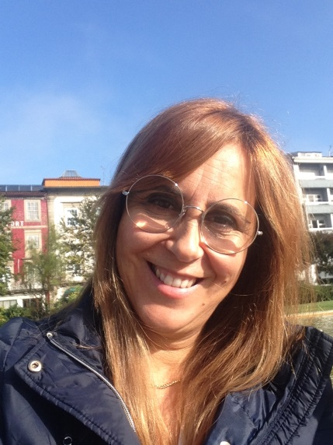
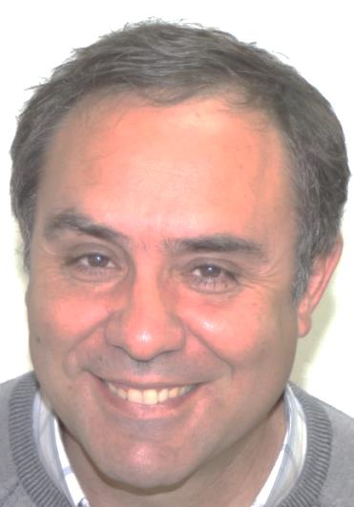
WHO
we are?
Cecília Cardoso
Anabela Vieira
Mário Moura

Slide 3
Who am I?
I’m a Physical Education teacher at the Agrupamento de Escolas da Póvoa de Lanhoso since 2003.
This year I am working with students from the primary school and the fifth and sixth grade, ages between six and twelve years old.
My name is
Cecília Cardoso
I am also responsible for the coordination of the class directors.

Slide 4
Who am I?
I live in Braga but I work in Póvoa de Lanhoso, a very special school because of my co-workers, the students and the staff that are all wonderful. It is a my second family.
Besides working, I also like cinema, theater, music, reading, traveling and cooking.
My name is
Cecília Cardoso

Slide 5
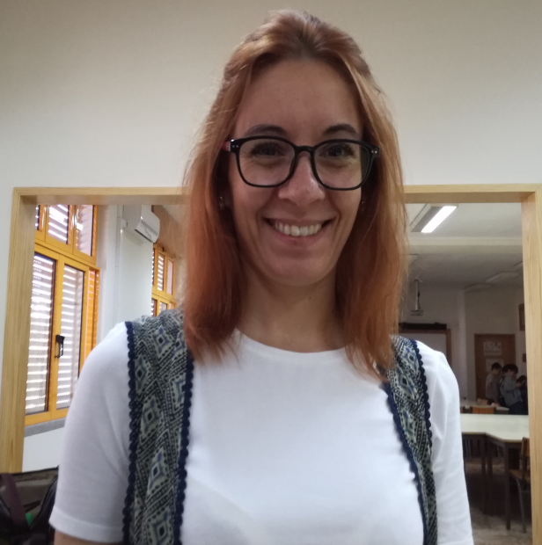
Who am I?
I teach in EBI do AVE. I’m a Portuguese and English teacher and I teach students between 6 and 12 years old.
This year, for the 1st time, we have 2 CLIL classes with children that are in the 5th grade (10 years old). It´s being a big challenge and a very great experience.
My name is
Anabela Vieira

Slide 6
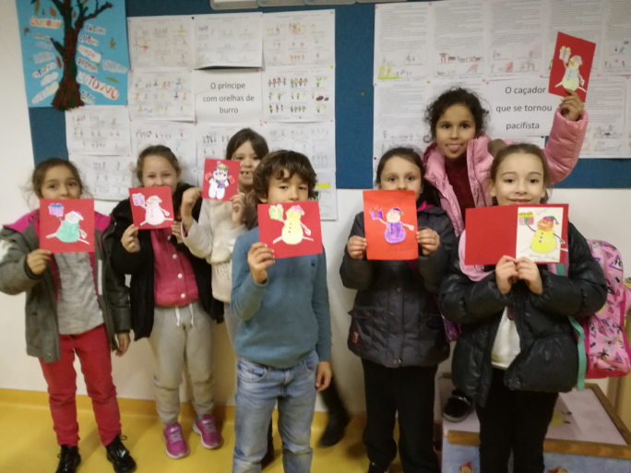
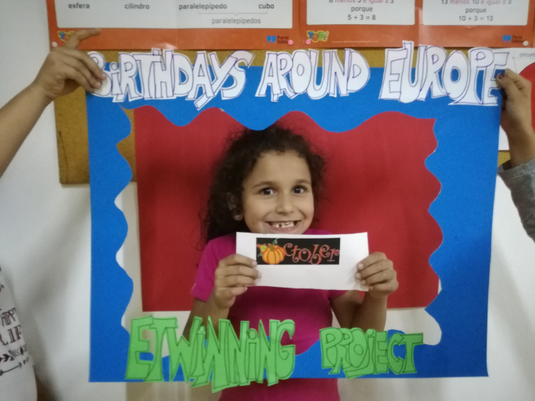
Who am I?
I like working in projects and this year I’m coordenating an eTwinning Project called “Legends Around the Europe” and participated in an other projects called “Christmas Cards Around Europe” and “Birthdays Around Europe”
I am also a class director, and the feeling is that I have 24 children!!

Slide 7
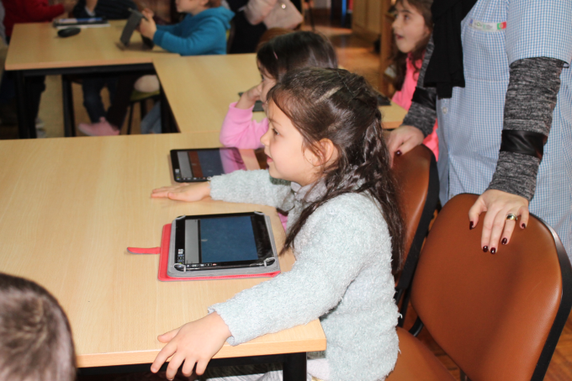
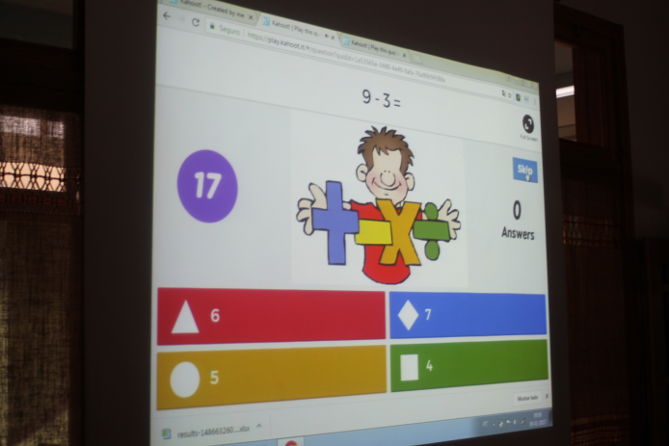
Who am I?
I like to use different tools in my classes as Kahoot, Socrative and EDMODO. The students like it alot and it’s a very good way for motivation. Me and my collegues organize different Kind of ativities, as reading and writing contests, a yearly Peddy Paper and celebrate festivities as Christmas, Halloween, Easter.
I have already participated in an ERASMUS Project about methodologies to teach younger students, in Malta.
My favourite hobbies is walking, dancing and eating!! And of course I love teaching!

Slide 8
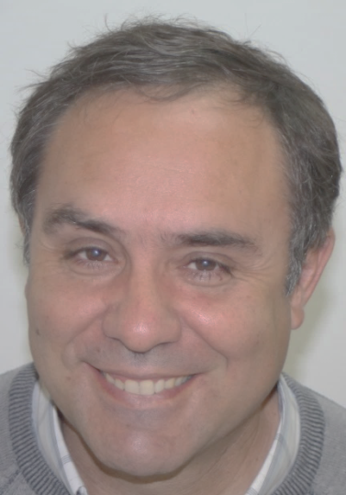
Who am I?
I am a History teacher.
This year I am working with student´s of the fifth grade and they have about ten – eleven years.
Both are CLIL classes.
I have three lessons per week.
My name is
Mário Moura
I am the responsible for the EBI do Ave where we have students from pre school to nineth grade (from three to fifteen years old).

Slide 9
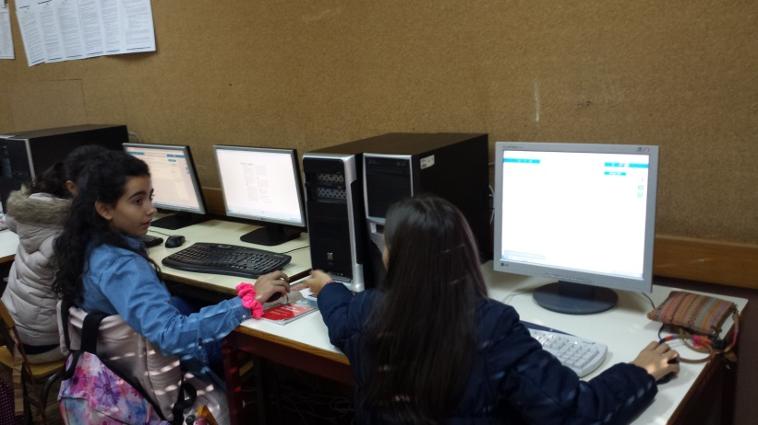
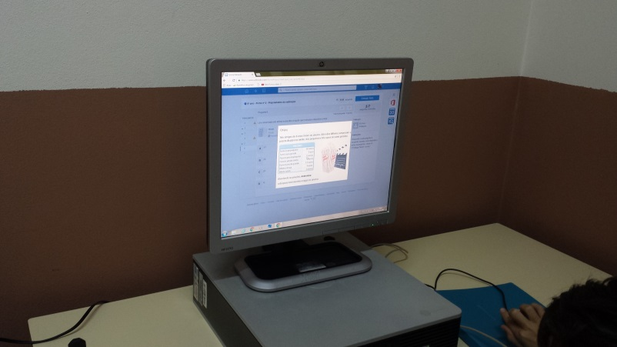
Who am I?
In my classes I use Edmodo, google tools, use tablets and cell phones to work with Kahoot, quizizz and Socrative.
We use Kahoot and quizizz with the students of primary school to organize championship of mental calculation and a serious games like Math Duel and Hypatiamat.
We also use Plicker’s, Ed Puzzle, Padlet and Quizlet.
In my free time I like to read thriller books, gardening, technologies and walk.

Slide 10
So … where we can find Agrupamento de Escolas Póvoa de Lanhoso?

Slide 11
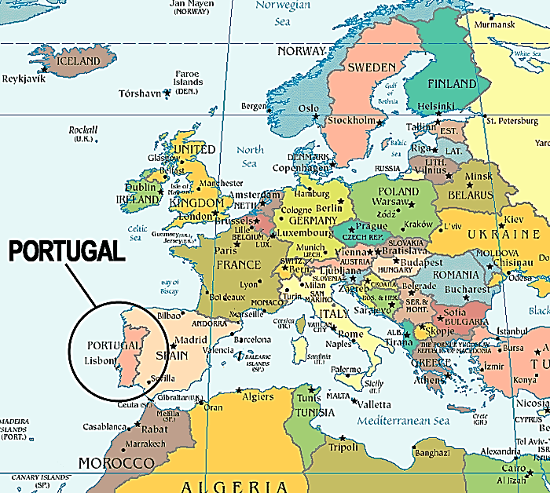
Where is Póvoa de Lanhoso?

Slide 12
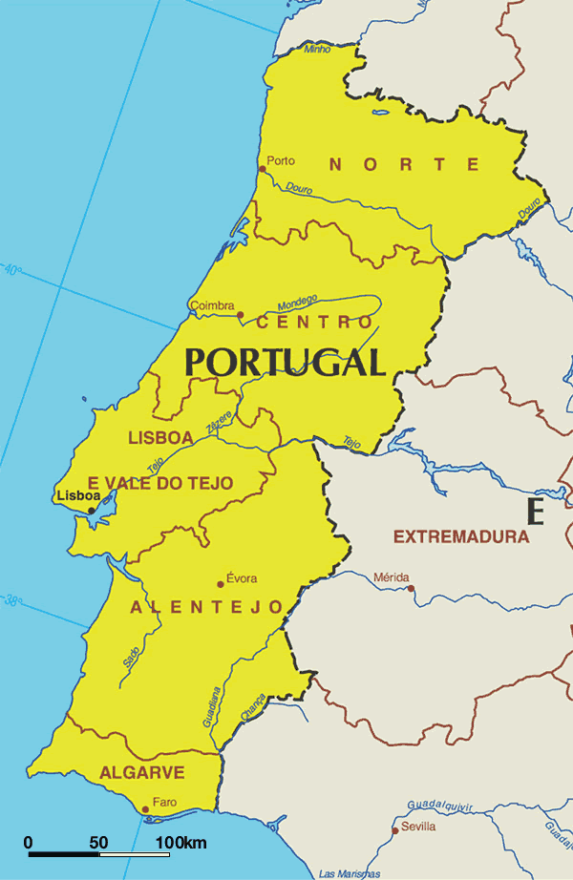
Where is Póvoa de Lanhoso?
Let´s find
Póvoa de Lanhoso !!!

Slide 13
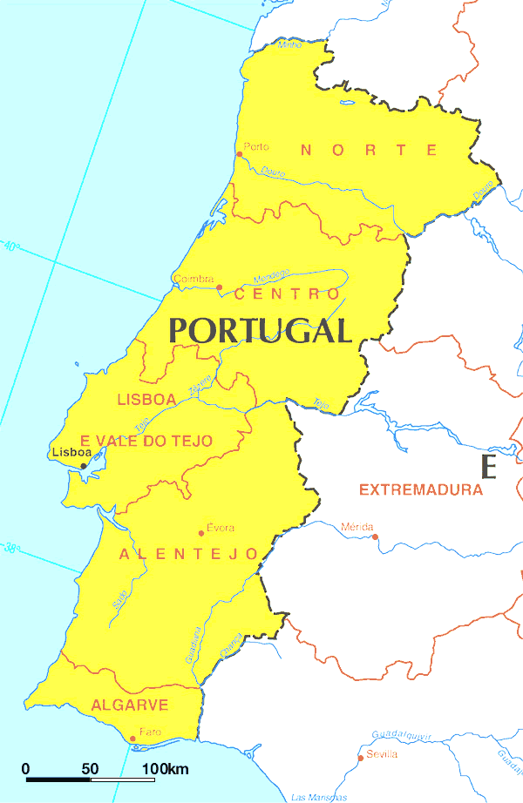
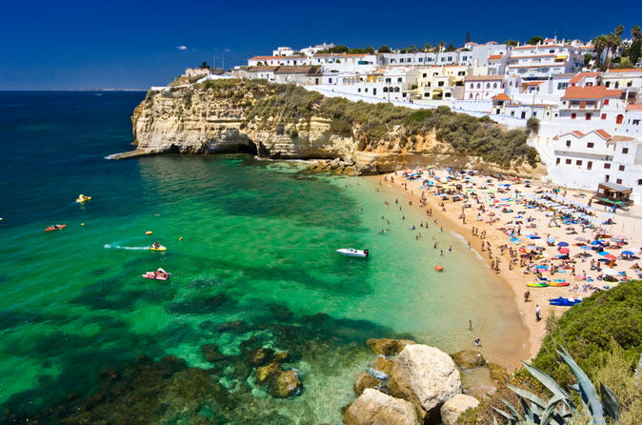
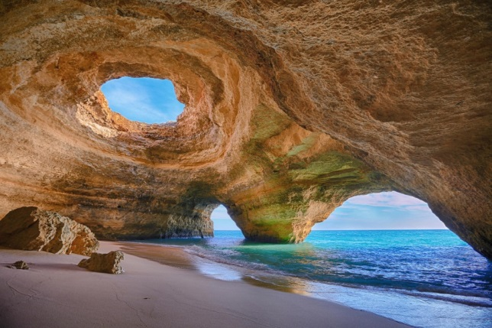
Where is Póvoa de Lanhoso?
In Algarve?
One of the most beautiful and safe areas of Europe for holidays …
Unfortunatly , Póvoa de Lanhoso isn’t in Algarve.

Slide 14
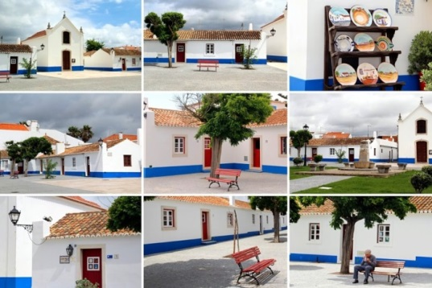
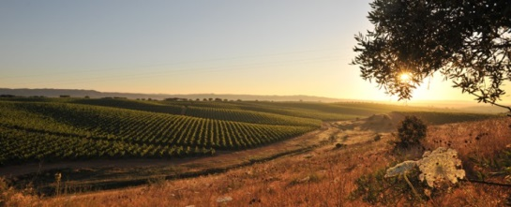
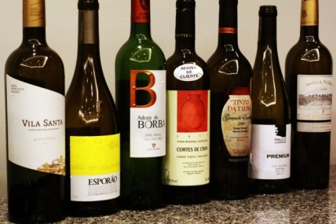
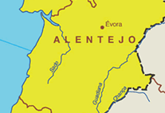
Where is Póvoa de Lanhoso?
In Alentejo
Several of the best wines of Europa are produced here…
Unfortunatly , Póvoa de Lanhoso isn’t in Alentejo.

Slide 15
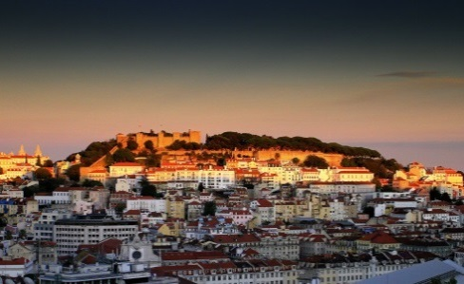
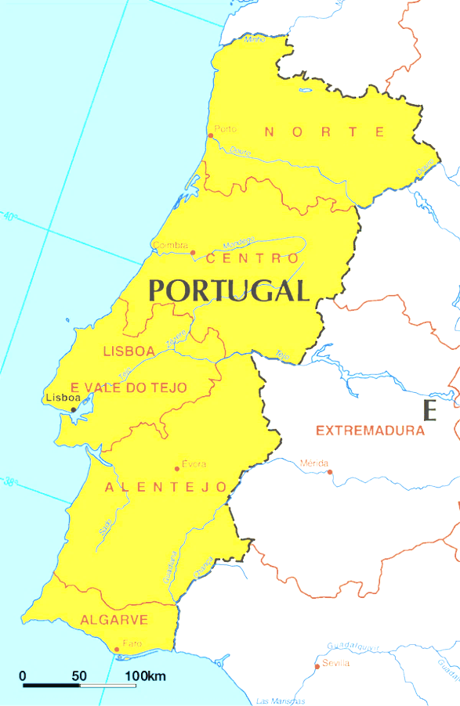
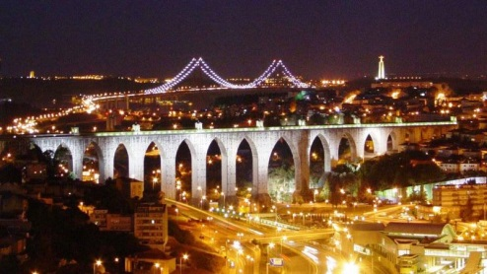
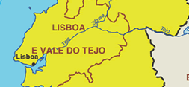
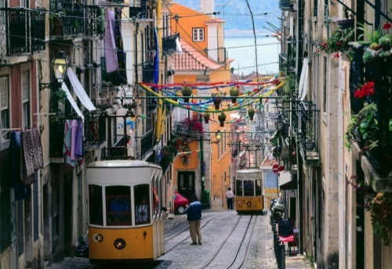
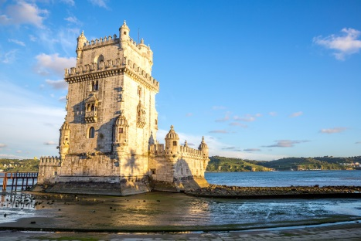
Where is Póvoa de Lanhoso?
Lisbon –
The city that leads the growth in tourism in Europe.
Unfortunatly , Póvoa de Lanhoso isn’t in Lisbon.

Slide 16
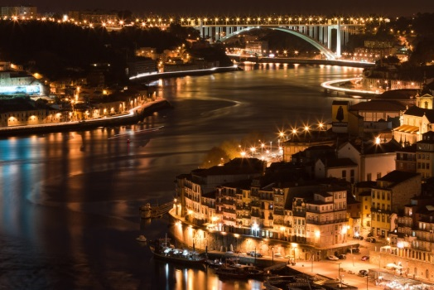
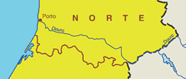
Where is Póvoa de Lanhoso?
In Oporto ?
The city of Porto was elected the Best European destination in an online poll organized by Best European Destinations.
Unfortunatly , Póvoa de Lanhoso isn’t in Oporto.

Slide 17
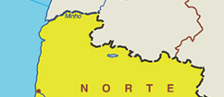
Where is Póvoa de Lanhoso?
So, let's look to the north.

Slide 18
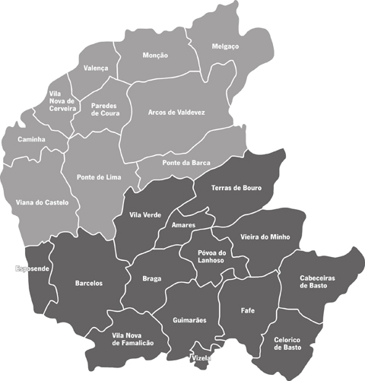
Where is Póvoa de Lanhoso?
Póvoa de Lanhoso is located near Braga and Guimarães.

Slide 19
Where is Póvoa de Lanhoso?
So, let's look to the north.

Slide 20
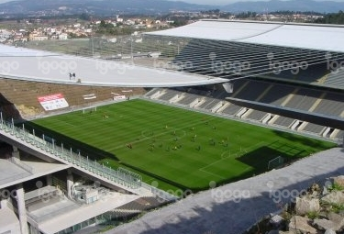
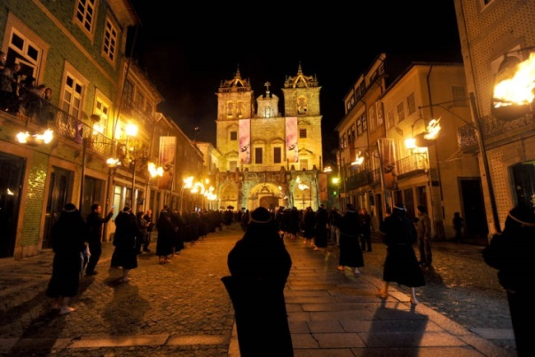
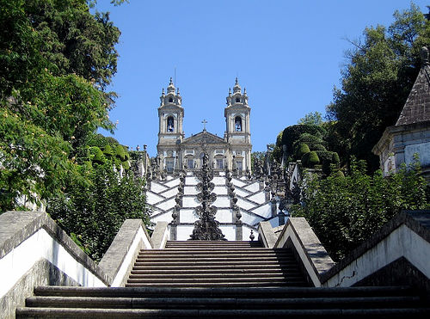
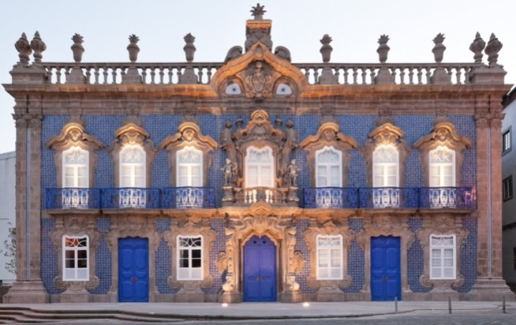
Where is Póvoa de Lanhoso?
Braga. The capital of our district.
Known as the Portuguese Rome, Braga was elected by the Guardian as the “most charming city of Portugal”. Why?
Souto Moura won the Pritzker award with our football stadium.
The holy week
(attracts thousands of tourists)
Bom Jesus – A fantastic baroque sanctuary where we can walk to the paradise.
Capital of baroque

Slide 21
Where is Póvoa de Lanhoso?
It’s time to Know Póvoa de Lanhoso
Vídeo

Slide 22
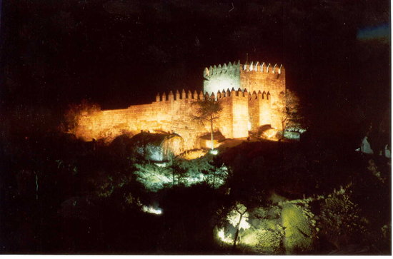
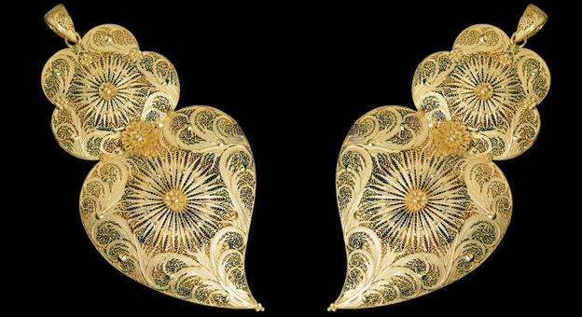
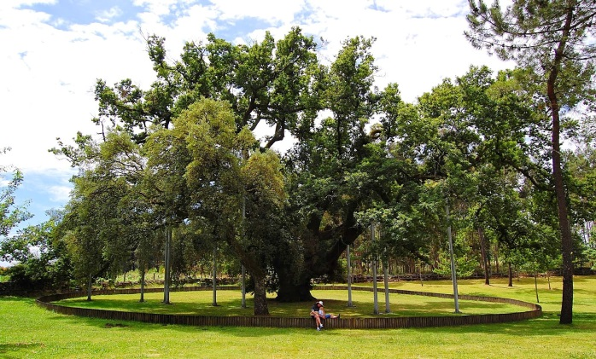
Where is Póvoa de Lanhoso?
The castle of Lanhoso
built over the largest monolithic of the Iberian Peninsula
The work of gold
Filigree
The old Oak
This oak has about 500 years

Slide 23
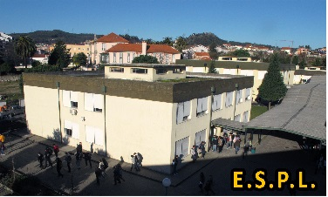
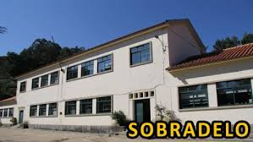
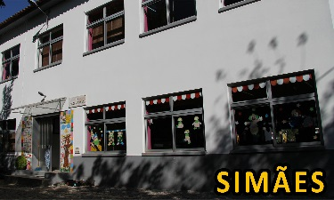
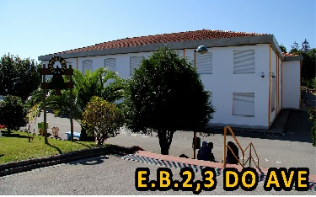
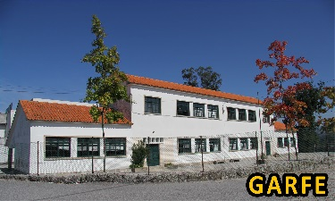
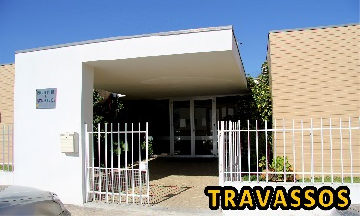
Agrupamento de Escolas da P. de Lanhoso
Now, It’s time to know Agr. de Escolas da Póvoa de Lanhoso
A GROUP OF SIX SCHOOLS
From 7 grade to 12 grade
From Pre school to 9 grade
Pre school

Slide 24
Who am I?
Vídeo

Slide 25
Agrupamento de Escolas da P. de Lanhoso
7º, 8º and 9º grade
(4 Clil Classes)
Subjects:
Portuguese
English
French
History
Geography
Maths
Physical and Chemistry
Natural Sciences
Tecnology
Arts
ICT
PE (physical education)
Citizenship
EMRC - Religion
10º, 11º e 12º grade
Regular courses
Common subjects
Portuguese
English
Philosophy
PE (physical education)
Science and tecnologie
Maths
Physical and Chemistry
Biology
Humanities
Foreign language
History
Geography
Economy
Maths
Economy
History or Geography
Escola Secundária da Póvoa de Lanhoso
10º, 11º e 12º grade
Vocacional courses
Multimídia
Electronics and tecnologies
Health

Slide 26
Agrupamento de Escolas da P. de Lanhoso
Pre school
7th, 8th and 9th grade
(4 Clil Classes)
Portuguese
English
French
History
Geography
Maths
Physical and Chemistry
Natural Sciences
Tecnologie
ICT
PE (physical education)
Citizenship
EMRC - Religion
EBI do Ave
1st, 2nd, 3rd and 4th grade
Portuguese
Maths
Art, PE
Social studies
Extracurricular activities
(Art, science, programming,
PE, music)
5th and 6th grade
(2 Clil Classes)
Portuguese
English
History and Geography
Maths
Natural Sciences
Technology and arts
EMRC - Religion

Slide 27
Agrupamento de Escolas da P. de Lanhoso
Schedules
Pre school – From 9 a.m. to 4 p.m.
Primary – From 9 a.m. to 5.30 p.m.
5º to 12º grade –
From 8.30 a.m. to 5.00 p.m ( 3 days)
From 8.30 a.m. to 1.15 p.m ( 2 days)
Vocacional courses
From 8.30 a.m. to 5.30 p.m ( 4 days)
From 8.30 a.m. to 1.15 p.m ( 1 day)

Slide 28
Agrupamento de Escolas da P. de Lanhoso
It’s time to “visit” Agr. Póvoa de Lanhoso
Vídeo. “School of the FUTURE”

Slide 29
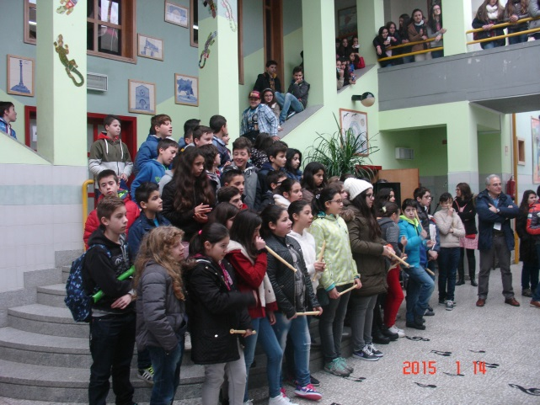
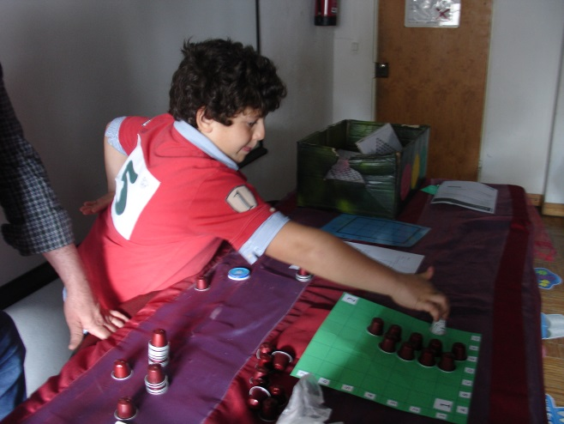
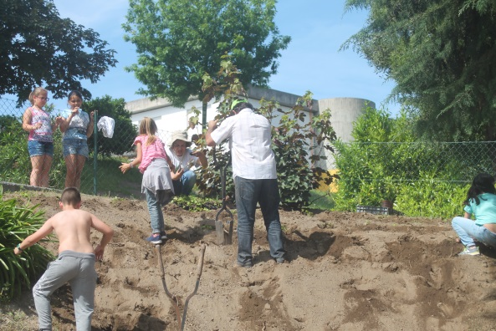
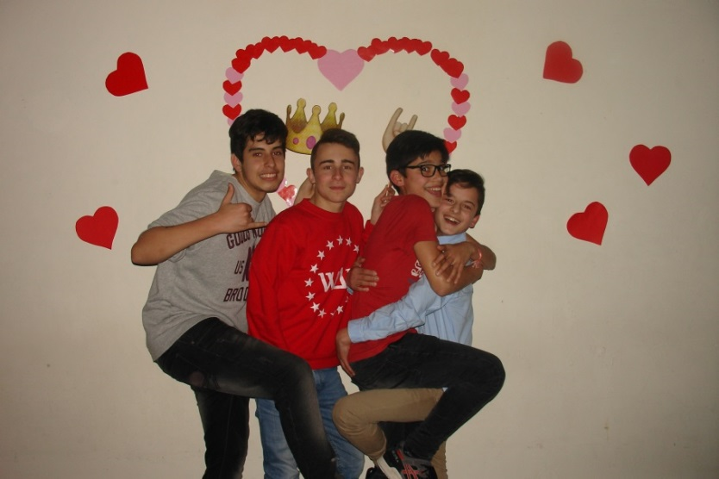
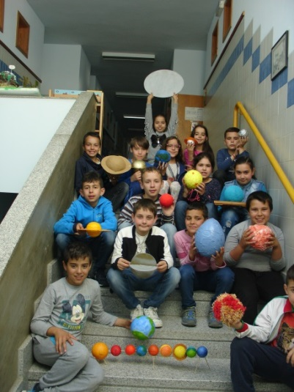
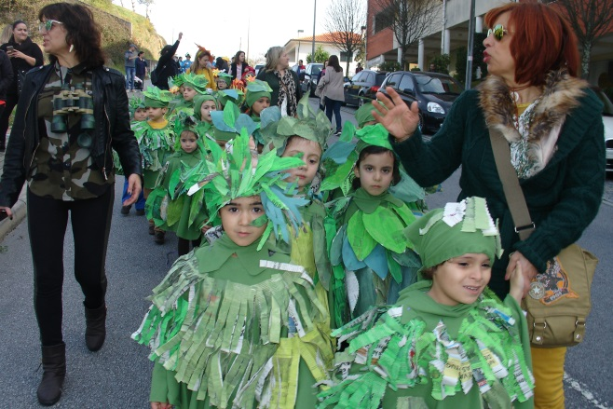
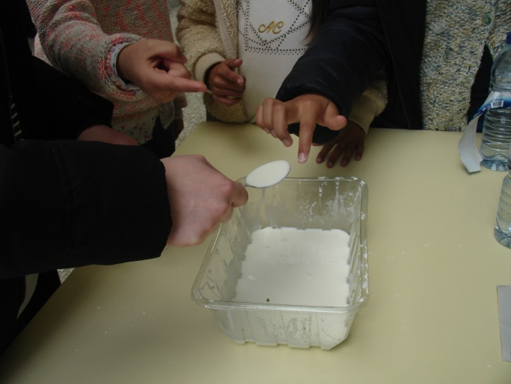
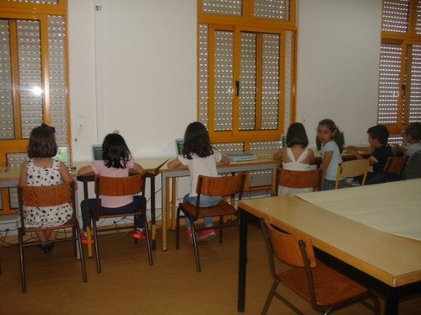
EBI DO AVE

Slide 30
EBI DO AVE

Slide 31
EBI DO AVE

Slide 32
EBI DO AVE

Slide 33
EBI DO AVE

