Slide 1
WHO
we are?

Slide 2
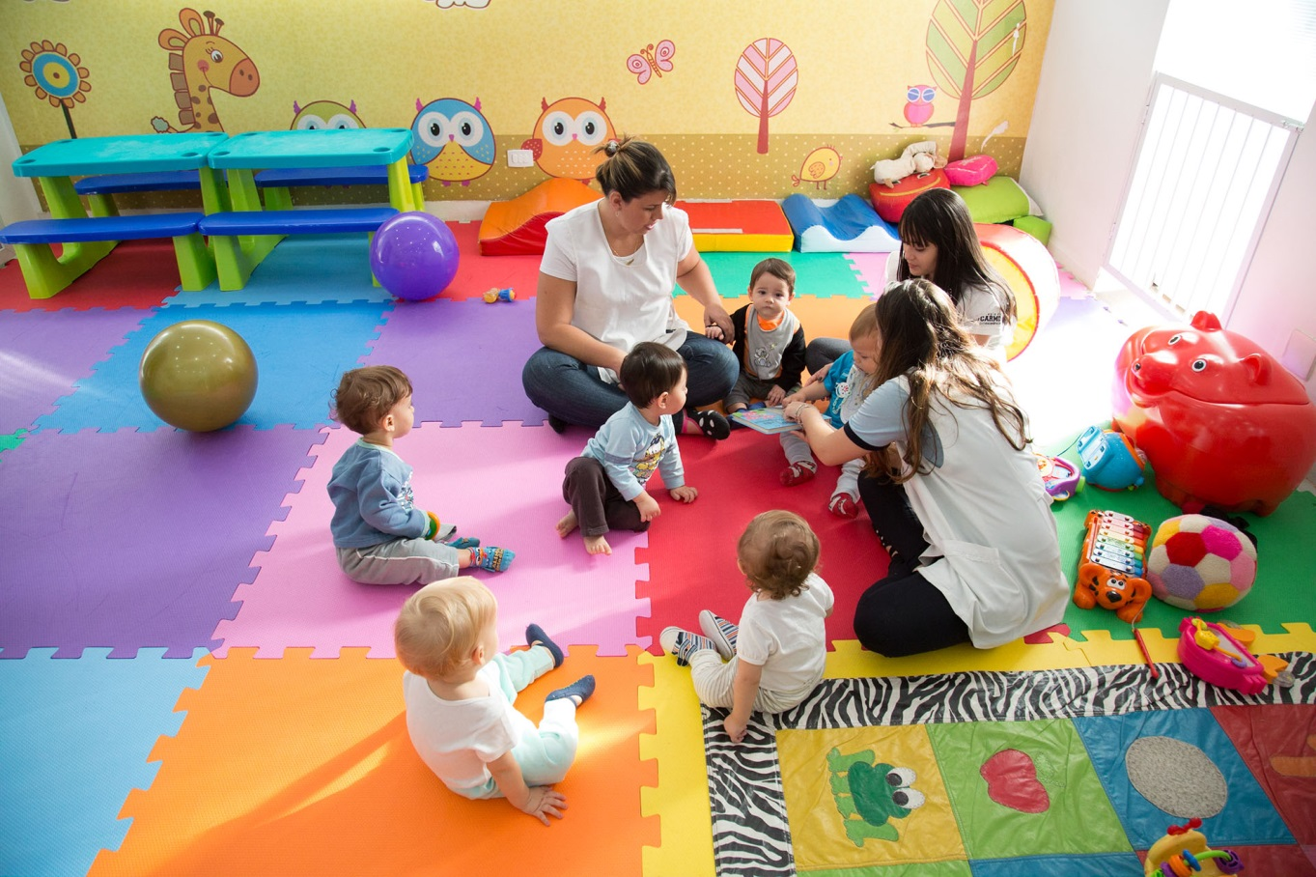
Nursery

Slide 3
Nursery
Where do we have this option?
Only in private schools / institutions?
For whom?
Children between 0-3 years old.?
AEPL
We don’t have this school option.

Slide 4
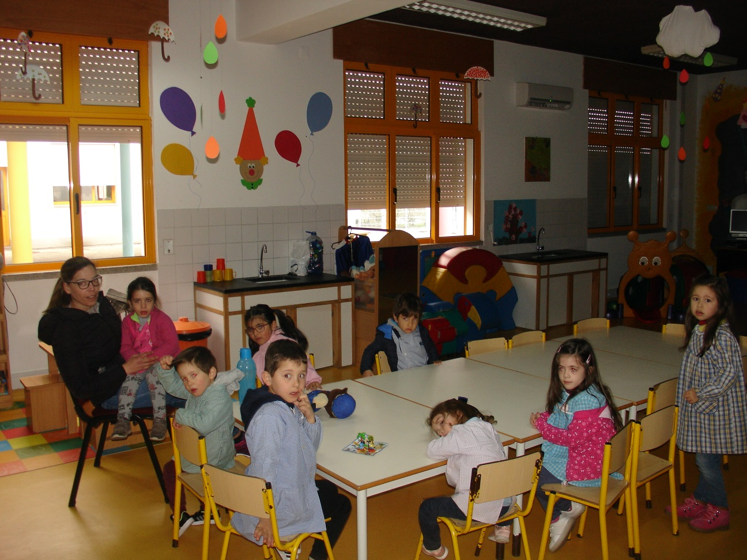
Kindergarden

Slide 5
Kindergarden
Where do we have this option?
We have this educational offer in public and private schools / institutions.
For who?
Children between 3 (sept.) to 6 (sept.) years old.?
AEPL
EB do Ave
JI Travassos
JI Sobradelo
JI Simães
JI Garfe
Schedule
School hours
Normal - From 9.00H to 15. 30H.
Extra - 07.30H – 09.00H and 15.30H – 19.30H (Parents have to pay this extra time).
(The value paid depends of the economic situation of the family)
Particularity
It isn’t compulsory.?

Slide 6
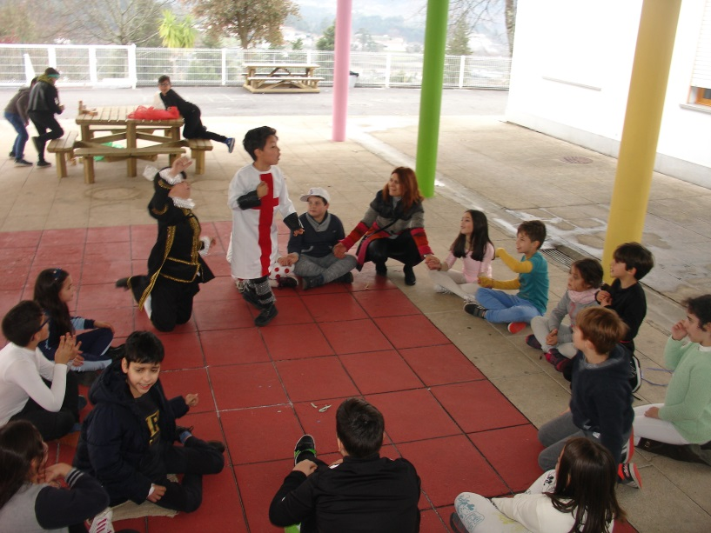
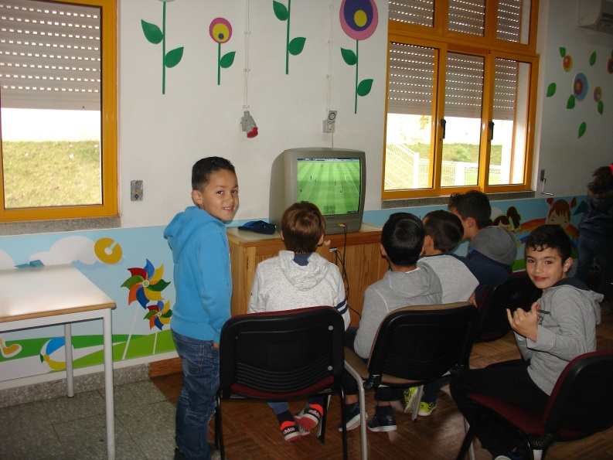
Primary school

Slide 7
Primary school
Where do we have this option?
We have this educational offer in the public and private schools. (In this last situation parents have to pay).
For whom?
Children form 6 (sept.) to 10 years old.?
AEPL
EB do Ave
Schedule
Timetable
Regular - 09.00H to 16.00H
Extracurricular activities - 16.30 to 17.20. (Music, Ph. Edu., Arts, Experimental Science Activities and English).
Students can stay at school from 07.30H to 18.30H.
Subjects
Portuguese, Math, Art, Music, Physic Expressions and Social Studies.
Particularity
Compulsory for children with 6 years
(15 september).

Slide 8
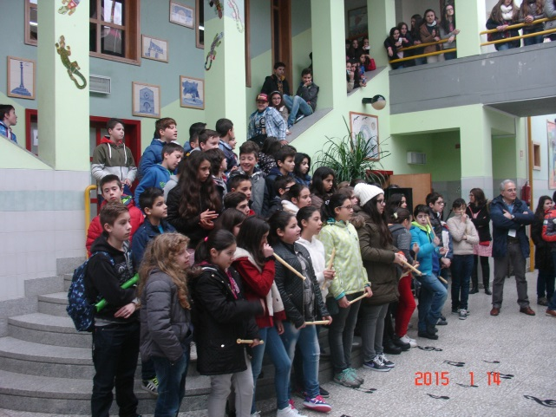
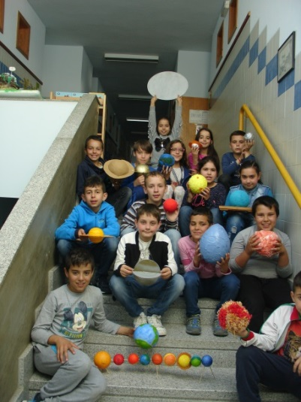
Second cycle

Slide 9
Second cycle (regular)
Where do we have this option?
We have this educational offer in the public and private schools. (In this last situation parents have to pay).
For whom?
Students between 10 and 12 years old.?
AEPL
EB do Ave.
Schedules
08.30H to 17.00H – 30 hours a week.
( 1 hour for lunch)
Ours students don´t have classes on Fridays afternoon.
Subjects
Portuguese, English, History and Geography, Maths,
Natural Science, Technology and Arts, Music and
Religion Education (option) and study suport.
Particularity
Is compulsory for all students.

Slide 10
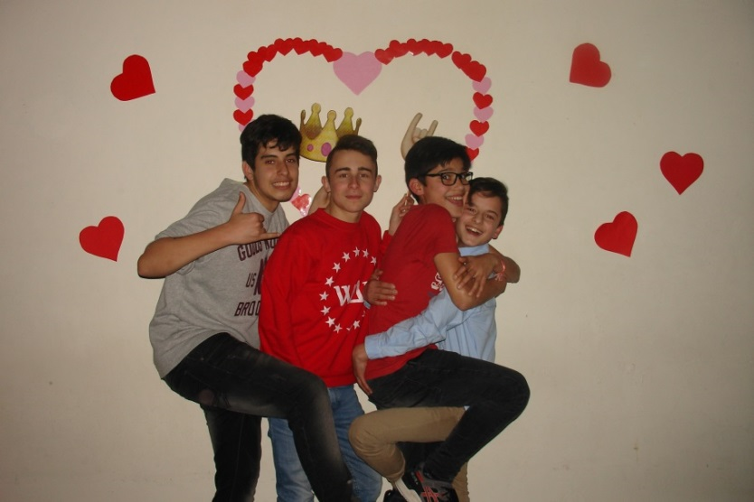
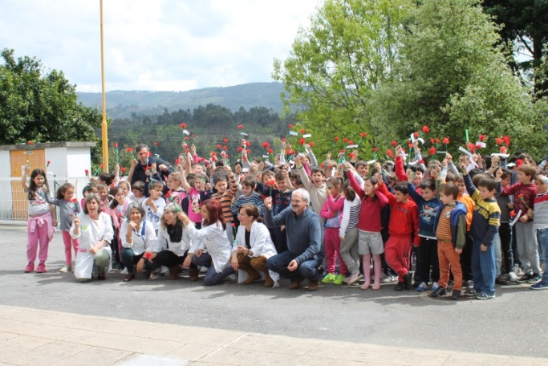
Third cycle

Slide 11
Third cycle (regular)
Where do we have this option?
We have this educational offer in public and private schools. (In this last situation parents have to pay).
For whom?
Students between 12 and 15 years old.?
AEPL
EB do Ave.
E. S. P. L.
Schedules
08.30H to 17.00H/ 18.30H - about 32 hours a week.
( 1 hour for lunch)
Our students don´t have classes 2 afternoons per week.
Subjects
Portuguese, English, French, History, Geography, Maths
Physics and Chemistry, Natural Science, Tecnology, ICT
PE (Physical Education), Citizenship, Religion Education (option)
Particularity
It’s compulsory for all students.
All students, at the end of the 9th grade, have to do a Portuguese and Maths national exame.

Slide 12
Third cycle (Vocacional)
Where do have we this option?
We have this educational option in:
public
private schools.
For whom?
To the students with school faillure. ?
AEPL
Only for students that are 15 years old, with two years of school faillure.
Schedule
About 2100 hours (2 years)
About 1200 hours ( 1 year)
Subjects
Portuguese, English, Citinzenship, ICT and
others related with the specific vocational training.
Particularity
If a student wishes to go to a regular secundary course he has to do a Portuguese and Maths national exames.

Slide 13
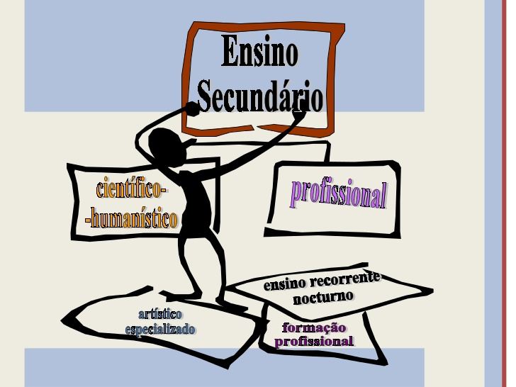
Secondary
Regular courses
Vocational courses

Slide 14
Secondary
Regular courses
Vocational courses

Slide 15
Secondary - Regular courses
Where do have we this option?
We have this educational offer in public and private schools. (In this last situation parents have to pay).
For whom?
Students between 15 to 18 years old.
(10th, 11th and 12th grade)?
AEPL
E. S. P. L.
Schedule
About 30 hours a week.
( 1 hour for lunch)
Our students don´t have classes 2 afternoons per week.
Options
Science and technology
Economy
Arts
Languages and humanities
Particularities
- It´s a good choice if students want to go to the university.
- All students, at the end of 11th and 12th grade, have to do 2 national exames.
-The marks of these national exames are important for the access to university.

Slide 16
Secondary - Regular courses
Where do we have this option?
We have this educational offer in public and private schools. (The student´s don’t pay and receive financial support given by European Union).
For whom?
Students between 15 and 18 years old.
(10th, 11th and 12th grade)
Students who want to start to work earlier.
They are usually students with learning difficulties, unmotivated and low school expectations.
Schedule
About 3100 hours.
Options
Several areas.
AEPL
Courses: Health assistant, computers and electronic, audiovisuals, multimedia, tourism.
Particularities
It´s a good choice for students that want to begin to work earlier in the job market.

Slide 17
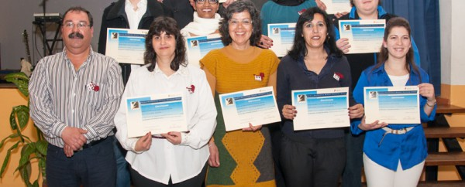
Adults
and
lifelong learning

Slide 18
Adults and lifelong learning
Where do we have this option?
We have this educational offer in some public schools and in a private institutions.
For who?
All those who left school without completing a certain level of schooling.
Unemployed people.
Options
Structured course (EFA)
Recognition and validation of skills acquired throughout life.
AEPL
CQEP

Slide 19
Agrupamento de Escolas da P. de Lanhoso
It’s time to “visit” Agr. Póvoa de Lanhoso
Vídeo - “School of the FUTURE”

Slide 20
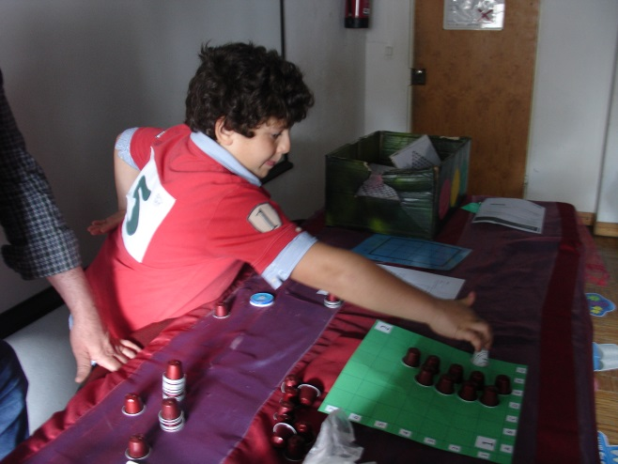
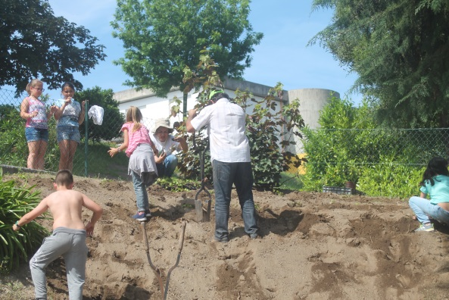
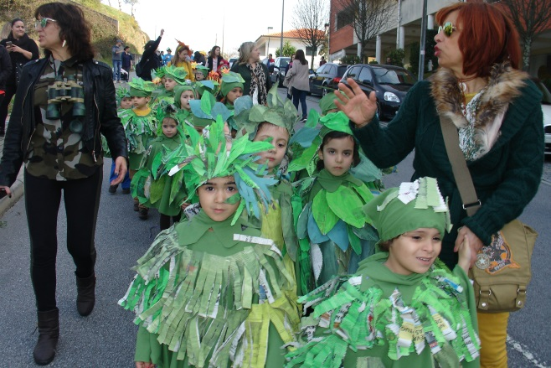
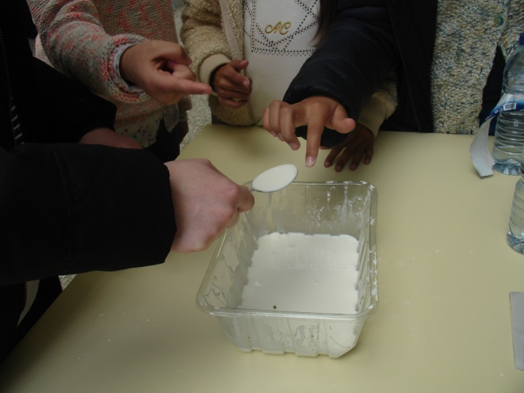
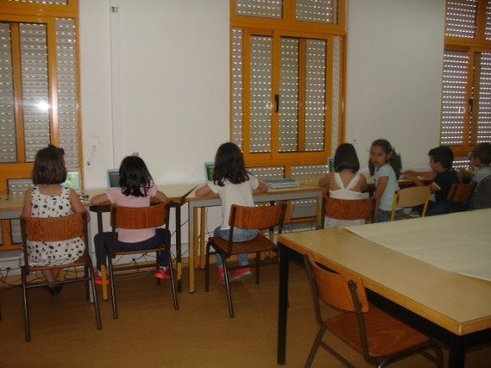
EBI DO AVE

Slide 21
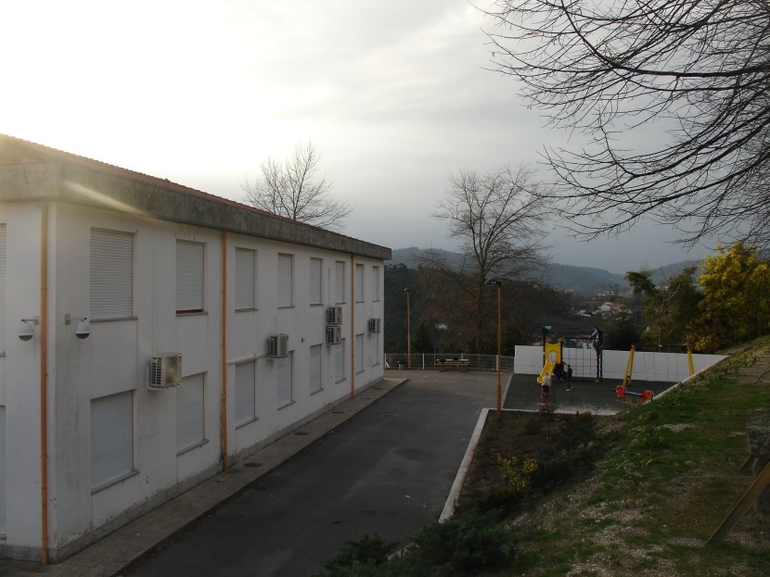
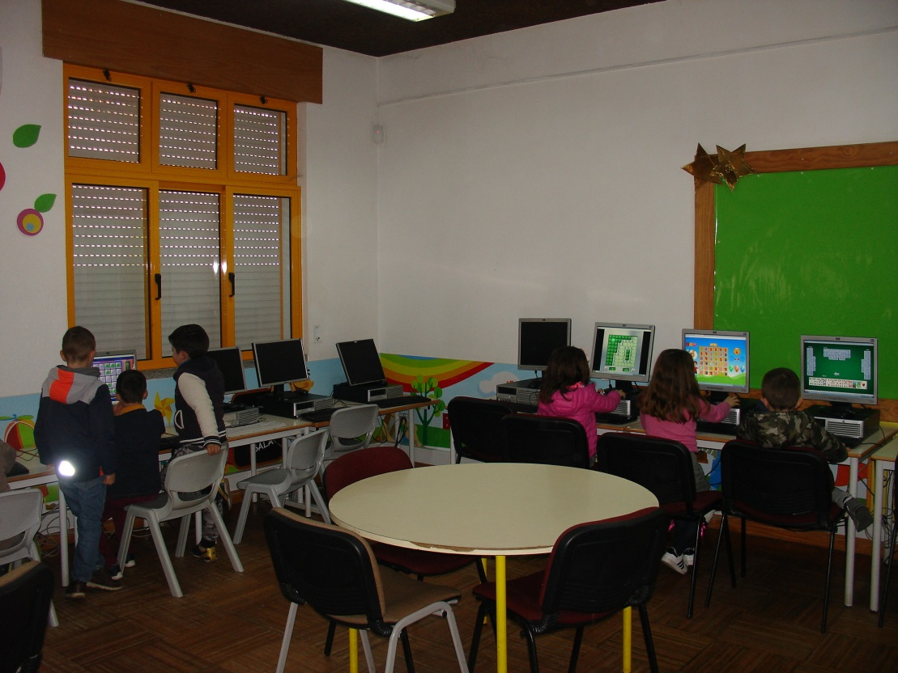
EBI DO AVE

Slide 22
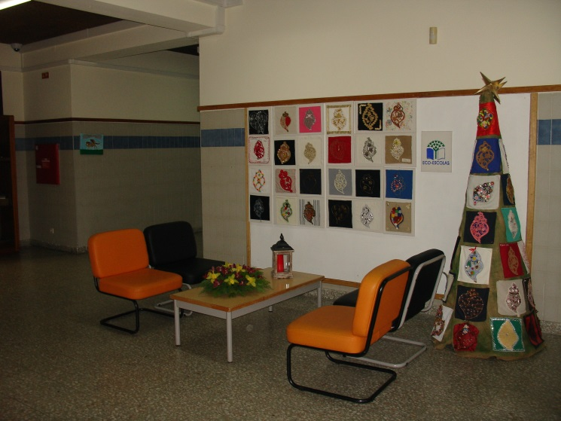
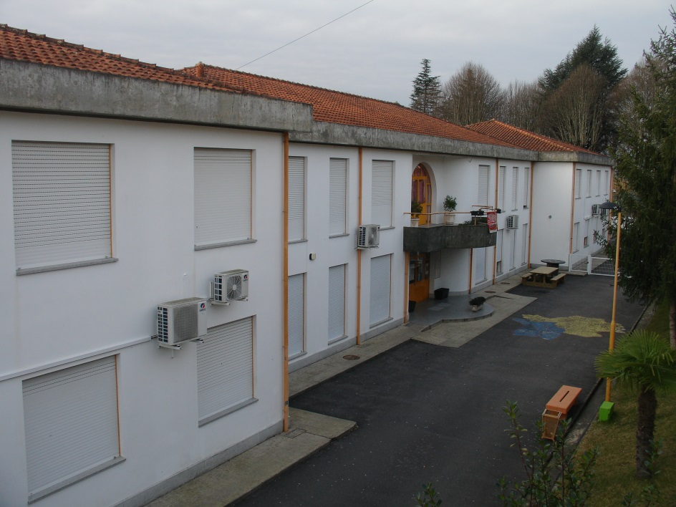
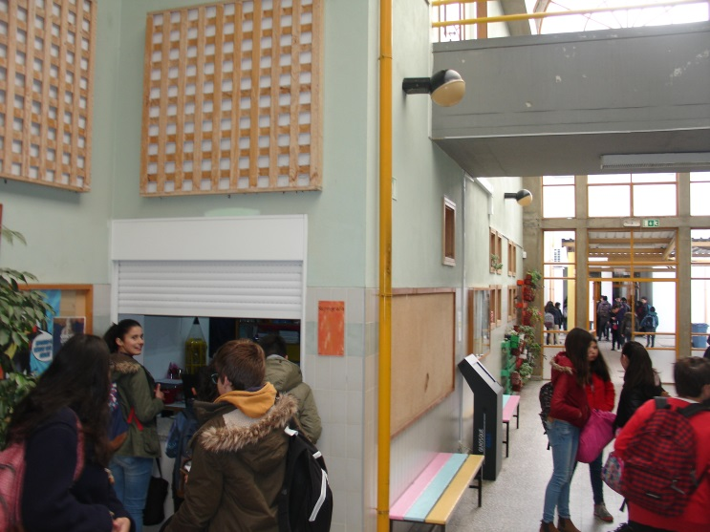
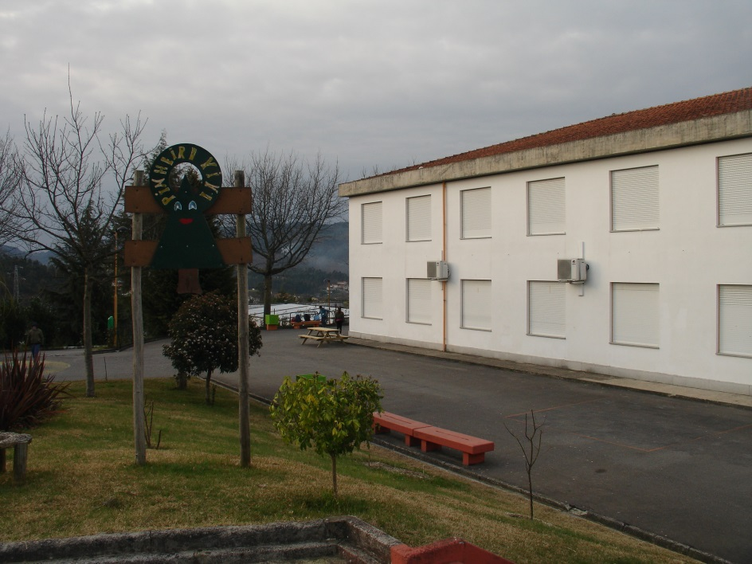
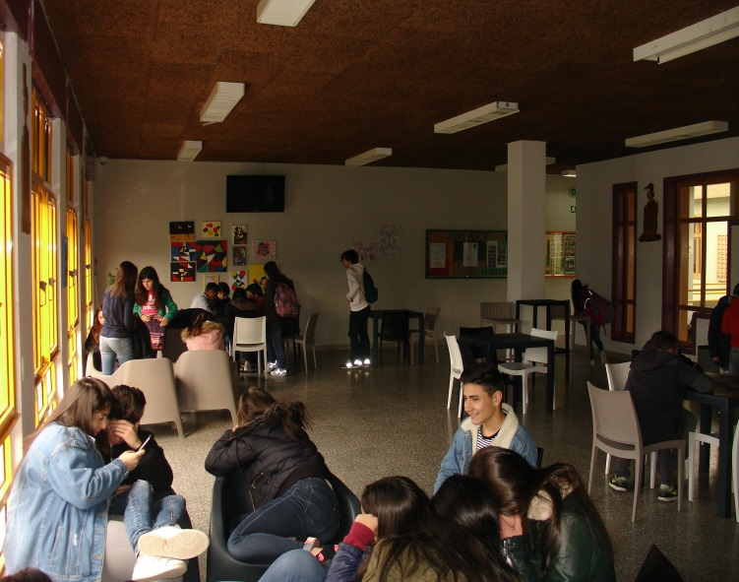
EBI DO AVE

Slide 23
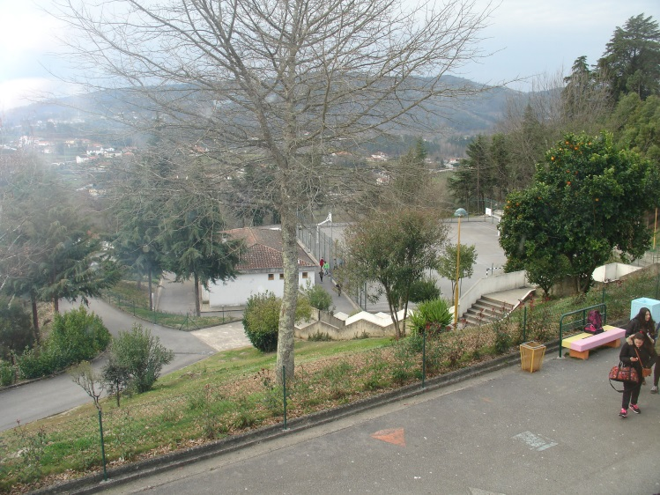
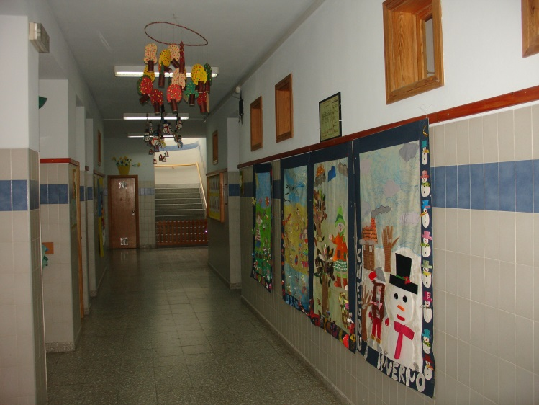
EBI DO AVE

Slide 24
EBI DO AVE

