Slide 1
EDUCATION SYSTEM in TURKEY

Slide 2
BASIC PRINCIPLES
Generality and equality
The needs of individuals and society
Orientation
Right to get education
Equal opportunity and facility
Continuity
Atatürk's Revolution and Principles and Atatürk's Nationalism

Slide 3
BASIC PRINCIPLES
Democracy education
Laicism
Scientific
Education everywhere

Slide 4
GOVERNANCE of EDUCATION
Turkish pre-primary, primary and secondary education system is under the supervision and control of the Ministry of National Education. It is represented by ‘Provincial directorate of national education’ and ‘District national education directorate’
The higher education system of Turkey is managed and supervised by the Council of higher education (CoHE).

Slide 5
DIGITAL DATA OF OUR EDUCATION (2018)
In total ,there are 17.885.248 students in pre-primary, primary and secondary schools and 65.568 schools in Turkey.
There are 1.030.130 teachers in total.
Schooling rate in
high schools : %83,58
Primary(second level): %94,47
Primary(first level): %91,54
Pre-Primary schools(5 years old): % 66,88

Slide 6
EDUCATION is DIVIDED into :
FORMAL EDUCATION
NON-FORMAL EDUCATION

Slide 7
FORMAL EDUCATION
Pre-primary education in Turkey is optional and is offered by the kindergartens, nurseries, day-care centres and other child-care institutions. Children aged 3 to 6 may attend this pre-primary schools. In Turkey, there are private as well as state preschools.

Slide 8
FORMAL EDUCATION (4+4+4 compulsory)
Primary education: in Turkey is for children aged 6 to 14. This educational level is compulsory to attend and is divided into two levels:
Level 1: First School (İlkokul 1. Kademe): The duration of this level is 4 years and covers grades 1 to 4.
Level 2: The duration of this level is 4 years and covers grades 5 to 8.

Slide 9
FORMAL EDUCATION
Secondary education in Turkey is for children aged 14/15 to 17/18. The duration of secondary education is 4 years. This education is offered by high schools (Lise).
Secondary education in Turkey comprises of general, vocational and technical education. This educational level prepares students for higher education or a vocation.

Slide 10
FORMAL EDUCATION
After primary or secondary school, you can get open education for the next level.
At the end of primary school(4+4), students take a national exam (LGS) to enter Science, Social Sciences, Project Anatolian High Schools and some Vocational schools.
It is not compulsory to take this exam.

Slide 11
HIGH SCHOOLS
Comprehensive High Schools
Vocational and Technical High Schools
Religious High Schools
Science High Schools
Social Sciences High Schools
Anatolian High Schools
Fine Arts High Schools
Sports High Schools

Slide 12
UNIVERSITY EDUCATION
After high school, students take a national exam(YKS) to get university education. There are two main exams; TYT(general and basic knowledge) and AYT.( knowledge on the field)
They make choices for a department at unıversity according to the points they get.
There are two, four, five-year long programmes. Most departments have preparatory classes for English.
The longest term department is medical faculty , six years.

Slide 13
NON-FORMAL EDUCATION
It stands for the education out of schools.
Public Education Centers organise this kind of education.
For example: learning a foreign language, traditional dances,fine arts, sewing,playing instruments, some sports, mind games, drama…. etc.

Slide 14
MAIN POINTS at SCHOOLS
Timing: whole day or two periods a day
Number of lessons a day: Primary school: First level- 6 lessons a day , Second level: 7 lessons a day , High school: 8 hours a day(different in Vocational schools)
The length of lessons: Each lesson is 40 minutes
Uniform: It depends on the decision of the school( students and parents)
Coursebooks: It is delivered by the state at the beginning of the year( free)

Slide 15
MAIN POINTS at SCHOOLS
Lessons in high schools: All the students get the same education in 9th-10th grade.(Turkish,Maths,History,Geography,Physics,Chemistry,Biology,English,Philosophy,Second foreign language,Religious Studies,P.E and some optional courses such as Music, Arts,Democracy,Project planning)
Then, they decide to take whether science lessons, maths-social or social lessons. In vocational schools, they choose their branch. In 11th and 12th grade, they study in their branch .

Slide 16
MAIN POINTS AT SCHOOLS
There are social clubs at school. Students choose one of them and join the activities. (Culture and Literature, Entrepreneurship, Communication, Social solidarity,Photography…….)
Counseling Services-Lessons: There are 1 hour counseling lessons every week. Each class has a counseling teacher( among the branch teachers). They deal with the problems of the class. They do different activities with the students to increase their awareness about lessons,school,society,citizenship.
There is also School Counseling teachers at school for general organisation and individual meetings with students.

Slide 17
MAIN POINTS at SCHOOLS
There are some important days and weeks in our country. Schools prepare ceremonies,corners to celebrate/remember them.
For example: 29 October-Republic Day, 10 November-Commemorating Atatürk, 12 March-Approval of Natonal antheme…

Slide 18
MAIN POINTS at SCHOOLS
After schools, students can get supporting courses in the field they want. It is optional. They can get more academic courses or courses about sports,art,music,mind games… etc.
In Turkey, there have been many private courses to support students for national exams. This situation has resulted in some problems. So, the ministery of education has started the supporting courses at schools for free. They are becoming more efficient now.

Slide 19
MAIN POINTS at SCHOOLS
Assessment and Evaluation: In the first 4 years, evaluation is not done with exams but different ways such as observing the students and giving projects. Exams become one of the main assessment tool in the second 4 year level. This point is taken more seriously in high schools. We have main exams, generally 2 exams for each term in each lesson. We give performance assignments to the students. In addition, students are evaluated for their during class performance and attittudes at school. Students have to take a project work from at least one lesson and prepare it during the year.

Slide 20
TECHNOLOGY IN EDUCATION
Some parts of education is directed by the state through different digital tools/portals.
E-okul
Mebbis

Slide 21
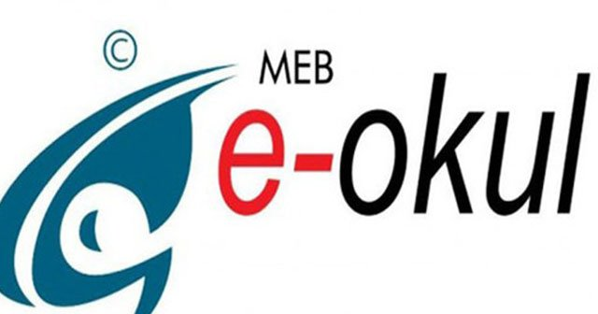
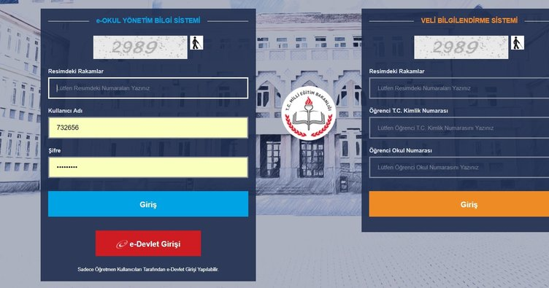
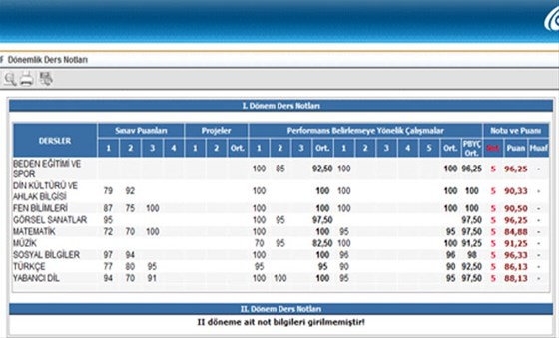
E-OKUL
This system includes all the necessary information about students.
Teachers have enter the evaluation results in this platform.
Students and parents can see all the information here.

Slide 22
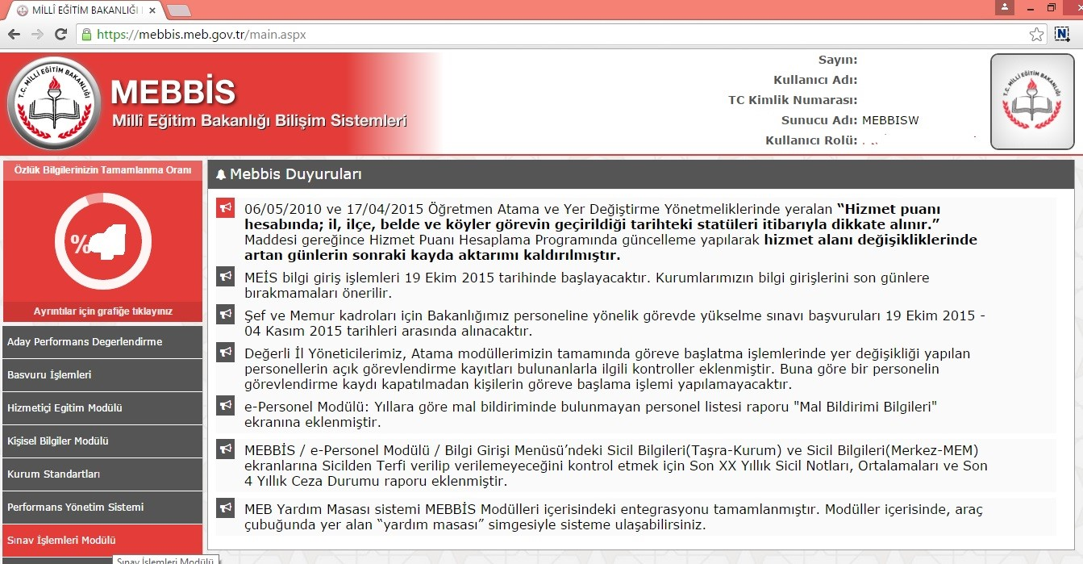
MEBBİS
This system includes all the information about teachers.
Teachers do their official acts on this platform.
They can apply for central courses,seminars on this platform.
Teachers can also take charge in central exams as an observer by applying through this platform.

Slide 23
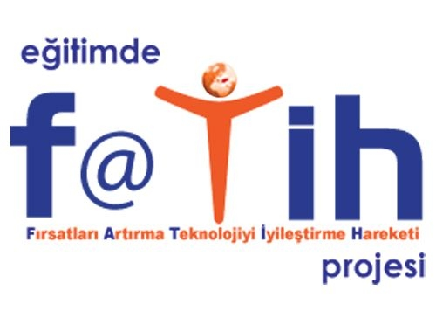
FATİH Project Movement for Increasing Opportunities and Improving Technology
This project started in 2010.
In the first step, interactive boards were delivered to schools.
Students were given tablets to use in education.
Printers and laptops were delivered to schools.
Teachers were given courses to use these tools effectively.
In the second step, powerful internet networks were provided for schools.
In the third step, a rich source EBA- a digital platform- was founded to use in education.

Slide 24
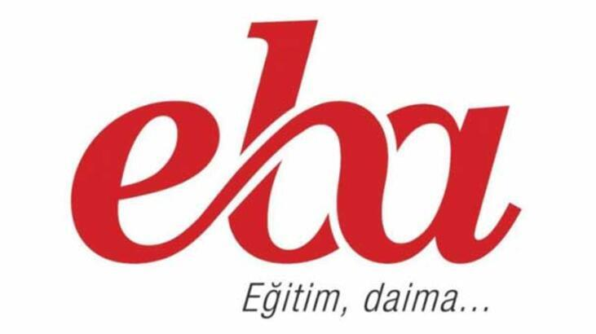
TECHNOLOGY IN EDUCATION
Turkish Ministry of Education provides a digital platform for the teachers, students and parents: EBA Education Informatics Network.
You can find and use loads of teaching materials here.
Teachers can also upload and share their teaching materials here.
You can also join online professional development courses, read the news about other schools.
You can create groups for your classes and give and check homework through this platform.

Slide 25
PROJECTS in EDUCATION
TÜBİTAK ( Turkey Scientific and Technological Research Institution)Projects
EU PROJECTS
eTwinning Projects
Hami Project
1 million Teacher 1 million Idea

Slide 26
PROJECTS in EDUCATION
Lets girls to School
Zero Waste Project
Turkey’s engineer girls
Try-do workshops

Slide 27
2023 TURKEY’S EDUCATION VISION
This vision document has been prepared in 2018 to regulate the education system to keep pace with today’s challenges and needs .
Within this vision :
Design-Skill Labs will be established at schools for the development of the interests and skills.
A school Development Model will be established in each school to provide all the components of children’s learning will take part in the school activities.

Slide 28
2023 TURKEY’S EDUCATION VISION
3. Data-Based Planning and Management System will be established for monitoring,evaluating and developing management and learning activities nationwide.
4. Measurement and evaluation: a qualification based evaluation system will be established. The need for national exams will be reduced. Exams will be restructured. E-portfolio will be used for evaluation.
5. Social, cutural andd sports activities of students will be monitored.

Slide 29
2023 TURKEY’S EDUCATION VISION
The professional development of teachers and school administrators will be restructured.
Human resources will be utilized efficiently and rewarded fairly.
Advisors from Universities
Capital workshops for Teachers
More professional seminars and trainings

Slide 30
2023 TURKEY’S EDUCATION VISION
Foreign Language Education
Online Learning Environments
Mobile Technologies
Interactive , game-based learning materials
Teacher proficiencies and qualifications will be improved.

Slide 31
2023 TURKEY’S EDUCATION VISION
School Finance
Inspection and Institutional Guidance Services
Special Education
Special Talents
A National Digital Contents Archive
Early Childhood
Changes in Basic,Secondary and Vocational Education curriculum
Lifelong Learning

Slide 32
HAPPY CHILDREN
STRONG TURKEY
ŞEHİT OĞUZHAN YAŞAR ANADOLU LİSESİ
ETİMESGUT-ANKARA
FİLİZ ÇAKIRLI

