Slide 1
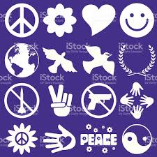
Peace Symbols
Bila Tserkva,
Ukraine

Slide 2
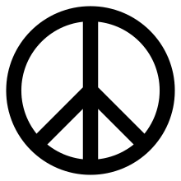
Much like a simple stock image that becomes a meme, the peace sign was invented for one specific purpose and adapted for much broader ones by countless people across the globe. British artist and activist Gerald Holtom designed the emblem in 1958 for the Campaign for Nuclear Disarmament.

Slide 3
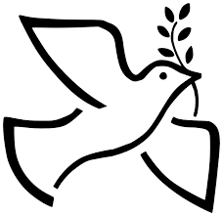
DOVE
In the Bible, when the flood waters receded, Noah sent out a dove which returned with an olive leaf, indicating life had returned to the Earth.

Slide 4
OLIVE BRANCH
The use of the olive branch as a symbol for peace and end of conflict dates back to ancient Greece, where it was worn by brides on Olympic winners.

Slide 5
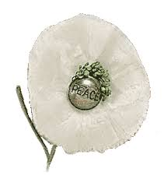
WHITE POPPY
The sprouting of poppy flowers on battlefields and grave sites across Europe marked the conclusion of World War I.

Slide 6
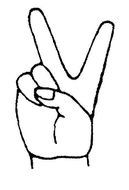
“V” HAND SYMBOL
The “V” gesture, middle and index fingers raised, is a versatile and long-lived one. it is the first letter of the French, Flemish, and English words for victory (victoire, vrijheid, and victory, respectively)

Slide 7
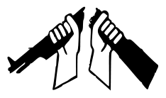
BROKEN RIFLE
London-based group War Resisters’ International uses an illustration of two hands breaking a rifle in two as its logo. Founded in 1921, the alliance is active in more than 40 countries and uses the cross-cultural simplicity of the emblem to convey its message. The Broken Rifle is also the name of its newsletter.

Slide 8
