Slide 1
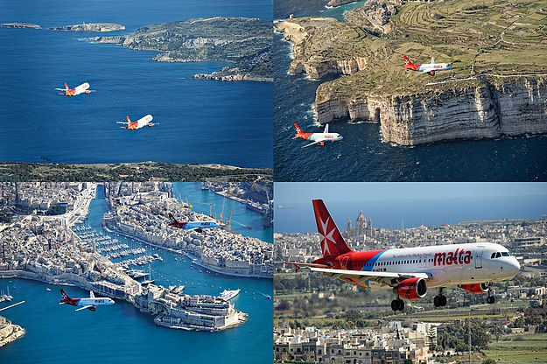
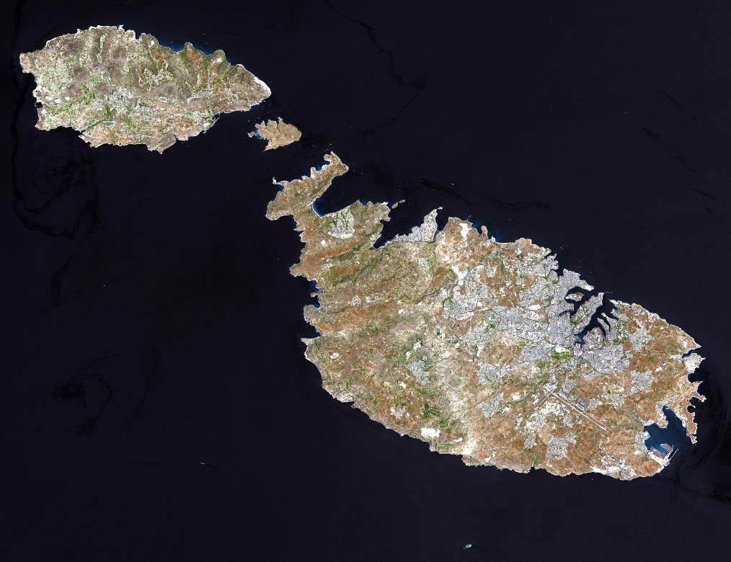
Visit Amazing Places around the Maltese Islands by Year 6 students
https://tourbuilder.withgoogle.com/builder#edit/ahJzfmd3ZWItdG91cmJ1aWxkZXJyEQsSBFRvdXIYgICgk7fK_QgM

Slide 2
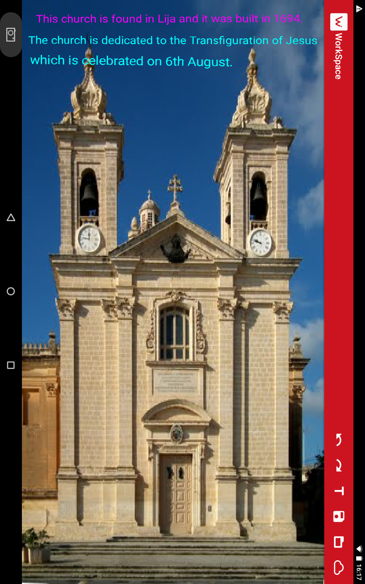

Slide 3
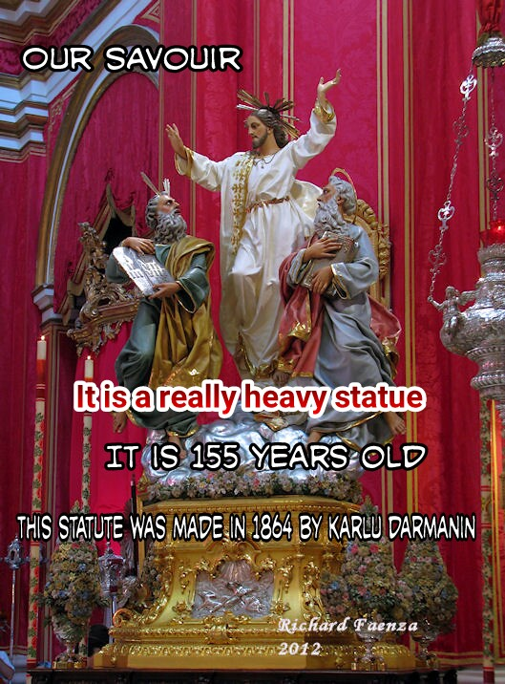

Slide 15
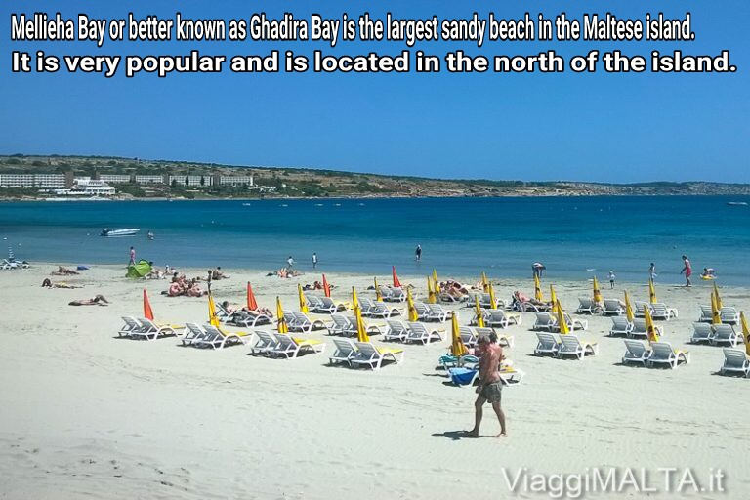

Slide 16
