Slide 1
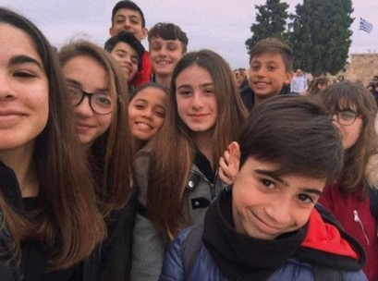
Our erasmus+ in Greece
Presentation of:
Alessandro Canu, Roberta Merella, Eleonora Balsamo, Andrea Oronti, Enrico Caggiari, Gabriele Puggioni, Goran Desole, Elisa Secchi, Marta Tiana, Mira E. Serra Das

Slide 2
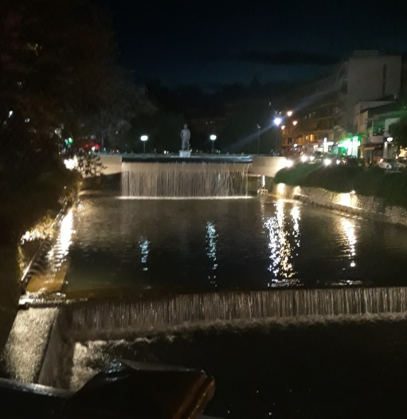
Monday
In the morning we went to school, Greek students every morning do a prayer and we made a board game with Greek and Spanish students
In the afternoon the Greek people who hosted us, brought us in the centre of Trikala.

Slide 3
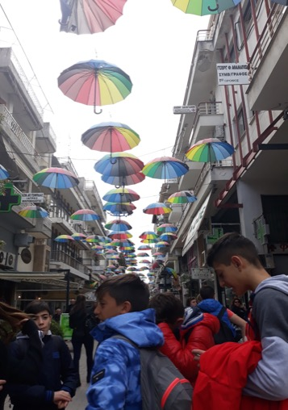
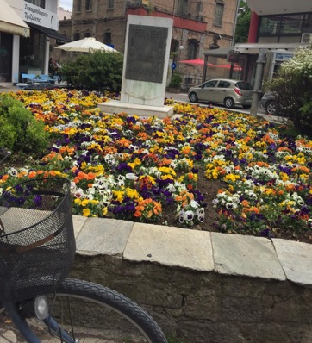
Trikala
Trikala is a beautiful city and we visited it
in different days, there are
minimarkets, café and
some
…flower shops

Slide 4
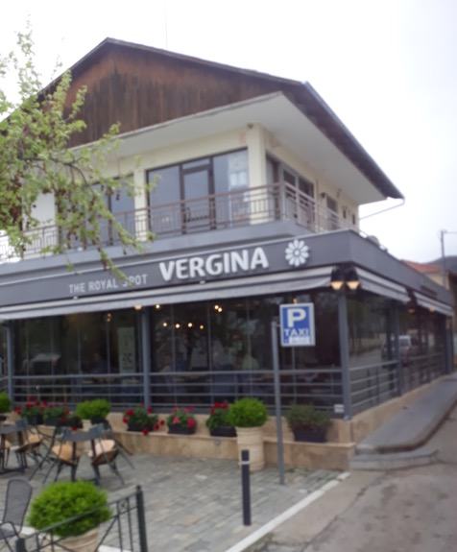
Tuesday
on Tuesday we went to Vergina and Thessaloniki, the capital of Macedonia. We visited the tomb of Alexander the Great and his father Philip II.
(we couldn’t do some photos)☹

Slide 5
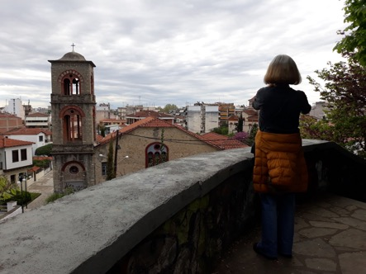
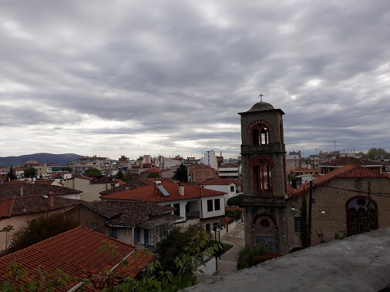
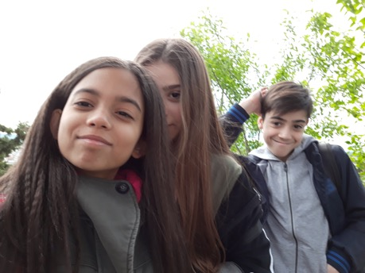
Wednesday
On Wednesday we went to the castle and then we returned to our home

Slide 6
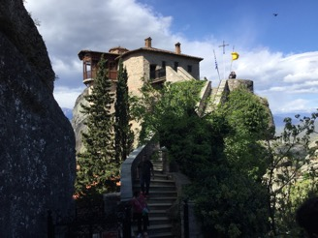
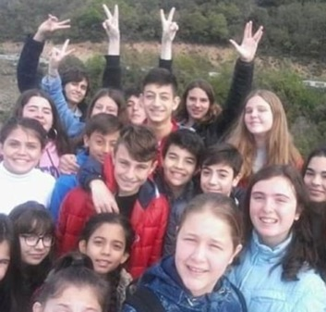
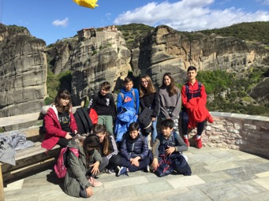
thursday
In the morning we went to school for a prayer and then we waited the bus which brought us to Meteora, a place where the Christians built monasteries on big mountains (their religion is very strange for us, for example they use to kiss the images of God).
In the evening some of us went to the bar of the mother of a Greek girl, other guys went to Fiki and the rest went to a shopping centre.

Slide 7
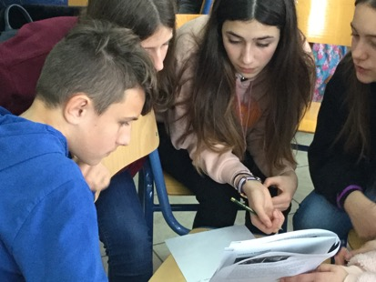
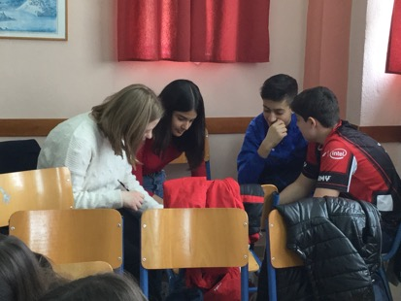
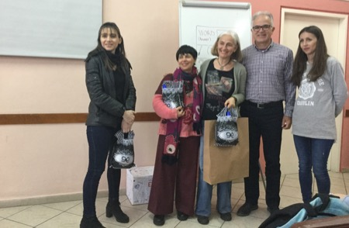
friday
In the morning we went to school, the Greek students did a prayer and then we continued the project: we made the questions and the cards of famous Greek people. In the evening we all together went to the restaurant of the father of another Greek girl for a party. We took some glasses and we wrote all our names on these for souvenir.

Slide 8
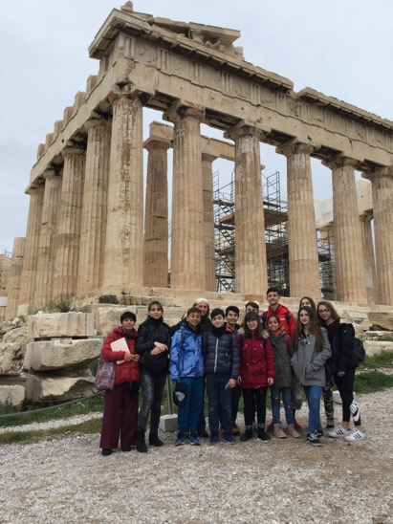
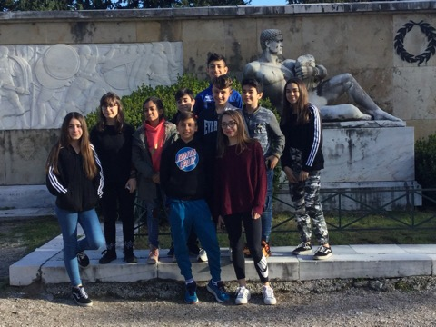
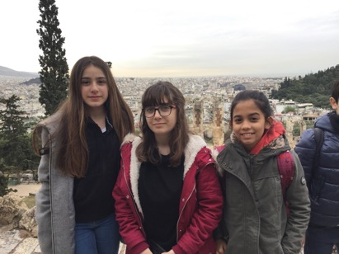
saturday
At 5 a.m. we said goodbye to the Greek students and then we took the bus to went to Athens. There we visited the Acropolis and we took the plane.

Slide 9
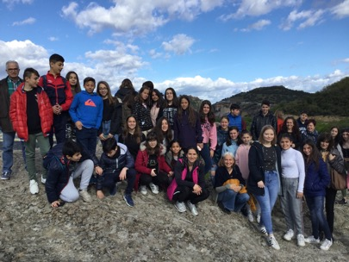
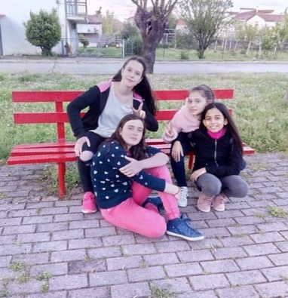
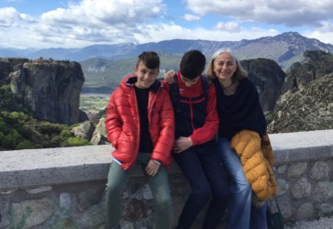
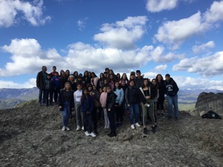
In this week we had a lot of fun!!!

