Slide 1
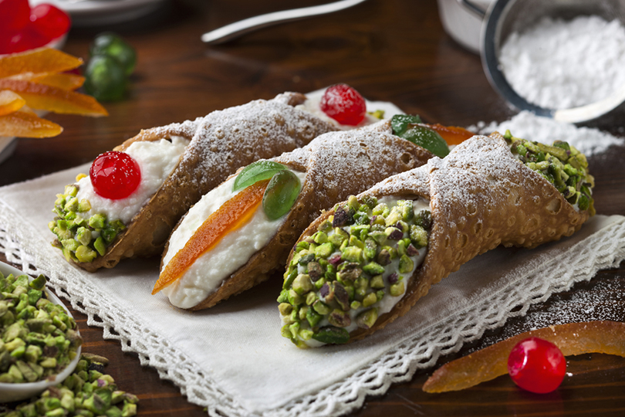
CANNOLI SICILIANI
.

Slide 2
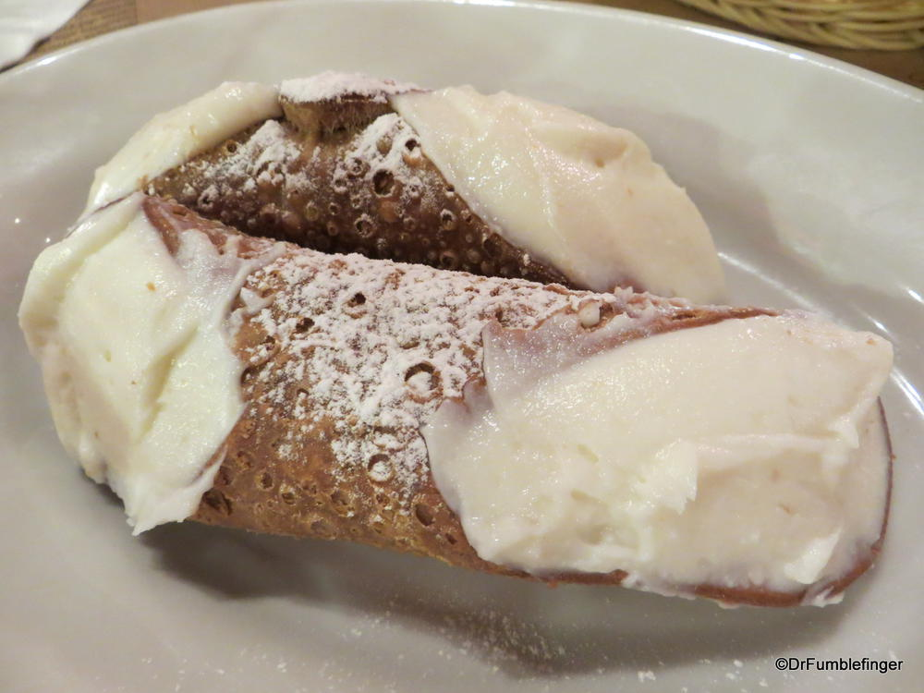
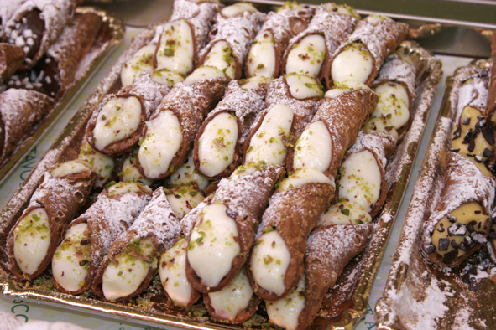
Cannoli are italian pastries that originated on the island of sicily and are today a staple of sicilian cuisine. Cannoli consist of tube-shaped shells of fried pastry dough, filled with a sweet, creamy filling usually containing ricotta.
They range in size from «canullichi», no bigger than a finger, to the fist-sized proportions typically found south of palermo. They are often flavored with cocoa, nuts, chocolate, or candied fruits.

Slide 3
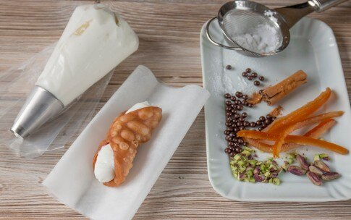
IGREDIENTS for the shells:
Flour 00 = 220 g
Sugar = 30 g
Lard (from fridge) = 40 g
Only a little bit of thin salt
1 egg
White wine vinegar = 25 g
Marsala = 25 g
(optional) a little bit of cinnamon

Slide 4
PROCEDURE
To make the shells:
Mix together the flour, butter or shortening, sugar, and salt. Begin to add the wine, adding enough so that you have formed a fairly firm dough.
Knead for a few minutes until smooth. Form into a ball, wrap in plastic wrap, and let sit a room temperature for one hour.
Cut the dough in half, and roll thinly to about a ¼ inch thickness. Cut into 4 square, and wrap the dough around the tube. Seal the edges with a little beaten egg white.

Slide 5
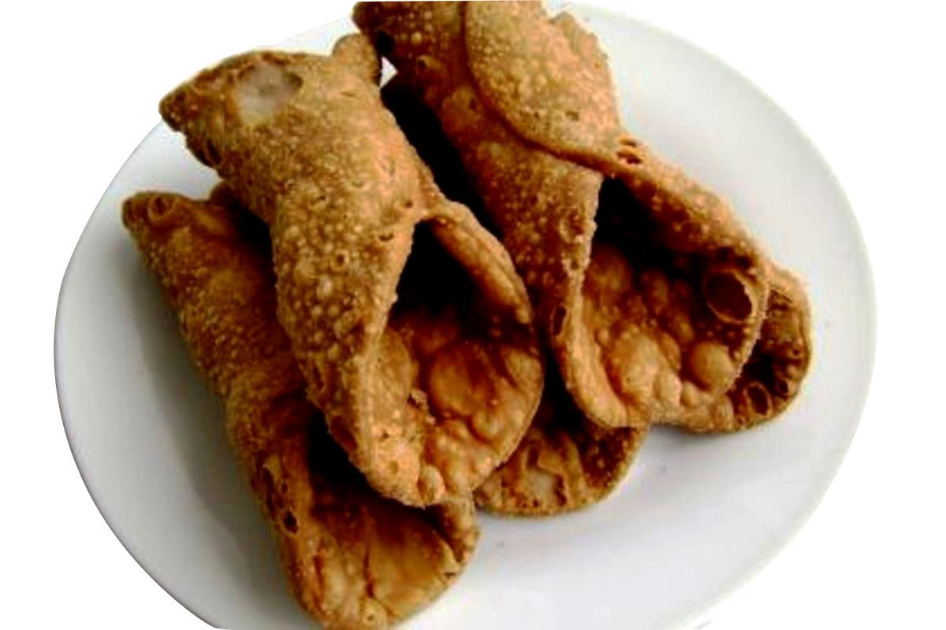
Heat the oil in a large pan until it reaches a temperature of 375 degrees F. Drop one or two tubes into the hot oil at one time, and cook until golden. Remove from the pan, cool, and gently slide the cannoli shell from the tube.
Continue to make the rest of the shells in this manner.

Slide 6
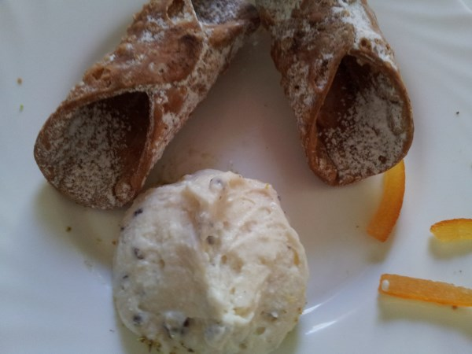
INGREDIENTS for the filling:
500g of cattle ricotta
500g of sheep ricotta
350g of sugar
1 berry of vanilla
Drops of dark chocolate
Orange’s skin

Slide 7
To make the filling:
First let the ricotta sit in a strainer over a small bowl in the refrigerator for 30 minutes to remove excess water.
Mix the ricotta with the rest of the ingredients. Chill in the refrigerator for at least 30 minutes.
Fill each cannoli shell carefully, and spinkle with a little extra powdered sugar if desired. Chill until you are ready to serve.

