Slide 1
Su Coccu, Sardinian amulet against the evil eye
Notes:
12/8/19
1
1

Slide 2
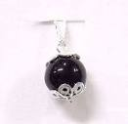
Symbology
Among the Sardinian amulets against the evil eye, the most widespread is certainly Su Coccu.
It symbolizes the good eye that is opposed to the bad one.
Notes:
12/8/19
2
2

Slide 3
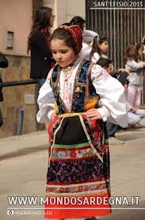
A sacred object
Su Coccu is a stone considered sacred.
It is often set in the most precious family jewels and passed down from mother to daughter.
Notes:
12/8/19
3
3

Slide 4
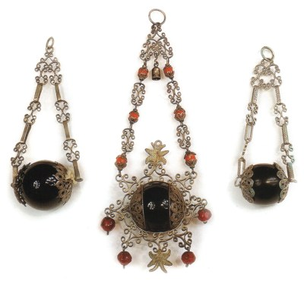
material and form
It consists of a smooth stone, traditionally black (onyx, obsidian) with a rounded shape, perforated for the passage of the support that holds the two side covers in foil or silver filigree. Very often the stone is supported by two chains of suspension.
Notes:
12/8/19
4
4

Slide 5
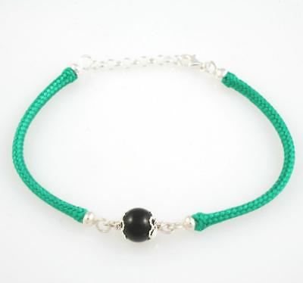
with the green ribbon… against the evil eye
In popular beliefs it is used against the evil eye, especially to protect children, to which it is worn on the wrist associated with a green ribbon or pinned in the cradles of babies.
Notes:
12/8/19
5
5

Slide 6
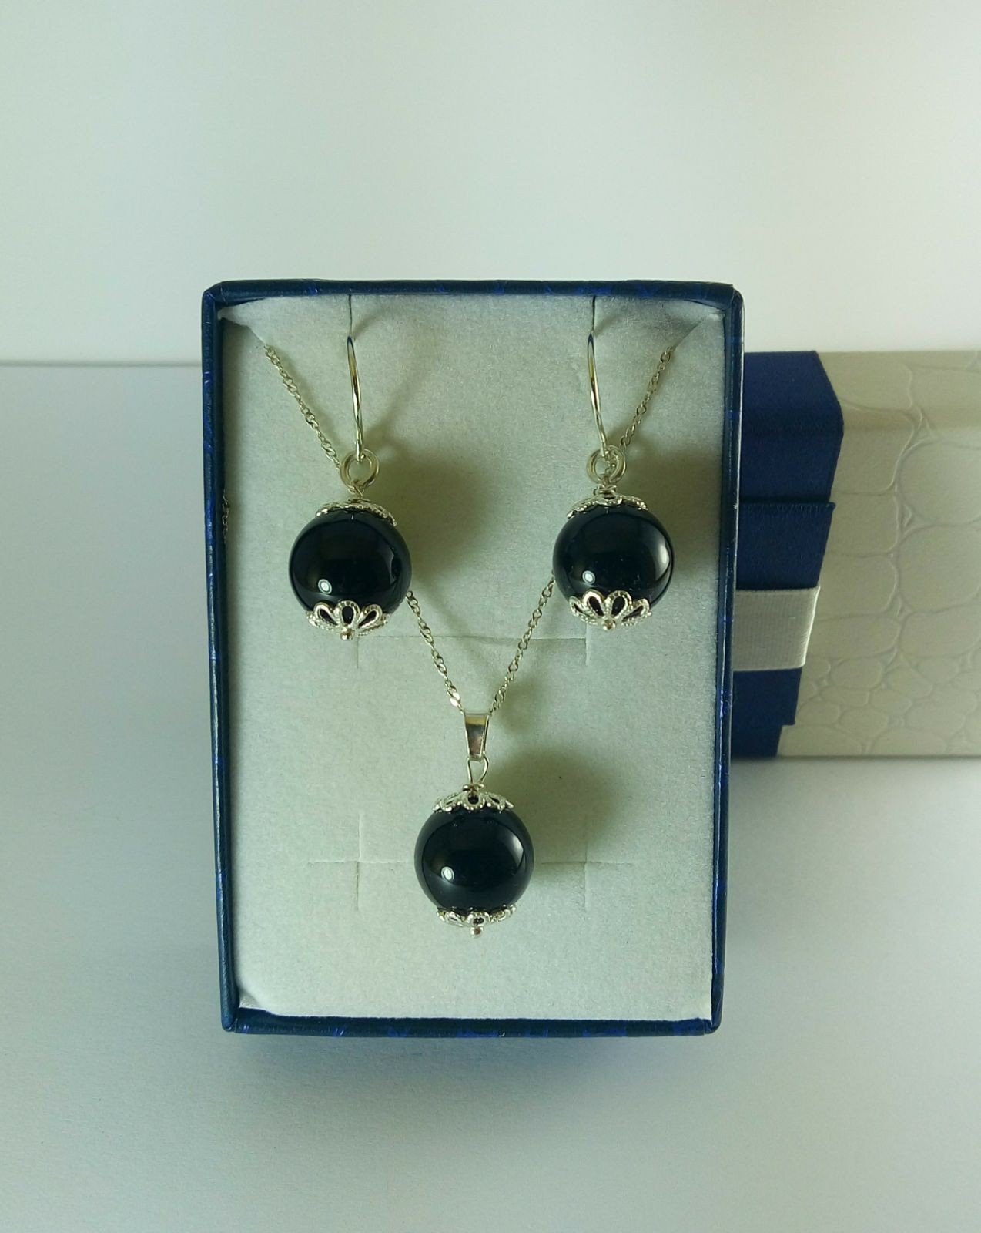
A gift
To ensure that the protection of the Coccu is effective, it must be received as a gift. Often it is the godparents who donate a jewel-amulet to their godson.
Notes:
12/8/19
6
6

Slide 7
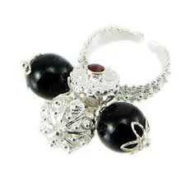
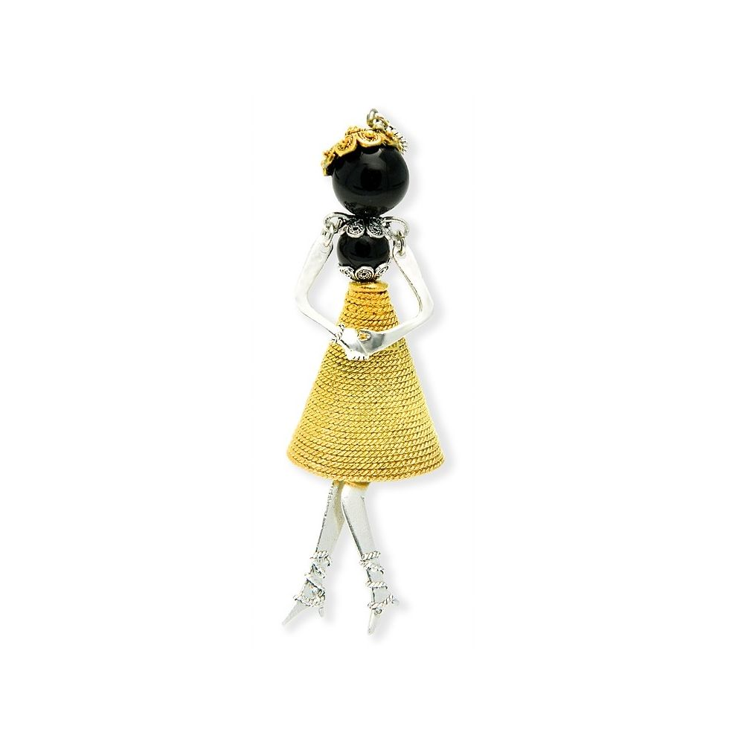
Su coccu today
Today the artisan production offers different models of jewelery containing Su Coccu. To wear for the beauty of the object, but also as a lucky charm.
Notes:
12/8/19
7
7

