Slide 1
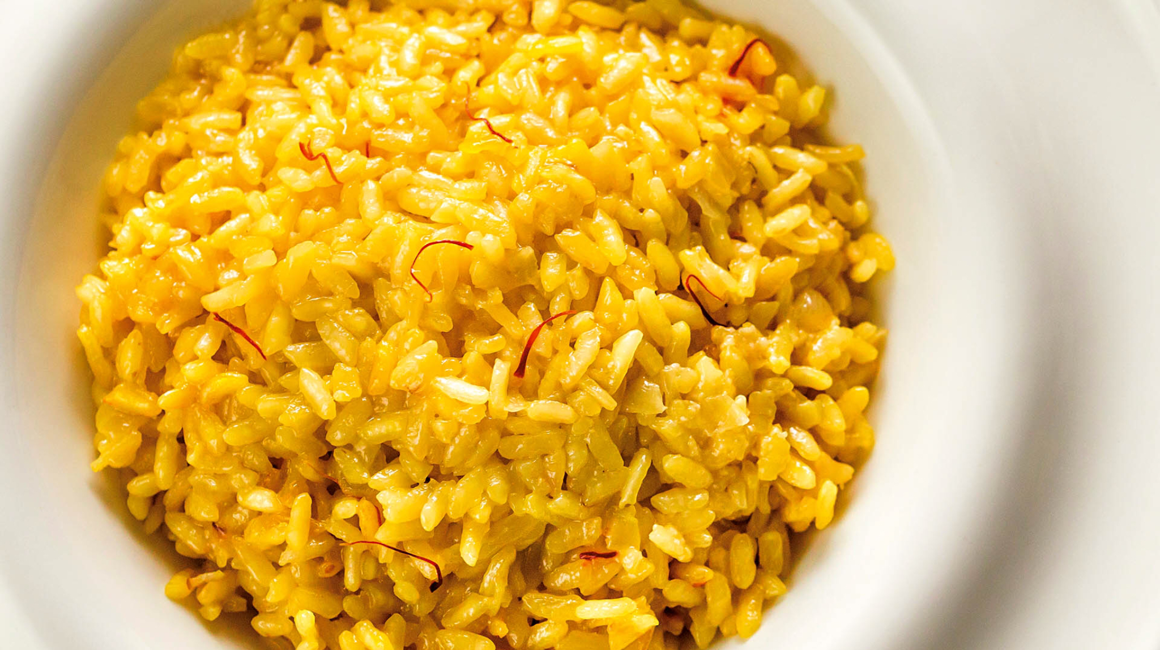
Il risotto alla milanese

Slide 2
Story
The Milanese risotto was born in 1574 at the table of the Belgian glassmaker Valerio of Fiandra, who at the time lived in Milan because he was working on the stained glass windows of Milan Cathedral. For his daughter's wedding, his glassmakers added to a white saffron butter risotto: this spice was in fact used by glassmakers to obtain a particular yellow colour. The new dish was immediately successful, both for its taste and for its yellow shade, which recalled gold, synonymous with wealth. Saffron has also recognized pharmacological properties and therefore the yellow risotto soon spread from tavern to tavern.

Slide 3
Ingredients
- Saffron : a pinch
- bone marrow: 40-50g
- Carnaroli rice: 320 g
- Butter: 125 g
- Onions: 1
- Grana padano DOP to be grated: 80 g
- White wine: 40 g
- Water q.b.
- Vegetable Broth: 1 l
- Salt

Slide 4
Procedure
Make a soffritto by sautéing the onion and marrow in the butter. When the marrow has melted and the onion is well wilted, add the rice and let it ‘toast’ in the soffritto without browning. Add a splash of white wine and let it evaporate.
Proceed with the risotto in the usual way. While the rice is simmering, take your saffron and simmer it very gently with a ladleful of broth so it releases its flavor and color into the broth. Then, either about halfway through the cooking process, or if you prefer a more assertive flavor, about 5 minutes before the rice is done, add the saffron and its broth into the risotto. Continue to cook as usual.
Risotto alla milanese is usually served all’onda, which is to say, rather more loose than firm, so begin the final enrichment, called the « mantecatura” in Italian, while the rice is stlll fairly brothy. Add the cheese and, if you like, a dab of butter for extra richness to the rice, then stir to toss the rice around vigorously for about two minutes. If you like your risotto a bit firmer, let it sit, covered, for a minute or two before serving.

