Slide 1
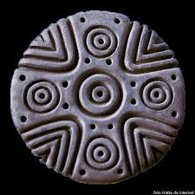
La pintadera
E caratterizzata da un disegno geometrico usato come stampo o timbro per decorare il corpo, il pane o i tessuti.
What is that?
The pintadera is a circular ceramic
or terracotta archaeological find
and it is characterized by a
geometric design.

Slide 2
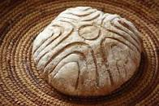
What was it for?
Was used as a
mold or stamp to
decorate the body,
bread or fabrics.

Slide 3
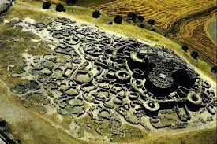
Where was it found?
It is typical of different
prehistoric cultures, it can be found in the Canary Islands,
in the Nuragic civilization in Sardinia, of the culture of
mouth jars square in Northern Italy
and the protopalafitte of Bad Buchau

Slide 4
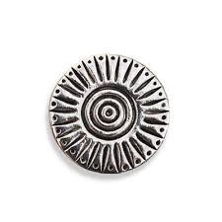
What age are you dating? A period of time ranging from the Bronze Age (from 1700 BC) to the 2nd century BC

Slide 5
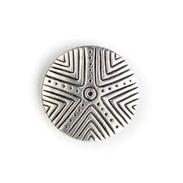
What size do they reach? Known specimens reach a diameter not exceeding 10 cm

Slide 6
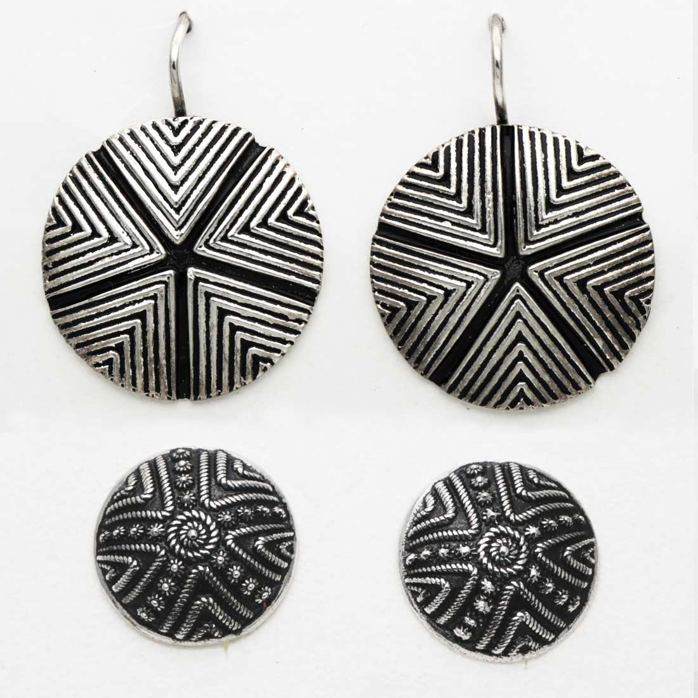
Current use
It is currently used as a model
in the reproduction of jewelry

