Slide 1
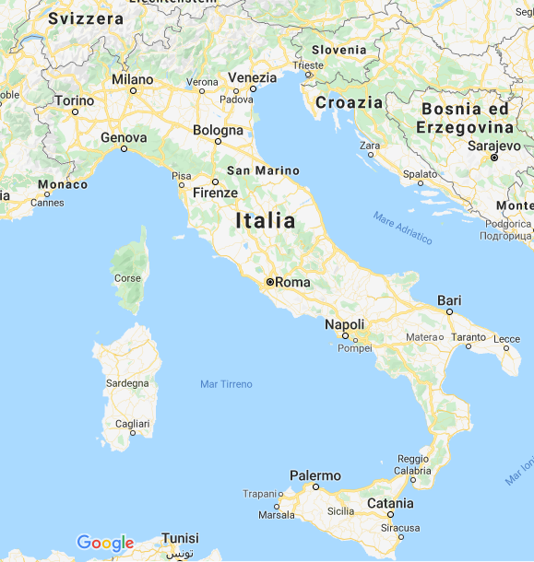

Slide 2
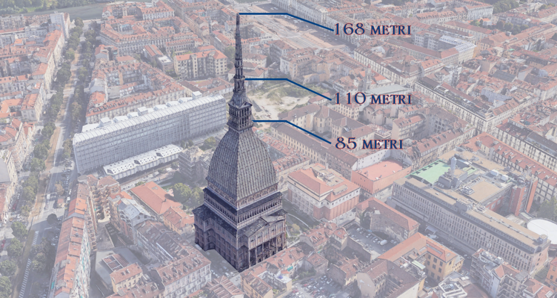
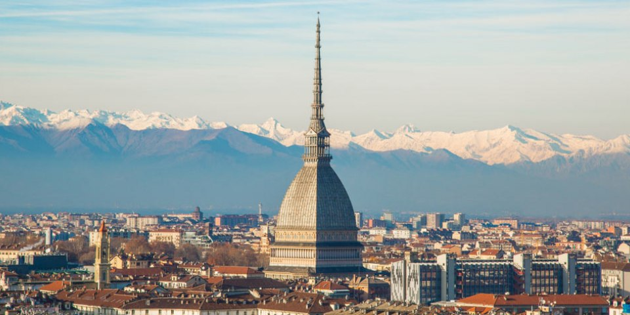
THE MOLE ANTONELLIANA
An architectural landmark of the city of Turin, it was initially conceived as a synagogue, before being bought by the Municipality of Turin a. Planned and begun by architect Alessandro Antonelli in 1863, it was only completed in 1889. With a height of 167.5 metres, it was the tallest brick building in Europe. The panoramic lift was inaugurated in 1961 and it was renovated in 1999. Today it still allows visitors to go up to the panoramic terrace which is 85 metres high and take in the amazing views of the city and the surrounding Alps.

Slide 3
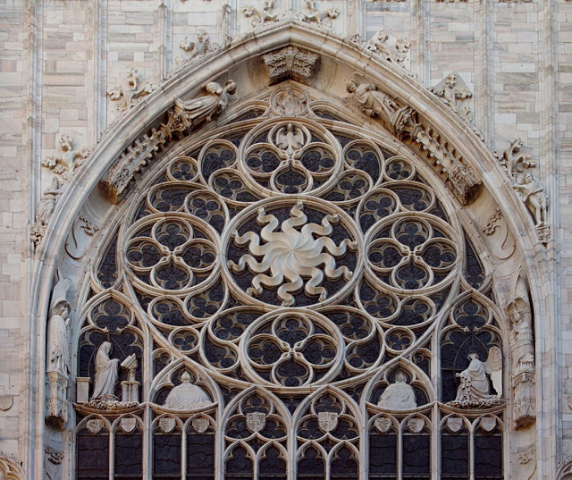
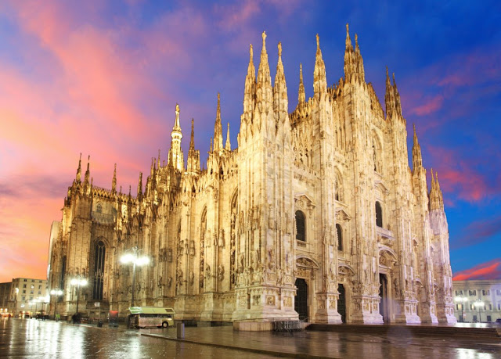
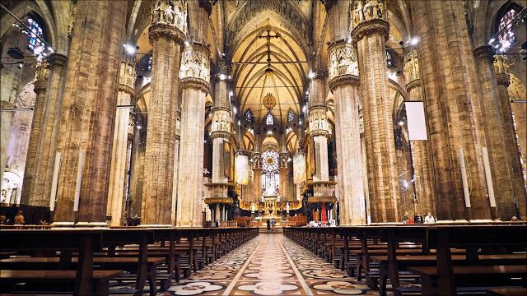
DUOMO DI MILANO - CATHEDRAL
The construction of the Duomo di Milano initiated in 1386. It is the largest and most complex Gothic building in Italy, made of pink-veined white marble from. It is 157 metres in length and covers an area of 11,700 m2. The highest spire measures 108.5 and, in October 1774, the golden 4,16 metre-high statue of the Madonna was placed on its pinnacle. The construction works were prolonged over five centuries and, during this extensive period, local and European architects, sculptors, artists and workers all proceeded in turn to work in the Fabbrica del Duomo. The result of all their labour is a unique style of architecture, a fusion of European Gothic style and Lombard tradition.

Slide 4
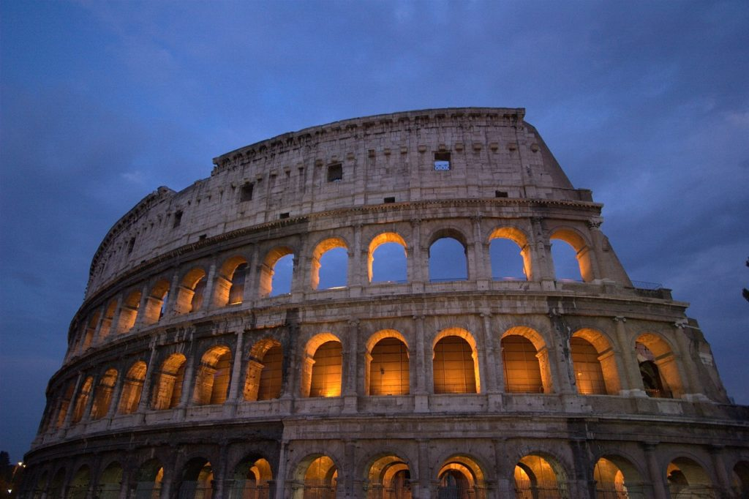
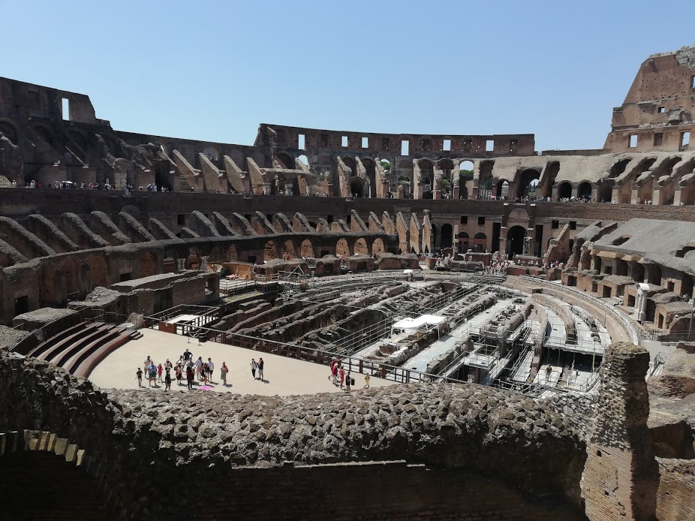
The Colosseum
The Colosseum, originally known as Amphitheatrum Flavium (Flavian Amphitheater) is the largest amphitheater in the world, located in the center of the city of Rome. Able to contain between 50,000 and 75,000 spectators, it is the most important Roman amphitheater, and the most impressive monument of ancient Rome. Its construction was started by Vespasian in 72 AD and inaugurated by Tito in 80, with further modifications made during the empire of Domitian in 90. The building forms an ellipse. In ancient times it was used for gladiatorial shows and other public events (hunting shows, re-enactments of famous battles, and dramas based on classical mythology)

Slide 5
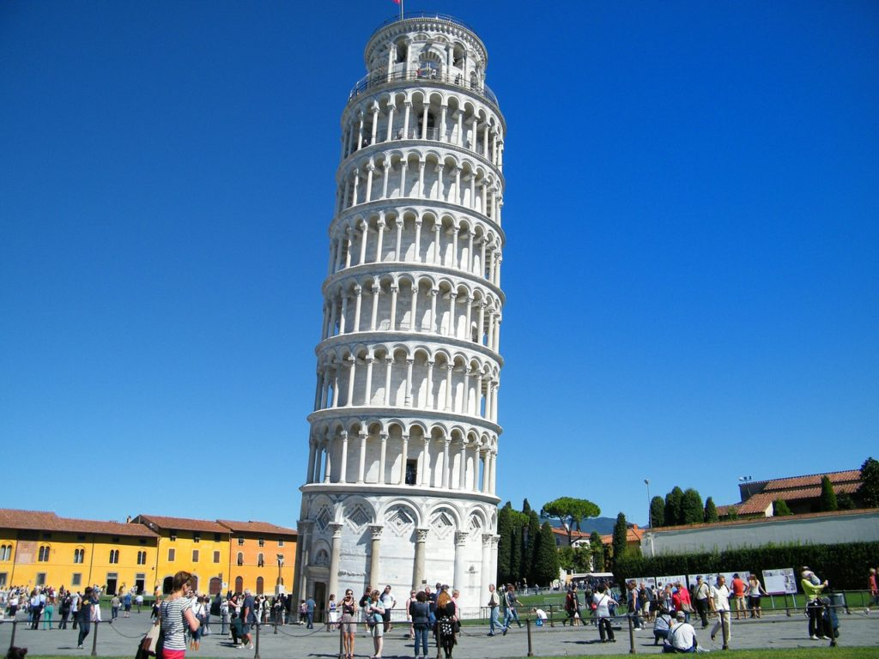
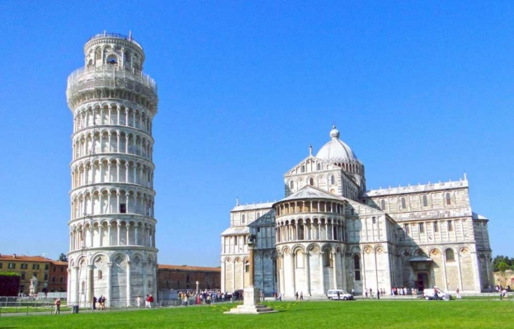
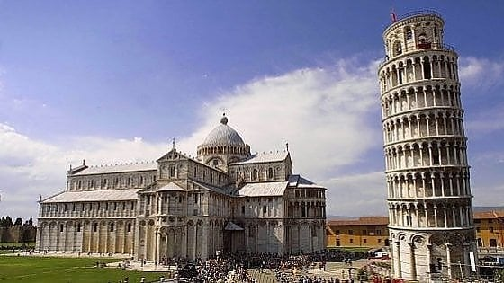
The Leaning Tower of Pisa
Pisa is a city in Tuscany especially known for its famous eight-floor-leaning Tower dating back to the 14th century. On the upper floor there are bells.
When it was completed in 1372 it was already off axis. The 56-meter-high white marble cylinder is the bell tower of the marble Romanesque cathedral that stands next to it in Piazza dei Miracoli dedicated to Saint Mary of the Assumption.

Slide 6
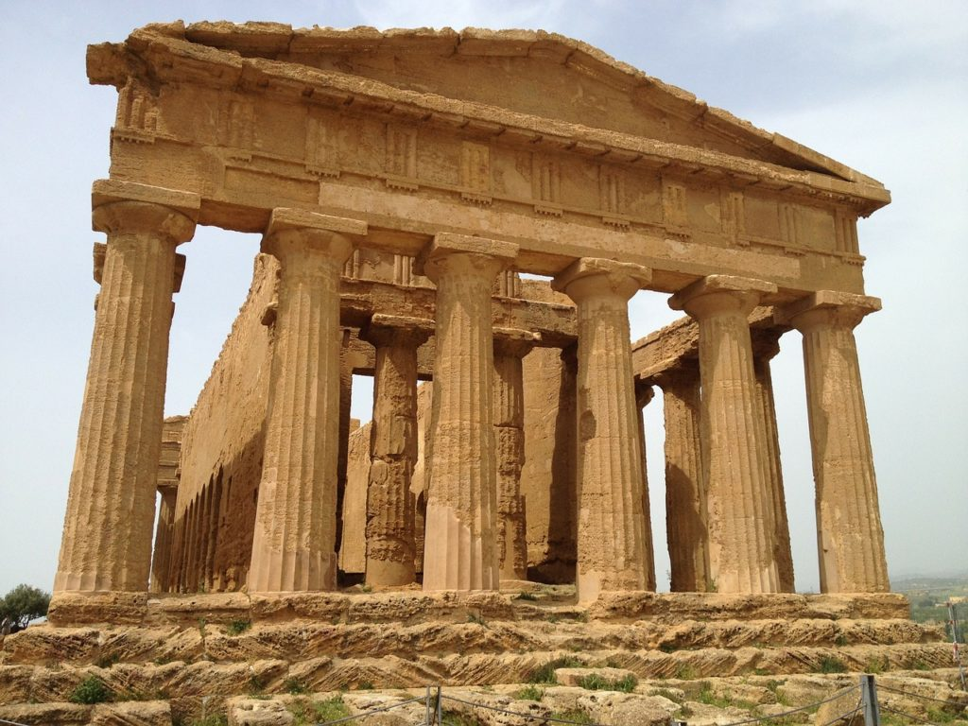
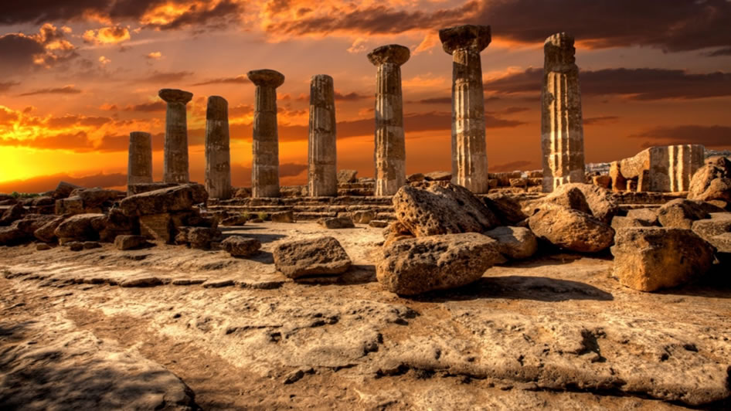
VALLEY OF THE TEMPLES IN AGRIGENTO
Agrigento is a hill town on the south-western coast of Sicily and in its province is the famous Valley of the Temples, an extensive archaeological area, which represents the maximum expression of classical Greek civilization, characterized by its exceptional state of conservation and important Doric temples from the Hellenic period.
It corresponds to the ancient Akragas, a monumental original nucleus of Agrigento. Today, the Valley is a regional archaeological park.

Slide 7
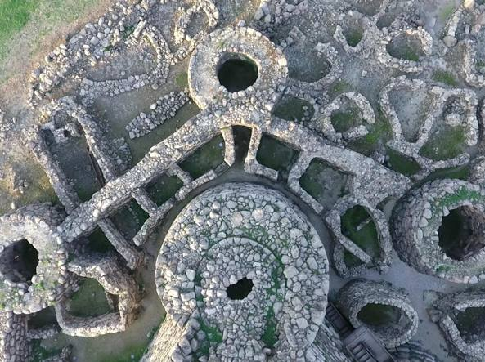
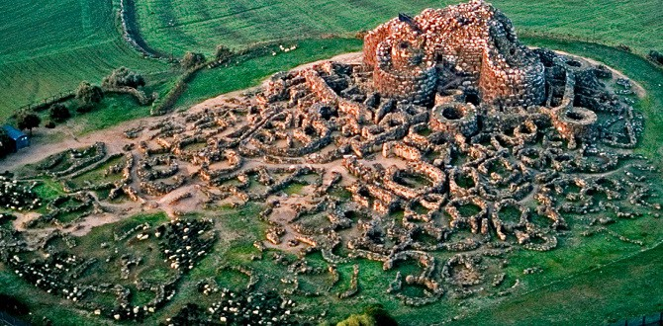
The Nuraghe
The ‘nuraghi’ represent Sardinia’s greatest – and most mysterious - archeological treasure: 8,000 ancient megalithic buildings found nowhere else in the world.
The Nuragic civilization began in the Bronze Age (1800 BC), as the evolution of pre-existing cultures present on the island of Sardinia since Neolithic times. The Nuragic civilization takes its name from the nuraghi, circular defensive towers-fortresses in the form of truncated cones built of dressed stone. Most of them were built on high ground, near the villages, and had defensive and military functions. Some reach a height of 22 meters, others were structured as interconnected towers, making them imposing fortresses. In Sardinia There are about 7 thousand nuraghi.

Slide 8
DOMUS DE JANAS
Domus de Janas - ‘Houses of Fairies’ - are usually artificial caves dug into rocky blocks and used as prehistoric burial sites. They consist of several chambers resembling houses in their layout. Many domus de janas can be found throughout the island, with the exception of Gallura (where the deceased were usually buried in megalithic circles). The shape of the internal chambers can vary from that of a rounded hut with conical or triangular ceiling. The walls are often decorated with reliefs or etchings depicting magical and religious symbols such as spirals, zig-zag motifs and bull’s horns. The corpses, painted with red ochre like the tomb's walls, were buried together with common life objects, jewels and tools. According to archaeologist Giovanni Lilliu, they were buried under shells of molluscs; according to other theories, they were left outside the tomb, being put inside only after they had reduced to a skeleton.

Slide 9
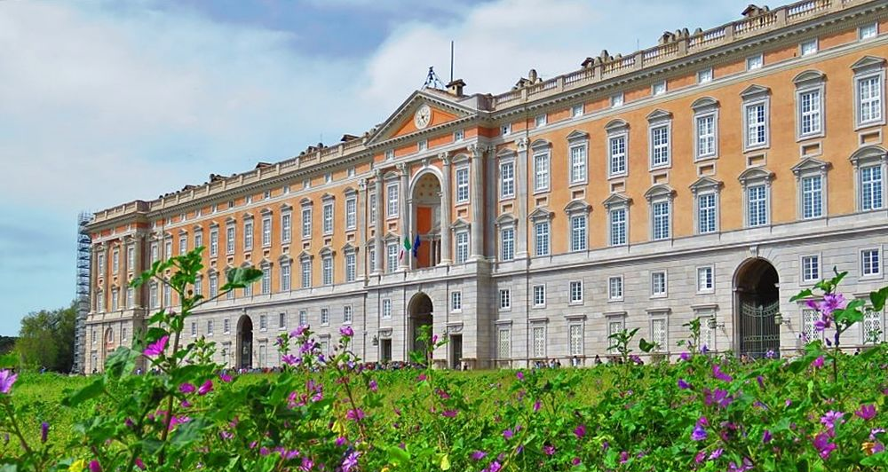
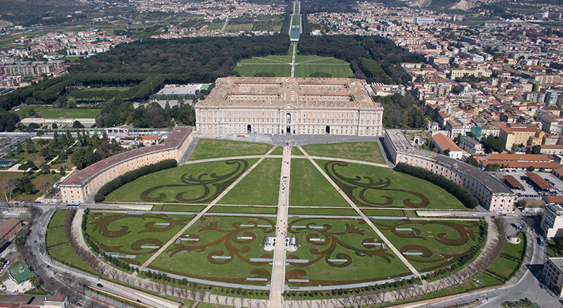
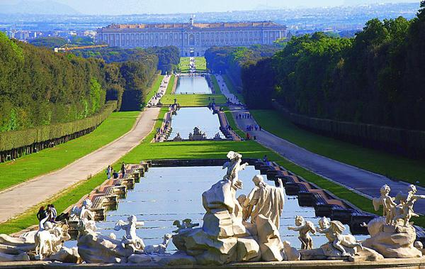
THE ROYAL PALACE OF CASERTA
The Royal Palace of Caserta (Italian:Reggia di Caserta is a former royal residence in Caserta, southern Italy, constructed by theHouse of Bourbon-Twoo Sicilies as their main residence as kings of Naples.
It is one of the largest palaces erected in Europe during the 18th century. In 1997, the palace was designated aUNESCO World Heritage Site. The Royal Palace of Caserta is one of the largest royal residences in the world covering an area of 47,000 m2.

Slide 10
GIANT’S TOMB
Giants' tomb is the name given by local people and archeologists to a type of Sardinian megalithic gallery grave built during the Bronze Age by the Nuragic civilisation. They were collective tombs and can be found throughout Sardinia, with 800 being discovered there.
A stone cairn lies over the burial chambers, with some examples having a cup-shaped entrance similar to the court cairn tombs of Ireland.

Slide 11
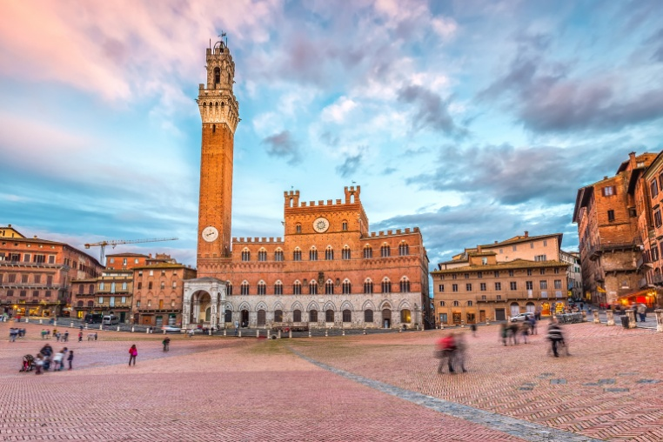
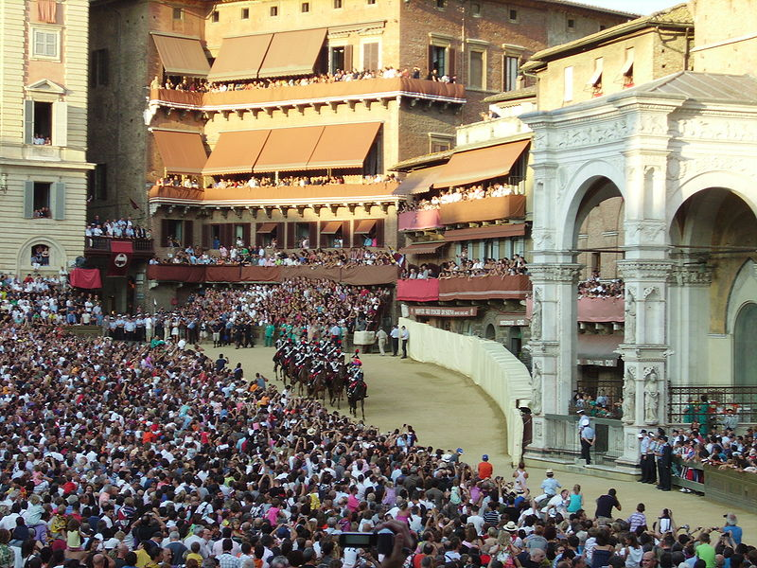
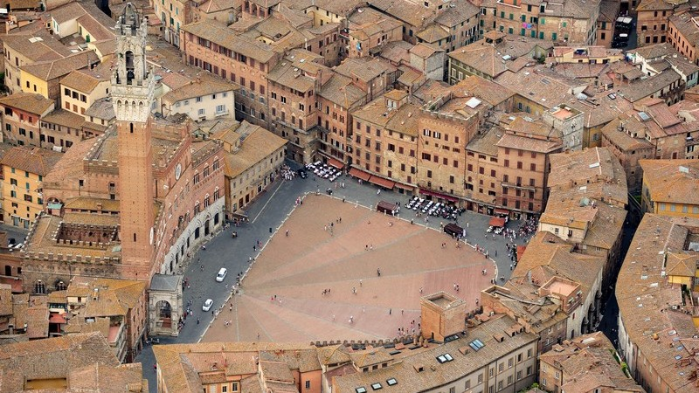
THE CAMPO IN SIENA
Piazza del Campo (or simply the Campo) is the main square of the city of Siena. Unique for its particular and original shell shape, it is renowned throughout the world for its beauty and architectural integrity, as well as for being the place where the Palio di Siena takes place twice a year.

Slide 12
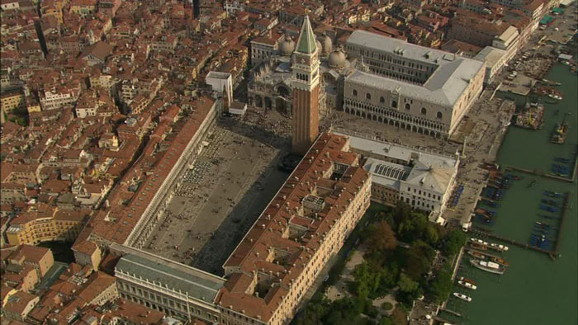
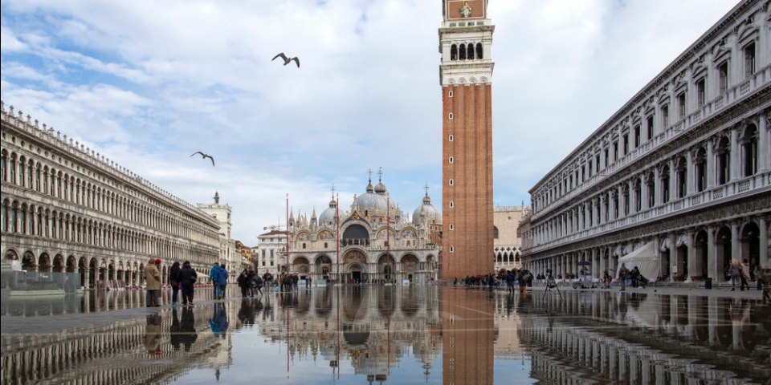
ST MARK’S SQUARE IN VENEZIA
St Mark’s square, located in Venice, is one of the most important Italian squares, named all over the world for its beauty and architectural integrity. Its main body has a trapezoidal shape and is 170 meters long. It is also known as "the square" or "the living room of Europe". At its center, surrounded by magnificent buildings such as the Basilica of San Marco, the Palazzo Ducale and the Procuratie, stands the imposing bell tower.
Originally the square was crossed by a canal and was an area destined for cultivation. In 1174 the canal was buried and in 1267 the square was finally paved. From that moment on it formed the religious, political and social center of Venice.

Slide 13
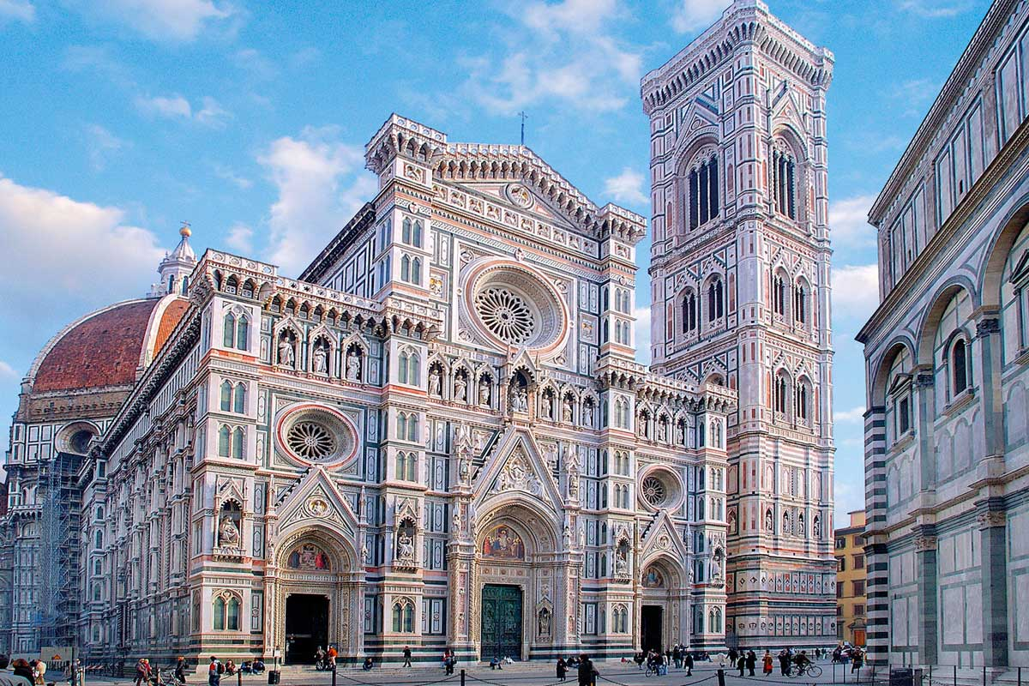
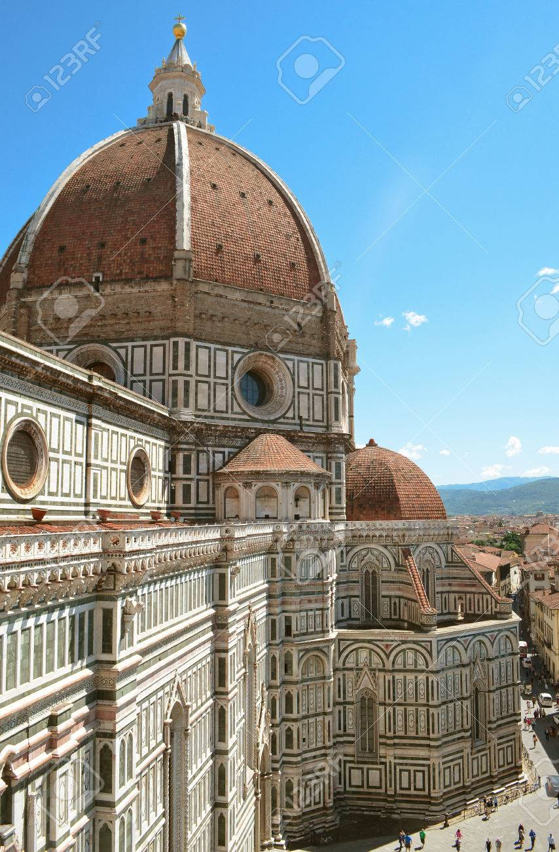
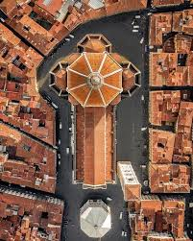
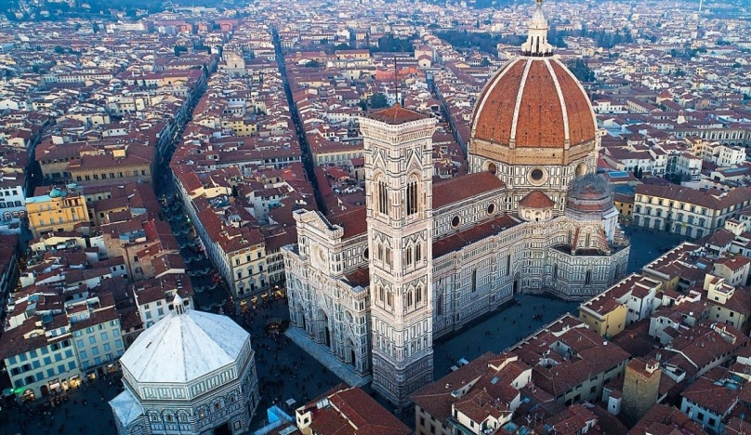
FLORENCE CATHEDRAL
Florence Cathedral (formally the Cattedrale di Santa Maria del Fiore), is the cathedra of Florence , Italy. It was begun in 1296 in the Gothic style and was completed by 1436, with the dome designed by Filippo Brunelleschi. The exterior of the basilica is faced with polychrome marble panels in green and pink.

Slide 14
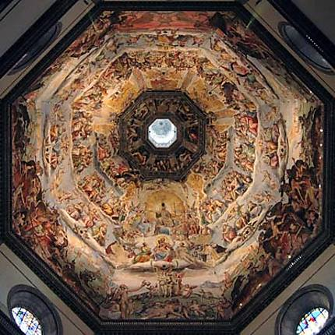
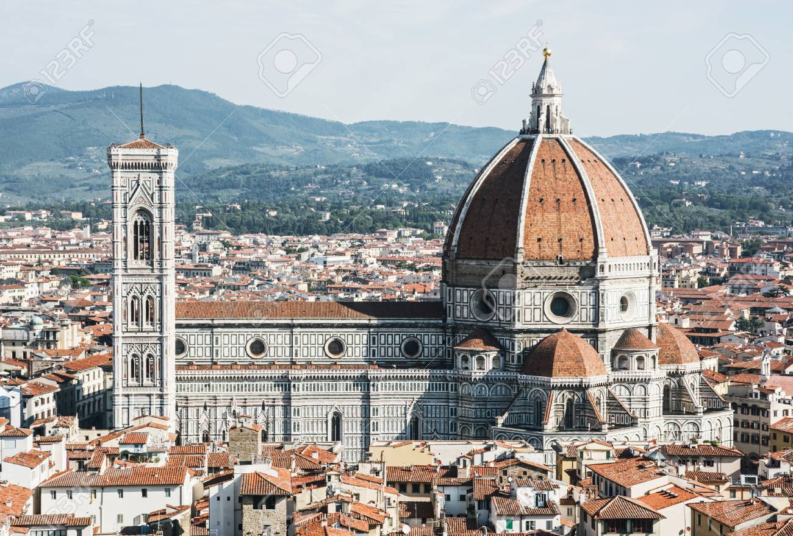
CUPOLA DEL BRUNELLESCHI
The cathedral complex, includes the Baptistery and Giotto’s Campanile. These three buildings are part of the UNESCO World Heritage Site covering the historic centre of Florence and are a major tourist attraction of Tuscany.

