Slide 1
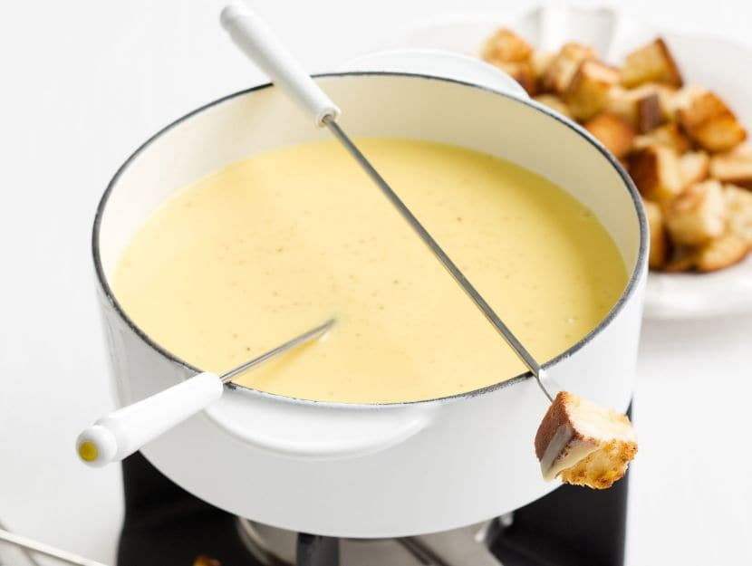
THE FONDUE
By:
Alessandro
Andrea
Giada
Irene
Sara

Slide 2
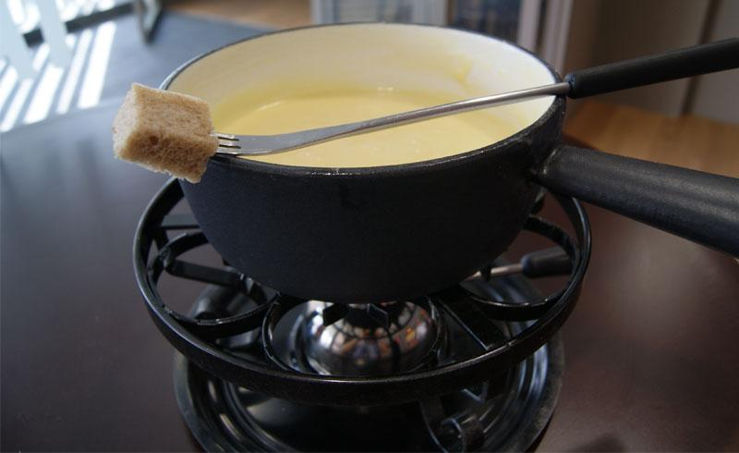
The fondue is an Italian dish from Veneto and it is a complete food. To prepare the fondue, you need good Fontina PDO, seasoned to perfection along with milk and fresh eggs. To ensure the success of the recipe, you have to pay special attention to the preparation and cooking time. In the tradition, this dish is served as a hot appetizer or "entrée" after the first course and before the meat.

Slide 3
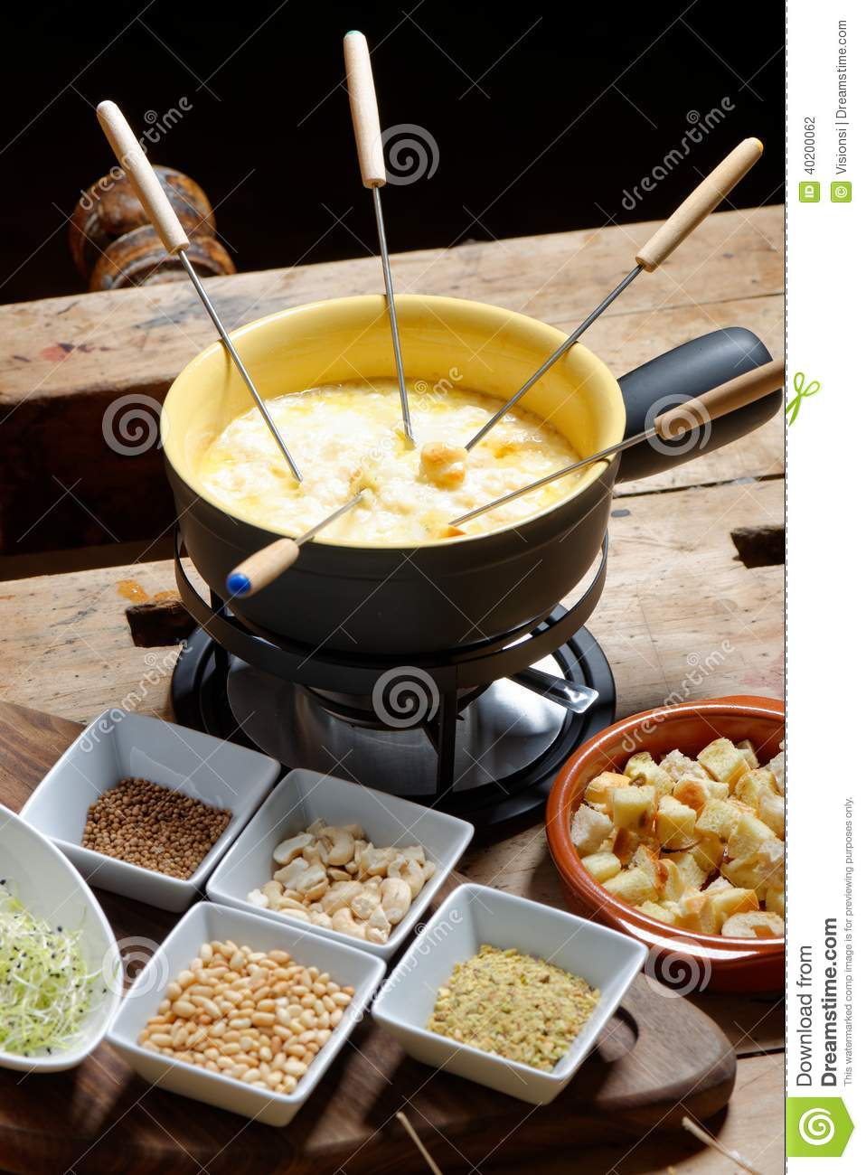
INGREDIENTS:
300 gr of Italian cheese (fontina) DOP
1.5 dl of whole milk
50 gr of butter
4 egg yolks
salt enough
4 slices of bread
white pepper enough

Slide 4
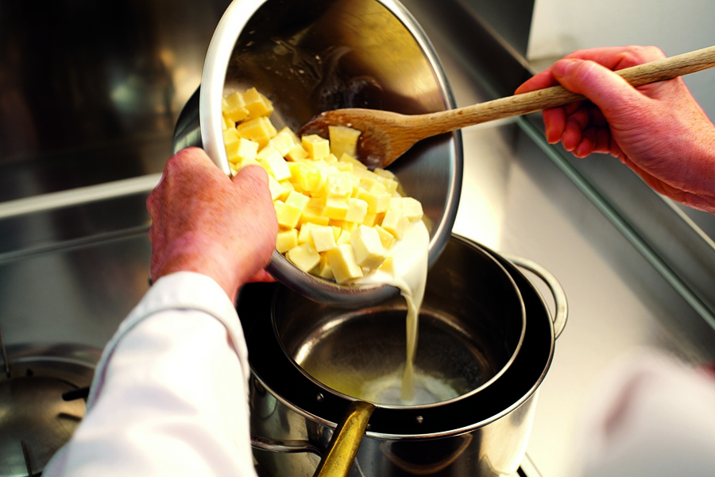
Method
Cut the fontina into thin slices and put it to soak for at least 2 hours in a pan with milk.
After two hours, place the pan on low heat and, after adding the butter, mix everything continuously with a metal whisk or wooden spoon, until the cheese is completely melted.
Then add the egg yolks and continue to cook, stirring for at least another 30 minutes until the mixture is smooth and fairly thick, but not too much.
Turn the fire off and serve the fondue in the special container with stove or, alternatively, in a crock previously warmed in the oven to make sure that the fondue remains warm and therefore still very thick.

