Slide 1
The masks of Barbagia
1
Notes:
1

Slide 2
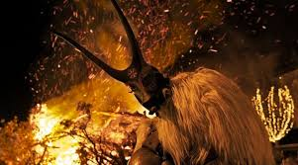
Notes:
2

Slide 3
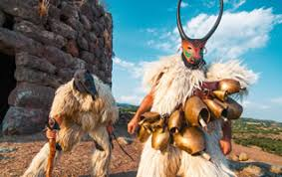
Among the most characteristic masks we recall the Boes and Merdules by Ottana.
3
Notes:
3

Slide 4
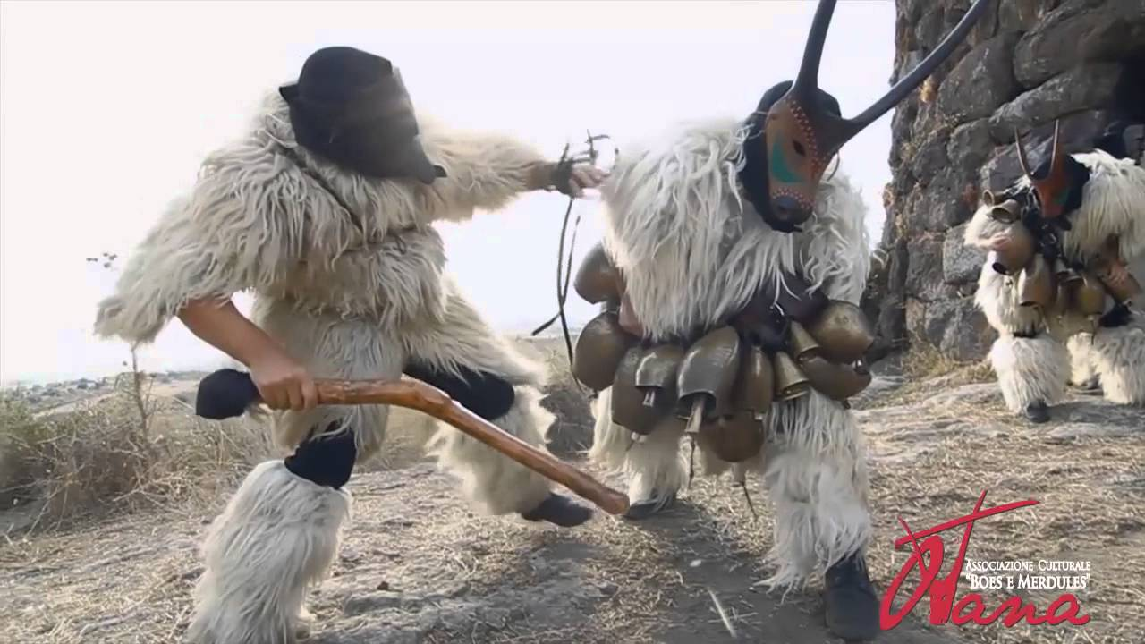
"BOES AND MERDULES" they are typical masks of the carnival of Ottana, a small town in the province of Nuoro.
4
Notes:
4

Slide 5
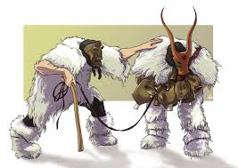
The "Boes and Merdules" represent an ox and his master. They summarize what was once life in the small town, when having a yoke of oxen meant being wealthy.
5
Notes:
5

Slide 6
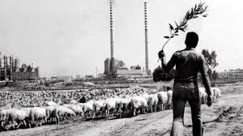
This until the beginning of the seventies, when in the vicinity of the village, a petrochemical industry arose that radically changed both its uses and customs.
6
Notes:
6

Slide 7
The Carnival
The radical change in the way of life has not, however, affected the tradition of the wooden masks of the "Boes and Merdules".
Therefore during the whole carnival period, the streets of the town are crossed by various groups of Merdules, both organized and spontaneous, which make their heavy load of bells intertwined on large leather straps resound, rhythmically shaking them throughout the day until evening.
7
Notes:
7

Slide 8
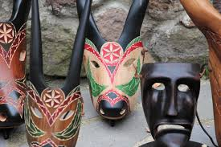
To make the masks, the wood of the wild pear is mainly used for its lightness and the almost lack of veins and knots.
8
Notes:
8

Slide 9
The meaning of the masks
The star that is carved on the forehead of the "BOE" was a good omen while for the figure of the shepherd "SU MERDULE" also called "SU GOBBEDDU" (the hunchback) it tended to make it as ugly and deformed as possible in order to be frightening even to the devil and so to avert the misfortunes of life.
9
Notes:
9

Slide 10
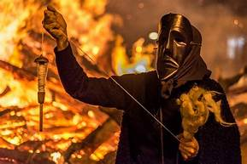
Always present in the fashion shows is the "FILONZANA" mask.
10
Notes:
10

Slide 11
What does it represent?
It depicts a mournful old woman, also humped, who goes around the streets of the town dressed all in black.
She is always intent on spinning the wool and threatens to cut the thread hanging from the distaff, if not offered to drink.
11
Notes:
11

Slide 12
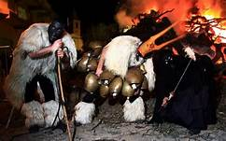
But after the narrow escape one returns to the fun
12
Notes:
12

Slide 13
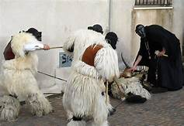
The wool thread represents the life of those in front of it
13
Notes:
13

