Slide 1
The symbols of the Sardinian artisan: la pavoncella
Sardinia boasts a large number of symbols, some of which are reproduced in ceramics, in textiles furniture and even jewelry.
1
Notes:
12/9/19
1
1

Slide 2
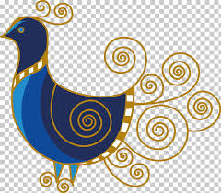
LA PAVONCELLA
2
Notes:
12/9/19
2
2

Slide 3
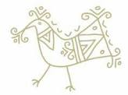
The origins As reported by various sources, its origin is to be found in ancient times, it is thought to have arrived in Sardinia with the Byzantines who dominated the island from 534 d.C.
3
Notes:
12/9/19
3
3

Slide 4
The meaning
4
Notes:
12/9/19
4
4

Slide 5
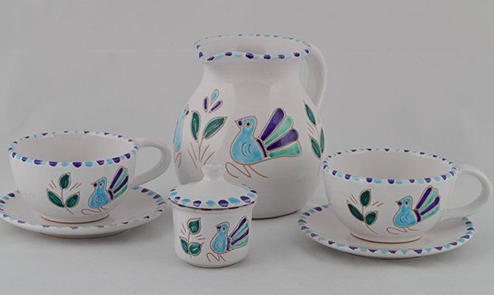
We find it represented in ceramic
5
Notes:
12/9/19
5
5

Slide 6
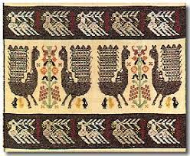
...in textile
6
Notes:
12/9/19
6
6

Slide 7
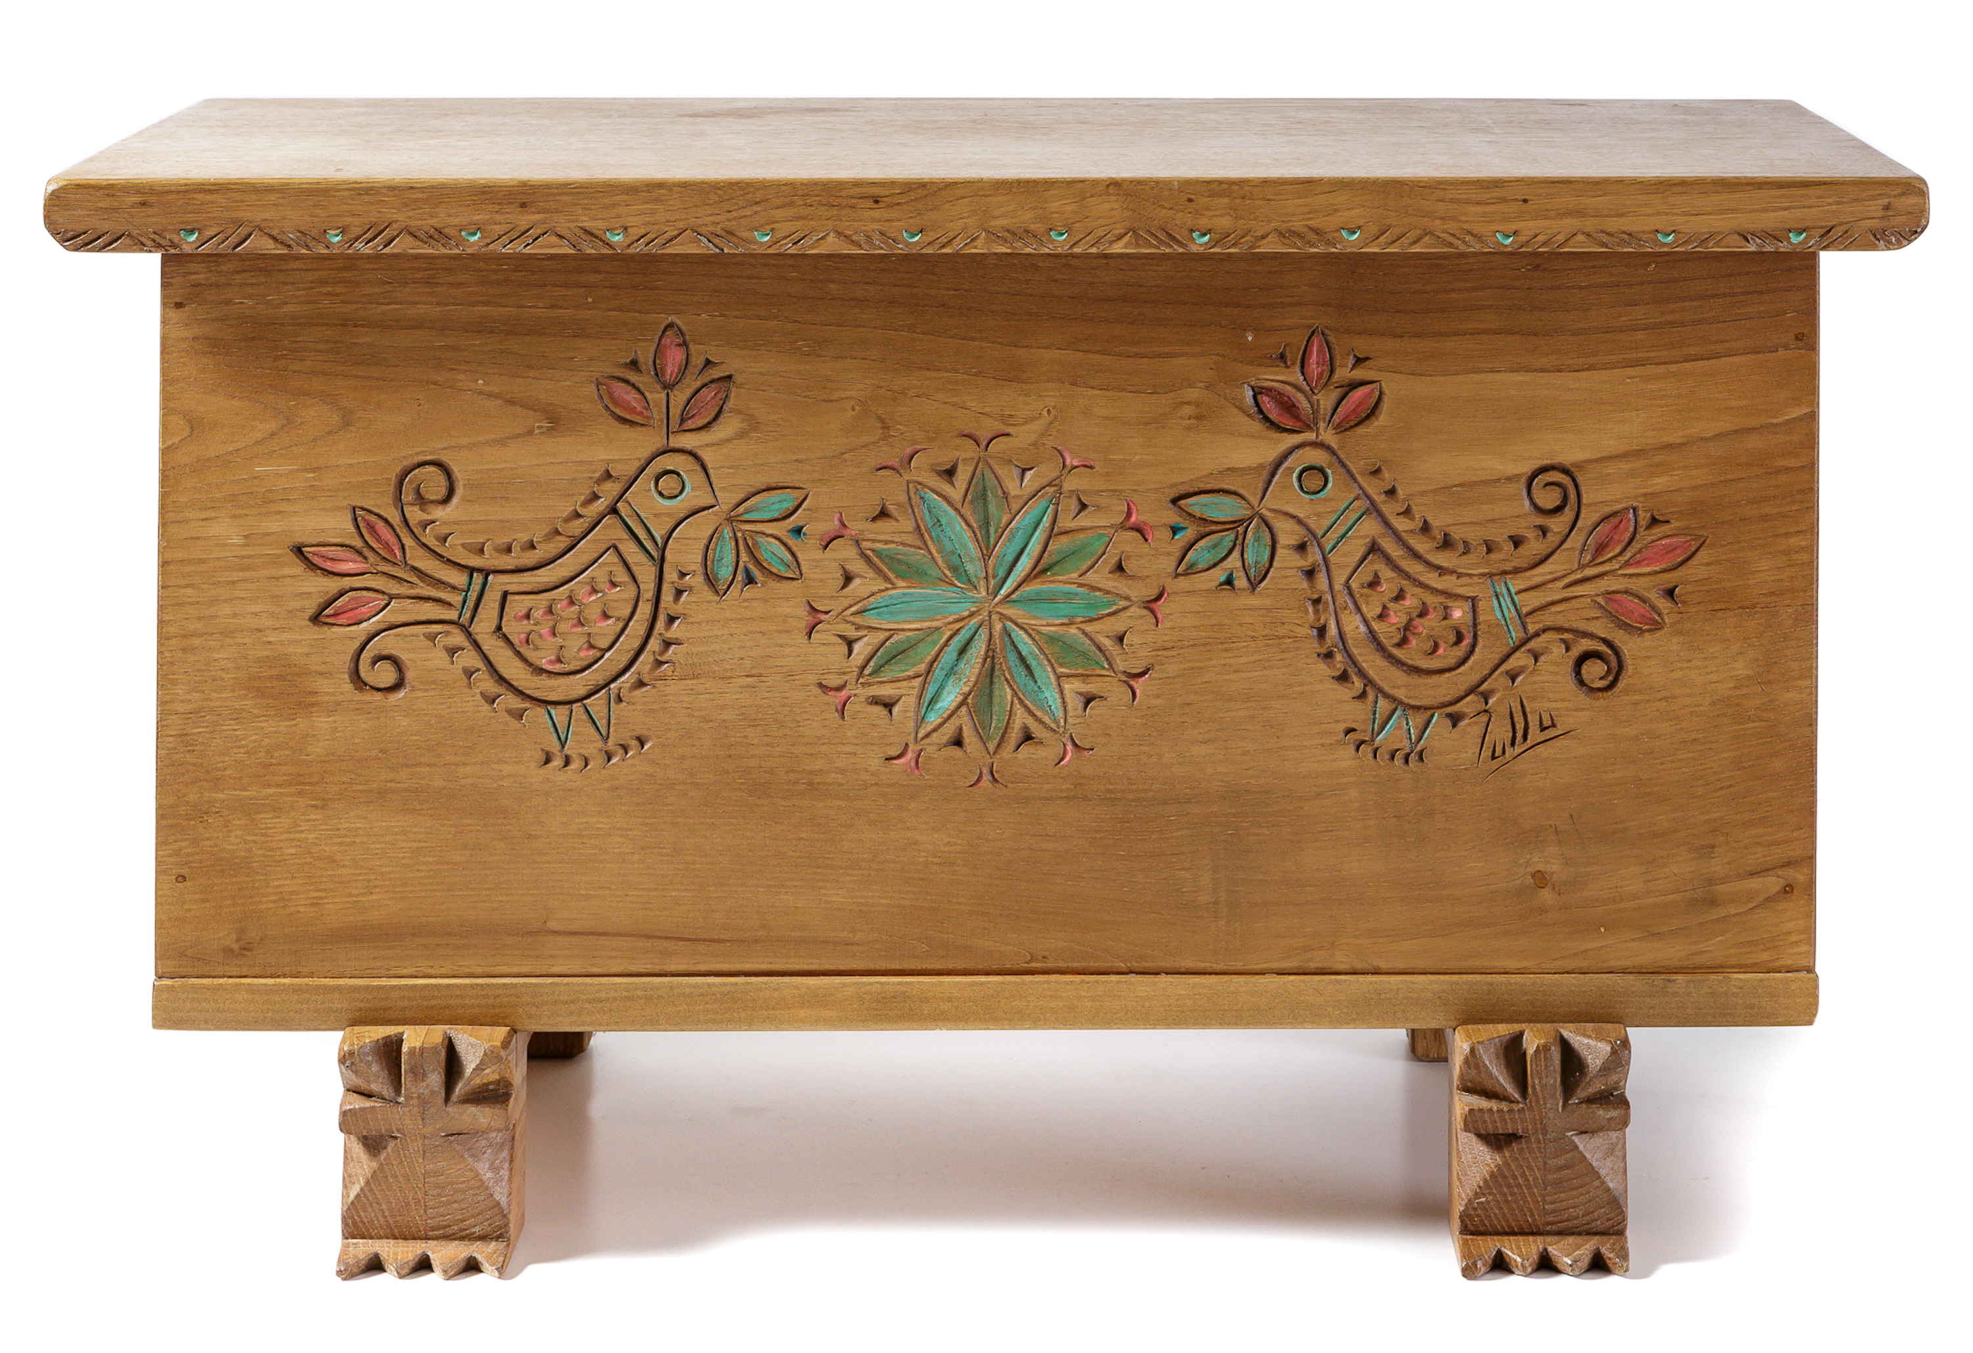
...in chests
7
Notes:
12/9/19
7
7

Slide 8
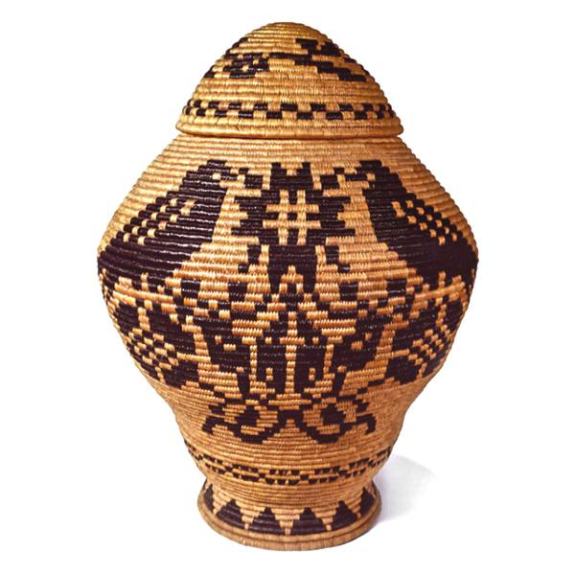
in the baskets
8
Notes:
12/9/19
8
8

Slide 9
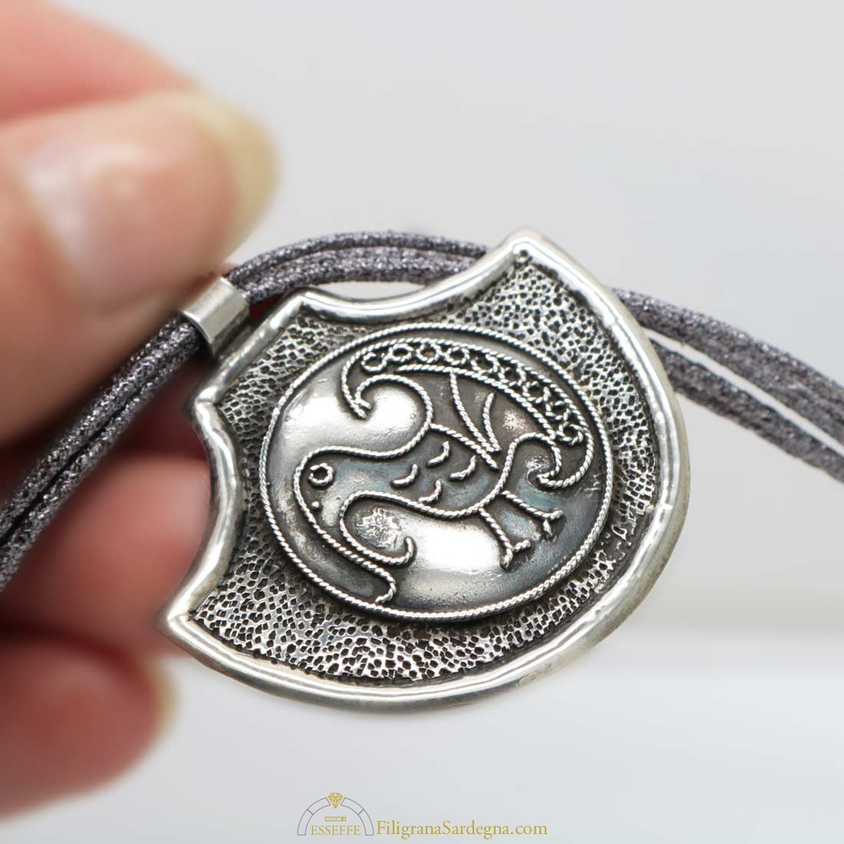
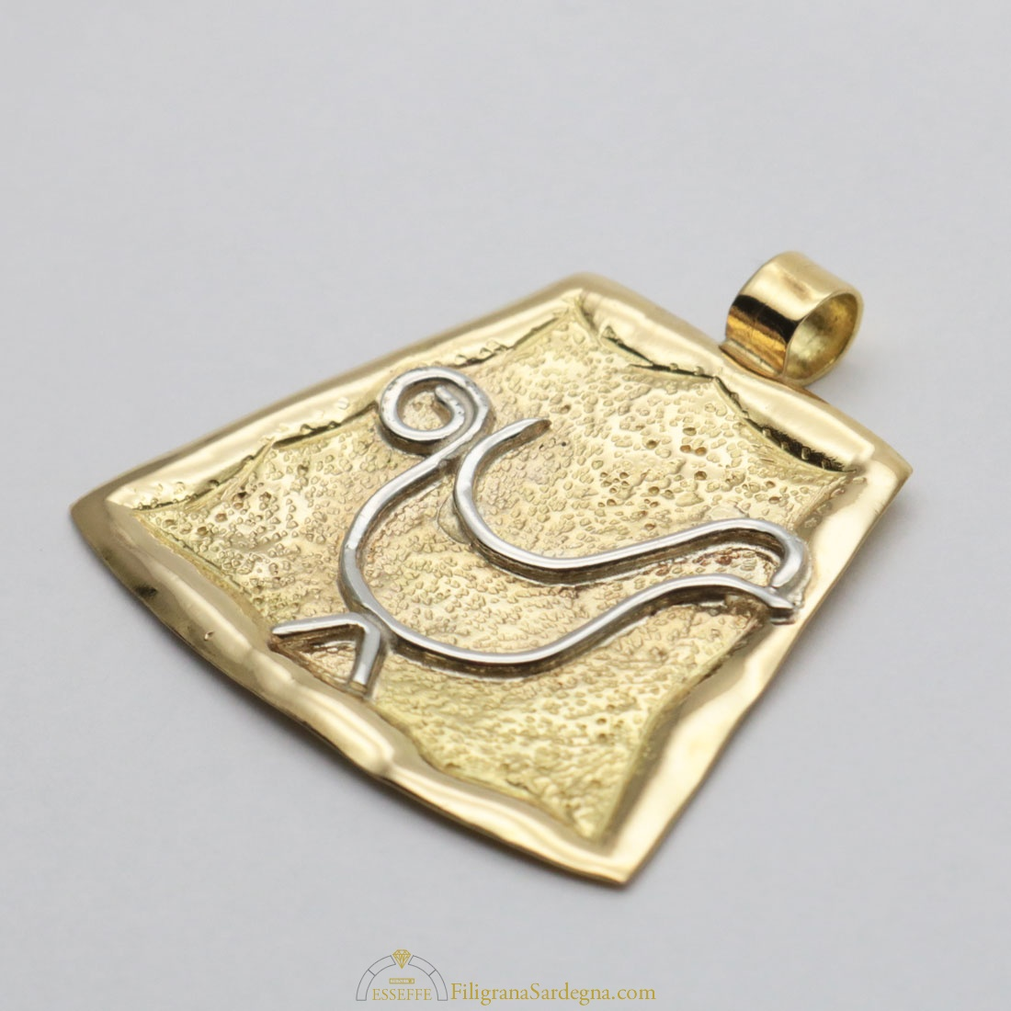
...in jewels
9
Notes:
12/9/19
9
9

