Slide 1
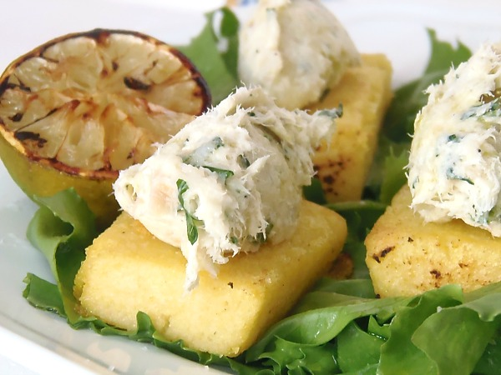
COD WITH POLENTA

Slide 2
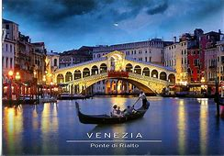
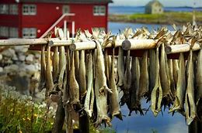
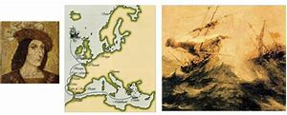
INTRODUCTION
Cod with polenta is a typical Venetian dish.
Back in the days (1432) when the Venetian
Republic was a major European trading hub, huge amounts of preserved fish found
their way from the icy north to the city in the lagoon.

Slide 3
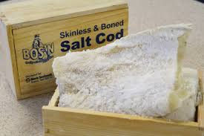
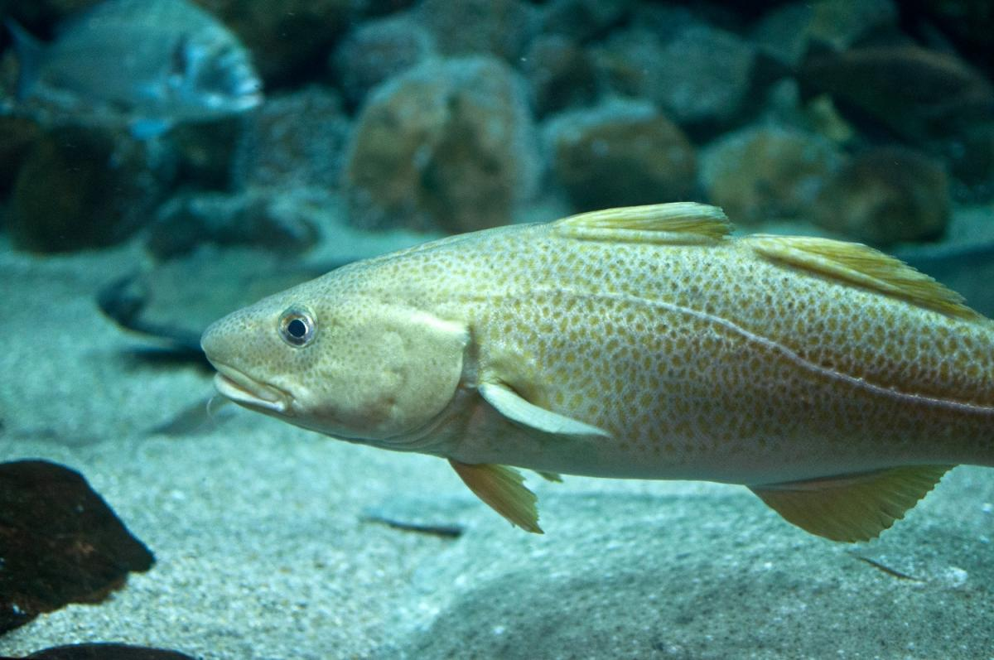
INTRODUCTION
In Italy, the term baccalà
usually refers to salt cod, however in Venice it’s used to mean Norwegian stockfish.

Slide 4
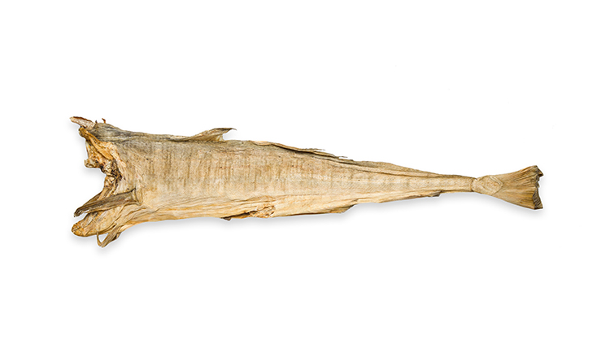
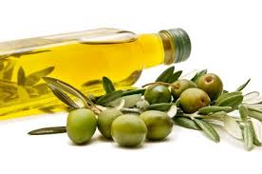
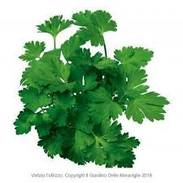
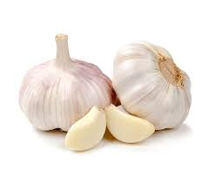
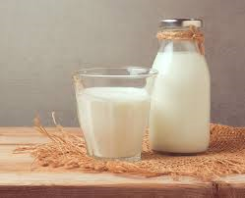
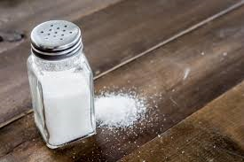
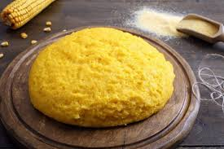
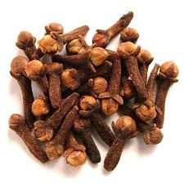
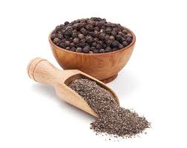
INGREDIENTS
Stockfish 800 gr
Olive oil 200 ml
Milk 200 ml
Parsley
Garlic
Clove and Salt
Black pepper
Polenta

Slide 5
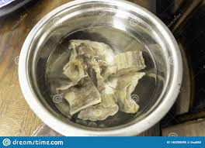
METHOD
· Start by soaking the stockfish for at least 24 hours in running water, letting a trickle of water flow or changing the soak frequently.
· Then cut the stockfish into pieces.

Slide 6
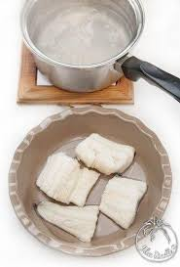
METHOD
After that, place it in a pan, covering it with cold water and 150 ml of milk, salt lightly and let it boil, skimming time to time.
Cook the cod for about 20 minutes until it’s well cooked and tender (if necessary, leave it 10 minutes longer).

Slide 7
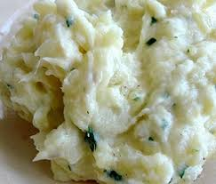
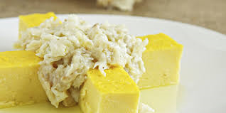
METHOD
Drain the cod and clean it depriving it of bones and skin, then reduce it into small pieces and place it in a bowl.
Mix the cod vigorously with a wooden spoon, adding the oil as in mayonnaise preparation. You will get a compact and homogeneous cream, with a shiny appearance and a few whole pieces.
Season with salt and pepper and add chopped parsley and garlic.
You can serve the creamed cod with crunchy polenta croutons: prepare a white or yellow polenta, let it cool on a tray and when it’s cold cut it into rectangles which you will toast in oven with grill.

Slide 8
THE END
- Miriana Sgarella
- Ida Piretta
- Marta Piras
- Greta Meloni
- Anna Delogu
Class 2A

