Slide 1
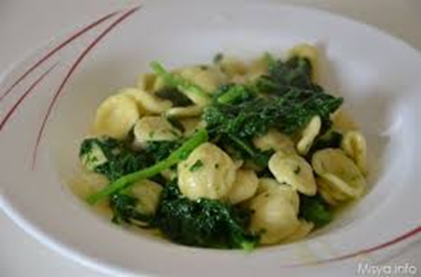
Orecchiette con cime di rapa
The orecchiette with turnip greens represent the most successful and widespread among the variants of this first course, which ranges from broccoli to tomato sauce. The preparation is of a moving simplicity, the one that will make you feel, even for a single day, the best cooks. As often happens, goodness hides in simple things. But be careful: simplicity always accompanies the quality of the raw materials! Orecchiette are a particular type of pasta originating from Puglia, in the shape of a small ear in fact. Their main virtue is to maintain excellent al dente cooking that makes the ideal appointment to be enjoyed, as well as the particular rough surface, perfect for holding the seasoning

Slide 2
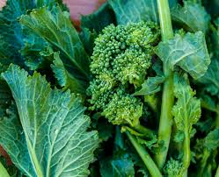
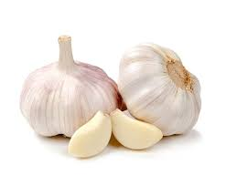
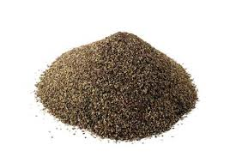
Ingredients:
• 400 g (14 oz.) Orecchiette pasta from Bari
• 400 g turnip tops
• 2 filets anchovies in olive oil
• 2 cloves garlic, crushed
• salt
• pepper
• extra-virgin olive oil to taste

Slide 3
Directions
The starting point is always a good garlic sauté (whole, if you prefer to remove it, otherwise cut into spikes), another essential ingredient for the perfect success of this dish, in a thin bed of oil. Once browned, add the previously washed anchovies. Allow the mixture to evaporate for a few minutes, then turn off the heat. Meanwhile, heat the water over the fire. Take the turnips, cut the tops of them and, when the water begins to boil, pour them. Wait a few minutes before adding the orecchiette. Take as a reference about 10 ′, but pay attention to the actual cooking level. Consider that the recipe prefers slightly crunchy turnips (I prefer them softer, almost creamy) and orecchiette al dente. Consider the cooking times required and light the flame again under the pan with oil and anchovies. Drain the pasta water together with the turnips, leaving a few ladles aside, then put everything in the pot and stir over a high heat, lengthening with the cooking water left aside as needed. Et voila, the dish is served!

