Slide 1




Our tribute to Maria Lai
The most recurring elements in her art
The thread
The loom
The goat
The mountain
The lizard

Slide 2
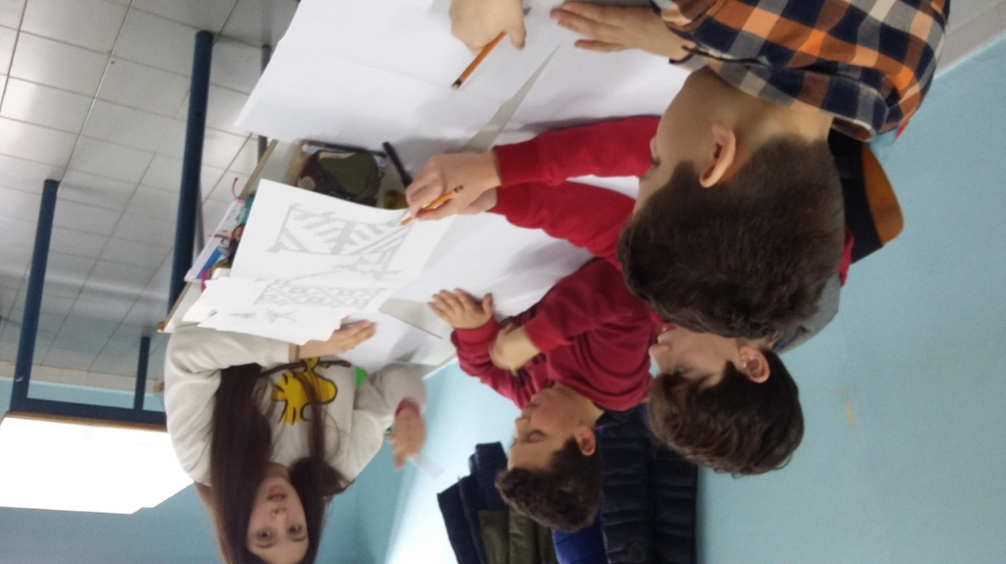

Slide 3
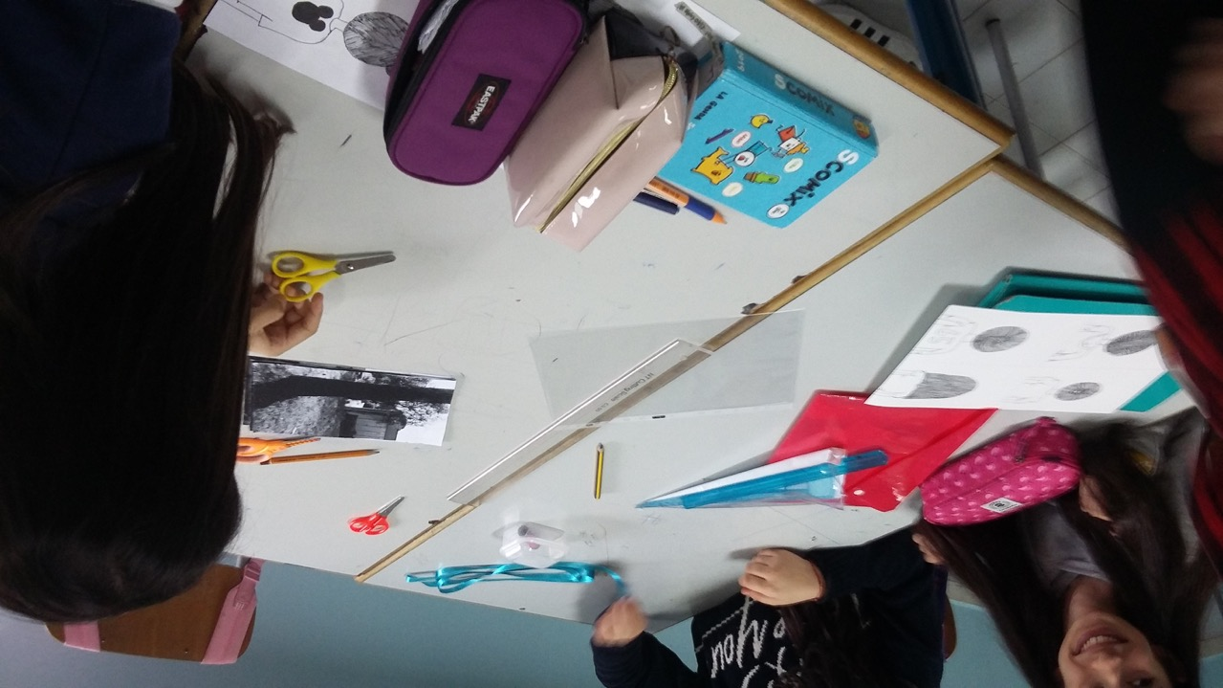

Slide 4
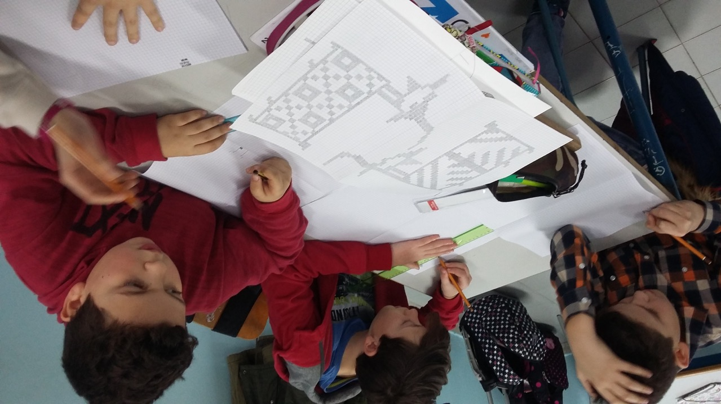

Slide 5
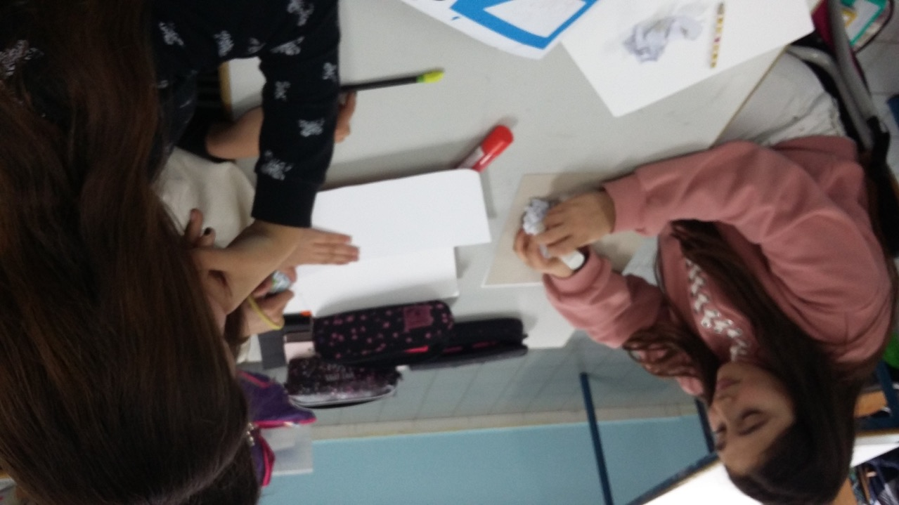

Slide 6
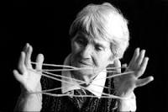
Maria Lai, a Sardinian artist
Maria Lai was born in 1919 in the village of Ulassai, in the sub-barbaricina region of Ogliastra.
Since the beginning of her careeer, she understands how important the traditions, myths and legends of her native land are, traditions such as the loom and the magic of its use, the bread, and objects from the archaic Sardinian past.
“Tying to the mountain” is a well-known operation on the territory, by the artist Maria Lai, realized in the town of Ulassai,
with the inhabitants of the same town, in 1981.

Slide 7
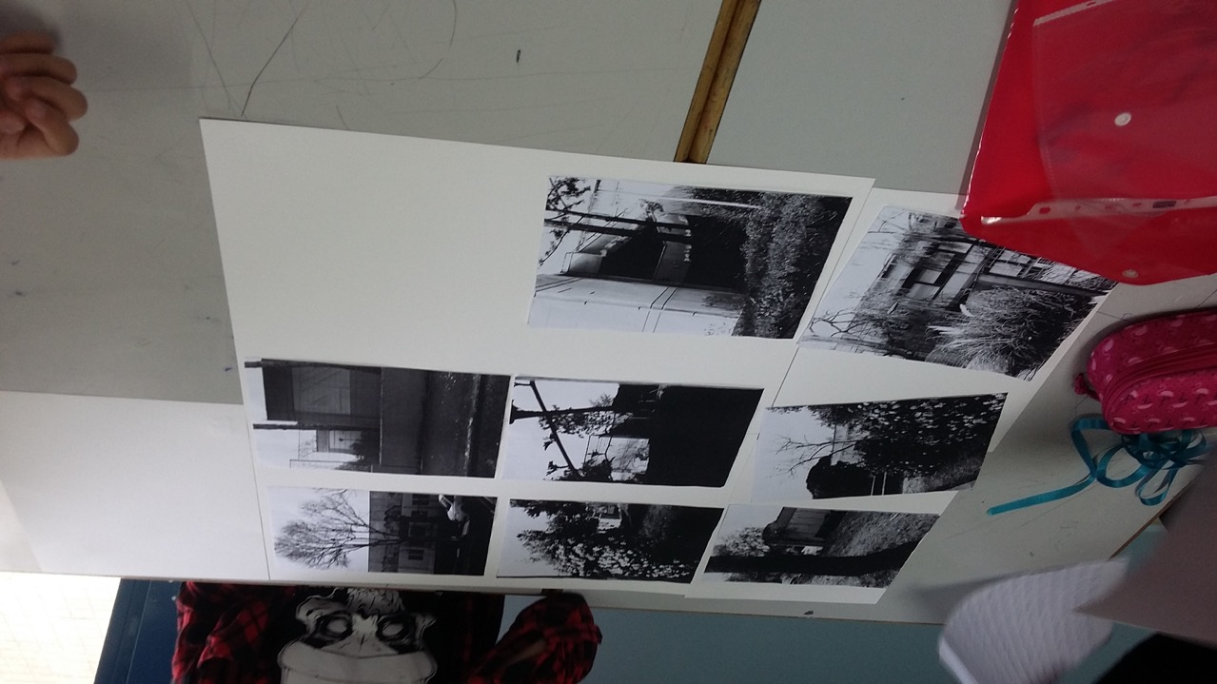

Slide 8
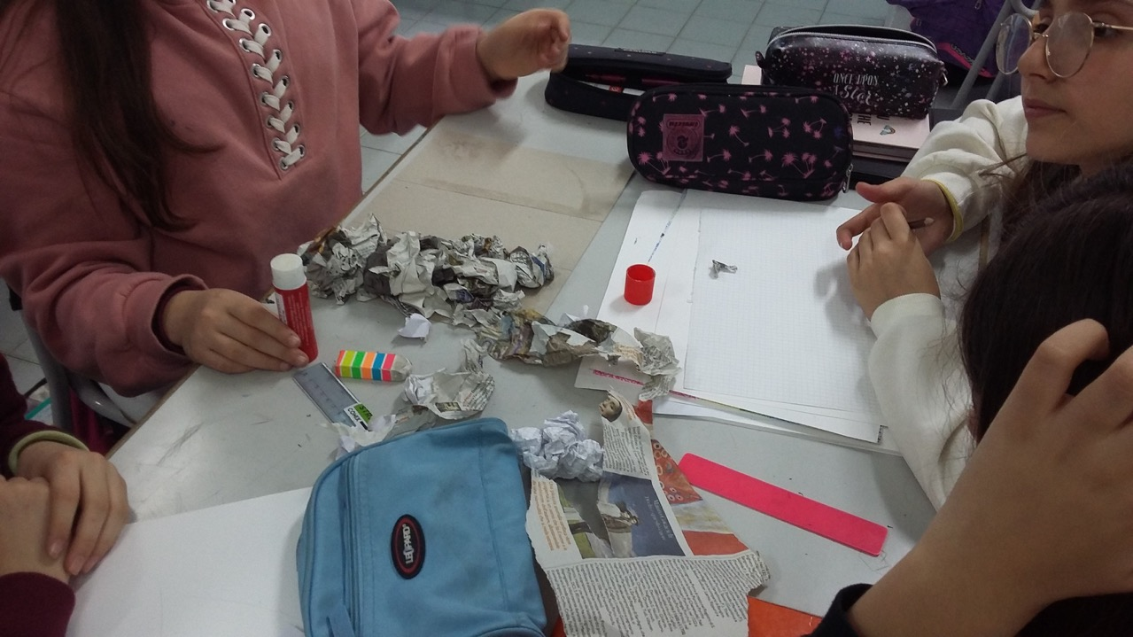

Slide 9
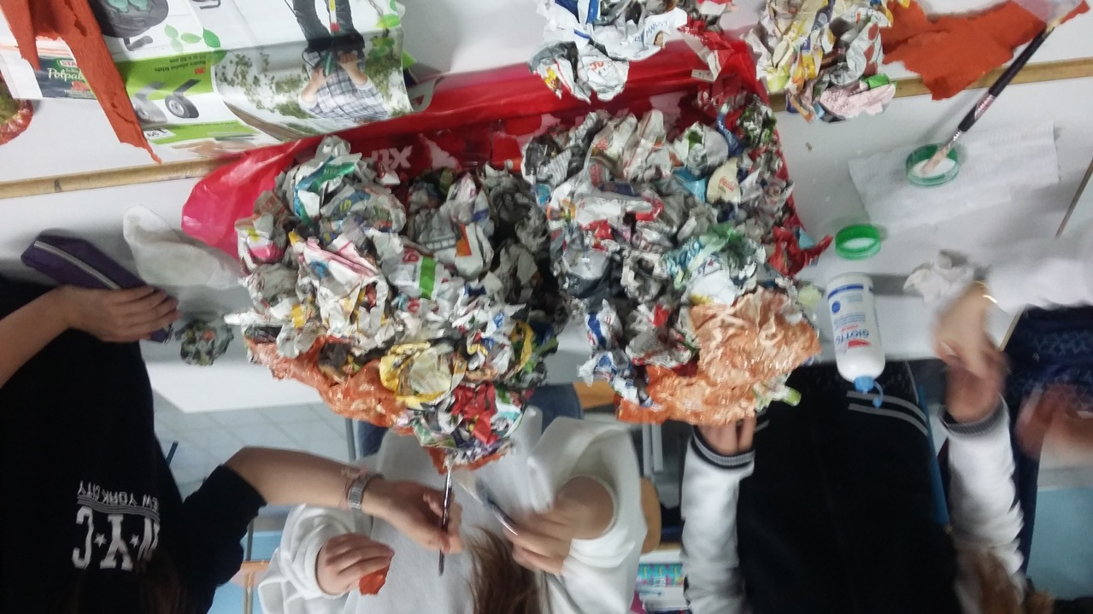

Slide 10
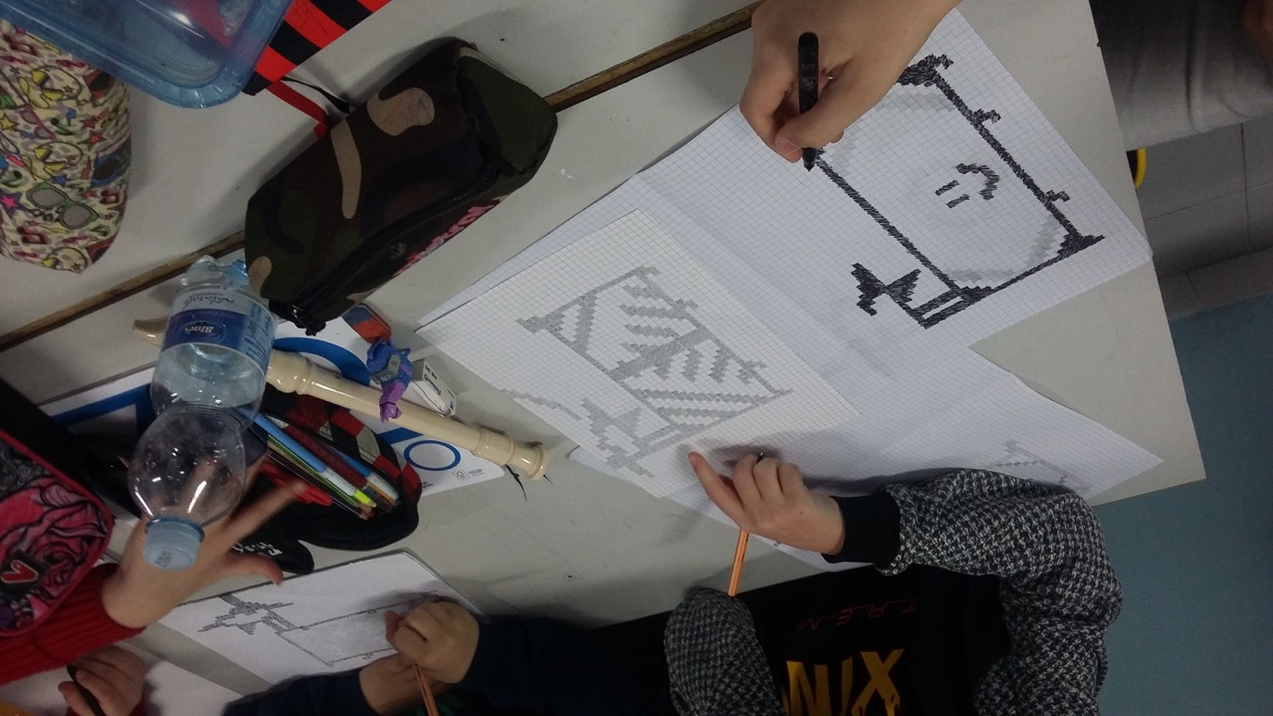

Slide 11
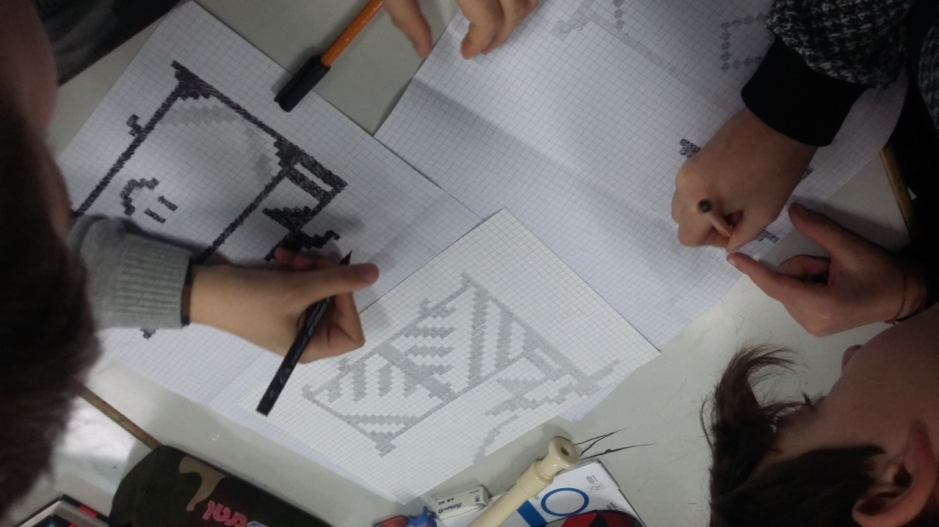

Slide 12
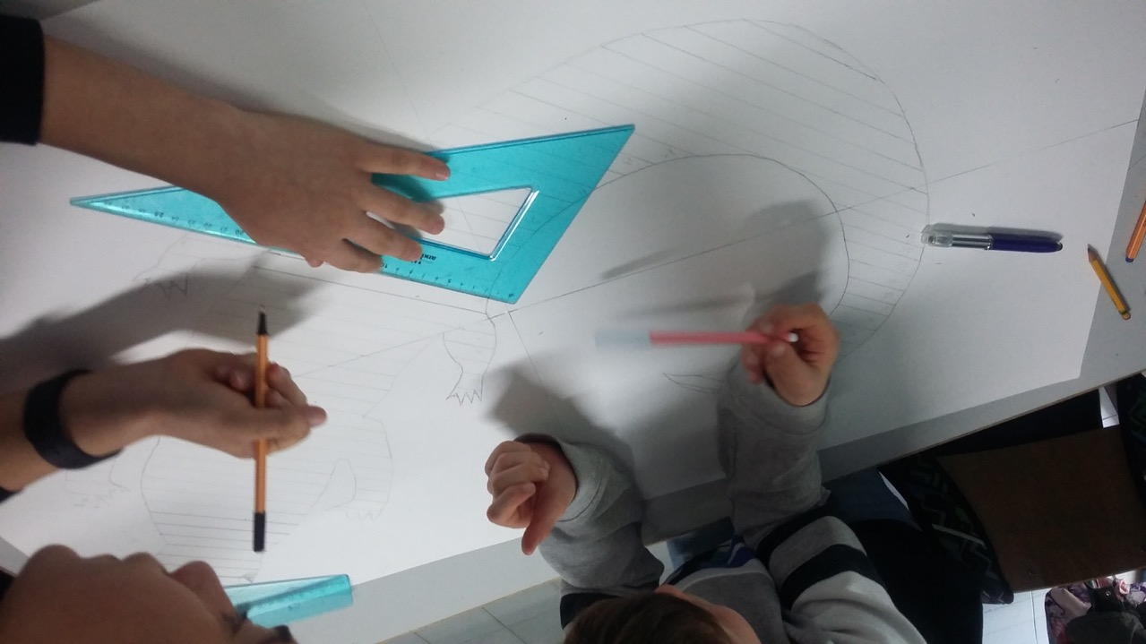

Slide 13
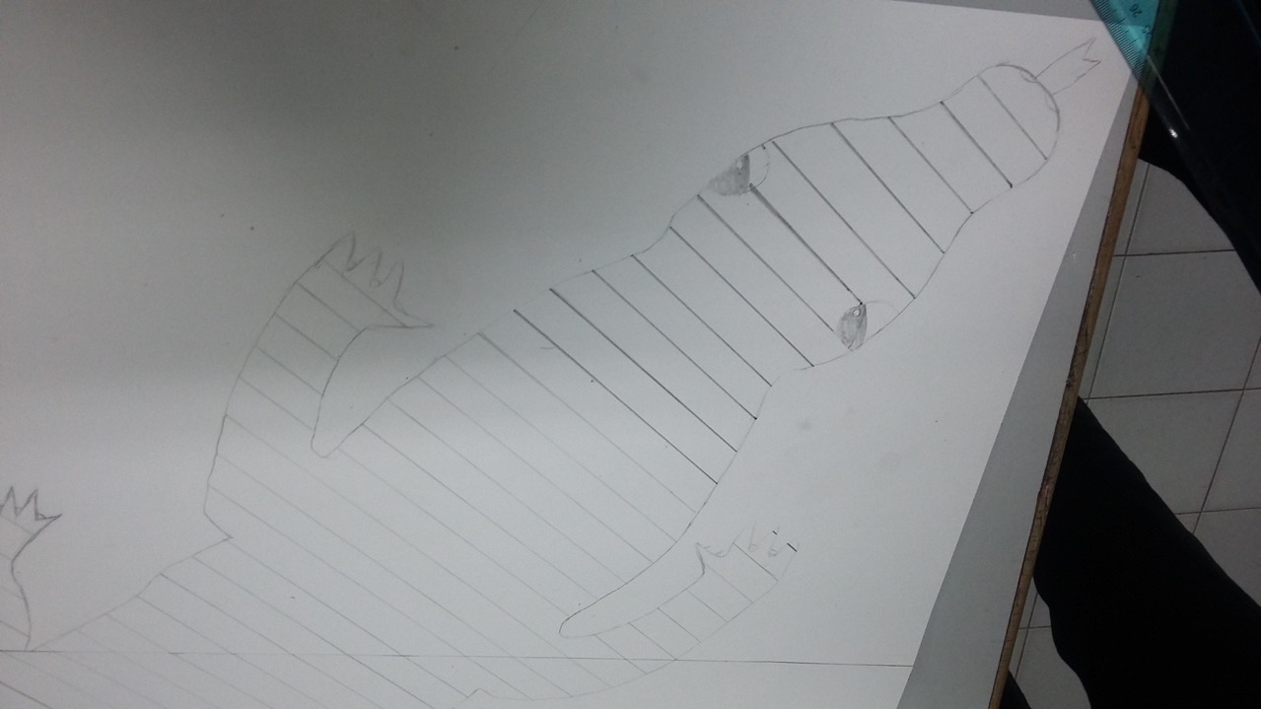

Slide 14
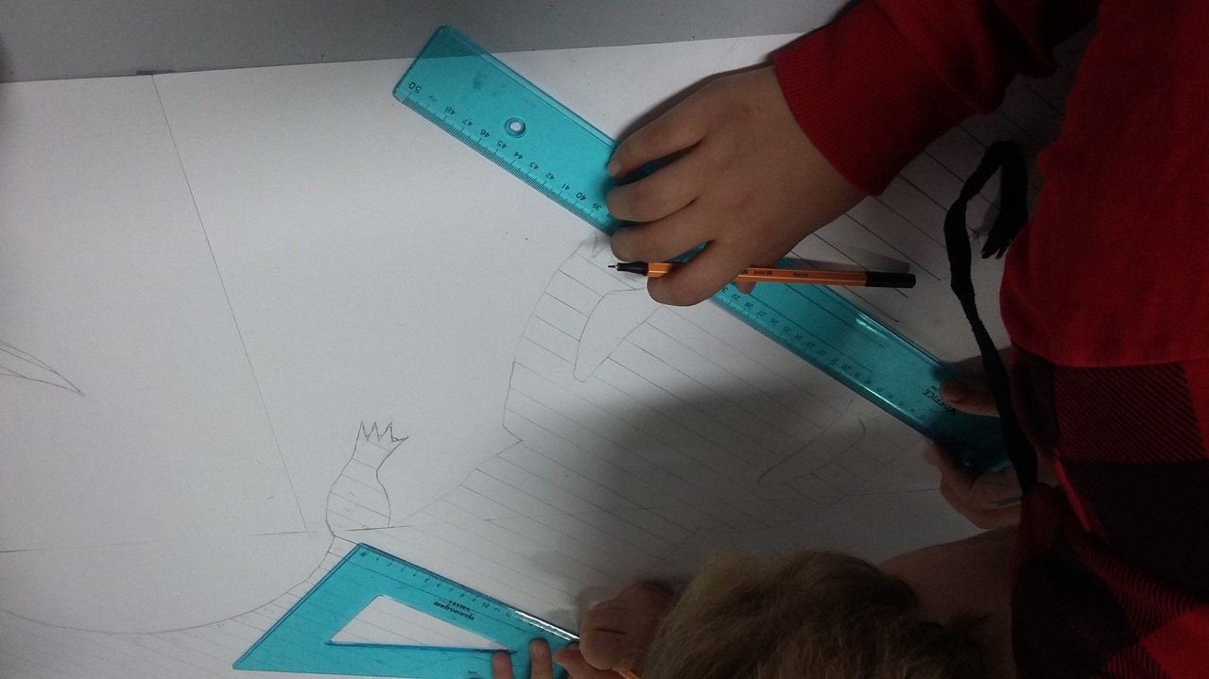

Slide 15
Reinterpreting an ancient legend of the town, she tied together with the inhabitants all the doors, the streets and the houses with about 27 km of blue cloth ribbons. The material operation lasted three days: the first day the fabrics were cut, the second day they were distributed and the third were tied up, involving women, children, shepherds, the elderly.
Where between families there was a bond of love, at the tape were tied some typical breads called "su pani pintau", where families were adverse the tape indicated the border of respect for the parties. Ulassai was bound, and was tied to its mountain.

Slide 16
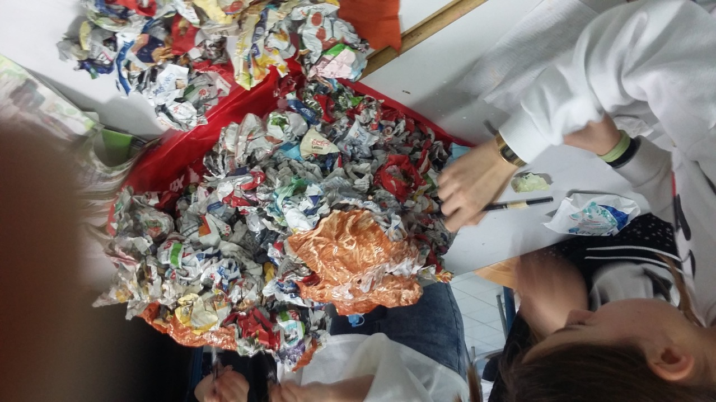

Slide 17
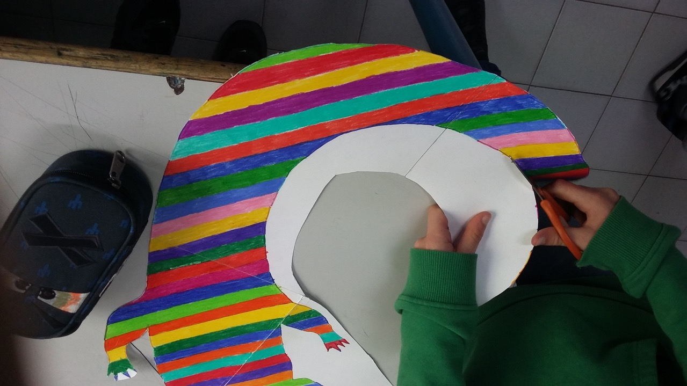

Slide 18
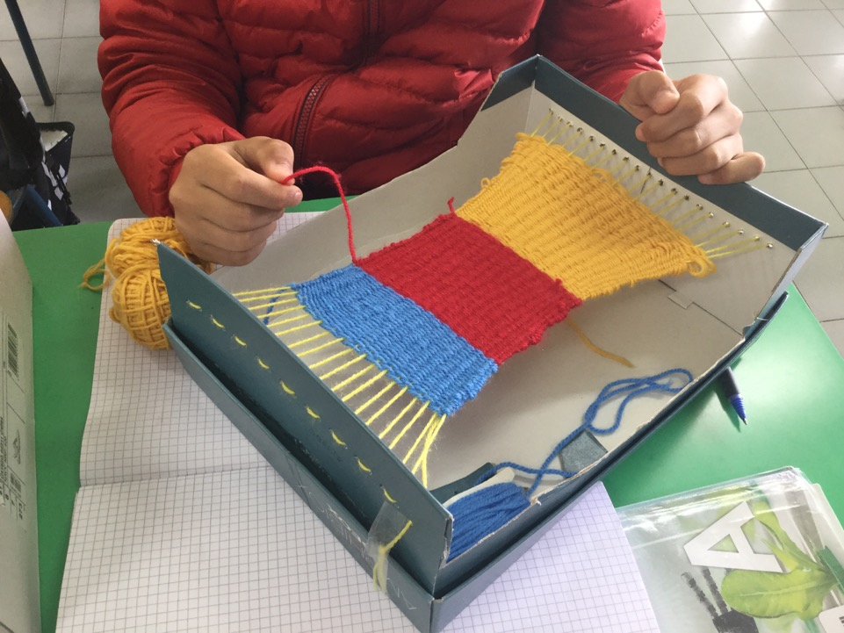
The loom

Slide 19
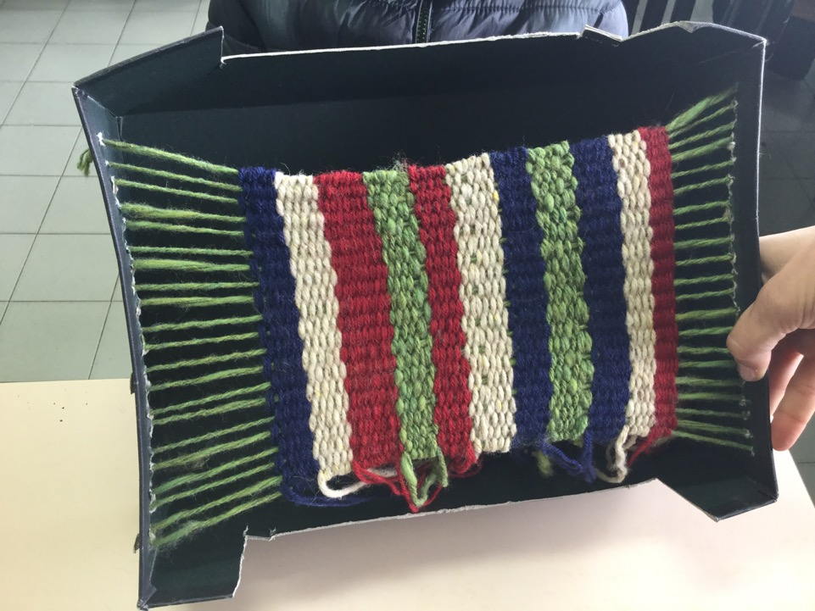

Slide 20
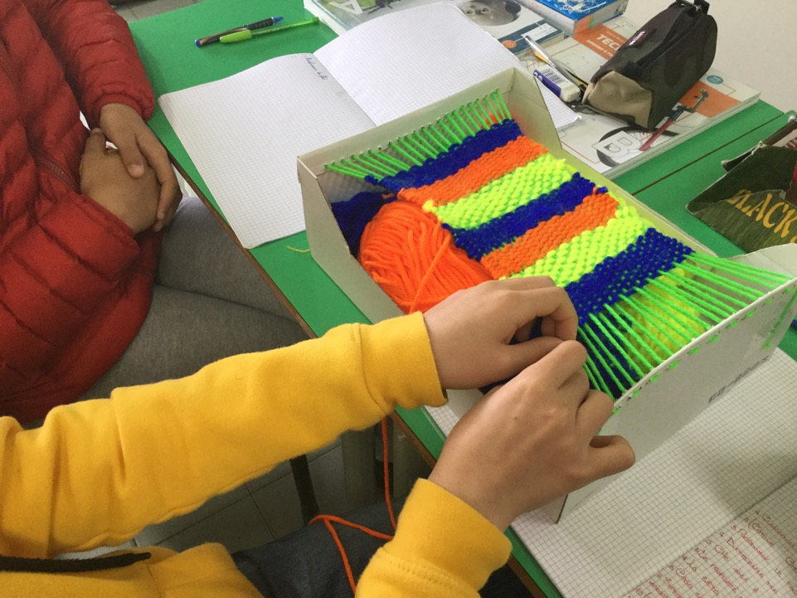

Slide 21
The legend from which all started is called "Sa Rutta de is'antigus", meaning "The cave of the ancients" and has its origins in a fact that actually happened in the country. In 1861, a ridge of the mountain broke off and overwhelmed a house in the highest part of the town. On that occasion three children died and one of them managed to save herself with a light blue ribbon in her hand. The common people saw this fact as a divine miracle and kept the memory of it, passing down from generation to generation a partly truthful and partly flowery version of picturesque shades of fantasy.

Slide 22
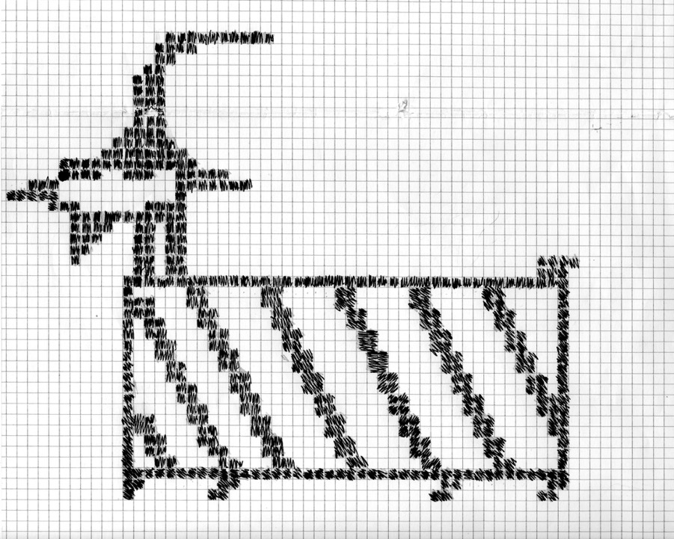
The goat

Slide 23
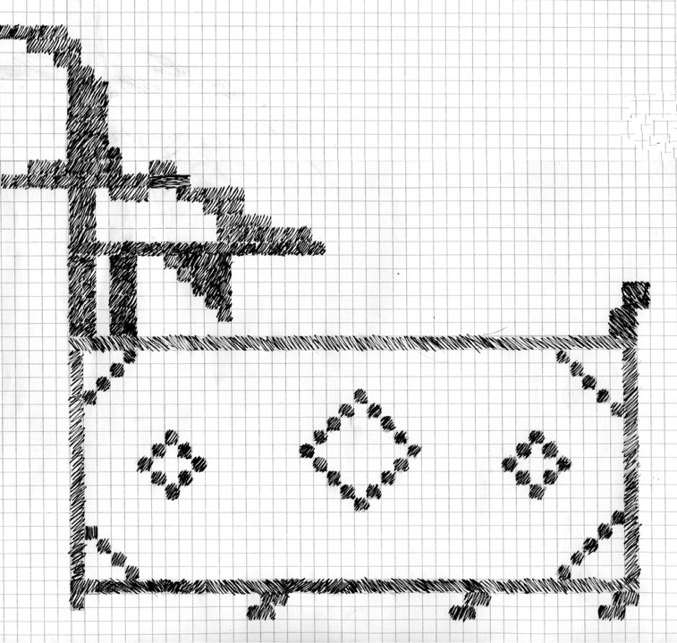

Slide 24
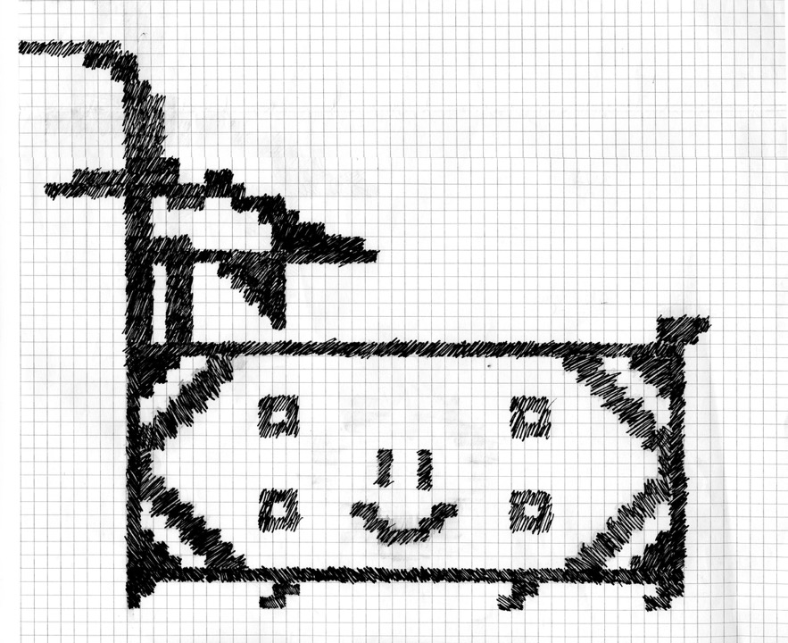

Slide 25
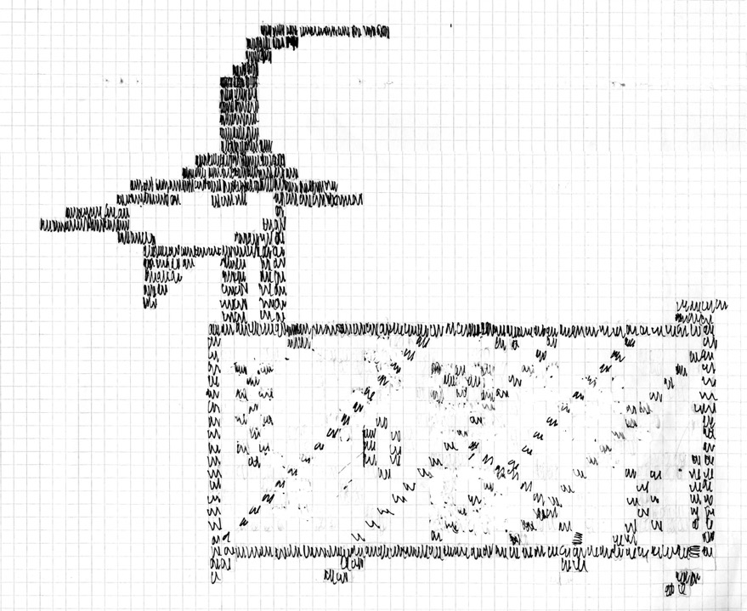

Slide 26
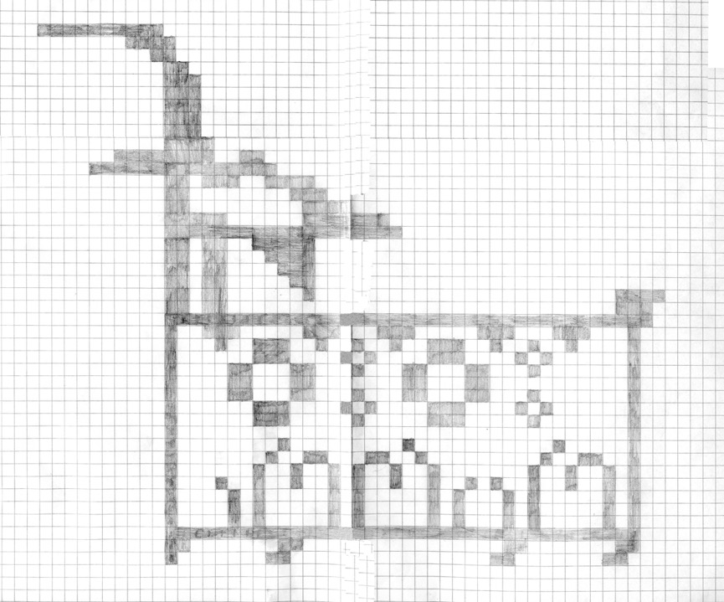

Slide 27
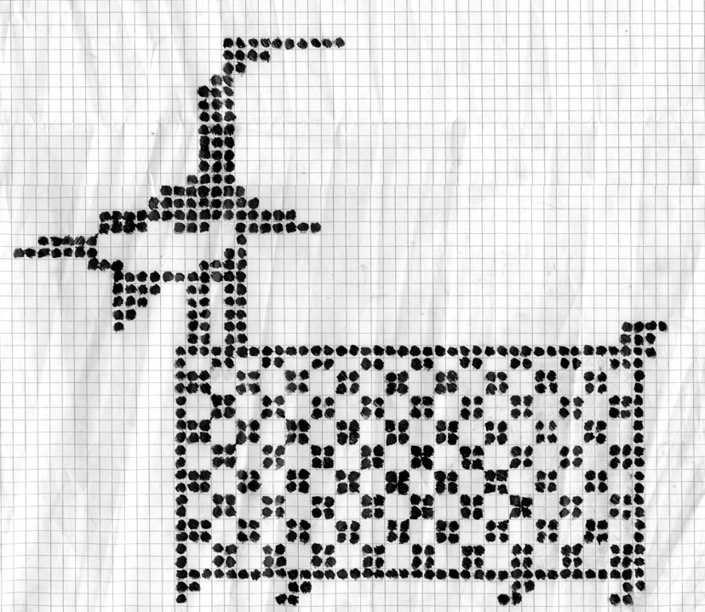

Slide 28
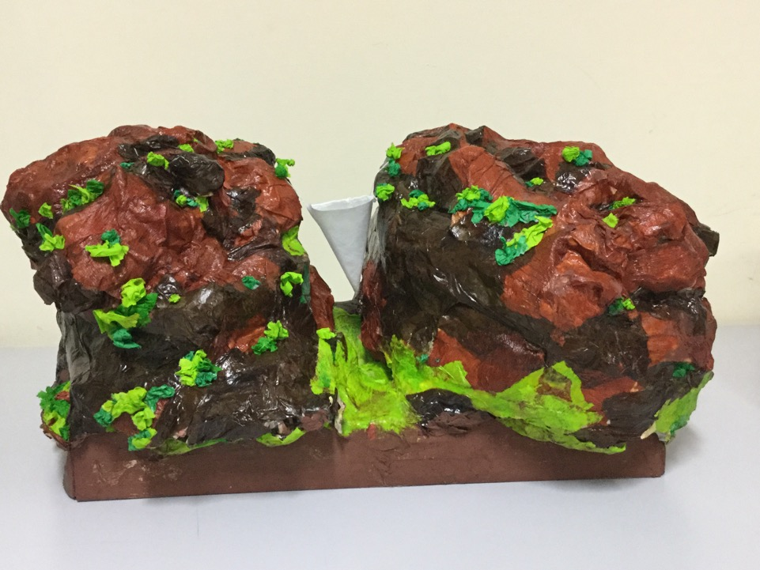
The mountain

Slide 29
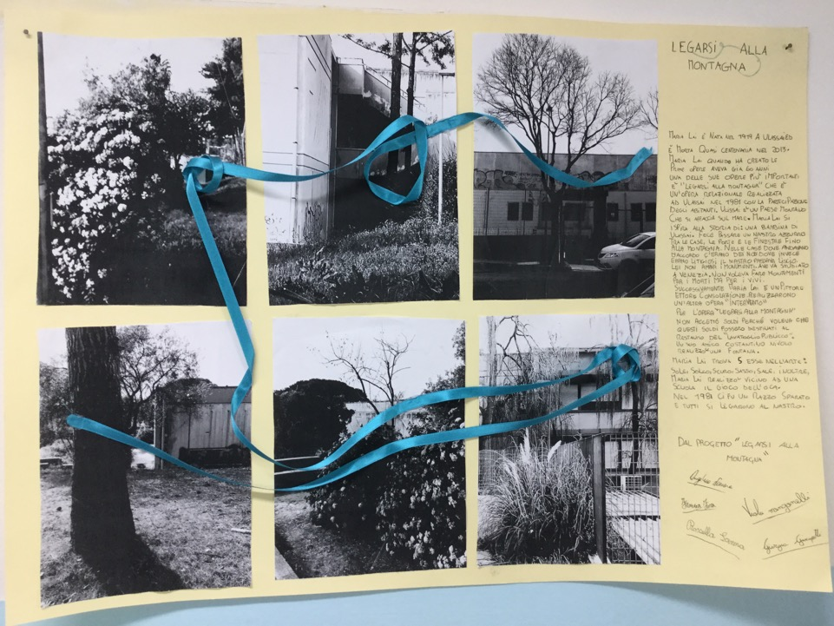

Slide 30
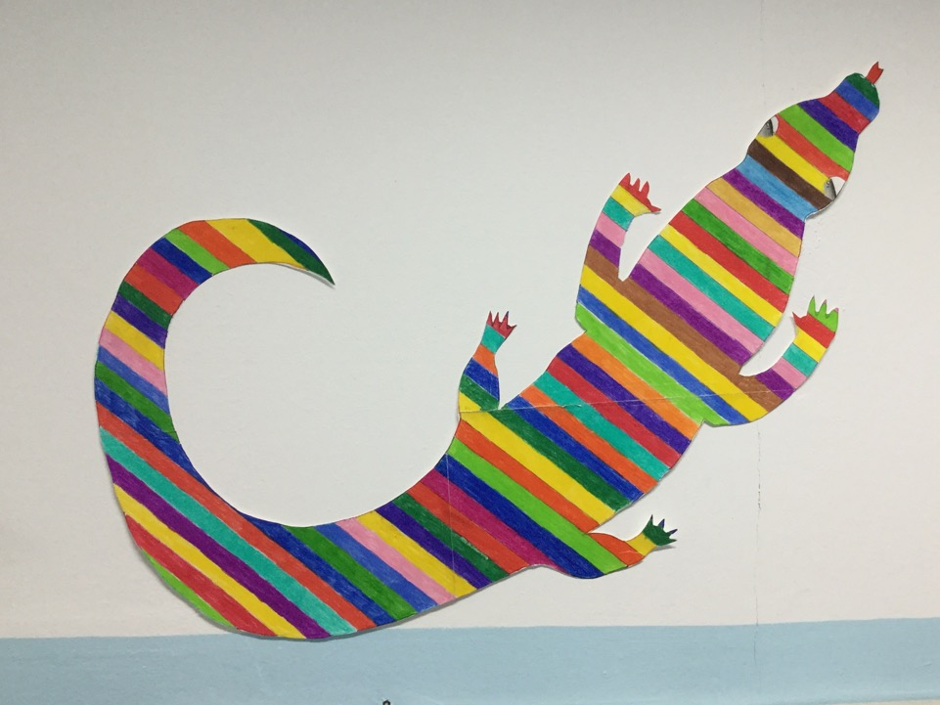
The lizard

