Slide 1
MAMUTHONES
https://youtu.be/6hpvYmSrnW0

Slide 2
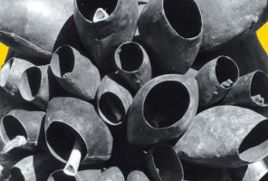
The carnival masks of shepherds and peasants from Barbagia, the central region of Sardinia, characterised by wooden face masks, bells and sheepskins, embody the distant roots and events that shaped are Mediterraean populations and their cultures.

Slide 3
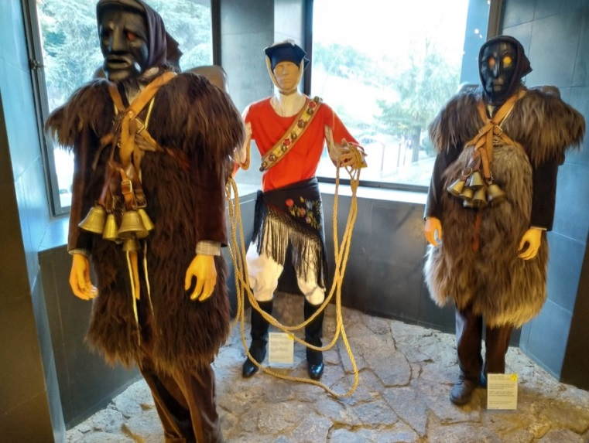
ORIGINE E SIGNIFICATO
Mamuthones and Issohadores masks origins can be linked to various traditions and have different interpretations.
It could be argued that their existance and meaning might be tied to Barbagia’s shepherds (issohadores) celebrations of victory over the Saracen invaders who where taken prisoners and led in in procession. However, they might also originate from totemic rites or from ritual processions held by nuragic people to honour agricoltural gods.

Slide 4
Mamuthones and Issohadores
Mamuthones hide their appearance behind a black wooden mask (sa bisera), characterised by a pronounced nose, chin and cheekbones and two holes for the eyes and mouth. The head is covered by a brown handkerchief tied under the chin. Above the black sheepskins that cover their brown velvet clothes, mamuthones carry sa garriga, the cowbells (su ferru), which weight 30 kg.
Issohadores accompany mamuthones. They wear a red jacket with a belt. They wear white canvas trousers, a shawl, a cap held in place by handkerchief tied above their head. They carry a rope and their face is covered with a white mask.

Slide 5
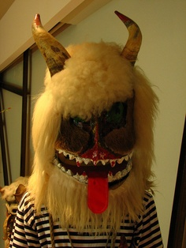
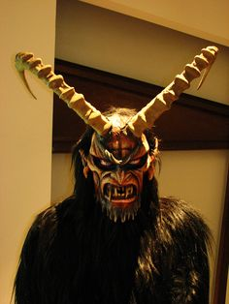
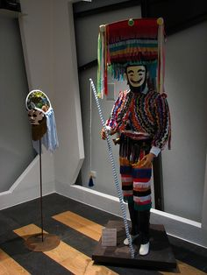
Sardinian masks look very similar to the ones of other Mediterranean countries, highlighting the cultural affinities among them.
Kurent - Slovenia
Krampus - Veneto
Boteiro - Galizia

Slide 6
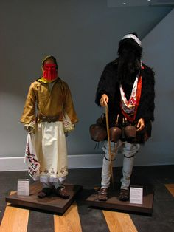
The masks of Geros, in the Greek island Skyros.
The island preserves an ancient tradition related to this figure. In fact, during the carnival, Geros, an old monstrous – looking goats wearing a mantle of goat skins, cowbells and holding a stick, wanders and dances around the streets.

Slide 7
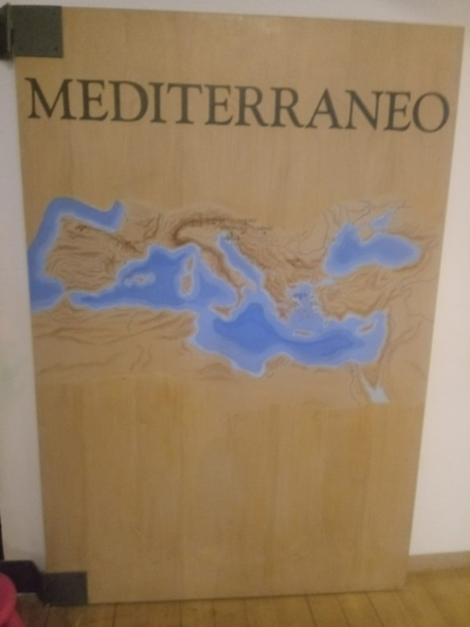
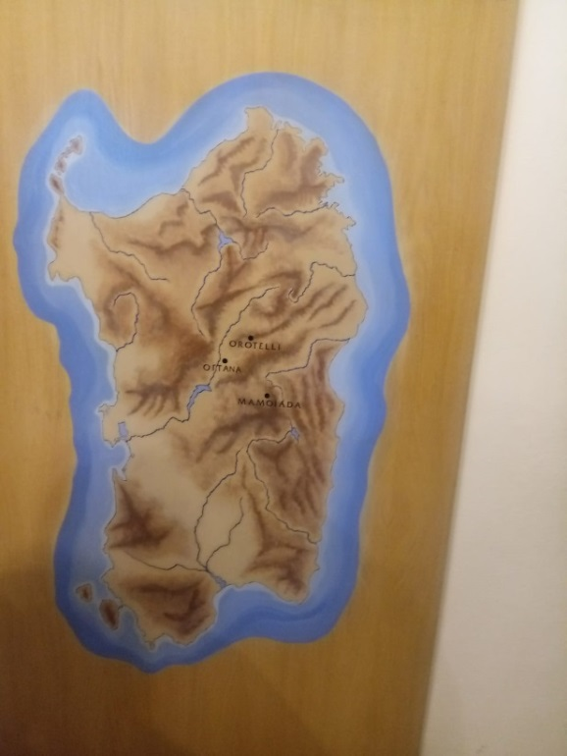
The carnivals of the Mediterranean countries are populated by extraordinary beings that appear to be related to their constituent elements and to the ritual meaning. The use of facial masks, sheep and mutton skins, and cowbells widely occurs across them.

Slide 8
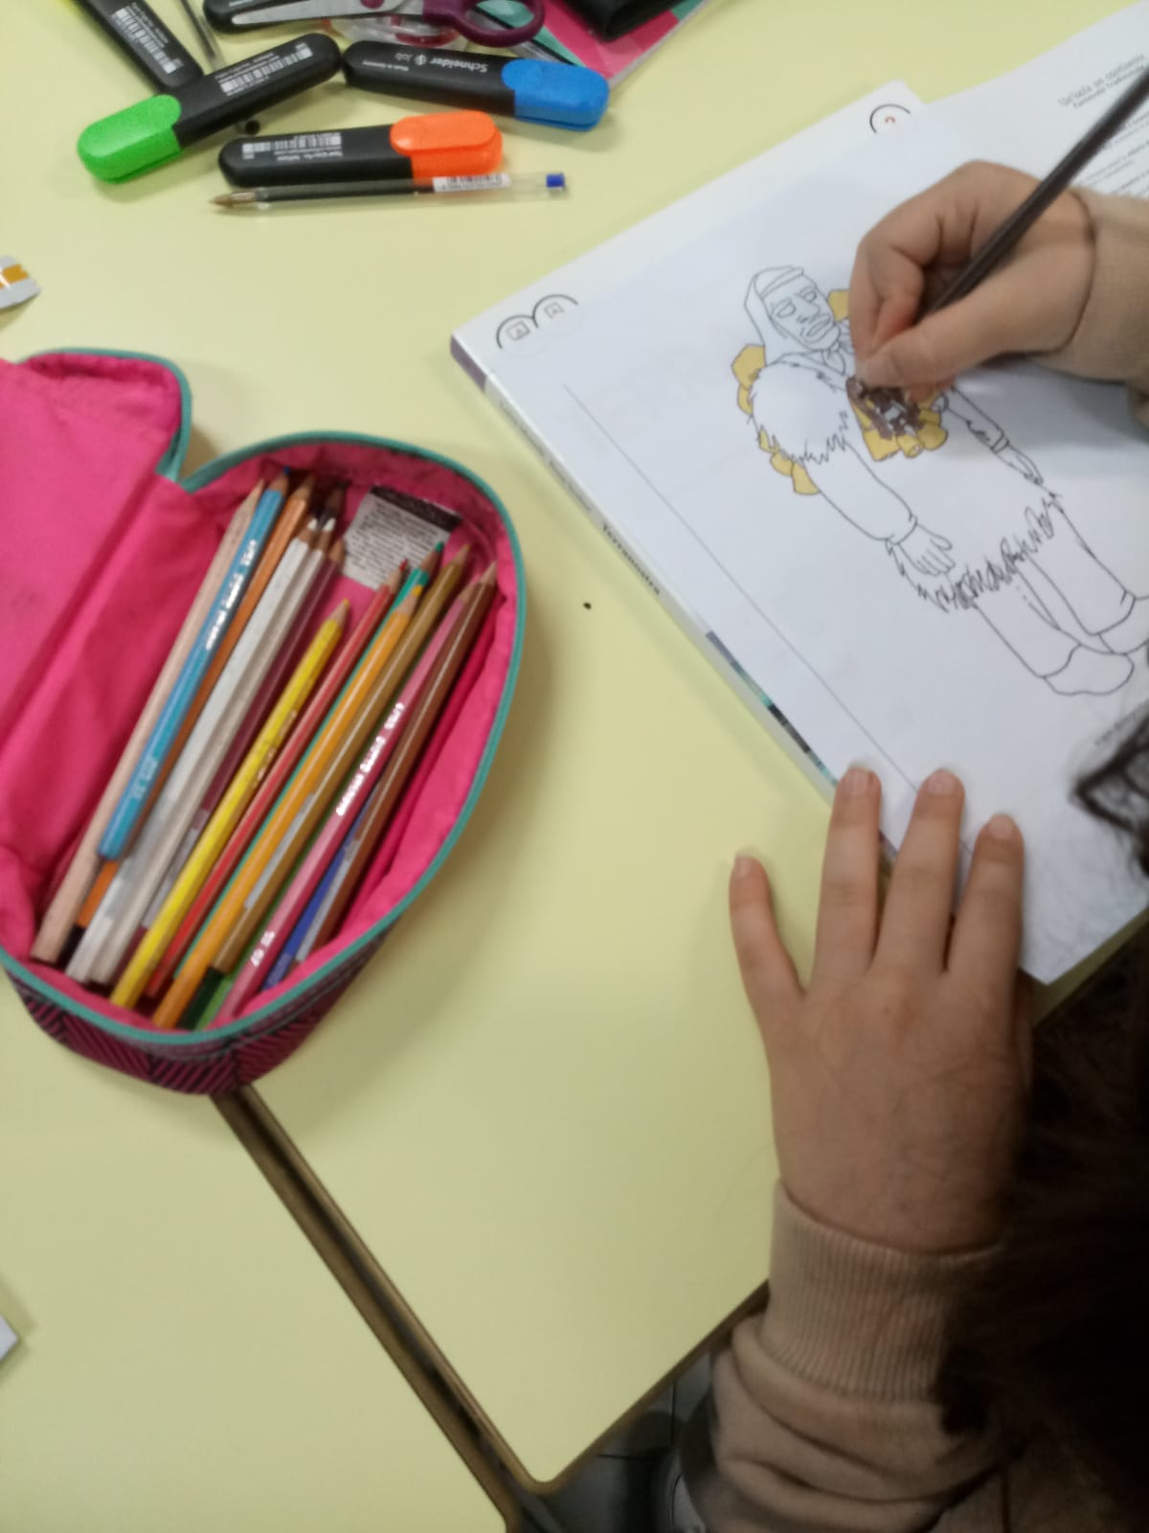
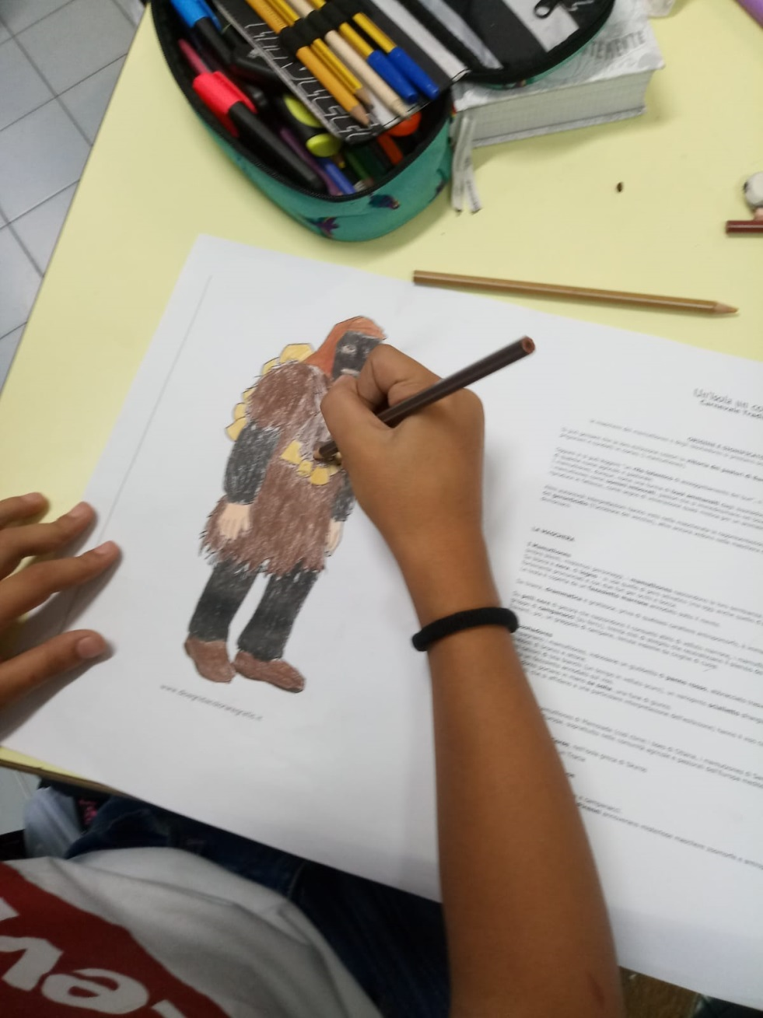

Slide 9
