Slide 1
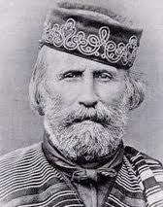
GIUSEPPE GARIBALDI Nizza 4 July 1807 – Caprera 2 June 1882
He is also known by the nickname of «Hero of Two Worlds» for which refers to his military achievements both in Europe and in South America

Slide 2
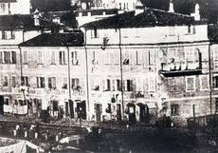
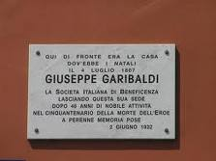
The origins
His father was a maritime merchant. Although he wanted his son to pursue a career in law or medicine, Garibaldi’s passion for the sea prevailed over everything else.

Slide 3
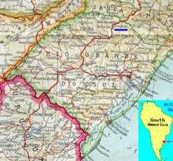
In South America
In South America, he was involved in fights for the secessionist government of the Brazilian province of Rio Grande del Sul.

Slide 4
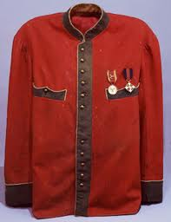
The red shirt
The red shirt holds great significance. In 1843 in Montevideo, Garibaldi chose red shirts as uniforms of the italian legion, which fought under his command in the Uruguayan Civil War.
Garibaldi bought the shirts at a discounted price, as they were meant to be worn by meat factories workers. The colour red was used to camouflage the blood stains of the slaughter.

Slide 5
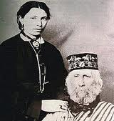
Garibaldi and the women
During his life Garibaldi had many relationships with different women. He married three times, but his greatest love was Anita.
Anita Garibaldi, 1821-1849;
Anita and Garibaldi had four children
together.

Slide 6
The exile
Garibaldi chose Caprera, first as a place of exile , and then as his permanent home.
Garibaldi helped enahncing Caprera’s agricolture and made the island an agricultural colony.

Slide 7
La Maddalena and Caprera
In the extreme north-east of Sardinia, there is the last home of the Hero of the Two Worlds: Caprera.
Surrounded by the sea, Mediterranean vegetation and granite, Caprera is the second largest island of the archipelago of La Maddalena.

Slide 8
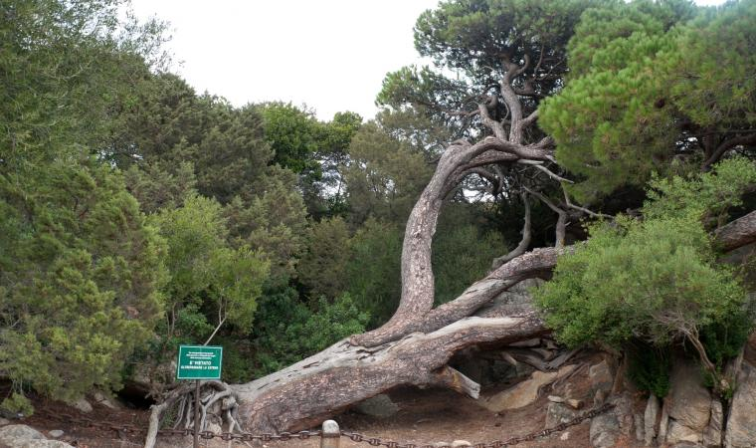
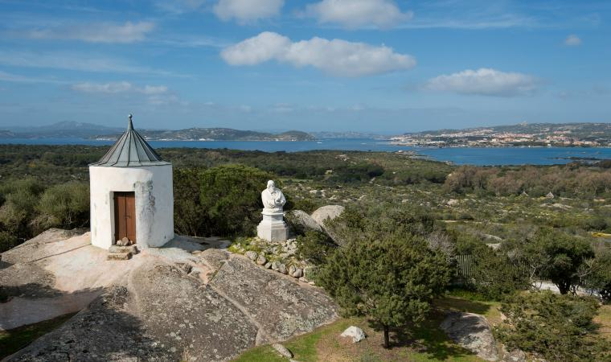
In this peace, he planned the actions that marked the Italian Risorgimento’s history.
«The white house» still stands there – a symbol that, to this day, causes astonishment and interest.

Slide 9
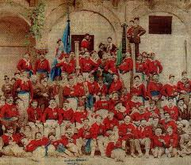
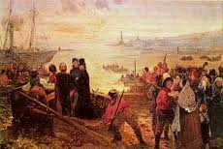
The dispatch of the Thousand
The expedition of the Thousand was one of the crucial episodes of Risorgimento. It happened in 1860, when a thousand volunteers, under the command of Garibaldi, sailed from Quarto, in the Kingdom of Sardinia, and landed in Sicily, in the Kingdom of the Two Sicilies.

Slide 10
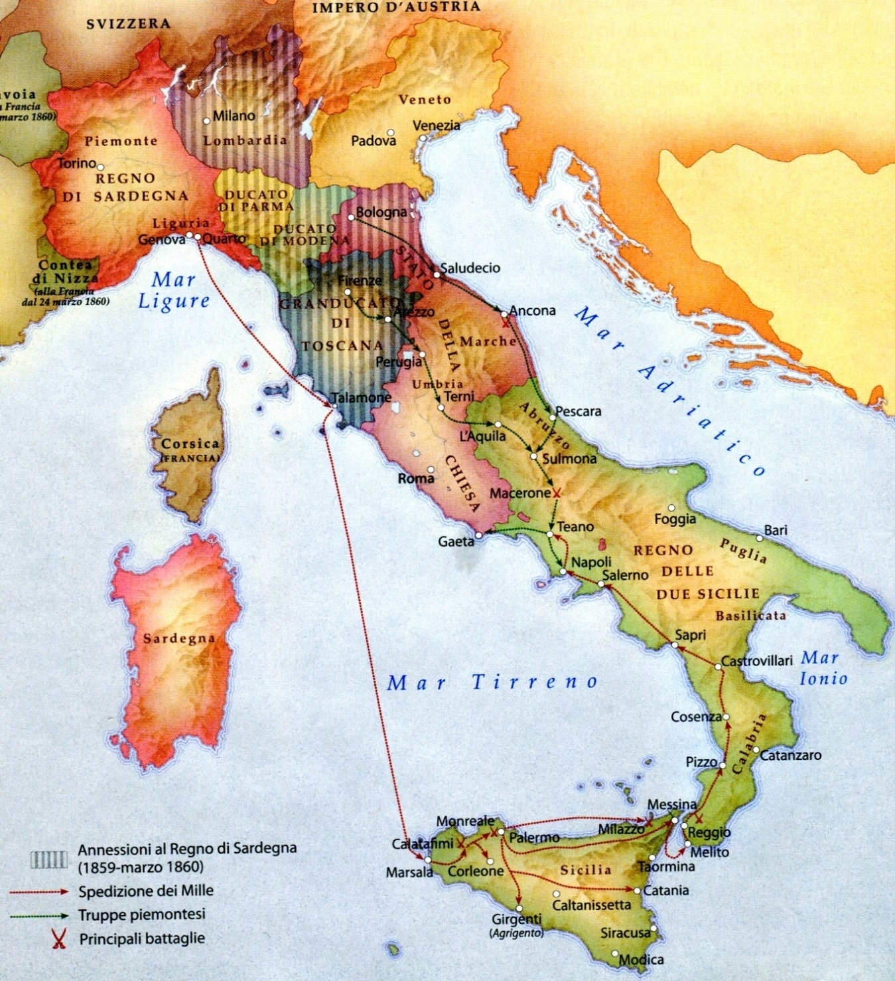

Slide 11
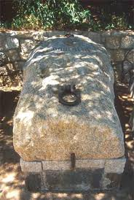
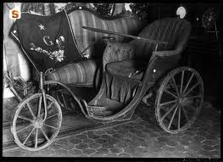
The last phase of life

Slide 12
