Slide 1
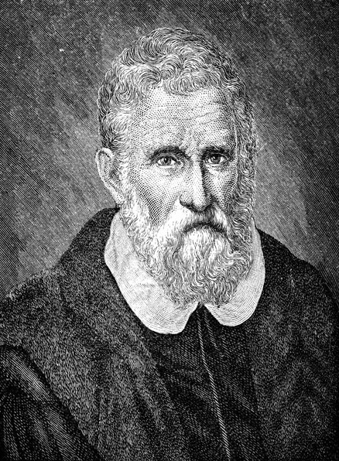
MARCO POLO

Slide 2
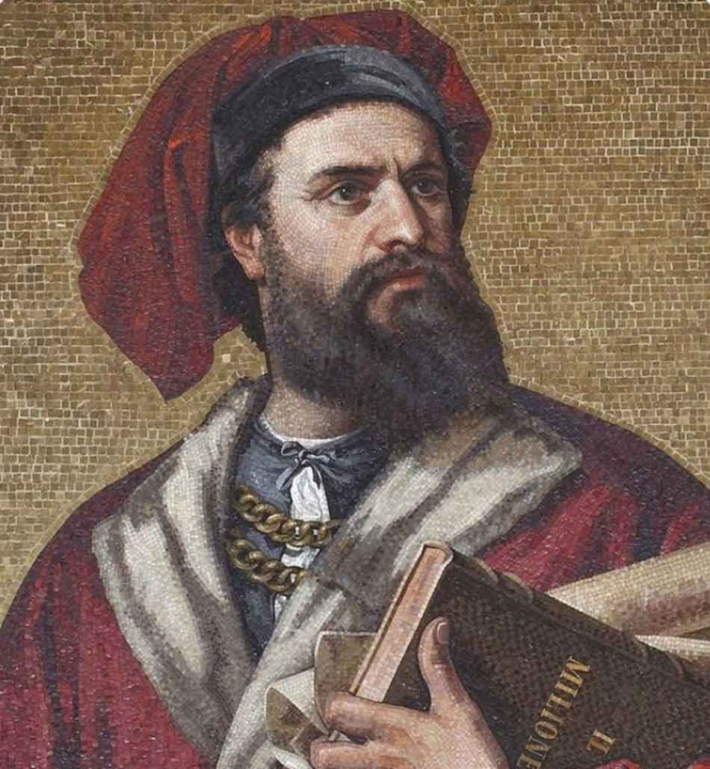
Who was he?
Marco Polo was born on the 15th of September 1254 in the Republic of Venice.
He was an Italian merchant, explorer and writer.
In 1300 he married Donata Badoèr, the daughter of a merchant. They had three children.
He died in 1324 and was buried inside the convent of San Lorenzo.

Slide 3
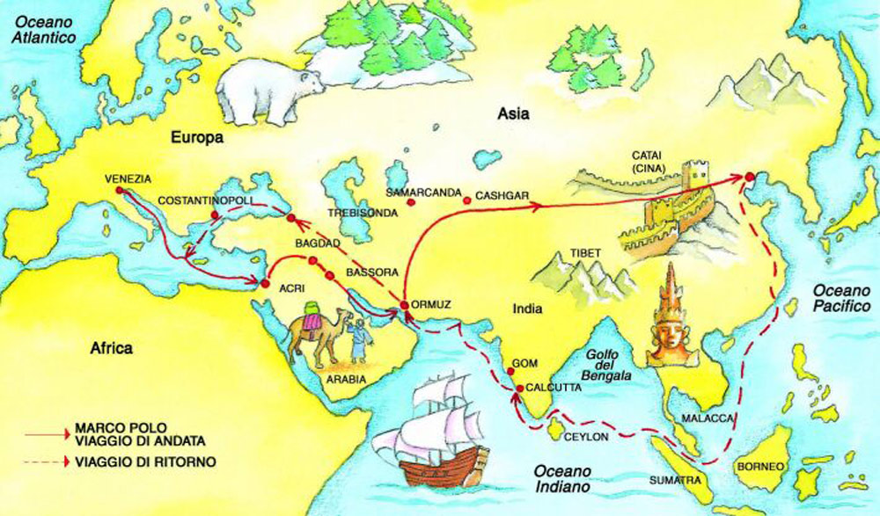
The travel
He was a member of the Venetian patriciate . He set off for a journey with his father Niccolò and his uncle Matteo; they traveled through Asia, along the Silk Road and reached China (Cathay) in the years 1271-1295. Kublai Kan appointed him as counselor and ambassador to his court. Marco Polo returned to Venice in 1295 with many riches and treasures that re-invested in the family business. He was caught by Genoans in 1296 and he spent several months of his imprisonment dictating a detailed account of his travels to Rustichello da Pisa (perhaps his cellmate) who wrote the tales in ancient French with the title "Divisiment dou monde".

Slide 4
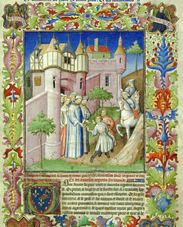
The travels of Marco Polo
The book soon spread throughout Europe in manuscript form, and became known as The Travels of Marco Polo. It depicts the Polos' journeys throughout Asia, giving Europeans their first comprehensive look into the inner workings of the Far East, including China, India, and Japan.
Although he was no the first European to rech China, Marco Polo was the first to draw up a detailed account of the journey. The book inspired generations of European travelers and provided ideas and materials for Western cartography.
In addition to a travel relationship, it is also a historical-geographical treaty. It has been defined "the geographical, historical, ethnological, political, scientific description of medieval Asia".

