Slide 1
WHO AM I?

Slide 2
WHO AM I?

Slide 3
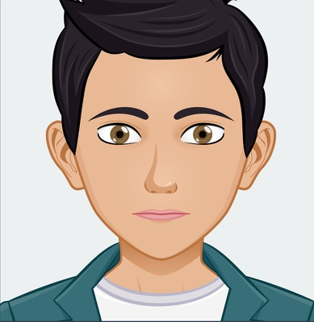
WHO AM I?

Slide 4
WHO AM I?

