Slide 1
Flower
Flower constructed dynamically through GeoGebra
by teacher Norma Lisa Neiman -I.T.C.G. Carlo Matteucci- Roma (IT)

Slide 2
In 9th grade students usually do not study polar points and goniometric functions.
So what happens if you draw a circle with a dynamic radius that moves in a range of non negative numbers and a point that can move freely on this parametric circumference?
Through GeoGebra build a slider and choose a range of non negative numbers.
Change the speed of the slider and of the point on the parametric circumference. What happens?
Discover it through GeoGebra.
Now hide all the objects except the point and select trace. Through advanced setting change dynamically the color of the point what happens?
Have fun and explore…………………………………………
If you let the dynamic point move for a long time you won’t have a flower anymore, but a circle of radius of maximum range, filled up with colourful points.

Slide 3
You tube video
https://youtu.be/5S1mkkr-Pa4
In 9th grade students usually do not study polar points and goniometric functions. So what happens if you draw a circle with a dynamic radius that moves in a range of non negative numbers and a point that can move freely on this parametric circumference? Through GeoGebra build a slider and choose a range of non negative numbers. Change the speed of the slider and of the point on the parametric circumference. What happens? Discover it through GeoGebra. Now hide all the objects except the point and select trace. Through advanced setting change dynamically the color of the point what happens? Have fun and explore………………………………………… If you let the dynamic point move for a long time you won’t have a flower anymore, but a circle of radius of maximum range, filled up with colourful points.

Slide 4
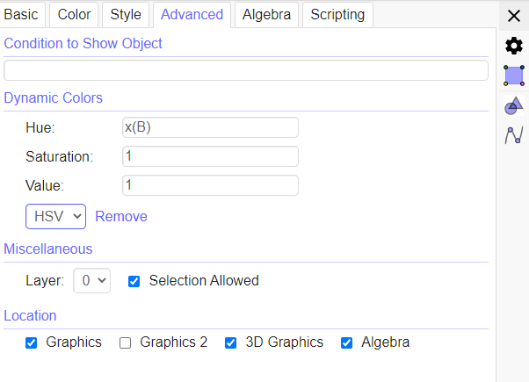
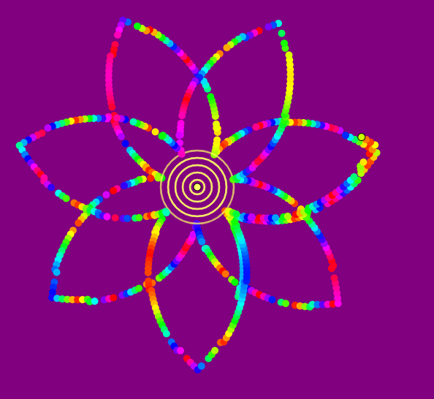
An example https://www.geogebra.org/classic/g2m8tjcm
Point B

