Slide 1
Bratislava guide by Tomas Mozolik

Slide 2
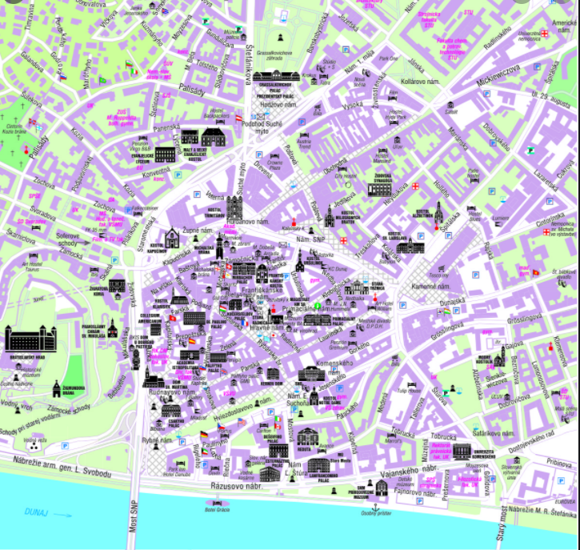
Bratislava is a large modern city – the capital of the Slovak Republic. It is situated on both banks of the river Danube.
The city is the seat of the President, Government and Parliament. It is the political, cultural and economic centre of the country. Here live more than half a million inhabitants.
Every century has left here a lot of historical and cultural monuments. The most valuable are from the Gothic, Renaissance and Baroque periods. That is why so many tourists come to see the sights of Bratislava every year.
The dominant building of the city is the medieval Bratislava Castle that is preserved till now. Other important and famous buildings are: The Michael´s gateway, the old Town Hall, st. Martin´s Cathedral just below the Castle Hill. Most admired is also the Grassalkovič Palace, now the seat of the Lady President Zuzana Čaputová.
I love Bratislava and I like wandering through narrow streets in the historical centre of the city together with my parents who are interested in the history of this beautiful town.

