Slide 1
Ivanka pri Dunaji is located in southwest part of Slovakia. In the district Senec and near capital city Bratislava.
Climate
Village is in mild climate. It is in warmer part of Slovakia.
Summer is hot and dry, sometimes with storms.
Winter is cold, but warmer than north part of Slovakia. Snow is not often.
There live 6788 people. It is the 3. biggest village in Slovakia.
Area of village is 1425 hectares.
Ivanka pri Dunaji

Slide 2
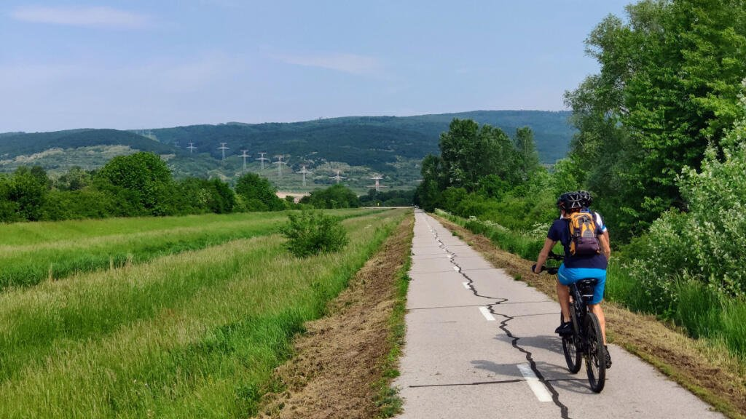
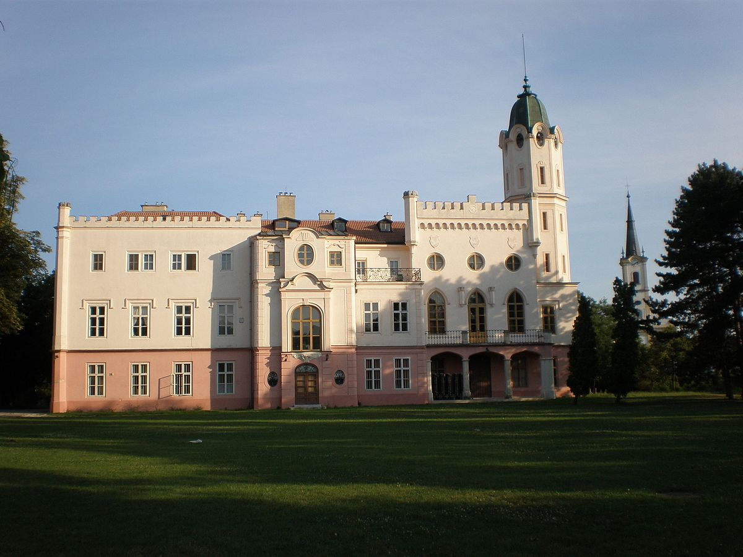
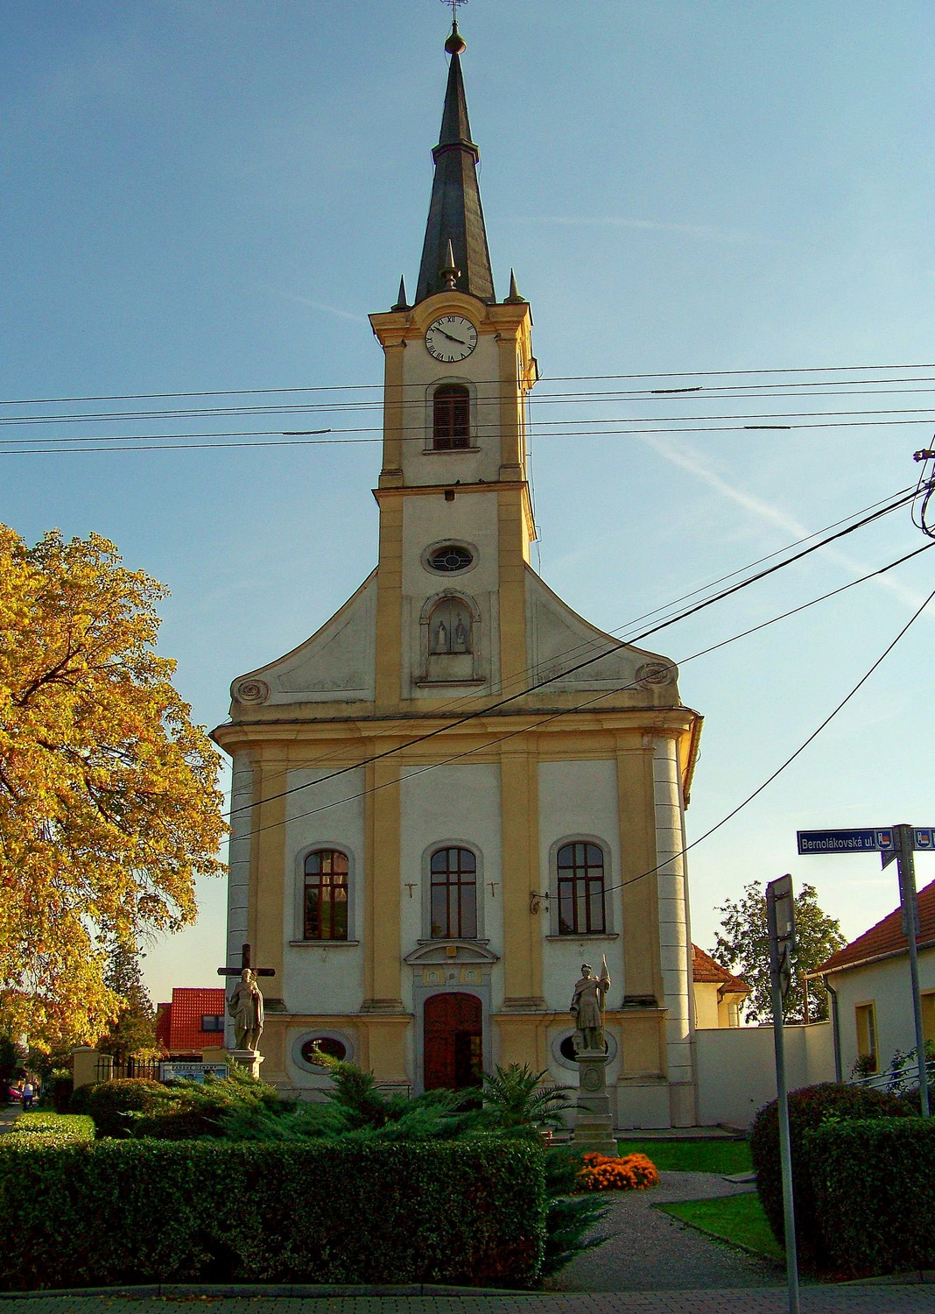
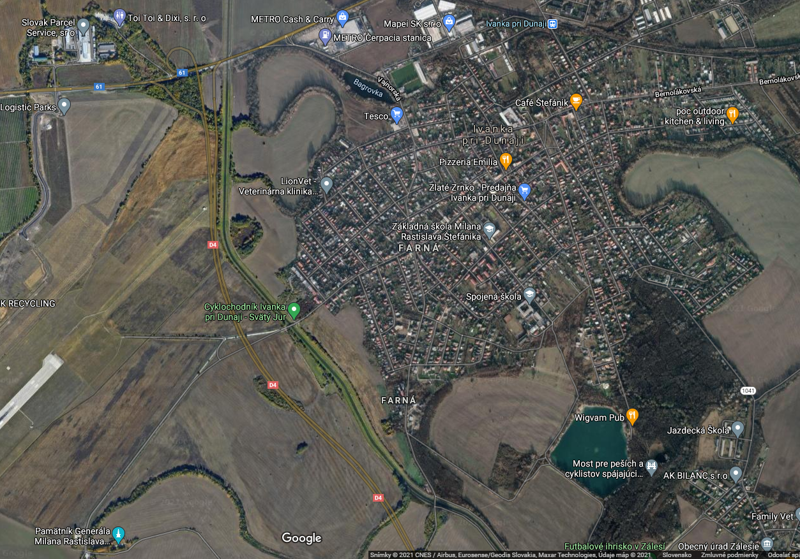
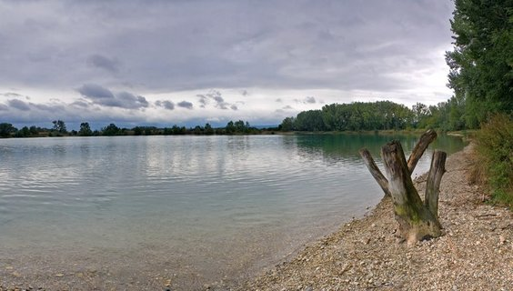
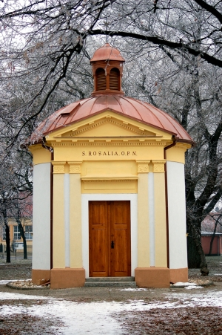
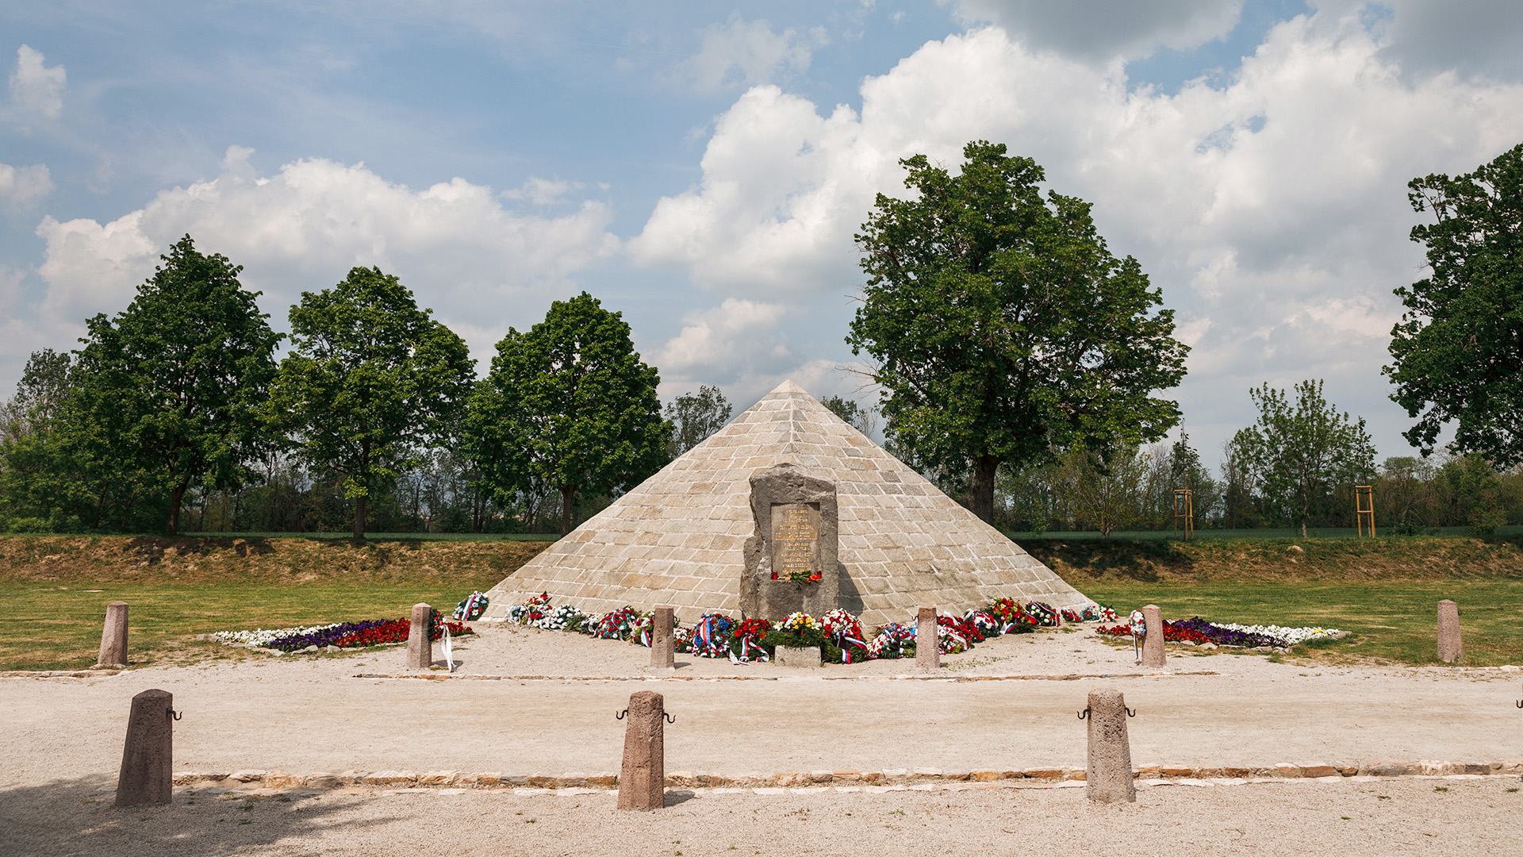
Bike path JuRaVa
It is very nice place for cycling for families.
Manor house with park
It is in center of village. It was build in 18. century for family Grassalkovich.
Church st. John
It is opposite manor house. It was build in 18.century. In front of church are 2 statues – st. Donát and st. Florian.
Lake Štrkovka
Families go there in the summer to relax. You can swimm there and see fishes.
Mohyla M.R. Štefánika
It si place where the plane crashed with general M.R. Štefánik.
Squirells live around mohyla.
Chapel of st. Rosalia
Build in memory of end of plague epidemy.

