Slide 1
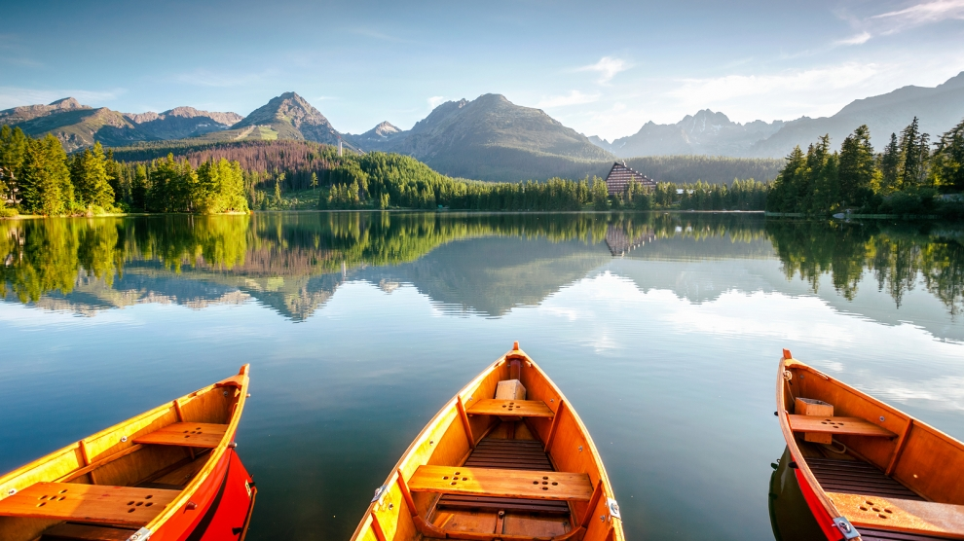
Slovakia
The Beautiful Heart of Europe
Completed by Dávid Rehák

Slide 2
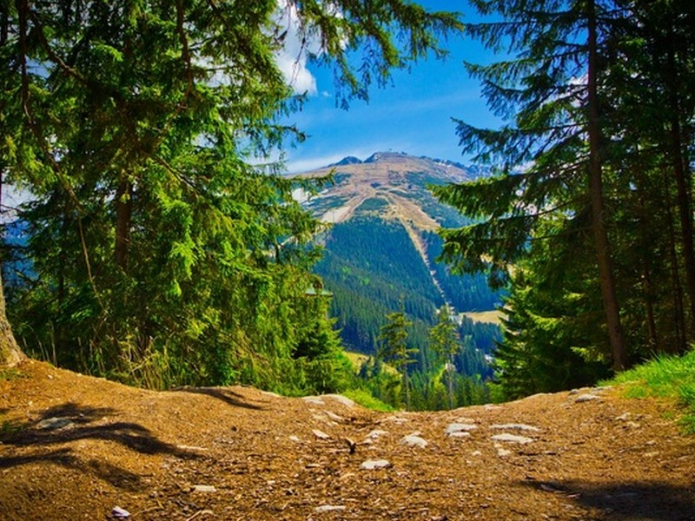
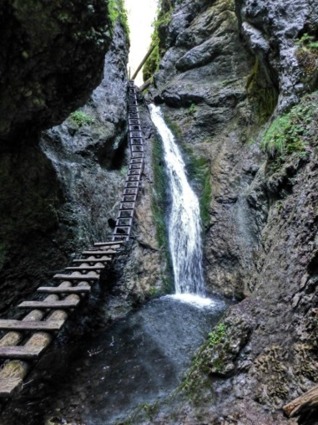
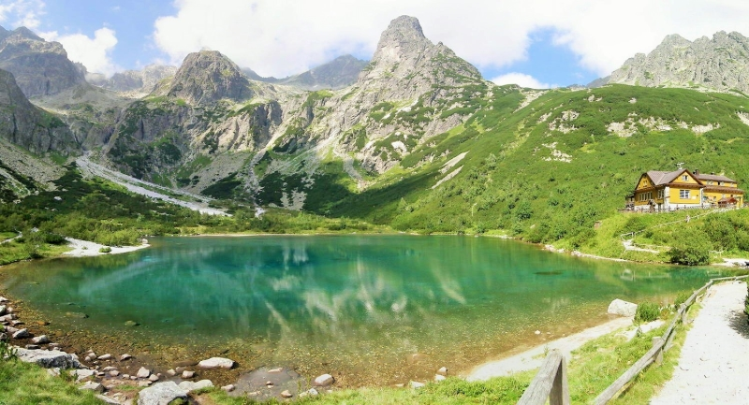
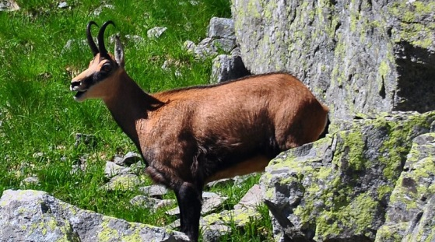
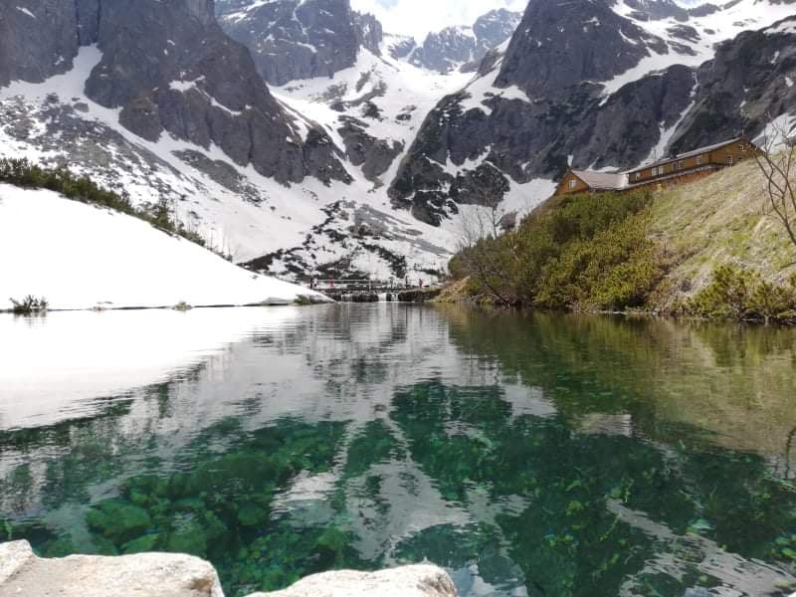
Nature
There are nine national parks in Slovakia. They are very beautiful. These include, for example, TANAP or Slovak Paradise.
Slovak Paradise
NAPANT
Chamois in TANAP
Green Lake
Green Lake in Winter
The Green Lake is located in TANAP, near the village Tatranska Javorina. There are two cottages nearby. It is very nice even in winter and still has a beautiful turquoise color.

Slide 3
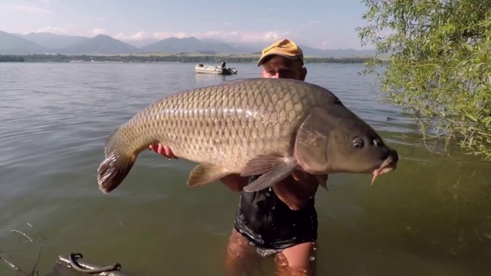
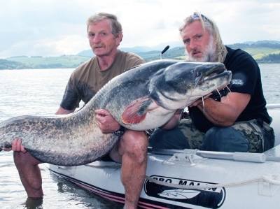
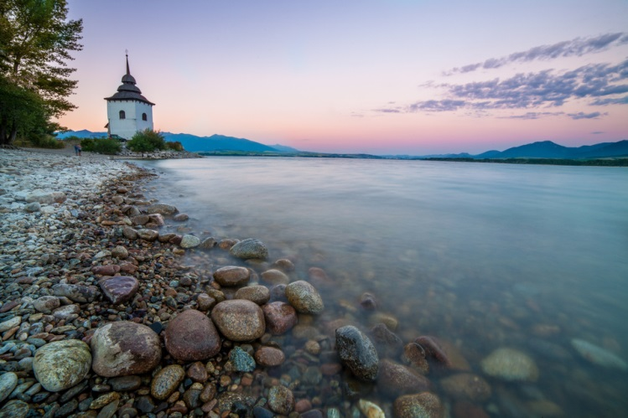
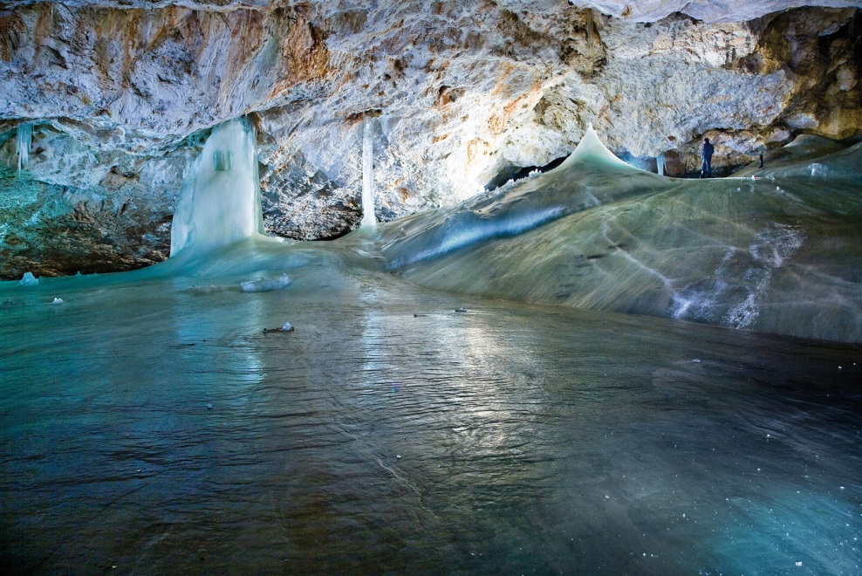
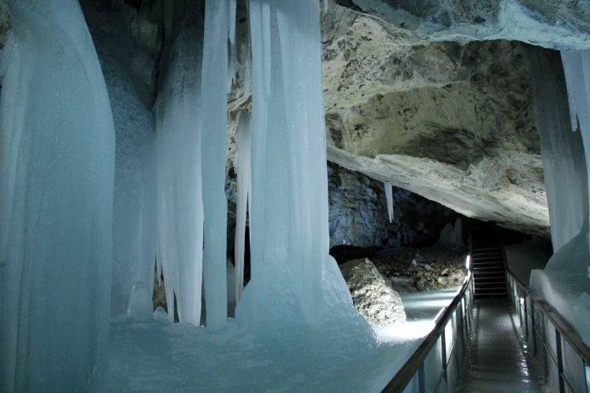
Liptovska Mara
Carp in Liptovska Mara
Liptovska Mara, also called the Slovak Sea, is a large reservoir. It is located near Liptovsky Mikulas. There are a lot of big fish in the lake so it is a good place for enthusiastic fishermen
Catfish caught in Liptovska Mara
We have more than 7000 caves. For example: Demanovska cave of Liberty or Dobsinska ice cave.
Dobsinska Ice Cave
Dobsinska Ice Cave is very beautiful. There are many ice stalactites and stalagmites. It is located in the Slovak Paradise National Park.
Beautiful ice decoration in Dobsinska Ice Cave

Slide 4
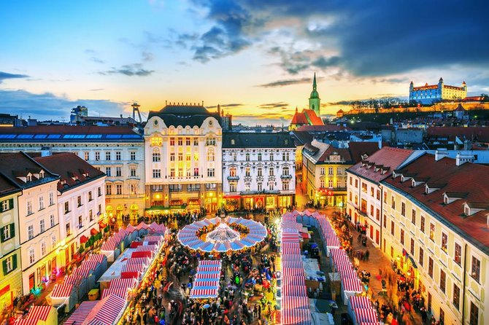
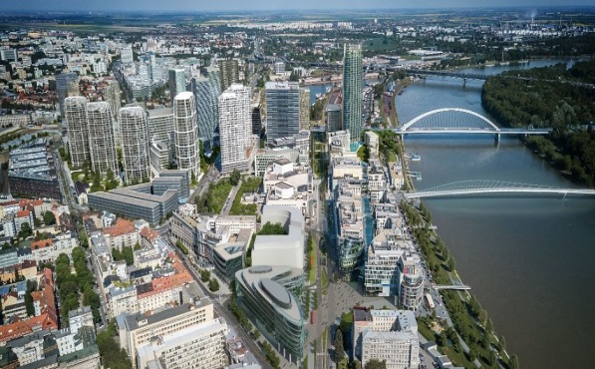
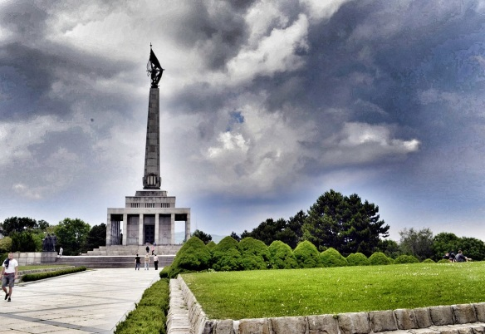
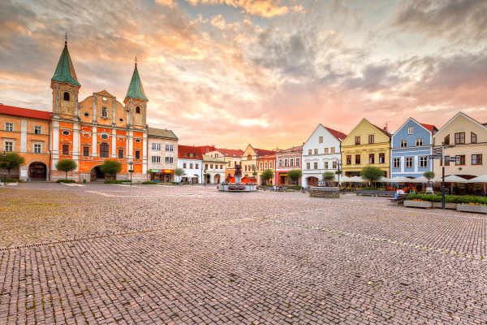
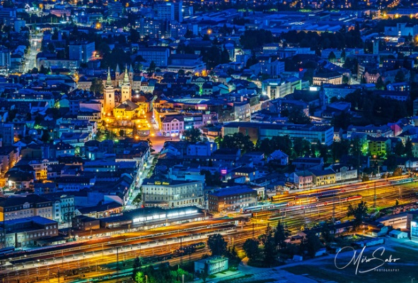
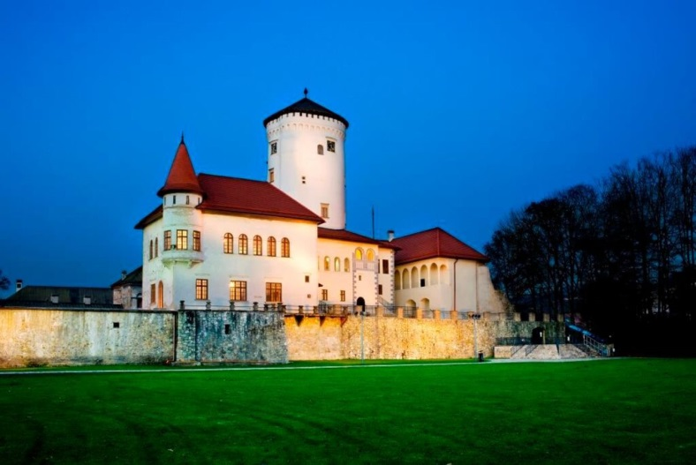
Towns
Bratislava
Bratislava is a capital city of Slovakia. It has many parts. Many kings, such as Maria Theresa, were crowned here.
Slavin
Old town (part of Bratislava)
There are seven bridges in Bratislava
Zilina
Zilina is a big town in Slovakia. There is
a nice square and the City Castle.
Square in Zilina
Zilina at night
Castle of Zilina

Slide 5
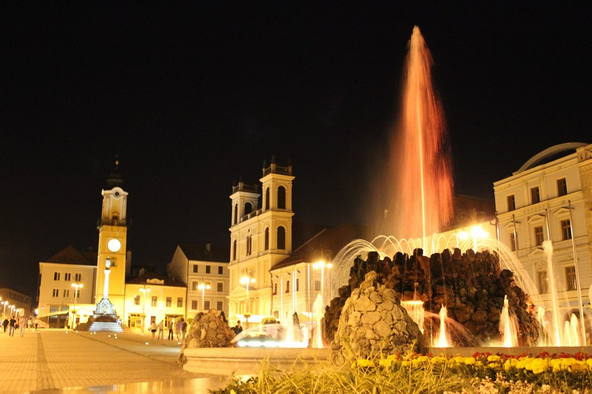
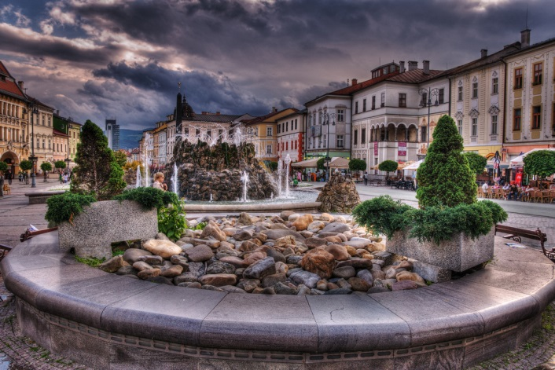
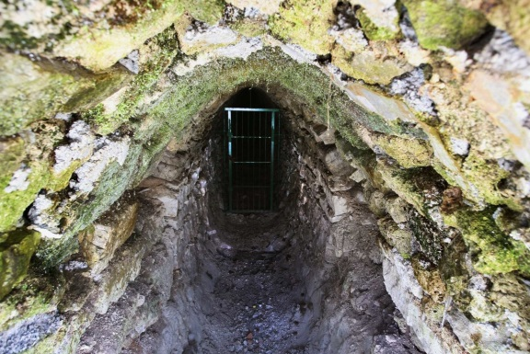
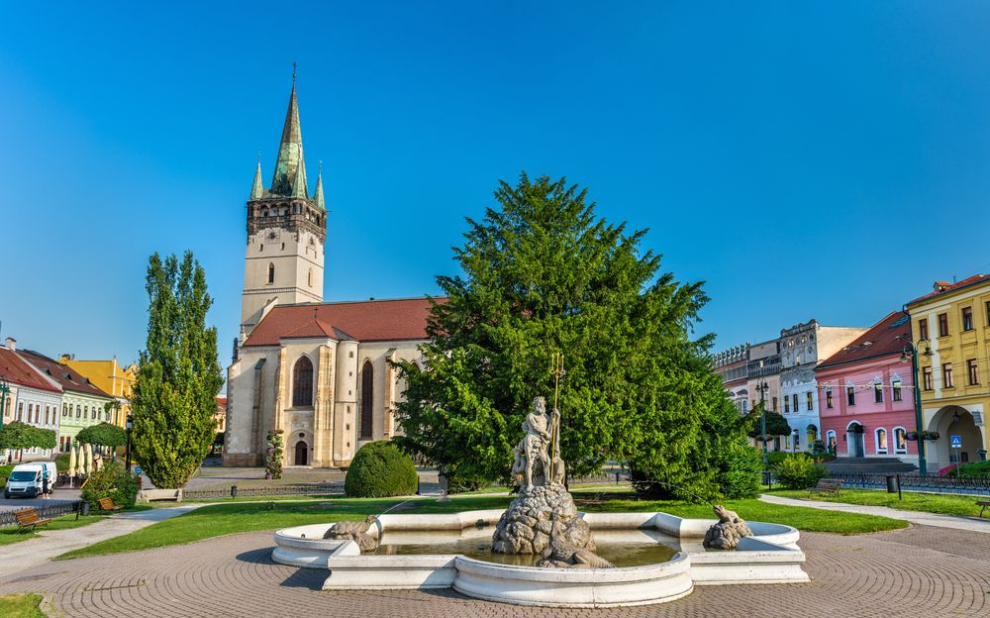
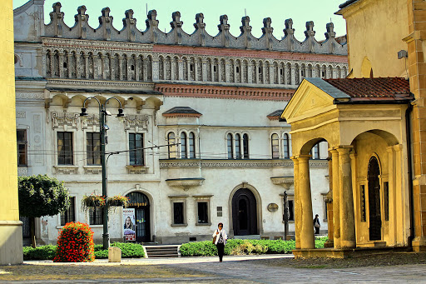
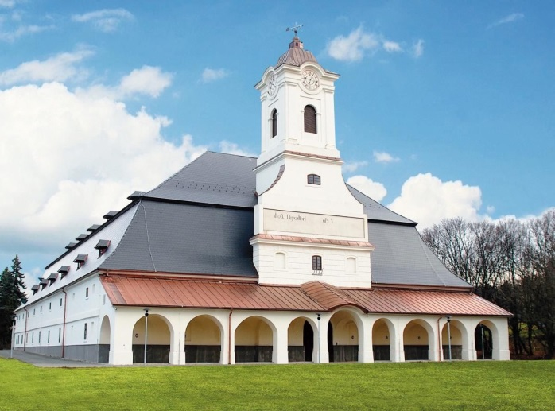
Banská Bystrica
Banska Bystrica is a beautiful city surrounded by mountains. Nearby is a geopark-important mineral deposit.
Square in Banska Bystrica
Singing fountain in Banska Bystrica
Geopark in Banska Bystrica
Neptune fountain in Presov
Presov
Presov is a town in eastern Slovakia. There are many historical monuments. There is also the only salttern in Slovakia.
Saltern in Presov
Rakoczi Palace

Slide 6
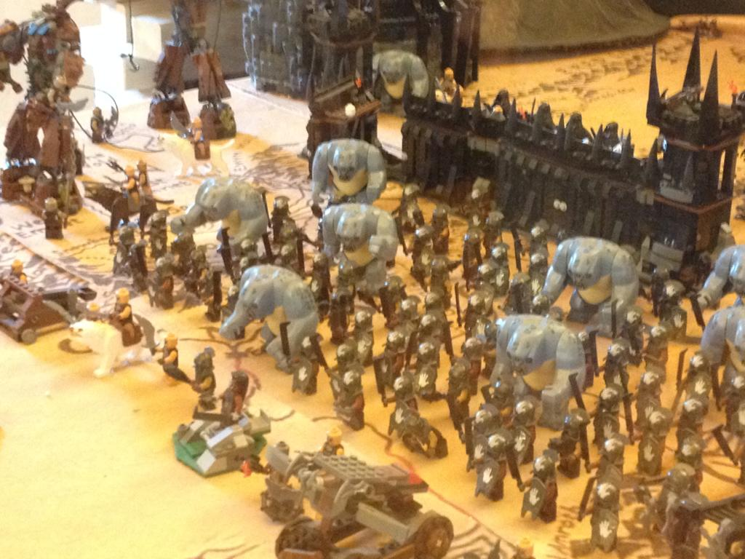
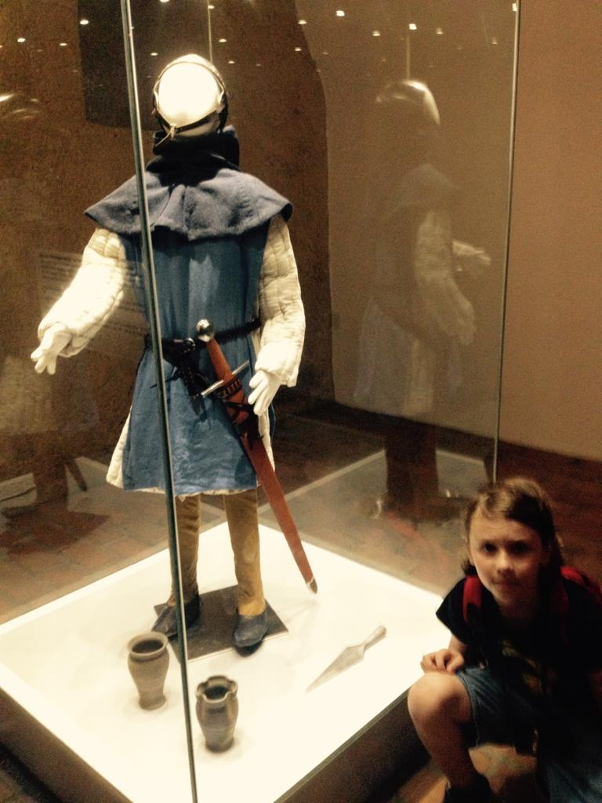
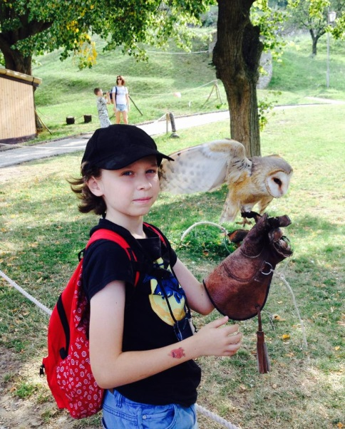
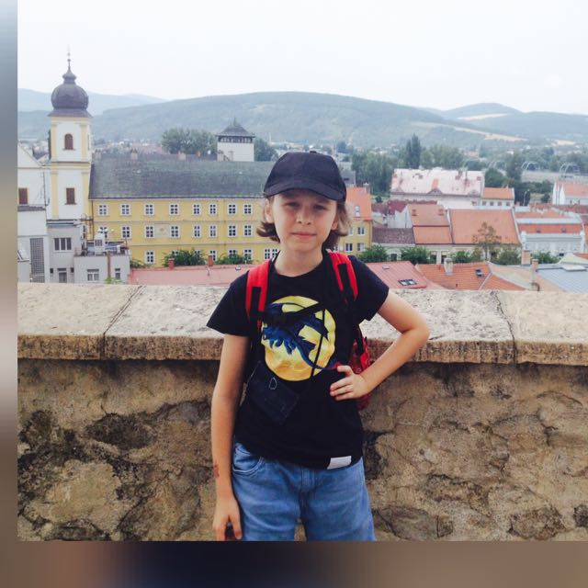
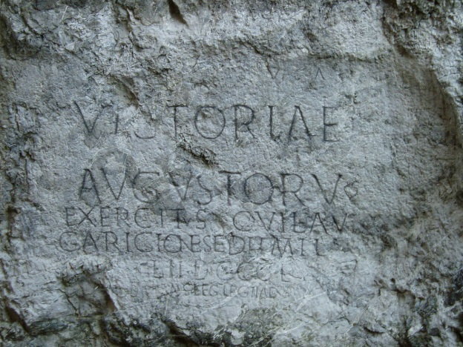
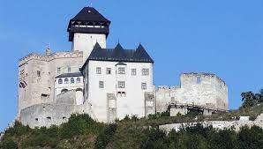
History
Slovakia is rich in various historical monuments such as castles, palaces or mines.
Trencin Castle
Trencin Castle is indeed one of the most beautiful castles in Slovakia. There are falconers in the castle garden and there are often small souvenir shops. The castle has two parts. There are various exhibitions about the past in the first part of the castle plus one that is constantly changing. This is, for example, a lego or a fairy tale exhibition. Below the castle, there is a hotel from which you can see a Roman inscription on a rock from the period of antiquity.

Slide 7
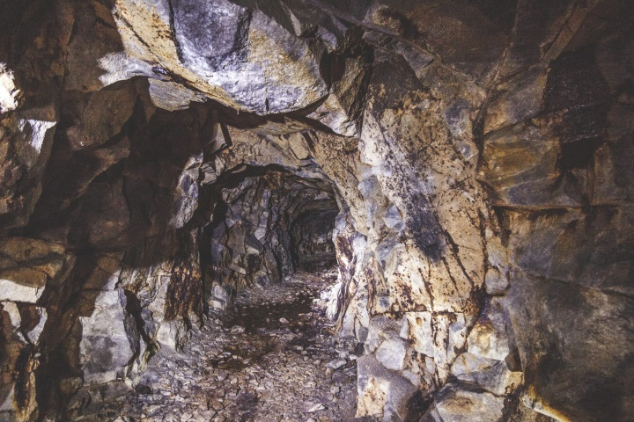
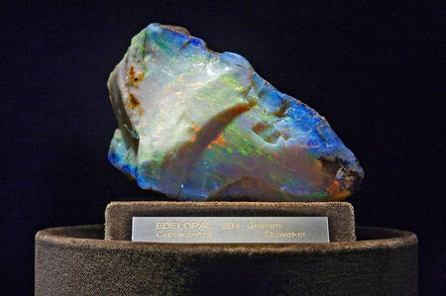
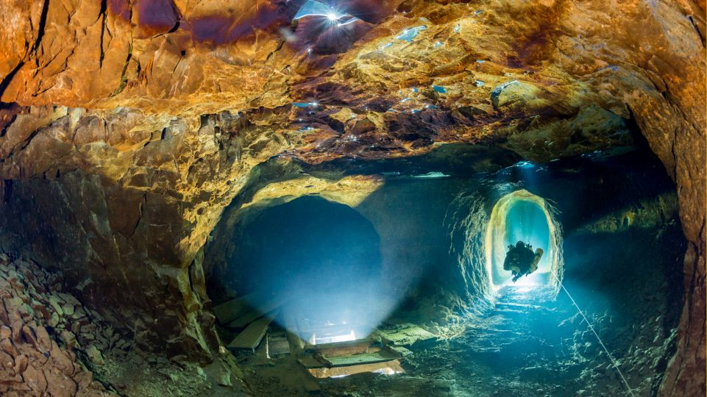
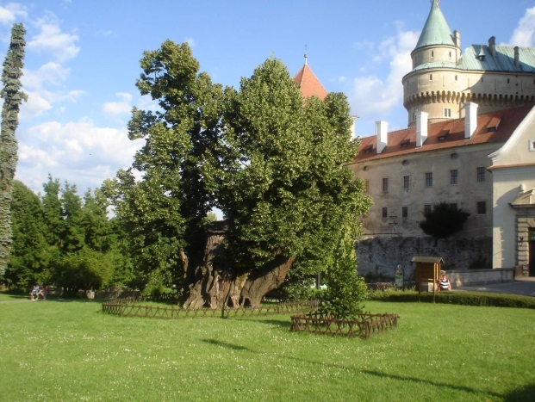
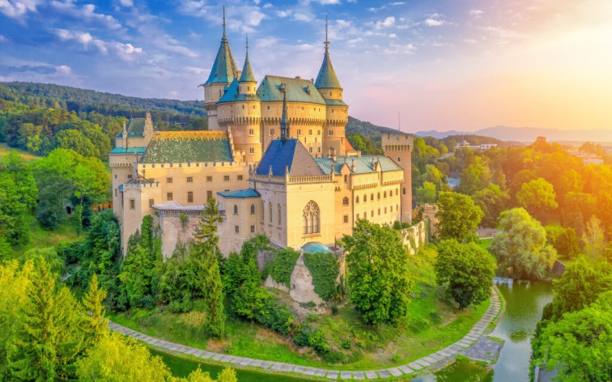
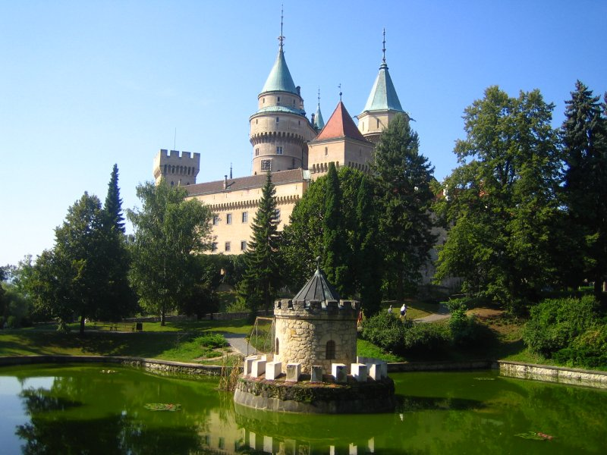
Dubnik opal mines
Dubnik opal mines are located near Presov in the village Cervenica. For a long time they were the only known opal mines in the world. The largest infused opal in these mines is Harlequin. Its price was estimated at 700,000 Dutch guilders. Today it is located in the Vienna Museum. There is also a pile on which you can find opals and take them home.
Harlequin
Bojnice Castle
Bojnice castle is a beautiful castle in the town of Bojnice. There are various exhibitions inside. The large zoo is near the castle. Below the castle is a botanical garden and outside Matej's linden tree - the oldest tree in Slovakia. The castle is a bit like a castle for Cinderella in Disneyland.
Matej's linden tree

Slide 8
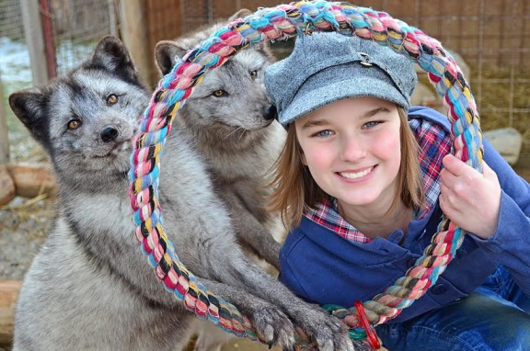
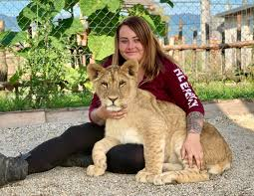
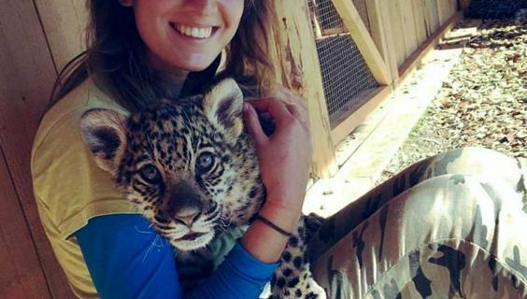
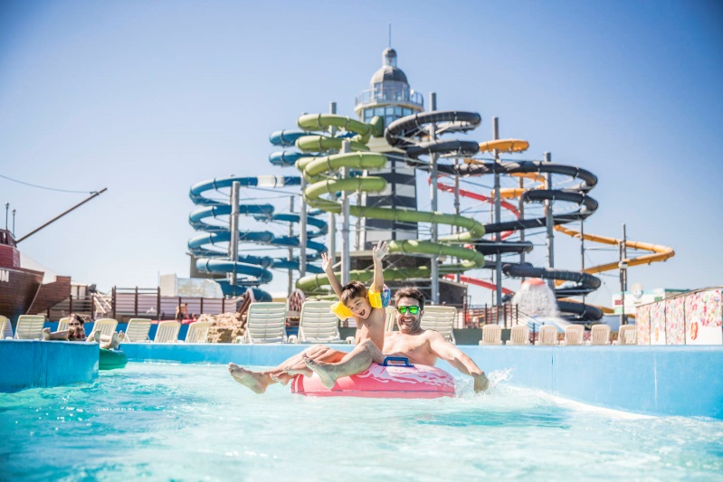
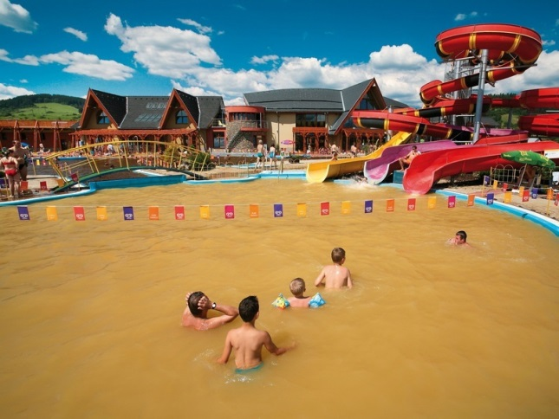
With kids
There are many zoo parks in Slovakia. For example Zoo Contact in Liptovsky Mikulas or Zoo Bojnice.
Zoo Contact Liptovsky Mikulas
You can pet different animals in The Zoo Contact. One can feed them and play with them. For example, you may have a parrot on the head or a snake around the neck.
There are also many aquaparks in Slovakia. For example aquapark Senec or aquapark Besenova.
Aquapark Besenova
Aquapark Besenova is a big aquapark in middle Slovakia. There are many attractions in it, for example, a water castle or a big water slide.

Slide 9
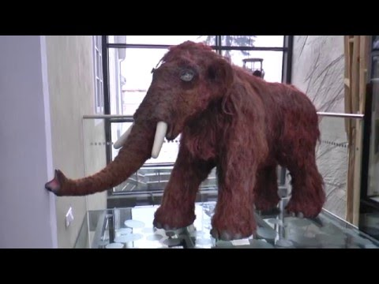
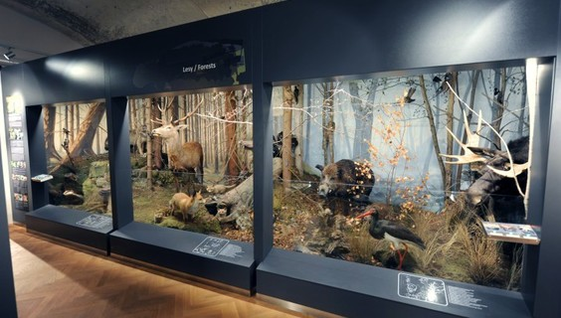
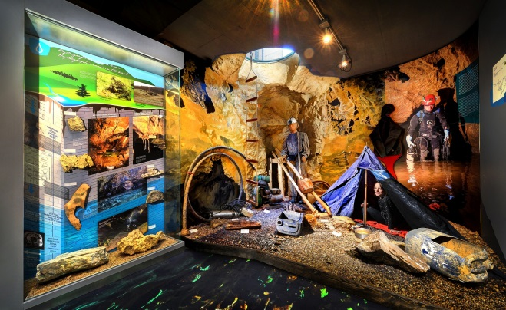
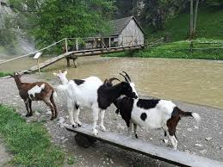
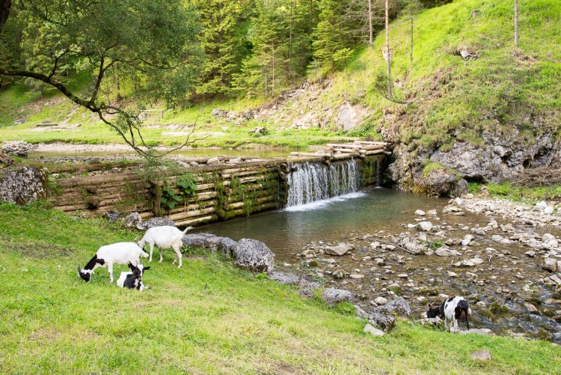
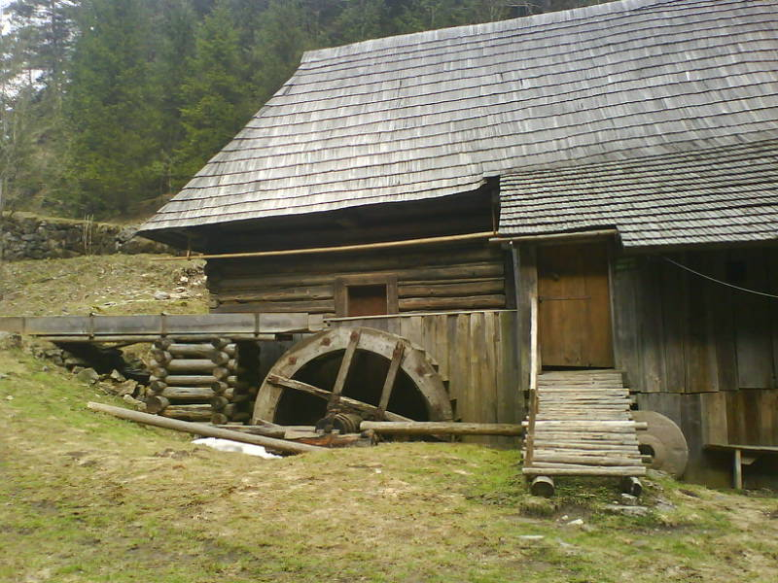
We have a lot of museums in Slovakia. For example Slovakia National Museum or SMOPaJ.
SMOPaJ (Slovakia Museum of Nature and Caves)
SMOPaJ is a big museum in Liptovsky Mikulas, there is, for example, an exhibition about Tatra animals or about Minerals in Slovakia.
Exhibition about Tatra animals
Mamut in SMOPaJ
Exhibition about Slovakia caves
Oblazy
Oblazy are nice touristic opportunity for famillies with kids. It is located in Liptov. There is a big water mill and a lot of goats you can feed.
Goats in Oblazy
Waterfall in Oblazy

