Slide 1
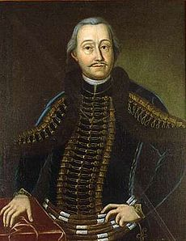
Antal Grassalkovich
1694 - 1771

Slide 2
Anton (Antal) Grassalkovich I
Probably the most important person in Ivanka pri Dunaji history
Significant Hungarian official and finally count
Lawyer of Hungarian Empire
Good friend of the Empress Maria Theresa
Founder of beautiful manor houses in Gödöllő (Jedľovo), Pozsony (Bratislava) and Aichen (Ivanka)

Slide 3
Youth and Poverty
Born in Mojmírovce u Nitry in 1694 in an impoverished family of the minor nobility
Studied at Hospitallers (milosrdní bratia) in Nitra, at Jesuits in Trnava, in Bratislava
He always remembered his difficult beginnings
As a student read under the light in Františkánské Square, as he did not have money for candles
Kept the clay bowl, which he had been bringing to Franciscan Monastery to get the soup for poor
Maria Theresa asked him about the bowl, seeing it on the dinning table next to the golden cutlery

Slide 4
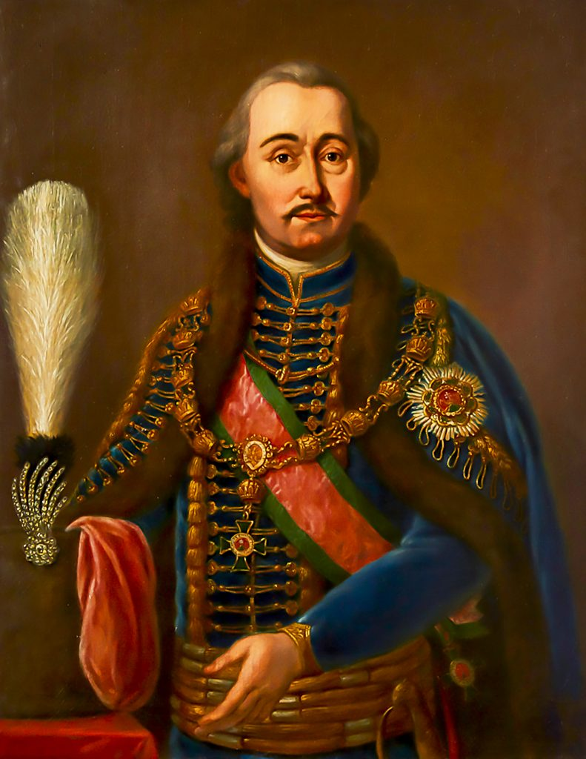
Career
Lawyer 1715
1716 working with the "Hofkammer" (the Royal Chamber), a body of the Habsburg financial administration in the 16–18th centuries
1727 president of Neoaquistica Commissio, dealing with the revision and arrangement of the chaotic ownership rights after the Turkish rule

Slide 5
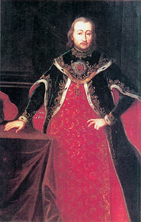
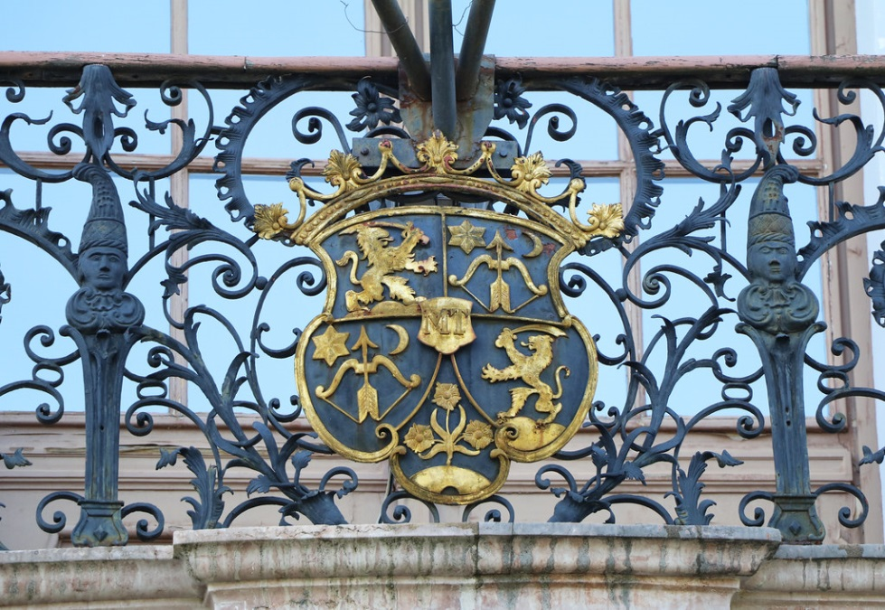
Count Grassalkovich de Gyarak
Helped Maria Theresa become Hungarian Queen
Hosted her in Ivanka and made a miracle
Sledging in summer
Became Baron and then Count
Notes:
Coat of Arms in Godollo

Slide 6
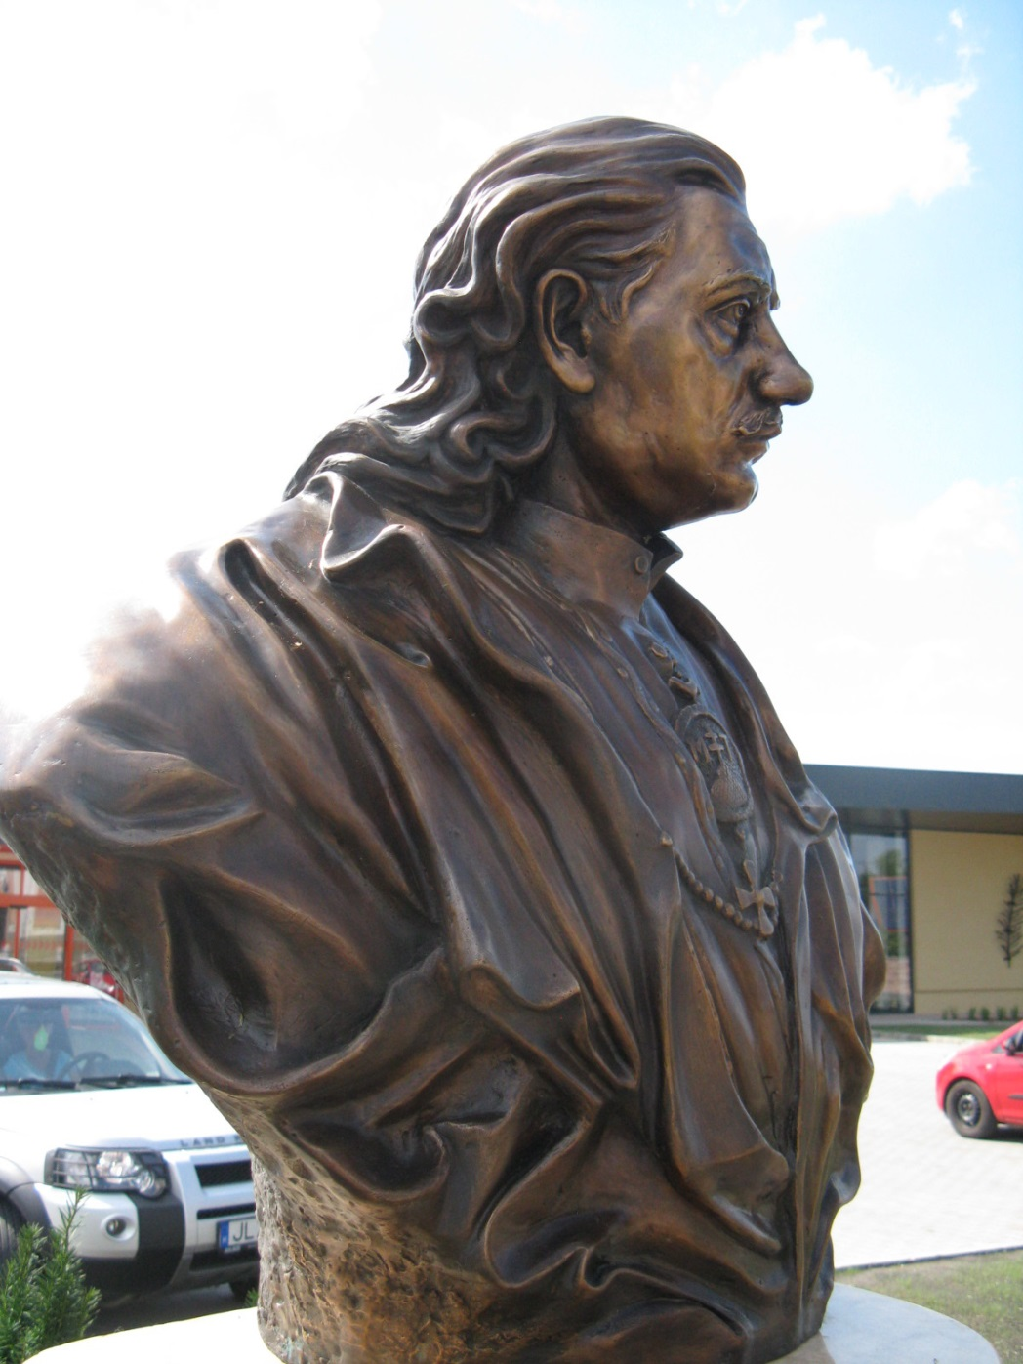
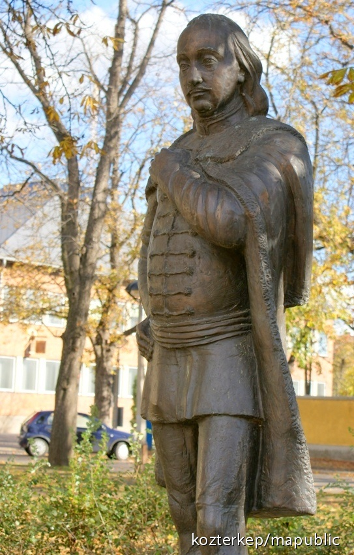
Helyszín
Hatvan

Slide 7
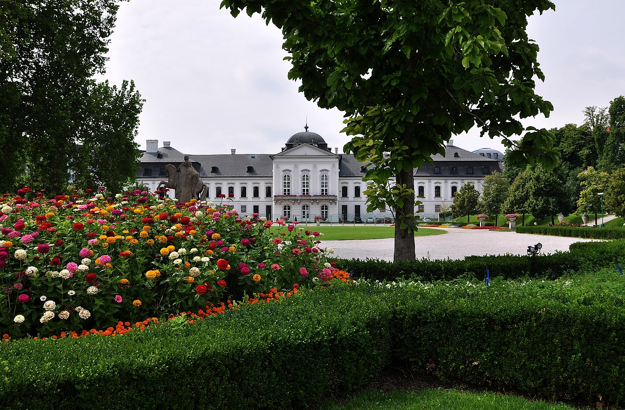
Palace in Bratislava
1760 by Andrey Mayerhofer, behind the walls
Concerts of Haydn
Now the Presidential Palace

Slide 8
Manor House in Ivanka pri Dunaji
Notes:
Čítanie z knihy Ivanka v plynutí času

Slide 9
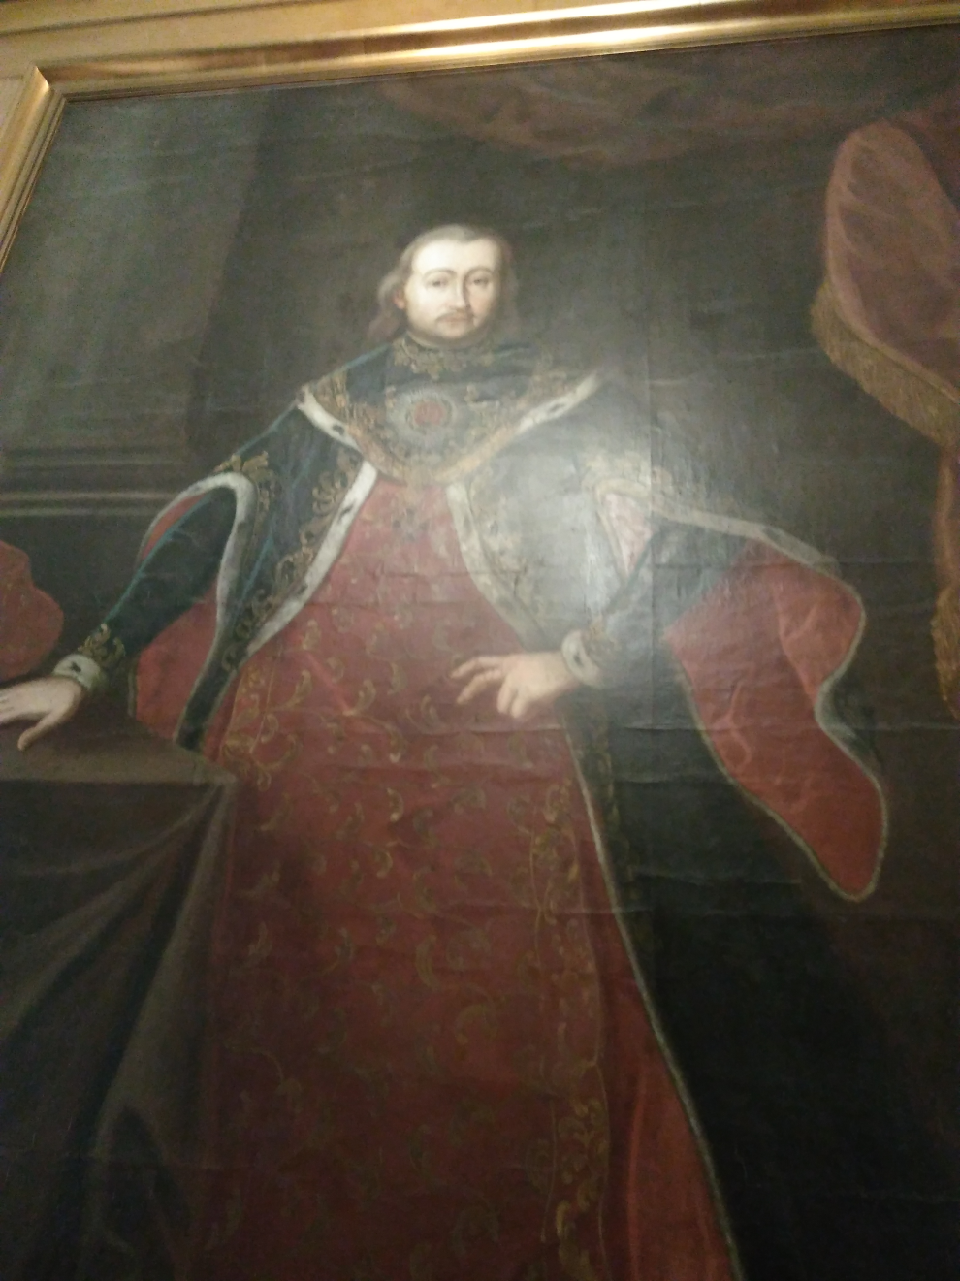
Palace in Gödöllő
The largest Baroque palace in Hungary and probably the most beautiful
After Antal III died, it was given to the Emperor Franz Josef and his wife Sissi
Sissi loved to come here
Damaged by the Soviet Army
Still being reconstructed

Slide 10
Gödöllő

Slide 13
Máriabesnyő Basilica of Our Lady of Assumption
Antal I built 33 churches
Baroque Capuchin church
Built in 1762-1769
A worker found a little sculture of Maria made of bone
Crypt of Grassalkovich family
Antal III was originally buried in the crypt in Ivanka
His widow, Maria Leopoldina took his remnants here, as well as his parents

Slide 14
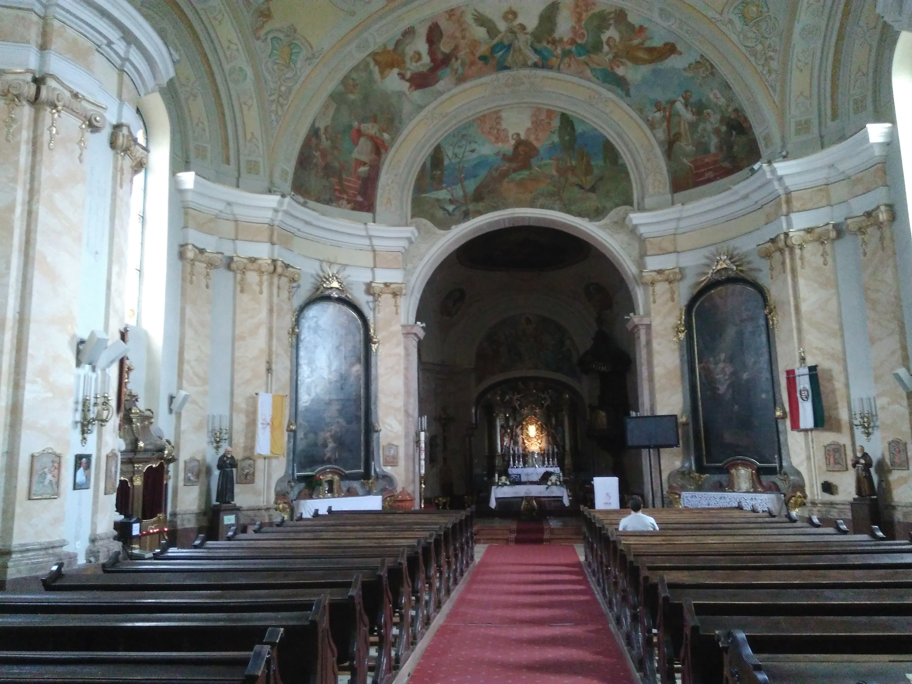

Slide 15
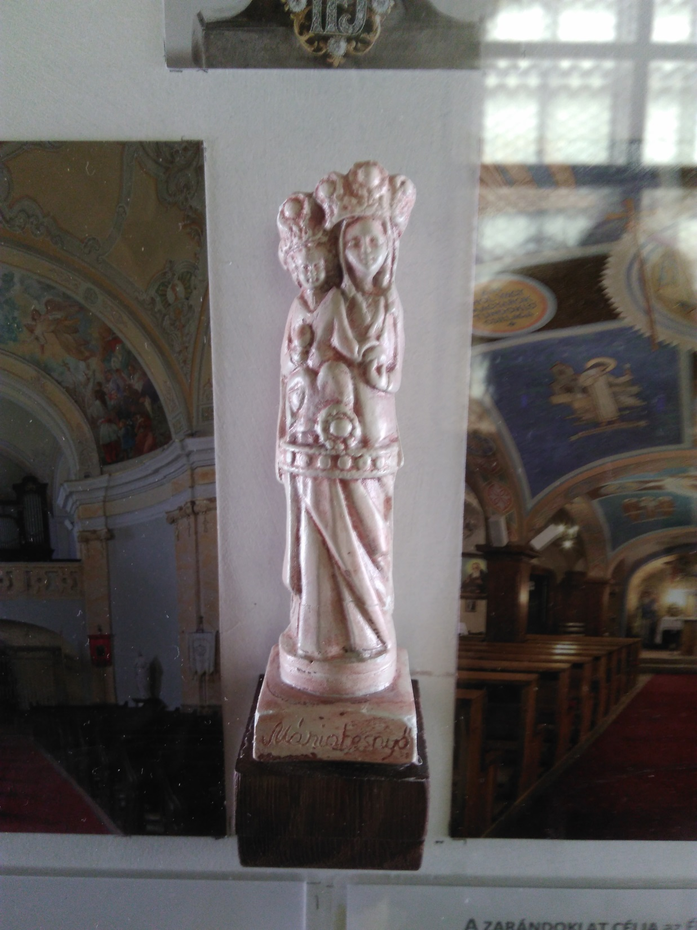

Slide 16
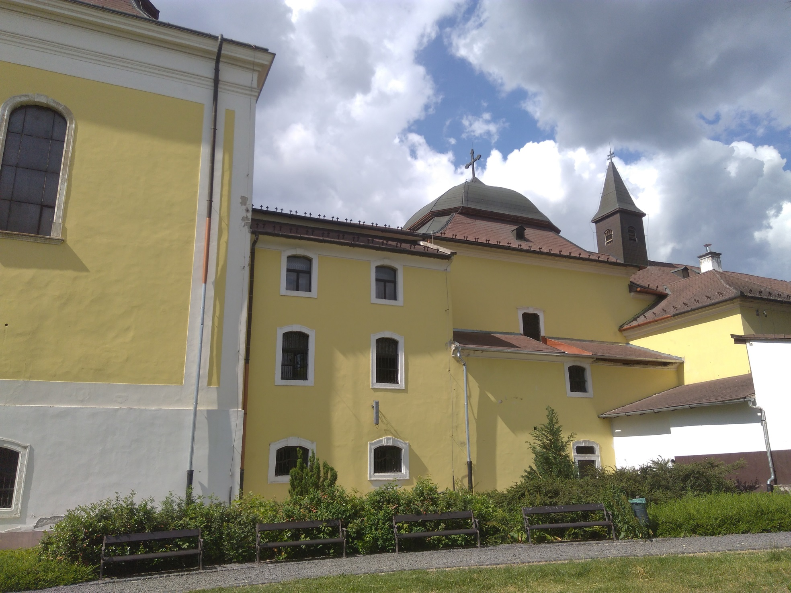

Slide 17
References
Škulavík, P. et al: Ivanka pri Dunaji v plynutí času. Ivanka pri Dunaji a HSI 2009, 71-77
Judita Blahutiaková: Prednášky v IC a v kostole v Ivanke, 2018
https://sk.wikipedia.org/wiki/Anton_I._Grasalkovi%C4%8D
https://en.wikipedia.org/wiki/G%C3%B6d%C3%B6ll%C5%91
https://hu.wikipedia.org/wiki/Grassalkovich_Antal_(korona%C5%91r)
https://hu.wikipedia.org/wiki/M%C3%A1riabesny%C5%91
https://www.kozterkep.hu/10926/grassalkovich-antal
https://www.orszagalbum.hu/grof-grassalkovich-antal_p_100958
https://cs.wikipedia.org/wiki/Grasalkovi%C4%8Dov%C3%A9
https://www.flickr.com/photos/travfotos/39935532371

