Slide 1
Guide about my country
Júlia Safková

Slide 2
Slovakia Main informations
Slovakia is situated in middle in Europe. There is „heart of Europe“.
Slovakia has 49 035 square kilometers in area.
In Slovakia we haven‘t got any sea.
Slovak country has got borders with Hungary, Poland, Czechia, Austria, Ukraine.
Capital city of Slovak Republic is Bratislava

Slide 3
Slovakia Climate
Slovakia has got warm summers and cold winters
In South is hotter than in North
The most coldest places are in mountains.
Temperature is usually between -20°C in winter and 40°C in summer

Slide 4
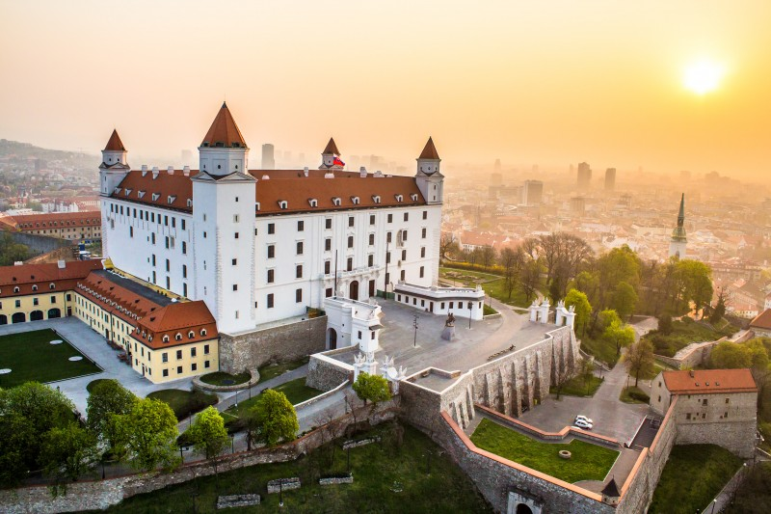
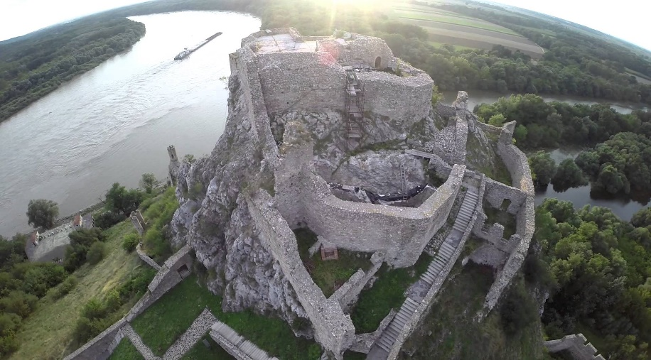
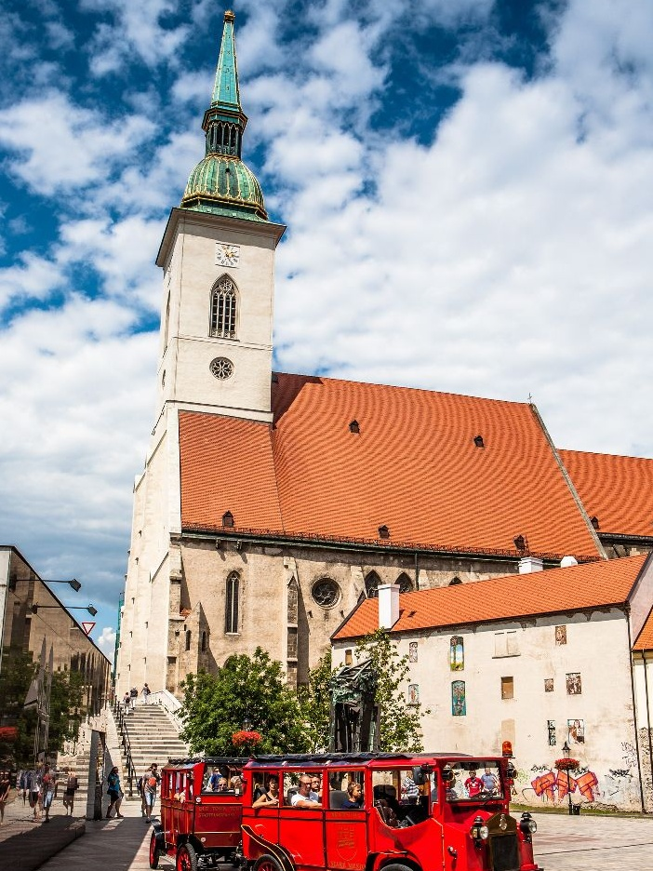
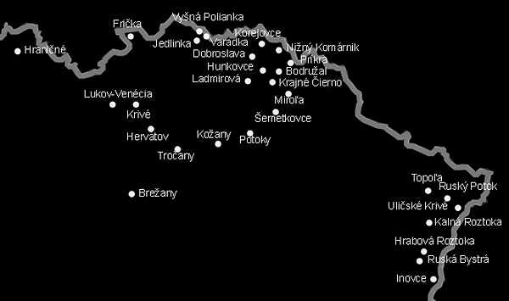
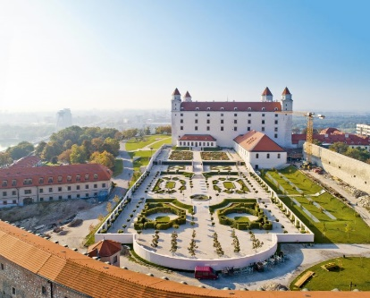
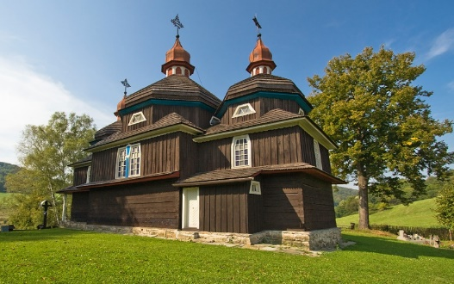
The most interesting places in Slovakia
Bratislava castle and town sightseeing and Devin castle
Banska Stiavnica town sightseeing
Wooden churches in the East of Slovakia
All in list of the world cultural heritage sites of UNESCO

Slide 5
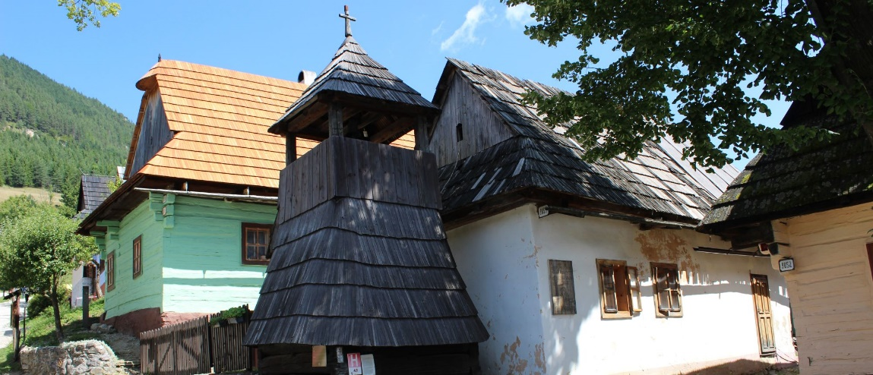
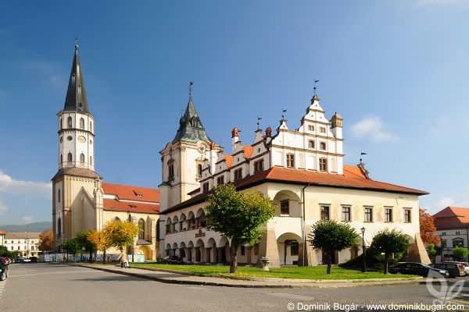
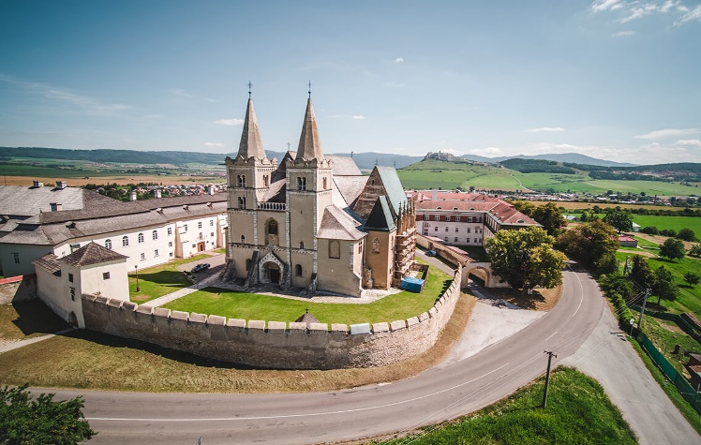
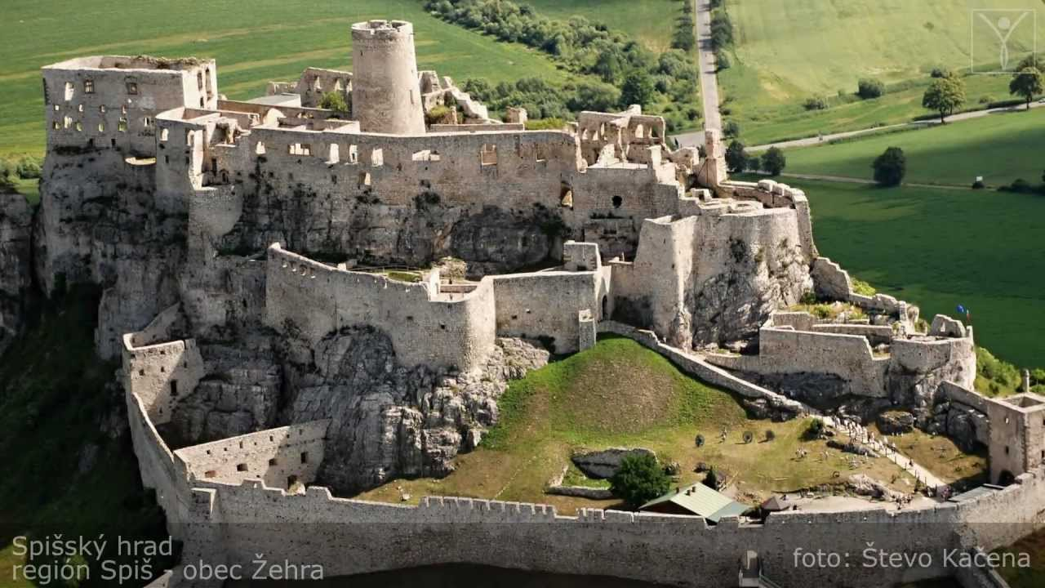
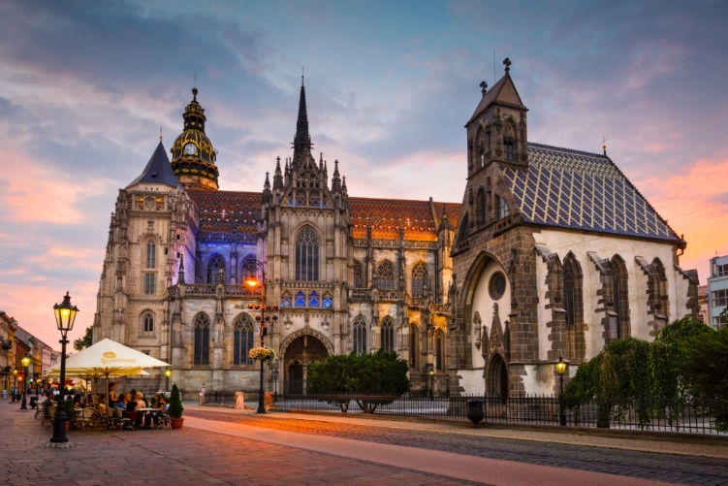
The most interesting places in Slovakia
Folk architecture in Vlkolinec
Historic town Levoca
Spis castle and Spisska kapitula town
All in UNESCO sites
Košice and Gothic Cathedral of st. Elisabeth

Slide 6
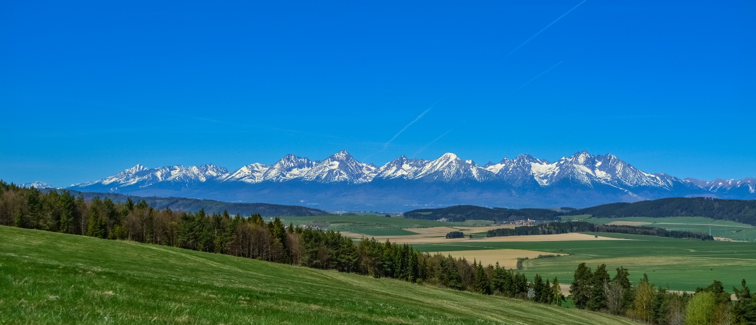
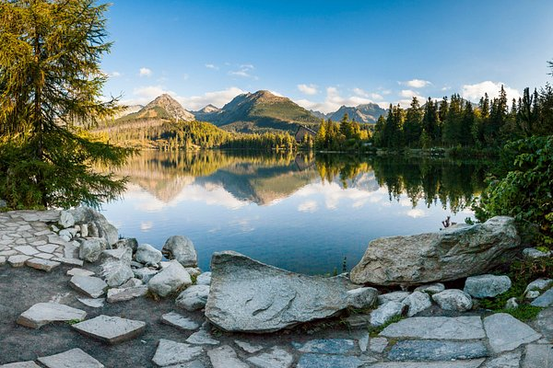
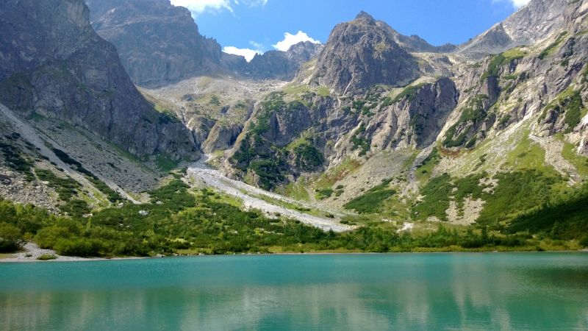
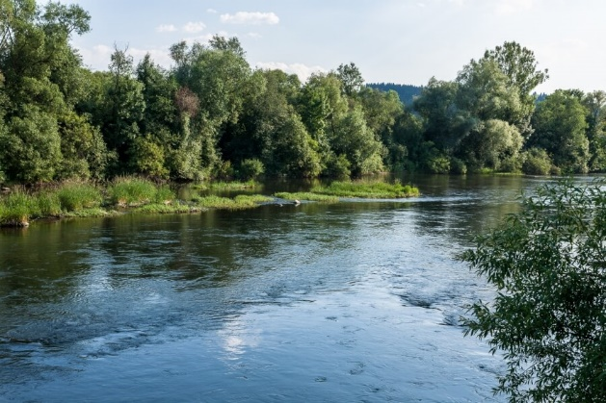
HighTatra mountains
Walking in the High Tatra mountains
Strbske pleso (glacial lake)
There are about 35 valeys, more than 110 Tatra peaks.
The longest river Vah springs there
High Tatra mountains

Slide 7
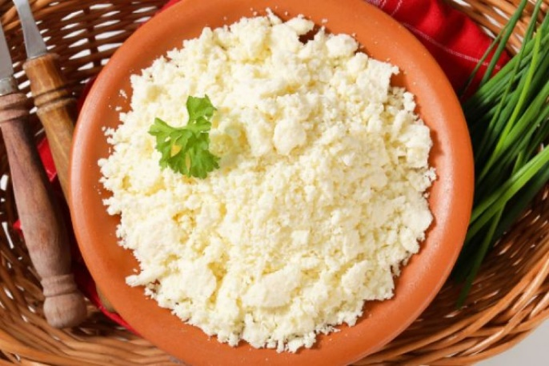
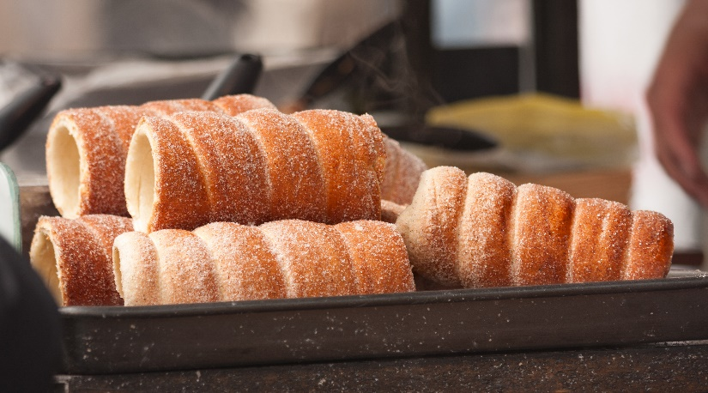
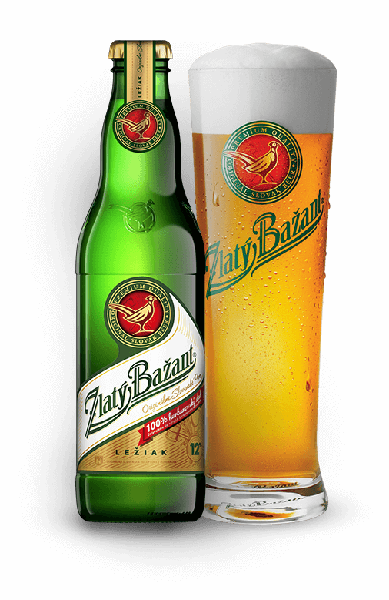
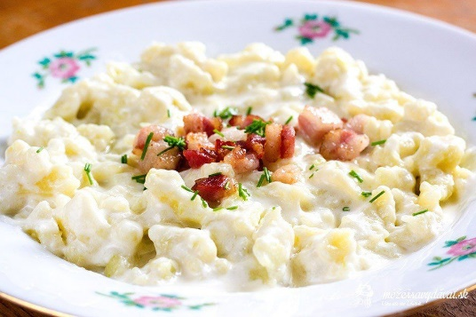
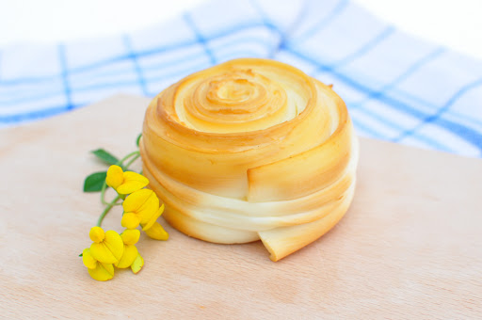
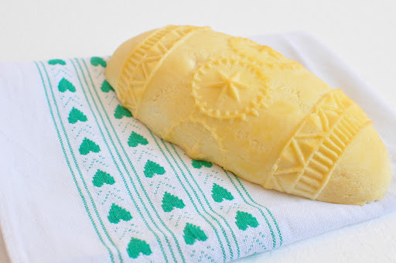
National food in Slovakia
Bryndza cheese
Dumplings with sheep‘s cheese
Funnel cake
Pierogis stuffed with bryndza
Parenica and ošriepok (traditional Slovak cheeses)
Golden phasant beer
Bacon

Slide 8
Thanks for watching
Júlia Safková

