Slide 1
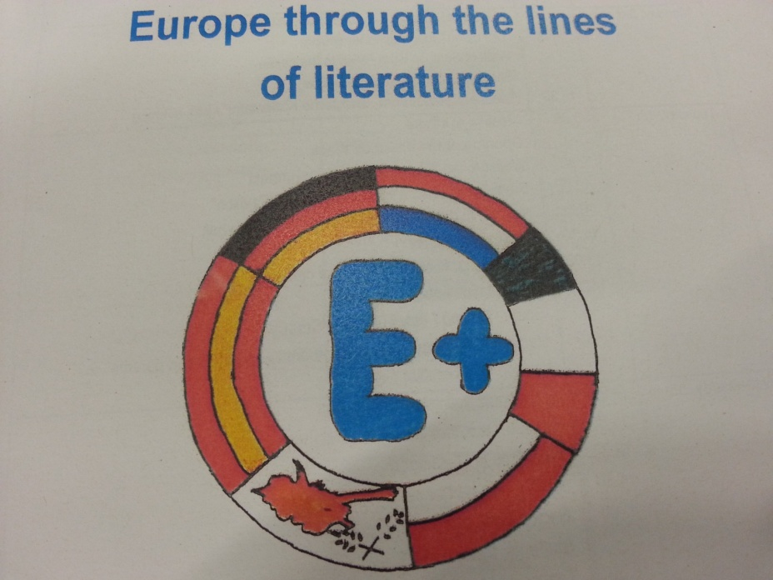
National Park WATTENMEER -
Schleswig-Holstein, Germany
III E - Palombini - Rome - 2015/2016

Slide 2
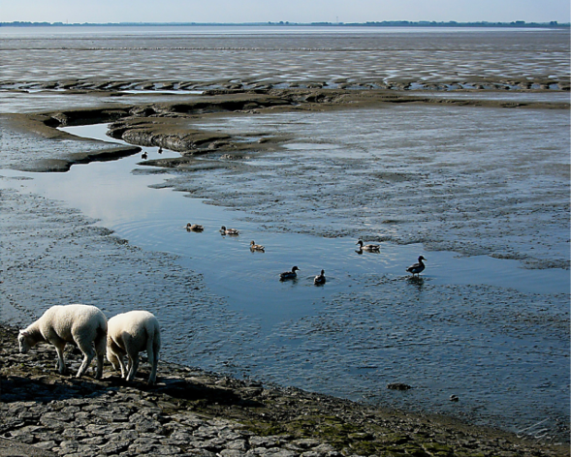
between Netherlands and Denmark :
the largest continuous tidal flats in the world
Twice a day the seabed meets the horizon: low tide exposes tidal flats full of worms, mussels and snails – a feast for birds
placed on the UNESCO World Heritage List in 2009.

Slide 3
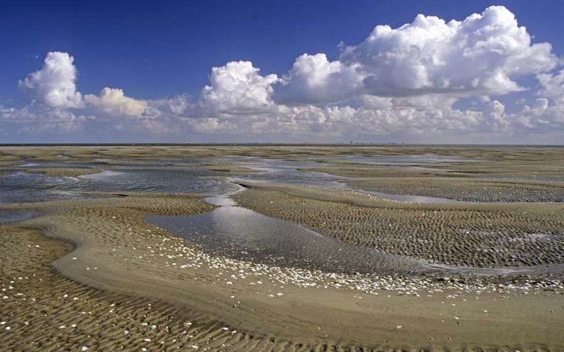
Why is it so important?
The tidal flats contain a high animal biomass : it’s something like a tropical forest, as variety. Beside crabs, mussels and snails there is a microcosm of tiny living creatures.

Slide 4
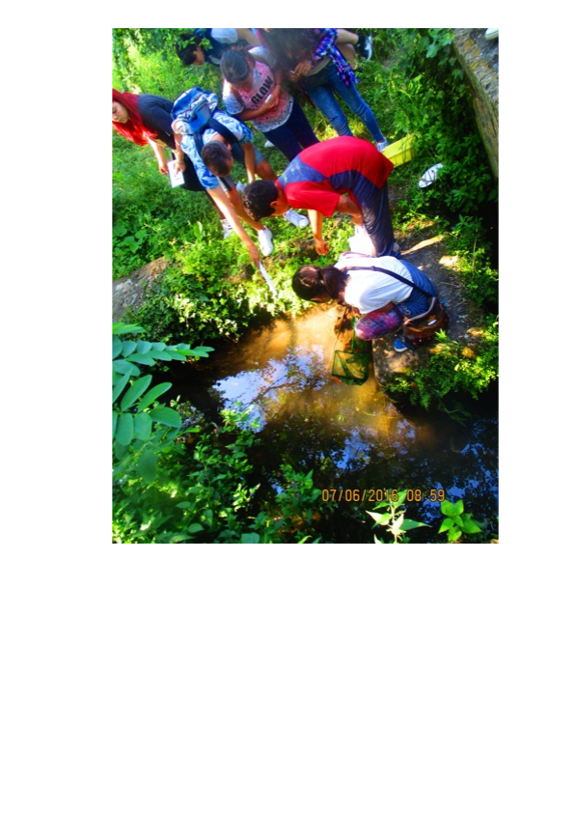
BIODIVERSITY
We analyze our neighborhood ; our school lies close to the Aniene Fluvial Reserve. In the river and in the streams of the catchment area we can find a lot of invertebrates. They testify the quality of water and let birds to select this area during their migration road.

Slide 5
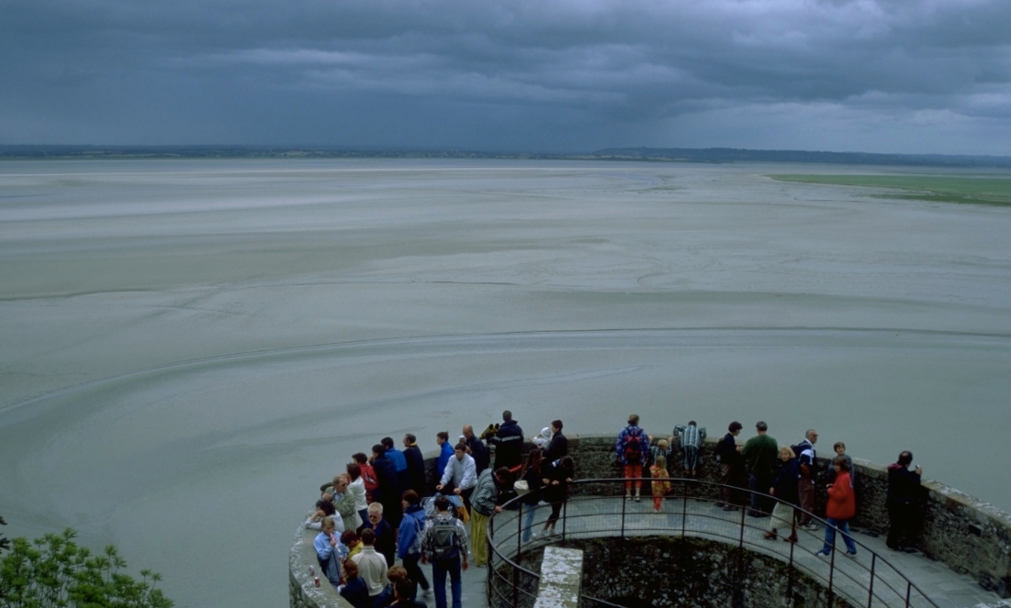
in the mediterranean area we don’t know SO BIG tidal FLOOD
Tides produce the sea level ricing until 3 meters on the Nord-Sea coasts (and until 15 meters in other places of the Earth).

Slide 6
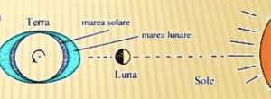
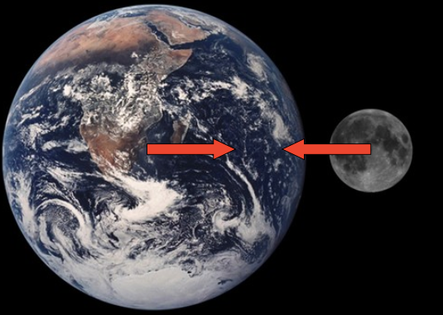
we investigate How is it possible
Because of the gravitational field of the Moon and the Sun, acting on liquid substances

Slide 7
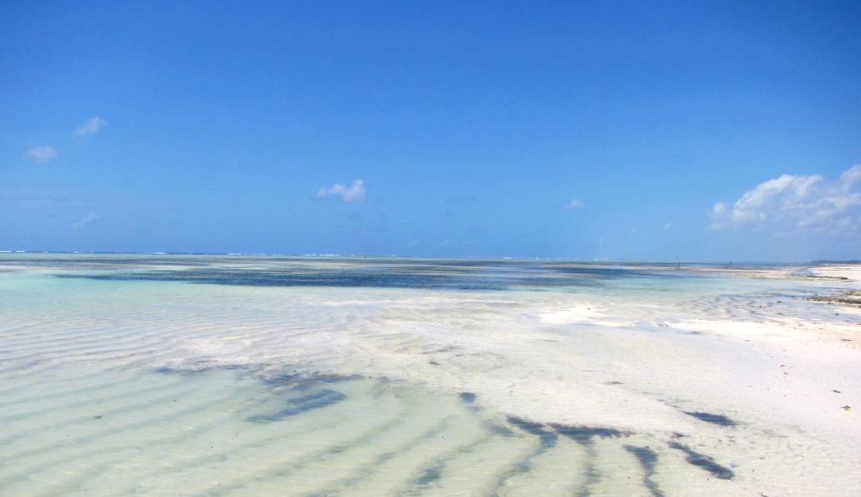
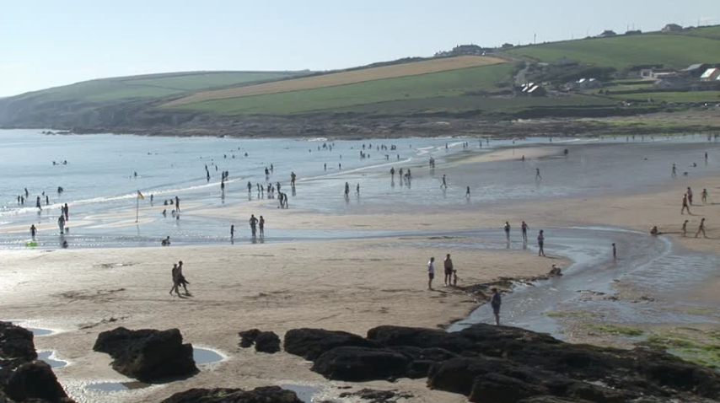
WE LOOK FOR OTHER PALCE ON EARTH WHERE TIDAL FLOOD IS SO IMPORTANT
ZANZIBAR
IRELAND

Slide 8
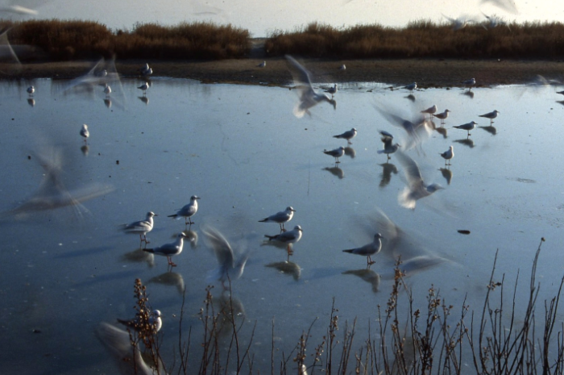
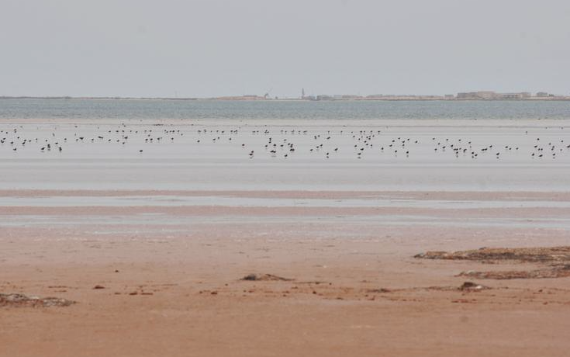
we have to safeguard this places, SO necessary in the life chain.

