Slide 1
Istituto Giovanni Palombini
Roma
Primary School - Class 5
Gastronomic specialties of German Länder

Slide 2
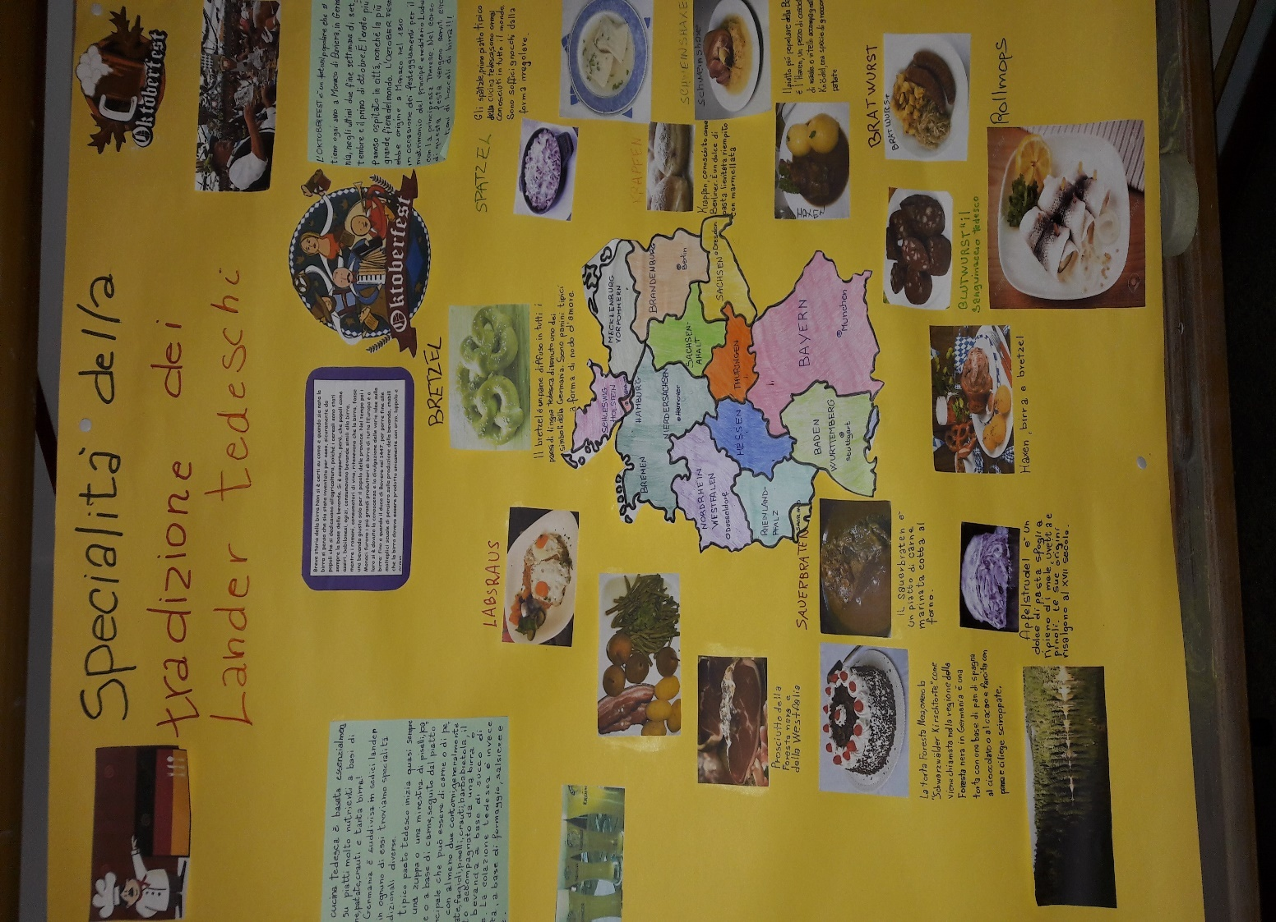
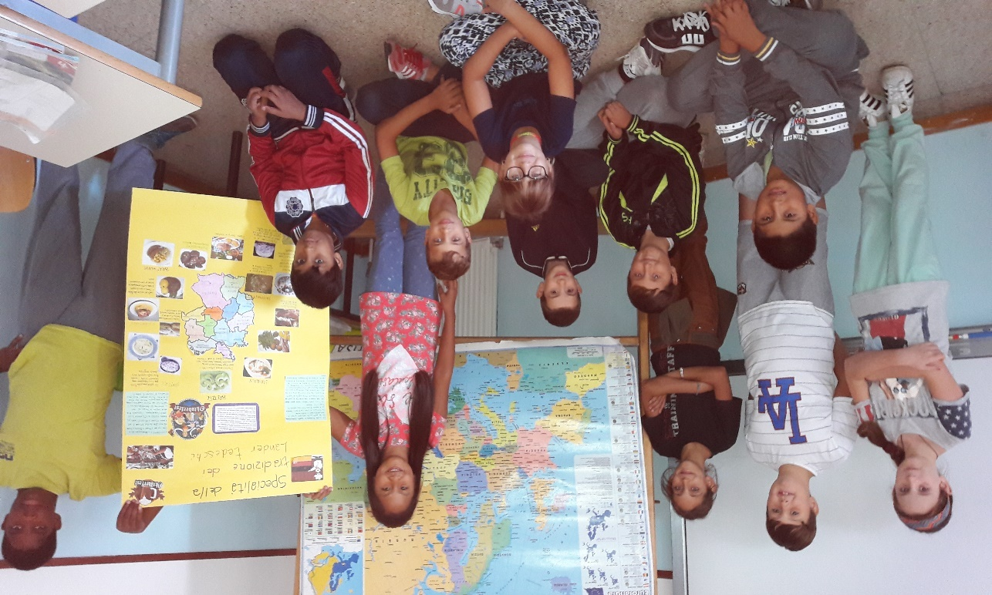
The children of the primary school realized a poster on the gastronomic specialties of the German lander. Through this activity they had the opportunity to know the geography of Germany and some interesting aspects of the culture and tradition of this great country.

Slide 3
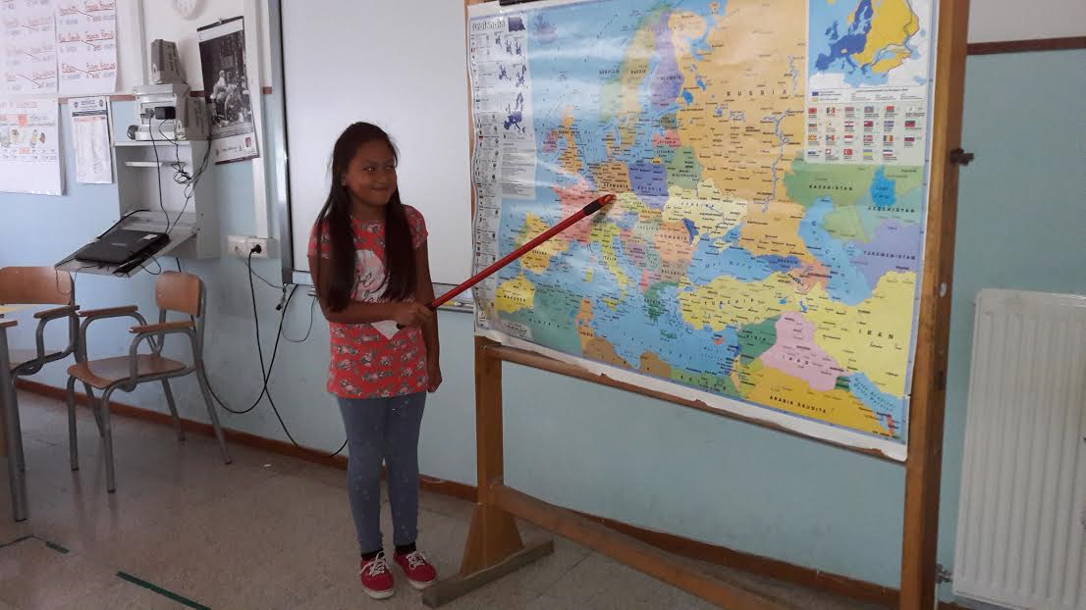
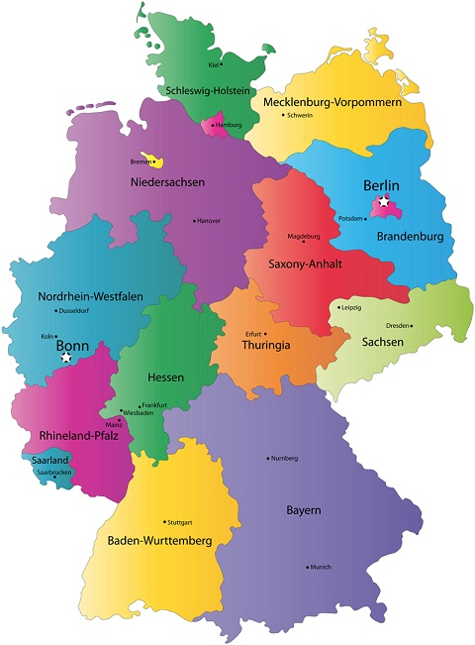
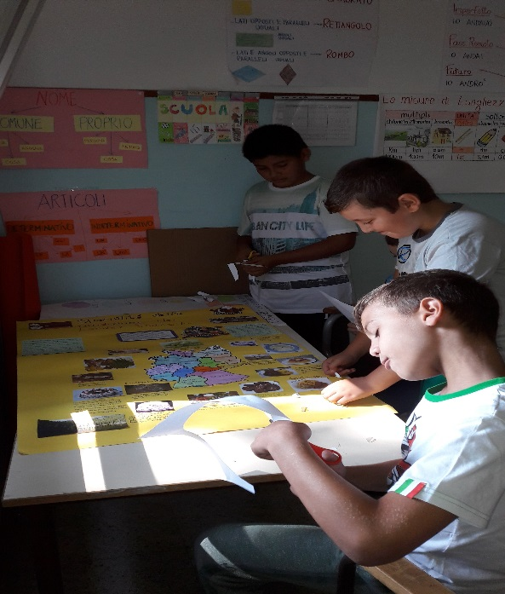
First of all we have looked for Germany in the Europe map.
It’s a big country located in the northern Europe and its capital city is Berlin.
Germany is divided in 16 lander and in each lander we have found out different traditions and various specialties.

Slide 4
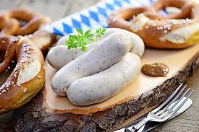
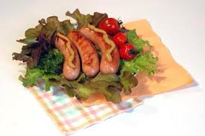
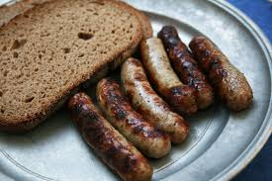
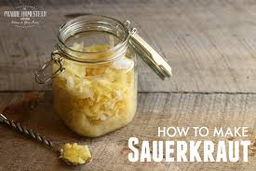
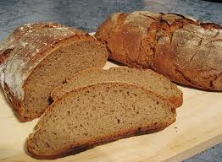
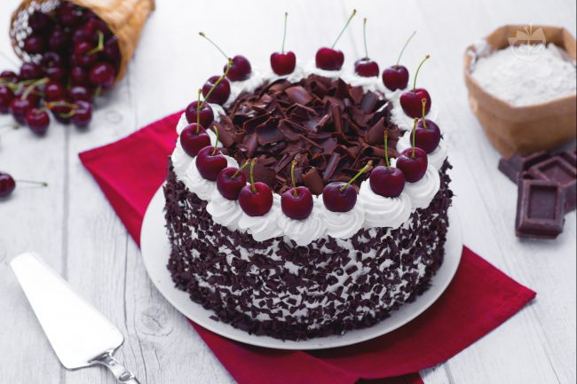
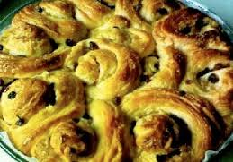
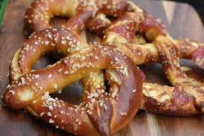
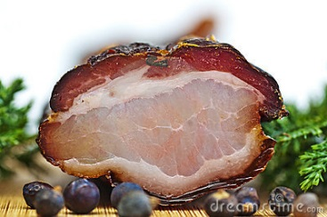
Specialities
German cuisine is specialized in cooked meats, such as the famous Frankfurter sausages, bratwurst and Nuremberg sausages. Very tasty are also the Black Forest ham (Wesfalia), while the fish is a specialty of the northern lander (herring, mackerel and eels). Among the most popular vegetables there are potatoes and cabbages Another staple food is bread, the pure rye bread Roggenbrot and the mixed, Mischbrot. Very famous are the Pretzeln. All the other grains, such as pasta and rice are rarely used; As for desserts the most famous are the cakes: the Black Forest, the Kranz and the Nuremberg gingerbread.

Slide 5
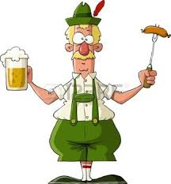
German cuisine
German cuisine is based mainly on meat, potatoes, sauerkraut and lots of beer! A typical German meal almost always starts with a soup or pea soup, potatoes or meat, followed by the main dish that can be meat or fish with at least two vegetables, usually potatoes, beans, peas, cabbage, beetroot, all accompanied by beer or a drink made of apple juice. The German breakfast is rather salty, made of cheese, sausage and bread

Slide 6
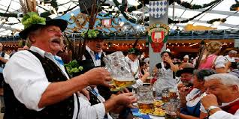
The October Fest
From mid or late September to the first weekend in October German people celebrate the OCTOBER FEST. It is the world's largest beer festival. It takes place in Munich , Bavaria with more than 6 million people coming from around the world. During the event people drink lot of beer. There is also a wide variety of traditional foods.

