Slide 1
Poems from a wandering people
I.C. «G. Palombini»
Roma
I B - III E - Junior Secondary School - I.C. Palombini

Slide 2
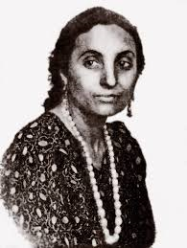
We worked on Papusza's poems
by reading, analyzing, talking, and writing ,
in a ‘poetry lab’.
In our school there are many
gipsy pupils.

Slide 3
We studied the gipsy culture and we spoke about their conditions of life, now and in the past.

Slide 4
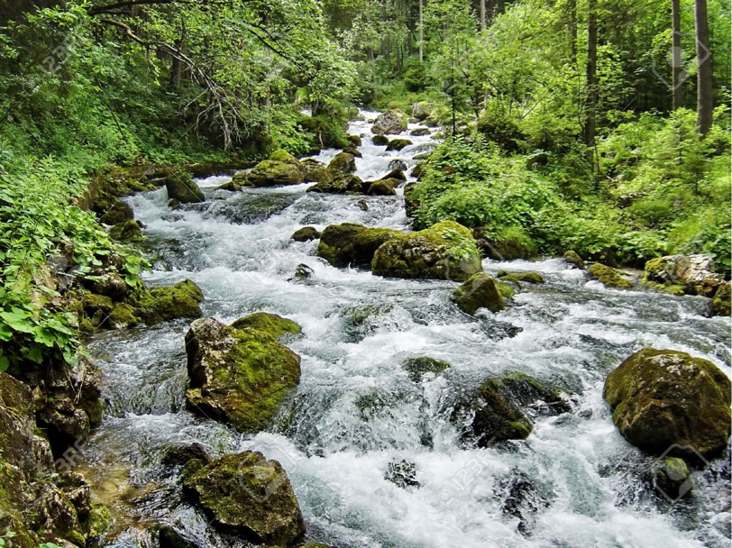
We studied some of Papusza’s poems, we talked about our emotions and we focused on the role of nature in her songs.

Slide 5
They move freely from one place to another. They belong to the world and their lives are not confined to a precise place.
Water has no voice: the voice of the Gypsies has never been heard. In the course of history it has been
stifled
We discuss the difficulty of a nomade style of life.
But also about the beauty of a freedom choice.
…

Slide 6
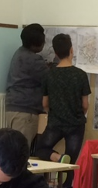
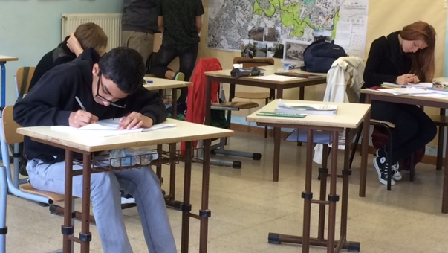
…Usually they aren’t tall, they don’t love water, they use the same clothes for a lot of weeks. They build wood barracks in the suburb
of the city, where they live close each other. They usually come in couple, and they look for a bedroom; then they become four, six, ten. Between them they speak strange idioms, probably ancient dialects…
We talked about
Italian people
wandering in the world
in the past century, in difficult
conditions but following
their dream of a better life.

Slide 7
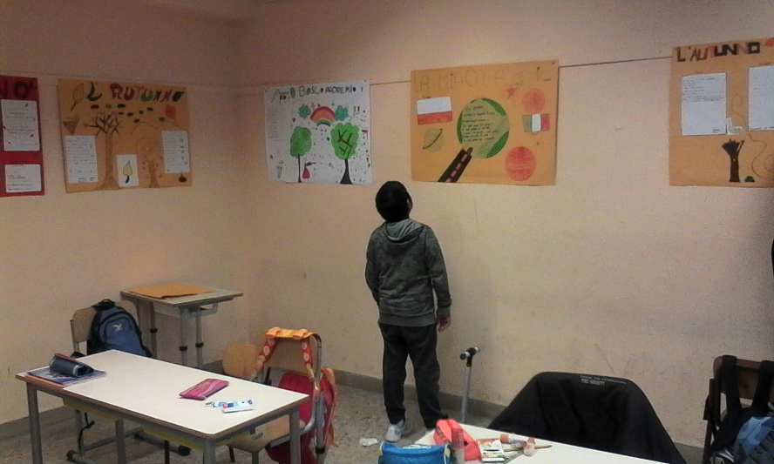
Then we started to write …

Slide 8
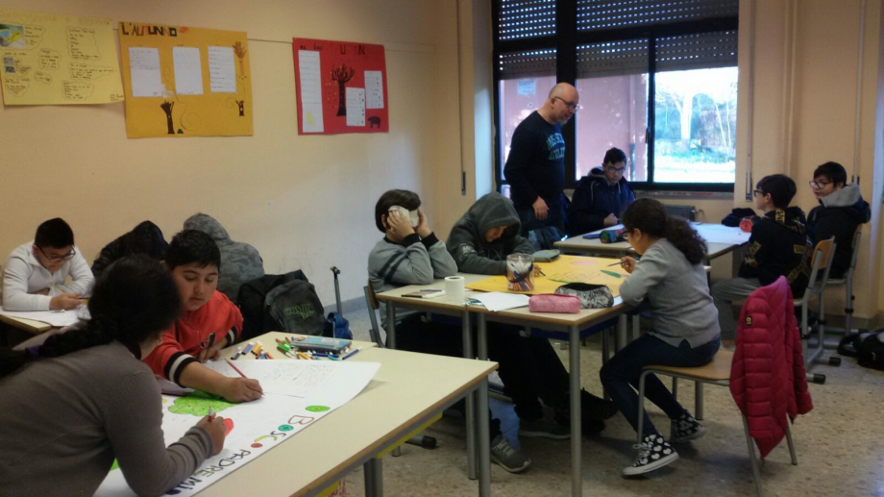
Our works are the outcome of the creativity of our pupils: we realized a «Poetry lab» about nature (seasons, places, etc.), imitating Papusza’s style.

Slide 9
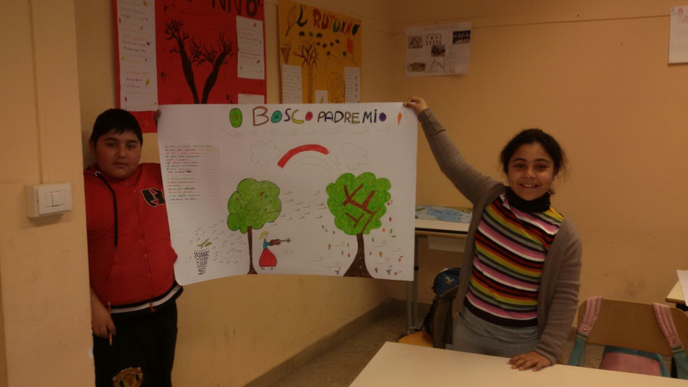
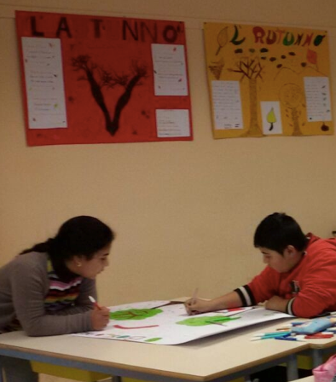
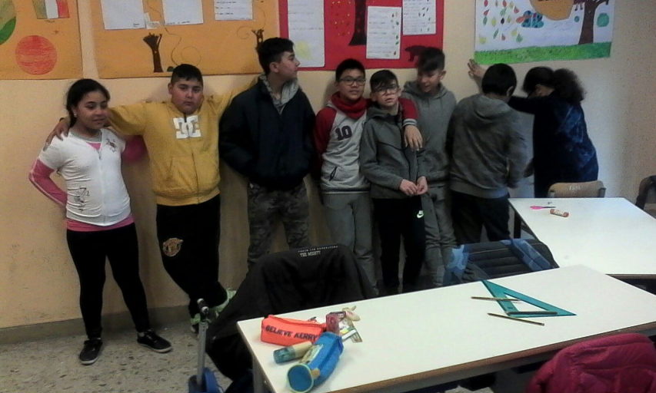
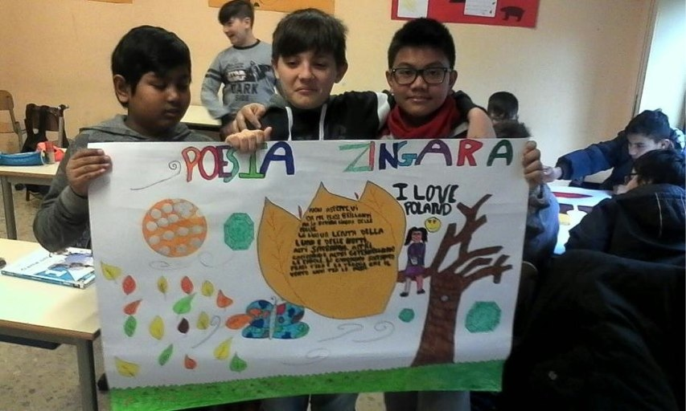
Wood, my father
Autumn
The team
Gipsy poems

Slide 10
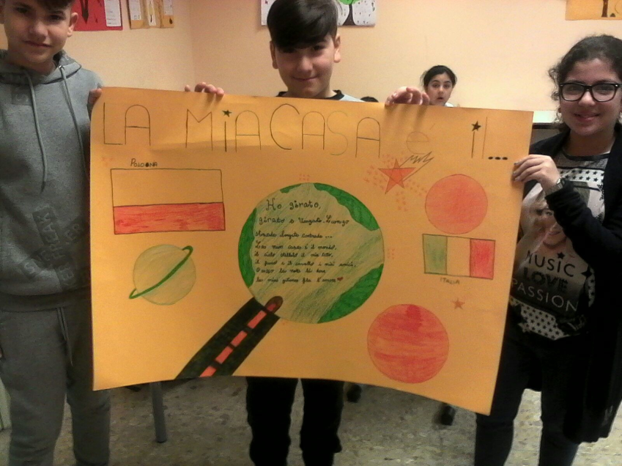
My house is the whole world
… i’m not a poet,
i’m just a gipsy girl of the forest.

